Slide 1

Unreal engine advnced
CPP Basic – Aliasing

Slide 2

Typedefs
creates an alias that can be used anywhere in place of a (possibly complex) type name.
The typedef specifier, when used in a declaration, specifies that the declaration is a typedef declaration rather than a variable or function declaration.
Typically, the typedef specifier appears at the start of the declaration, though it is permitted to appear after the type specifiers, or between two type specifiers.

Slide 3
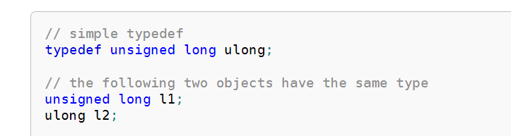
Example

Slide 4
Using-declaration
Introduces a name that is defined elsewhere into the declarative region where this using-declaration appears.
Using-declarations can be used to introduce namespace members into other namespaces and block scopes.
They can also introduce base class members into derived class definitions

Slide 5
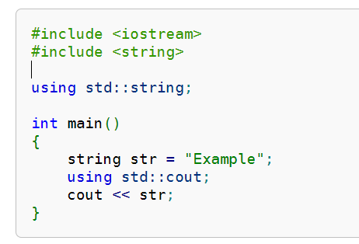
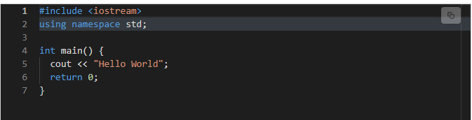
Example

Slide 6
Unreal Engine - FVector
FVector<T> is a typedef for TVector<T>

Slide 7


Resources
https://en.cppreference.com/w/cpp/language/typedef
https://en.cppreference.com/w/cpp/language/using_declaration

Slide 8
Thank you!
Best of luck!

