Slide 1

Unreal engine advnced
CPP Intermediate – ranged for loop

Slide 2

Ranged for loop
Executes a for loop over a range.
Used as a more readable equivalent to the traditional for loop operating over a range of values, such as all elements in a container.

Slide 3
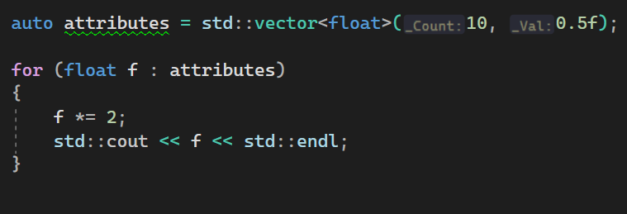
Example

Slide 4


Resources
https://en.cppreference.com/w/cpp/language/range-for

Slide 5
Thank you!
Best of luck!

