Slide 1

CPP Beginners
CPP Intermediate – Time complexity

Slide 2

Time complexity
Time complexity is a measure of how long an algorithm takes to run as a function of the size of the input.
It is often expressed in big O notation, which gives an upper bound on the number of steps an algorithm takes.

Slide 3
Time complexity
For example, if an algorithm has a time complexity of O(n), this means that the number of steps it takes grows at most linearly with the size of the input.
If the input size is doubled, the number of steps taken by the algorithm will approximately double as well.

Slide 4
Time complexity
On the other hand, if an algorithm has a time complexity of O(n^2), this means that the number of steps it takes grows at most quadratically with the size of the input.
If the input size is doubled, the number of steps taken by the algorithm will approximately quadruple.

Slide 5
Time complexity
Time complexity is an important consideration when designing algorithms, as it determines how well an algorithm scales with larger inputs.
Algorithms with a lower time complexity are generally preferred, as they will run faster for larger inputs.
However, it is often necessary to trade off time complexity for other factors, such as simplicity or memory usage.

Slide 6

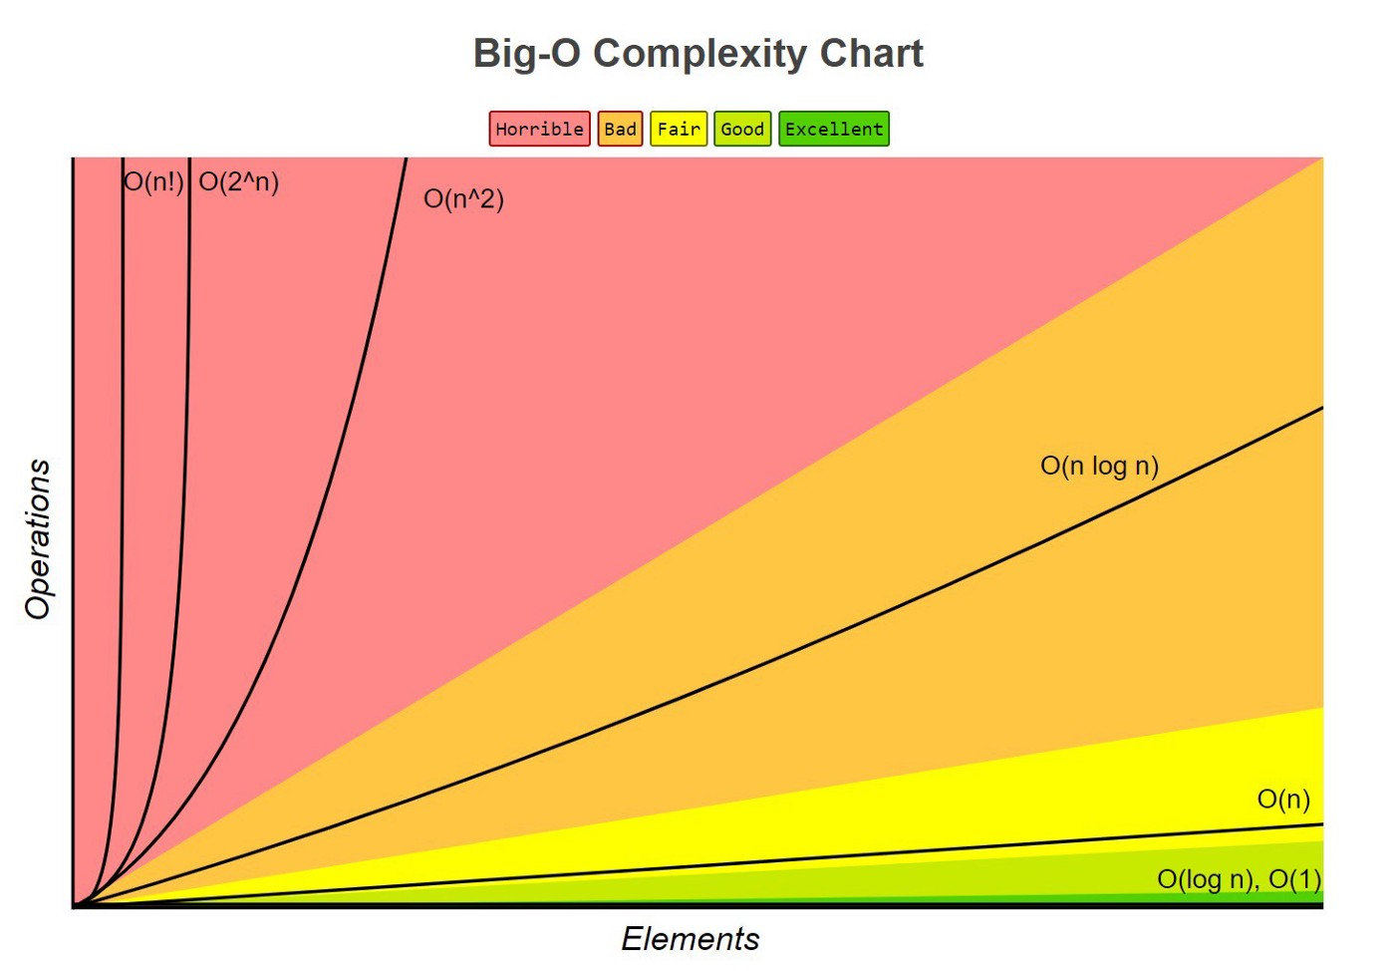
Time Complexity

Slide 7
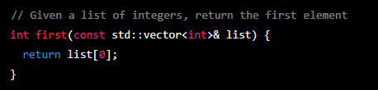
O(1)
This algorithm has a time complexity of O(1), since it always takes the same number of steps regardless of the size of the input..

Slide 8
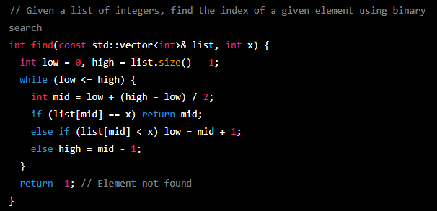
O(log n)
This algorithm has a time complexity of O(log n), since the number of steps it takes grows logarithmically with the size of the input.
For example, if the input size is 10, it will take approximately 3 steps to find the element.
If the input size is 100, it will take approximately 7 steps to find the element.

Slide 9
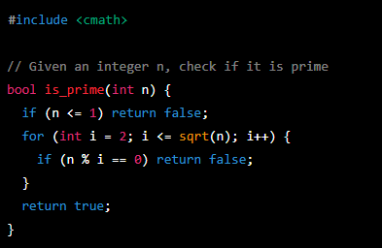

O($\sqrt{N}$)
This algorithm has a time complexity of O(sqrt(n)), since the number of steps it takes grows at most with the square root of the size of the input.
For example, if the input size is 100, it will take approximately 10 steps to check if it is prime.
If the input size is 10000, it will take approximately 100 steps to check if it is prime.

Slide 10
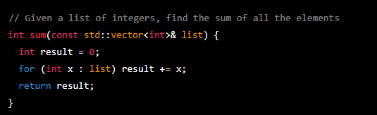
O(n)
The time complexity of this algorithm is O(n), since the number of steps it takes is directly proportional to the size of the input.
For example, if the input size is 10, it will take 10 steps to compute the sum.
If the input size is 100, it will take 100 steps to compute the sum.

Slide 11
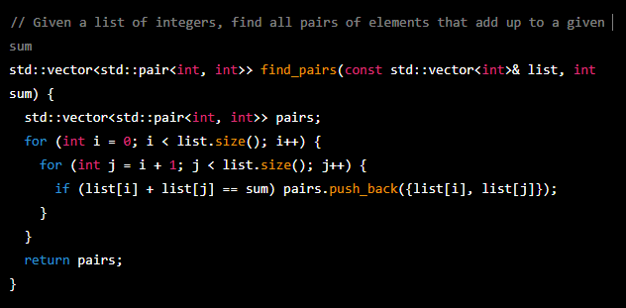
O(n^2)
This algorithm has a time complexity of O(n^2), since the number of steps it takes is proportional to the square of the size of the input.
For example, if the input size is 10, it will take 100 steps to find all the pairs.
If the input size is 100, it will take 10000 steps to find all the pairs.

Slide 12
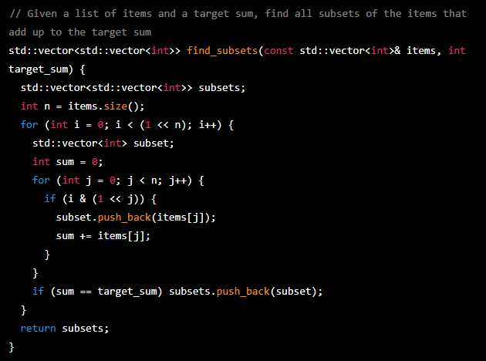
O(2^n)
This algorithm has a time complexity of O(2^n), since the number of steps it takes grows exponentially with the size of the input.
For example, if the input size is 10, it will take 1024 steps to find all the subsets.
If the input size is 20, it will take 1048576 steps to find all the subsets.

Slide 13
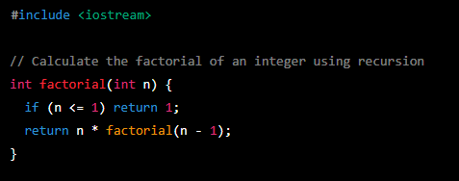
O(n!)
This algorithm has a time complexity of O(n!), since the number of steps it takes grows factorial with the size of the input.
For example, if the input size is 4, it will take 24 steps to compute the factorial.
If the input size is 5, it will take 120 steps to compute the factorial.

Slide 14

Resources
https://www.mygreatlearning.com/blog/why-is-time-complexity-essential/
ChatGPT

Slide 15
Thank you!
Best of luck!

