Slide 1

Unreal engine advnced
CPP Basics –
Switch Statements

Slide 2

Switch statement -
Transfers control to one of several statements, depending on the value of a condition.

Slide 3
Switch statement -
The body of a switch statement may have an arbitrary number of case: labels, as long as the values of all constant-expressions are unique (after conversions/promotions).
At most one default: label may be present (although nested switch statements may use their own default: labels or have case: labels whose constants are identical to the ones used in the enclosing switch).
If condition evaluates to a value that is equal to the value of one of constant-expressions, then control is transferred to the statement that is labeled with that constant-expression..

Slide 4
Switch statement -
If condition evaluates to a value that doesn't match any of the case: labels, and the default: label is present, control is transferred to the statement labeled with the default: label.
If condition evaluates to a value that doesn't match any of the case: labels, and the default: label is not present, then none of the statements in the switch body is executed.

Slide 5
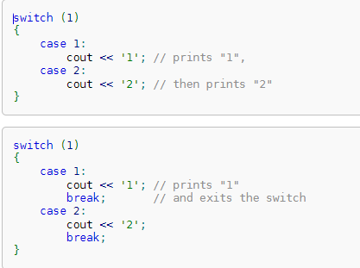
explanation
The break statement, when encountered in statement exits the switch statement:

Slide 6
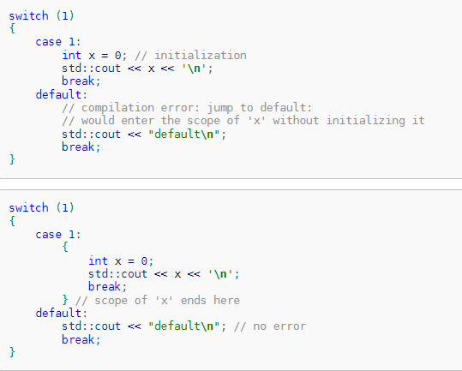
explanation
Because transfer of control is not permitted to enter the scope of a variable, if a declaration statement is encountered inside the statement, it has to be scoped in its own compound statement:

Slide 7


Resources
https://en.cppreference.com/w/c/language/switch

Slide 8
Thank you!
Best of luck!

