Slide 1

Unreal engine advnced
CPP Basics – Variables

Slide 2

Variables
In C++, a variable is actually just a bit of memory that has been reserved for the program’s use.
You refer to it using a variable name, so you don’t need to worry about where it is in memory (though you can find out its memory address, and even specify its location, if you want).
The C++ type system keeps track of the size of the memory block, and how to interpret the value in it (that is, it will know whether the value 65 in a certain memory block actually refers to the number 65, the letter ‘A’ (the ASCII/Unicode code number for the character ‘A’ is 65), or even perhaps a complex number with real part 6 and imaginary part 5).
To create a variable in C++, you need at least two things: a name and a type.

Slide 3
Variables - Identifiers
Variable names are identifiers. Identifiers are labels used for various things in C++, including functions, classes, and namespaces as well as variables.
The rules for identifiers are the same whether the identifier refers to a variable, function, or whatever else. Identifiers can be pretty much whatever you like, taking into account a few rules. In general, the name of an identifier must consist of the characters a-z, A-Z, 0-9 and _, not begin with a digit or _ and not be a keyword. There are more rules that must be followed. You can read about them here.
Identifiers are usually not stored in the final program – unless you use certain debugging settings – so you don’t have worry about descriptive names giving hackers clues. You also don’t have to worry about the size of identifiers; if they’re stripped out, they take up no space in the final program.

Slide 4
Variables - TYPES
C++ is a strongly-typed language, which means that when you say a variable is an integer, it stays an integer. This is unlike weakly-typed languages like Javascript, where variables can change types.
The two reasons for this are efficiency and safety. If you allow variable’s types to change, you must keep track of what type a variable currently is, which has a cost. Keeping types fixed eliminates that cost.
As for safety, consider this: in Javascript, if variable a equals 1 and variable b equals 2, and both are integers, then “a + b” gives 3... if both are text strings, “a + b” gives 12... but what do you get if one is an integer and one is a string? You could make up rules to answer the question, but that just makes things more complicated.
It is safer to require programmers to explicitly say whether they want to add two integers or two strings. Type safety is a very important feature of C++, that makes your code efficient and easy to predict how it will behave.

Slide 5
Variables - TYPES
There are several fundamental types in C++ – the exact number depends on the version. Here are some of the more basic ones:
Signed integer types, which can hold positive and negative whole numbers. The basic signed integer type is int, which can hold at least −32,767 to 32,767.
Unsigned integer types, which can hold only positive whole numbers. The basic unsigned integer type is unsigned int, which can hold at least 0 to 65,535.
Character types, which can hold characters, including letters, digits, punctuation, spaces, and control codes (like newline and tab). The basic character type is char, which is guaranteed to hold at least all upper and lowercase Latin letters (‘a’ – ‘z’ and ‘A’ – ‘Z’) and digits (‘0’ – ‘9’), some basic punctuation (‘{’, ‘}’, ‘[’, ‘]’, ‘#’, ‘(’, ‘)’, ‘<’, ‘>’, ‘%’, ‘:’, ‘;’, ‘.’, ‘?’, ‘*’, ‘+’, ‘-’, ‘/’, ‘^’, ‘&’, ‘|’, ‘∼’, ‘!’, ‘=’, ‘,’, ‘\’, ‘"’, ‘'’, ‘_’), and some control codes (like carriage return, newline, tab, and null).
Boolean types, capable of holding one of the two values: true or false
Floating point types, which store real numbers in two parts – a mantissa and an exponent.

Slide 6
Variables - TYPES
For example, it would rewrite 1.25 as 1.25×10⁰, then store it as {1.25, 0}; 0.0043 → 4.3×10⁻³ → {4.3, −3}; −25000 → 2.5×10⁴ → {−2.5, 5}. This enables the storage of huge or tiny numbers, but with limited precision (few significant digits). The basic floating point type is double. The limits of floating point numbers is a complicated topic, but double is guaranteed to hold positive values as large as at least 1.79769313486231571×10³⁰⁸ and at least as small as 2.22507385850720138×10⁻³⁰⁸.
Note that the limits given are just the minimum limits. On some systems, the limits can be much greater. For example, on 32-bit systems, the range of an int is usually −2,147,483,648 to 2,147,483,647.
C++ also includes dozens of types in its standard library, like std::string to hold text strings and std::vector to hold multiple values.

Slide 7
Creating variables
C++ requires you to declare all variables before you use them – it does not allow variables to appear out of nowhere. However, C++ is flexible about where you can declare them.
To create a variable for use, the normal syntax is:
<type> <identifier> = {<initializer>};

Slide 8
Creating variables
For example, to create an integer variable named “value” with an initial value of 42, you would write:
int value = {42};

Slide 9
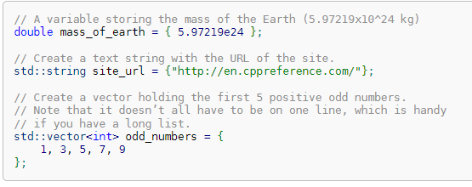
Creating variables
Here are some other examples of creating variables:

Slide 10

Creating variables
If you leave the braces empty, the variable will be default-constructed – that is, created with its default value. For fundamental types like int and double, the default value is zero. Default-constructed strings and vectors are empty (zero length strings and vectors with no items in them).

Slide 11

Creating variables
When creating a variable, the equal sign is optional:

Slide 12
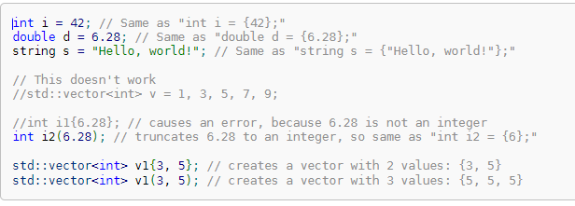
Creating variables
In some cases, the braces are optional (if you drop them, you must include the equal sign), or you can use parentheses instead, but this may subtly change the meaning in surprising ways:
*Unless you intend to specifically call a class’s constructor (which will be covered later) or to force a value to fit in a type (like cramming 6.28 into an int), it is better not to use parentheses. In cases where the braces are optional, whether to use them or not is usually a style choice.

Slide 13
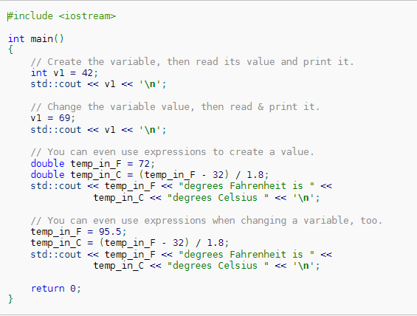
using variables
Reading the value stored in a variable is as easy as simply using the variable’s name in an expression.
To change the value in a variable, you have to put the variable on the left-hand side of an assignment operator. The most basic assignment operator is just the equal sign (‘=’), which assigns the result of whatever is on the right-hand side into the variable.

Slide 14

Type deduction - auto
Starting with C++11, C++ is now smart enough to figure out the types for variables automatically. For example, if you use an integer value like 42, C++ can figure out that you want an int; if you use a decimal value like 6.28, C++ can figure you that you don’t want an int, you want a double.
To get type deduction, you can use auto as the variable type:

Slide 15


Resources
https://en.cppreference.com/book/intro/variables

Slide 16
Thank you!
Best of luck!

