Slide 1

Unreal engine advnced
CPP Basics – Strings

Slide 2

Strings
The C++ strings library includes support for three general types of strings:
std::basic_string (std::string) - a templated class designed to manipulate strings of any character type.
Null-terminated strings - arrays of characters terminated by a special null character (‘\0’).
std::basic_string_view (C++17) – not in course scope.

Slide 3
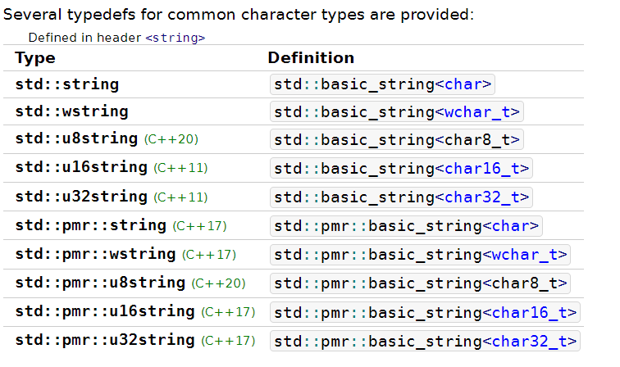
std::string
std::string is an alias for std::basic_string<char>.
Elements are stored contiguously.
In CPP, a string is mutable.
Because of different char encoding, there are different types of strings.

Slide 4
Char encoding
ASCII – 128 characters (English, control commands, numbers and punctuation marks).
Extended ASCII – 255 characters (some common foreign characters).
https://theasciicode.com.ar/
UTF-8 – Variable-width encoding, backwards compatible with ASCII. ASCII characters take up only 1 byte, other languages and signs take between 2-4 bytes.
https://www.charset.org/utf-8
UTF-16 – All characters that fit in 2 bytes, take up 2 bytes. Others take up 4 bytes.
https://asecuritysite.com/coding/asc2
UTF-32 – Fixed width encoding. All characters take up 4 bytes.
https://www.fileformat.info/info/charset/UTF-32/list.htm

Slide 5
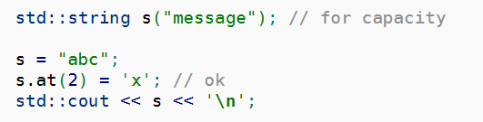
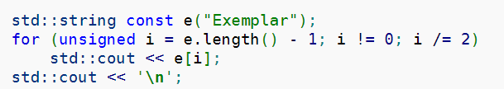
Useful methods
Get/Set a character:
oprator[]
at (bounds checking)

Slide 6
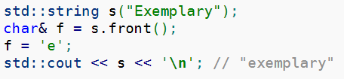

Useful methods
Access first/last character (c++ 11):
front
back

Slide 7

Useful methods
Get the string as a C-style array
c_str
We will cover pointers in this class – it is important to remember that c_str() returns the string as a:
const char array

Slide 8
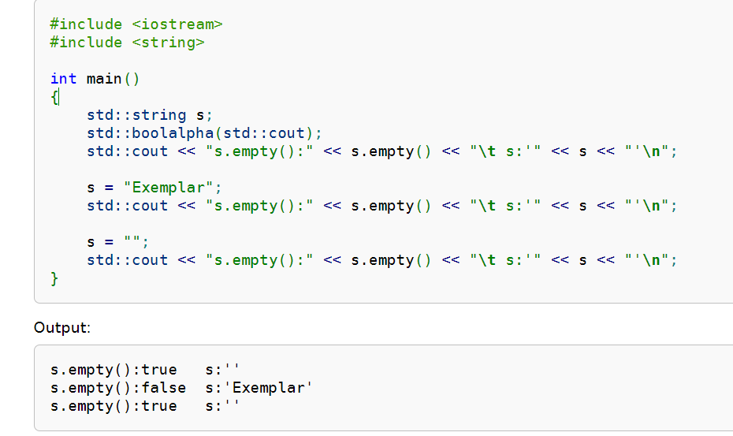
Useful methods
Check whether a string is empty
empty

Slide 9
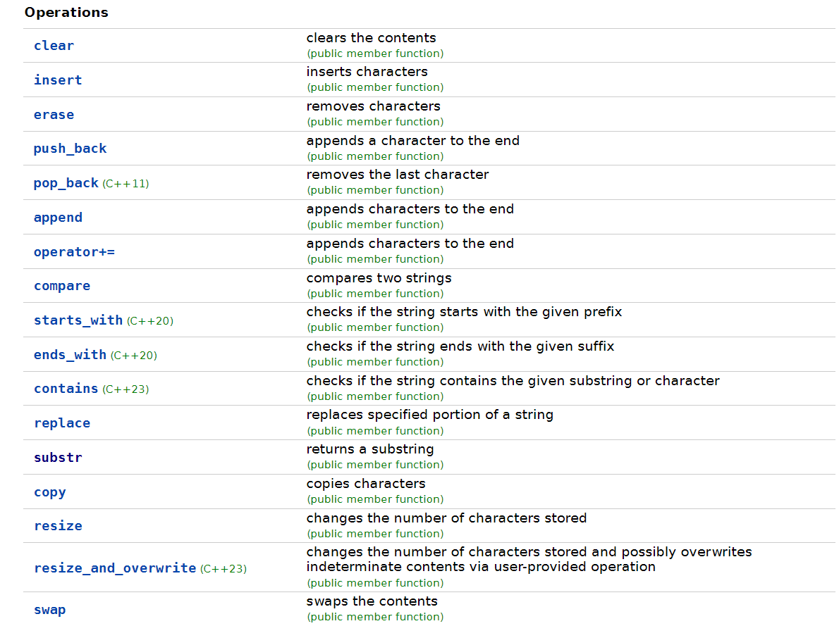
Useful methods

Slide 10
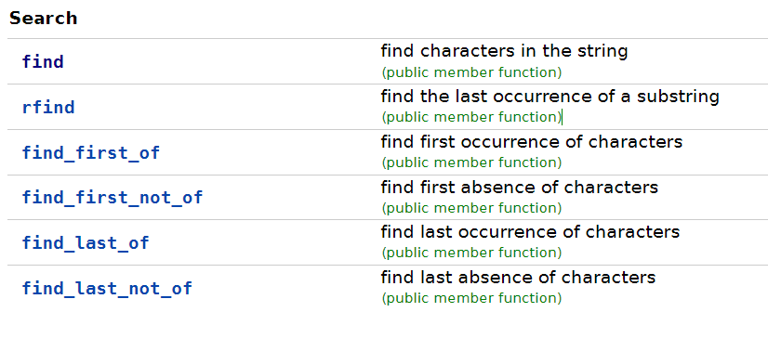
Useful methods

Slide 11

“No value” indicator
static const unsigned int npos = -1
This member represents ‘no value’ or ‘value not found’
Example:

Slide 12
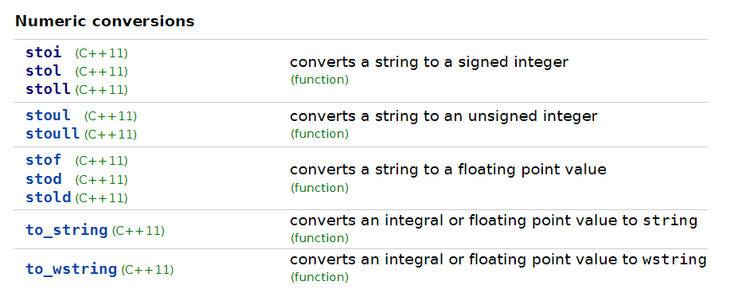
conversion

Slide 13
conversion
Example signature (stoi):
Parameters:
str – the string to convert
pos – address of an integer to store the number of chars processed
base – the number base
Return value:
int value corresponding to the content of str

Slide 14
conversion
Example signature (stoi):
Parameters:
str – the string to convert
pos – address of an integer to store the number of chars processed
base – the number base
Return value:
int value corresponding to the content of str

Slide 15
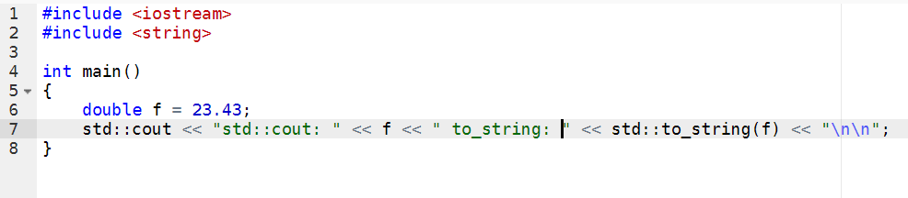
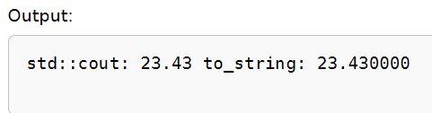
conversion
to_string example:

Slide 16


Resources
https://en.cppreference.com/w/cpp/string/basic_string

Slide 17
Thank you!
Best of luck!

