Slide 1

Unreal engine advnced
CPP Basics –
For Loop

Slide 2
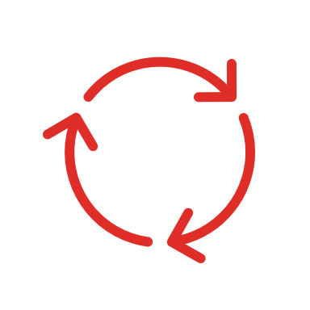
For Loop-
Executes init-statement once, then executes statement and iteration-expression repeatedly, until the value of condition becomes false.
The test takes place before each iteration.

Slide 3
explanation
If the execution of the loop needs to be terminated at some point, break statement can be used as terminating statement.
If the execution of the loop needs to be continued at the end of the loop body, continue statement can be used as shortcut.
As is the case with while loop, if statement is a single statement (not a compound statement), the scope of variables declared in it is limited to the loop body as if it was a compound statement.

Slide 4


Resources
https://en.cppreference.com/w/cpp/language/for

Slide 5
Thank you!
Best of luck!

