Slide 1

CPP Beginners
CPP More Cast types

Slide 2

Const cast (Do Not Use)
const_cast is used to cast away the constness of variables. Following are some interesting facts about const_cast.

Slide 3
Const cast (Do Not Use)
const_cast is used to cast away the constness of variables.
const_cast can be used to change non-const class members inside a const member function.

Slide 4

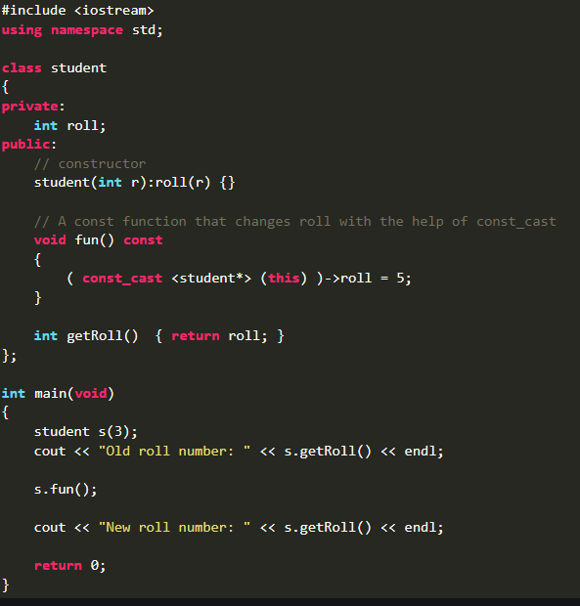
example
In this example: Inside const member function fun(), ‘this’ is treated by the compiler as ‘const student* const this’, i.e. ‘this’ is a constant pointer to a constant object, thus compiler doesn’t allow to change the data members through ‘this’ pointer.
const_cast changes the type of ‘this’ pointer to ‘student* const this’.

Slide 5
reinterpret cast (Uncommon)
reinterpret_cast is a type of casting operator used in C++.
It is used to convert a pointer of some data type into a pointer of another data type, even if the data types before and after conversion are different.
It does not check if the pointer type and data pointed by the pointer is same or not.

Slide 6
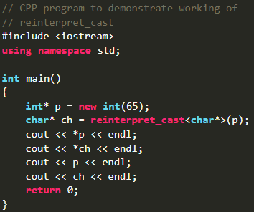
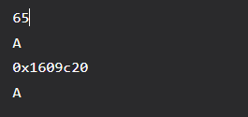
example
In this example: We can see how reinterpret_cast simply changes the type it is given.

Slide 7

Resources
https://www.geeksforgeeks.org/const_cast-in-c-type-casting-operators/

Slide 8
Thank you!
Best of luck!

