Slide 1

CPP Beginners
CPP Intermediate – Iterators

Slide 2

Iterators
Iterators are used to point at the memory addresses of values in STL containers.
They reduce the complexity and execution time of the program.

Slide 3
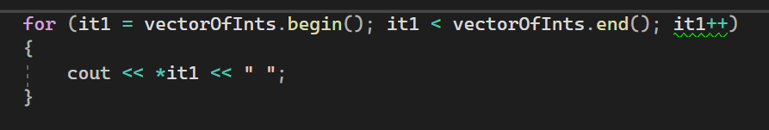
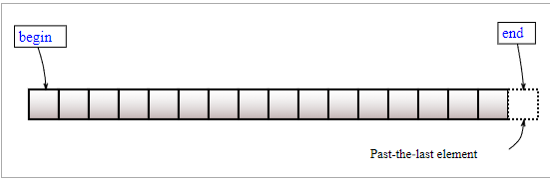
Common methods
begin() : This function is used to return the beginning position of the container.
end() : This function is used to return the after end position of the container.

Slide 4
Common methods
begin() : This function is used to return the beginning position of the container.
end() : This function is used to return the after end position of the container.
Should be ++it1
Notice the dereference (*) operator

Slide 5
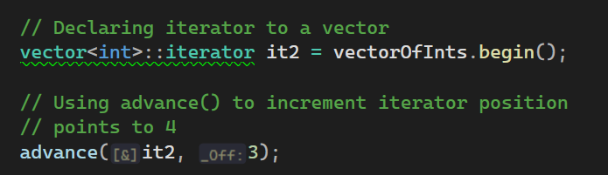
Common methods
advance() : This function is used to increment the iterator position till the specified number mentioned in its arguments.

Slide 6
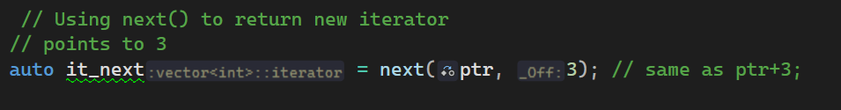
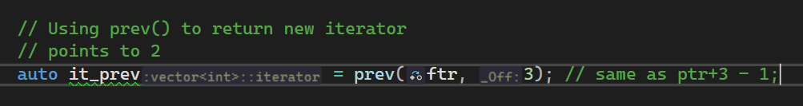
Common methods
next() : This function returns the new iterator that the iterator would point after advancing the positions mentioned in its arguments.
prev() : This function returns the new iterator that the iterator would point after decrementing the positions mentioned in its arguments.

Slide 7
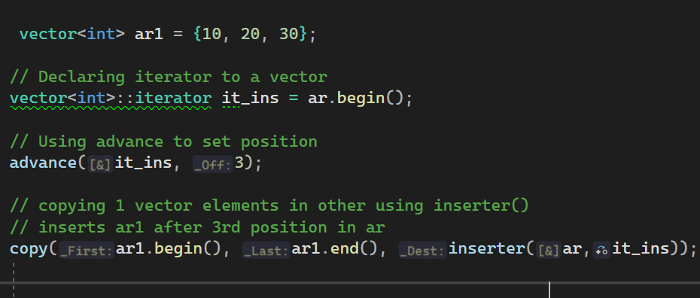
Common methods
inserter() : This function is used to insert the elements at any position in the container.
It accepts 2 arguments, the container and iterator to position where the elements have to be inserted.

Slide 8


Resources
https://www.geeksforgeeks.org/iterators-c-stl/
Plural sight – “C++ beyond the basics” – Kate Gregory

Slide 9
Thank you!
Best of luck!

