Slide 1

CPP Beginners
CPP Operators

Slide 2

Operators
In C++, operators are special symbols that perform specific operations on one, two, or three operands, and then return a result.
There are many types of operators in C++, including:

Slide 3
Arithmetic
Arithmetic operators: These operators perform basic arithmetic operations, such as addition (+), subtraction (-), multiplication (*), division (/), and modulus (%).

Slide 4
Increment/Decrement
Increment and decrement operators: These operators increase or decrease the value of a variable by 1.
The increment operator (++) increments the value, while the decrement operator (--) decrements the value.

Slide 5
Relational
Relational operators: These operators compare two values and return a Boolean value (true or false) based on the comparison.
Examples include equal to (==), not equal to (!=), greater than (>), less than (<), greater than or equal to (>=), and less than or equal to (<=).

Slide 6
Logical
Logical operators: These operators perform logical operations on Boolean values.
Examples include AND (&&), OR (||), and NOT (!).

Slide 7
Assignment
Assignment operators: These operators assign a value to a variable.
The most basic assignment operator is the equal sign (=), but there are also compound assignment operators such as +=, -=, *=, and /=.

Slide 8
Conditional
Conditional operator: This operator is a ternary operator (operates on three operands) that evaluates a boolean expression and returns one of two values based on the result of the evaluation.
It is written as "?:" and has the following form:
int val = condition ? value1 : value2.

Slide 9
Bitwise
Bitwise operators: These operators perform bit-level operations on integers.
Examples include AND (&), OR (|), XOR (^), NOT (~), left shift (<<), and right shift (>>).

Slide 10
special
Special operators: These include the sizeof operator, which returns the size of a data type or variable in bytes.
the address-of operator (&), which returns the memory address of a variable.

Slide 11
Operator overloading
Operator overloading is a feature in C++ that allows you to define the way that operators (such as +, -, , etc.) work with your custom types.
For example, you might define an operator+ function for a "complex" class that adds two complex numbers together, or you might define an operator function for a "matrix" class that multiplies two matrices together.

Slide 12

Operator overloading
To overload an operator, you define a function with a special name and prototype.
For example, to overload the + operator for a class called "MyClass", you would define a function like this:

Slide 13

Operator overloading
You can then use the overloaded operator just like you would use the built-in version. For example:

Slide 14
Operator overloading
Operator overloading can be a powerful tool, but it can also make your code more difficult to understand if used excessively or in a way that is inconsistent with the way that the operators are normally used.
It's important to use operator overloading carefully and only when it makes your code more readable and maintainable.

Slide 15
Assignment Operator overloading
In C++, you can overload the assignment operator (=) for your own custom classes.
This allows you to define how the assignment operator should work with objects of your class.

Slide 16
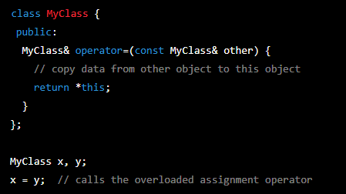
Assignment Operator overloading
For example:

Slide 17


Resources
https://en.cppreference.com/w/cpp/language/operator_precedence
C++ fundamentals including C++ 17 by Kate Gregory – PluralSight.com
ChatGPT

Slide 18
Thank you!
Best of luck!

