Slide 1

Unreal engine advnced
UE5 – Basic environment

Slide 2

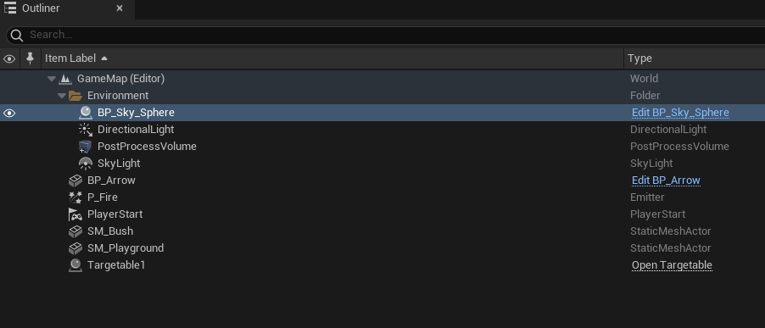

Basic default environment
We need 4 elements:
Sky Sphere blueprint
Directional light
Post-Process volume
Sky light

Slide 3
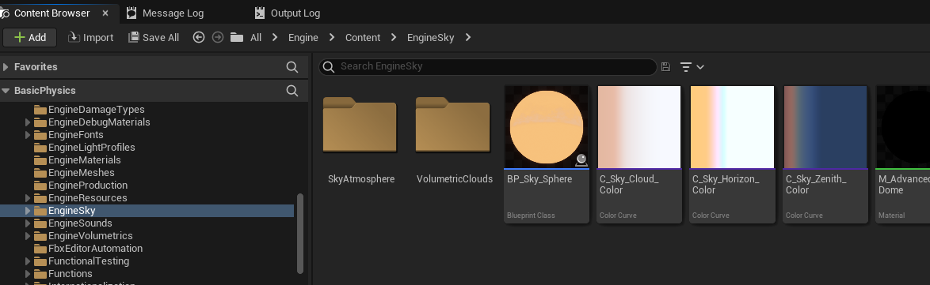

Sky sphere
Locate the sample sky sphere in the Engine\Content\EngineSky folder
Place the Blueprint “BP_Sky_Sphere” in the scene

Slide 4
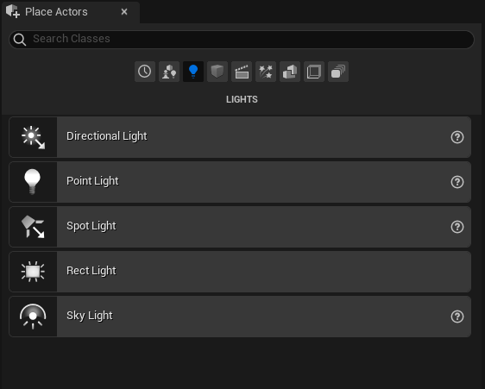
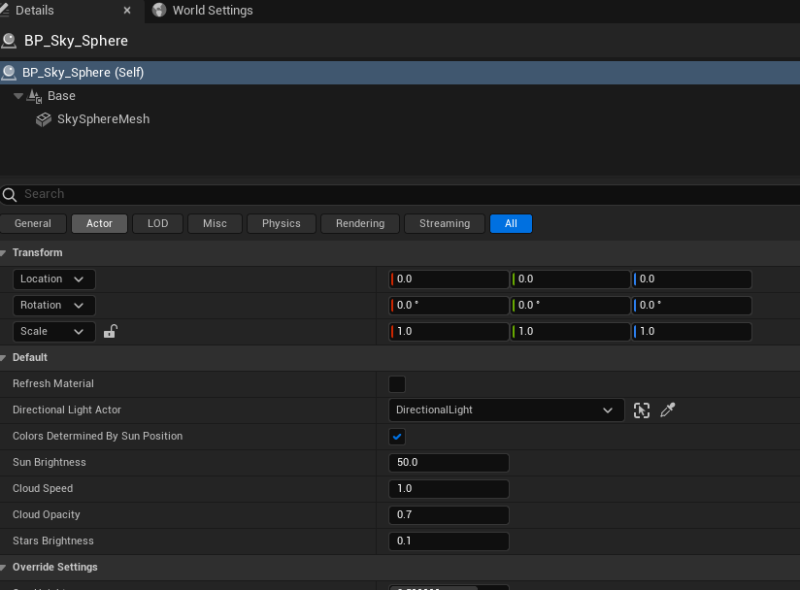

Directional light
In the “Place Actors” pane select the “Lights” category
Drag the “Directional Light” Actor into the scene
In the SkySphere “Details” pane’s “Default” category, assign the directional light under “Directional Light Actor”

Slide 5
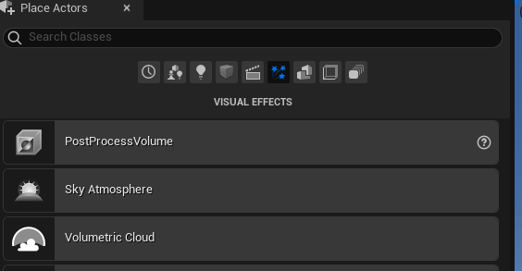
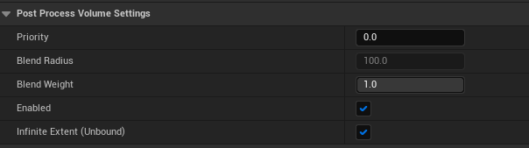


POST PROCESS volume
In the “Place Actors” pane select the “Visual Effects” category
Select the “PostProcessVolume” actor and place it in the scene
In the “Details” pane under the “Post Process Volume Settings” category, check “Infinite Extent (Unbound)”

Slide 6
Sky light
In the “Place Actors” pane select the “Lights” category
Drag the “Sky Light” Actor into the scene
In the SkySphere “Details” pane’s “Default” category, assign the directional light under “Directional Light Actor”

Slide 7
Controlling the sun
In order to control the sun movement we need to turn off the sky sphere
In order to stop the skies from being black we need to add the “Sky Atmosphere” from the visual effects to our scene
Exponential height fog can solve the problem where the ground appears black
More on clouds and skies can be found at the “Resources” Slide at the end of this presentation

Slide 8


Resources
https://https://docs.unrealengine.com/5.0/en-US/
https://cghero.com/tutorials/skies-clouds-unreal-engine-5

Slide 9
Thank you!
Best of luck!

