Slide 1

Unreal engine advnced
UE5 – Our first Actor

Slide 2

What is an actor?
Actor is the base class for an object that can be placed or spawned in a level.
*similar to Unity’s GameObject class

Slide 3
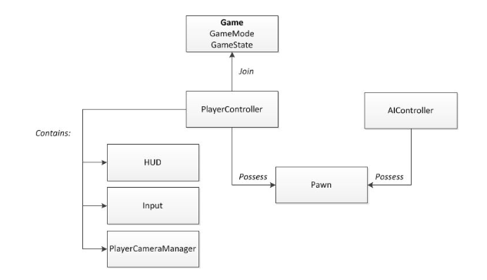
What types of actors are there?
In the following classes we will go in more depth for each of the types

Slide 4
PaWN
A Pawn is an Actor that can be an "agent" within the world.
Pawns can be possessed by a Controller, they are set up to easily accept input, and they can do various other player-like things.
Note that a Pawn is not assumed to be humanoid.

Slide 5
Controller
Controller is an Actor that is responsible for directing a Pawn.
They typically come in 2 flavors:
AIController
PlayerController
A controller can "possess" a Pawn to take control of it.

Slide 6
Player Controller
A PlayerController is the interface between the Pawn and the human player controlling it.
The PlayerController essentially represents the human player's will.

Slide 7
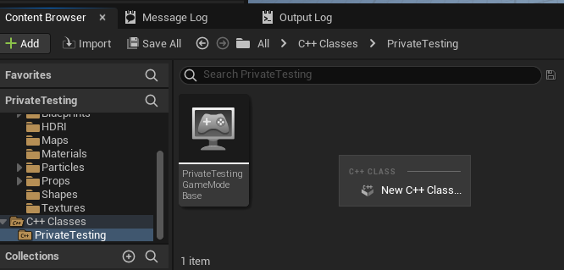
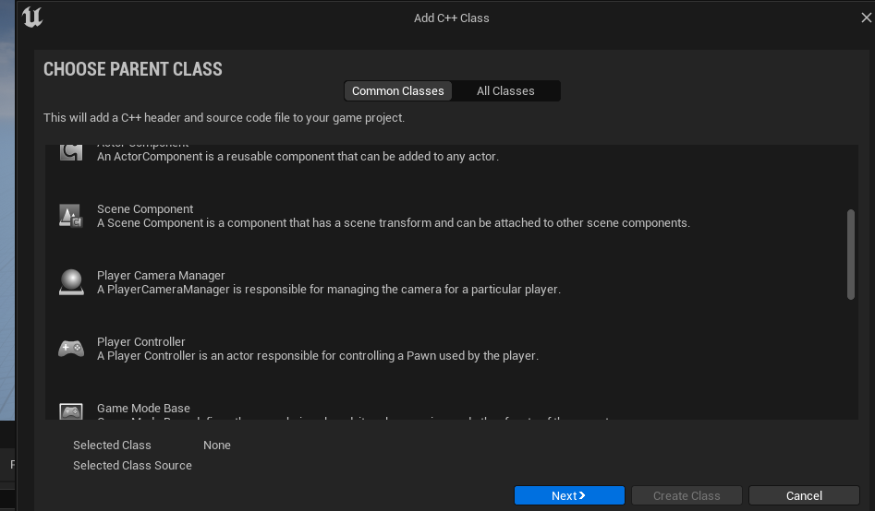

Creating our player controller
Create a new cpp class of type PlayerController

Slide 8
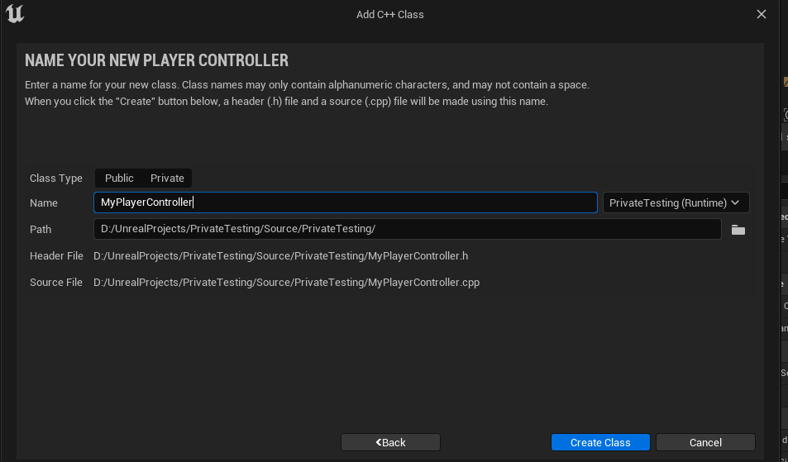
Creating our player controller
Name your class
Decide the class’s accessibility to other modules:
Public – the class can be included in this module and other modules
Private – the class can only be included in this module

Slide 9
Creating our player controller
If Visual Studio is not open it will start now
If it is already open then it will have to reload and display a message for reload confirmation
In UE5 the “Live Coding” feature is activated by default – which can save time compiling. In this course we will disable it because it has some stability issues when trying to debug

Slide 10


Resources
https://docs.unrealengine.com/5.0/en-US/gameplay-framework-quick-reference-in-unreal-engine/
https://docs.unrealengine.com/4.27/en-US/ProgrammingAndScripting/ProgrammingWithCPP/IntroductionToCPP/

Slide 11
Thank you!
Best of luck!

