Slide 1

CPP Beginners
CPP Intermediate – Inheritance

Slide 2

Inheritance
Inheritance is a fundamental concept in object-oriented programming (OOP) that allows one class to acquire the properties and methods of another class.
It is used to establish a relationship between two classes, where one class (the subclass/derived class) is a specialized version of the other class (the superclass/base class).

Slide 3
Inheritance
Inheritance allows you to create a new class that is a modified version of an existing class, without having to rewrite the code that is already present in the existing class.
This can save a lot of time and effort, and helps to reduce redundancy in your code.

Slide 4
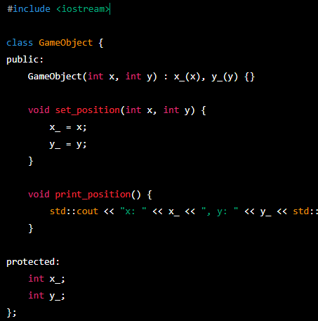
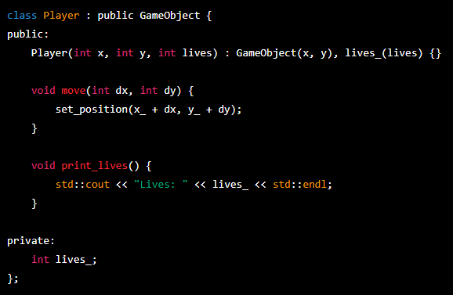
Derived classes can add or override member variables and functions.

Slide 5
Accessibilty
class Player : public GameObject
When a class is inherited from a public class, the members of the base class are accessible to the derived class and to any code that has access to an object of the derived class.
This is the most common type of inheritance, and it is the default if no access level is specified.

Slide 6
Accessibilty
class Player : private GameObject
When a class is inherited from a private class, the members of the base class are not accessible to the derived class or to any code that has access to an object of the derived class.
This is known as "private inheritance," and it is used to specify that the derived class is a more specialized version of the base class, rather than a subclass that is meant to be used directly.

Slide 7
Accessibilty
class Player : protected GameObject
When a class is inherited from a protected class, the members of the base class are accessible to the derived class, but not to any code that has access to an object of the derived class.
This is known as "protected inheritance," and it is used to specify that the derived class is a subclass of the base class that is meant to be used as a base class for further subclassing.

Slide 8


Resources
https://en.cppreference.com/book/intro/inheritance
PluralSight.com – “C++ fundamentals including c++ 17 by Kate Gregory”
PluralSight.com – “Learn to program with c++ 17 by Kate Gregory”
ChatGPT

Slide 9
Thank you!
Best of luck!

