Slide 1

CPP Beginners
CPP Intermediate – STL Containers

Slide 2

Standard library containers
The Containers library is a generic collection of class templates and algorithms that allow programmers to easily implement common data structures like queues, lists and stacks.

Slide 3
Standard library containers
There are 3 kinds of containers:
Sequence
Associative
Unordered associative
each of which is designed to support a different set of operations.

Slide 4
Standard library containers
There are 3 kinds of containers:
Sequence
Associative
Unordered associative
each of which is designed to support a different set of operations.

Slide 5
Standard library containers
The container manages the storage space that is allocated for its elements.
Provides member functions to access them, either directly or through iterators (objects with properties similar to pointers).

Slide 6
Standard library containers
Most containers have at least several member functions in common, and share functionalities.
Which container is the best for the particular application?
Depends not only on the offered functionality, but also on its efficiency for different workloads.

Slide 7
Standard library containers
STL containers have several advantages:
Written and optimized by the C++ committee
Work great with STL algorithms (more on that in the next lessons)
The containers know their size and manage themselves.
You don’t have to worry memory management! When the container destructs, so do its contents (**not raw pointers)

Slide 8

Common types
Category | Container | Description
Sequence containers | array | Fixed size
 | vector | Dynamic size (contiguos)
 | deque | Double ended queue
 | forward list | Singly-linked list
 | list | Doubly linked list
Associative containers | set | Sorted and unique values
 | multiset | Sorted and duplicate values
 | map | Sorted unique keys
 | multimap | Sorted duplicate keys
Unordered Associative containers | unordered_set | Unique values (faster access)
 | unordered_multiset | Duplicate values (faster access)
 | unordered_map | Unique keys (faster access)
 | unordered_multimap | Duplicate keys (faster access

Slide 9
STD::Array
std::array is a container that encapsulates fixed size arrays.
Array size and type must be known at compile time.
std::array<int, 3> a = {1,2,3};
Use arrays when you know the size of the container won’t change (i.e months of the year)

Slide 10
Std::list
std::list is a container that stores elements in a doubly linked list
std::list<int> lst = {3, 1, 4, 1, 5, 9};
Use list when you want fast adding or removal of elements but don’t need the a contiguous collection

Slide 11
Std::Set
std::set is an associative container that contains sorted unique elements
std::set<int> s = { 3, 1, 4, 5, 9 };
Use set when you need to store unique values

Slide 12
Std::map
std::map is a sorted associative container that contains key-value pairs with unique keys (keys are sorted)
std::map<int, char> example = {{1,'a'}, {2,'b'}};
Use map when you need to associate elements with keys and need a fast way to search for them

Slide 13
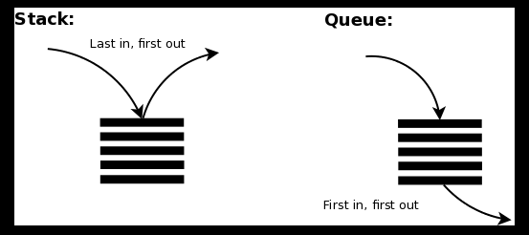
Container adaptors
Std::stack<T> (LIFO)
Std::queue<T> (FIFO)
Singly-linked list under the hood…

Slide 14
Std::stack
The std::stack class is a container adaptor that gives the programmer the functionality of a stack - specifically, a LIFO (last-in, first-out) data structure.
std::stack<int> s;

Slide 15
Std::queue
he std::queue class is a container adaptor that gives the programmer the functionality of a queue - specifically, a FIFO (first-in, first-out) data structure.
std::queue<int> q;

Slide 16

Resources
https://en.cppreference.com/w/cpp/container
Plural sight – “C++ beyond the basics” – Kate Gregory
ChatGPT

Slide 17
Thank you!
Best of luck!

