Slide 1

Unreal engine advnced
CPP Basic – Preprocessor and macros

Slide 2

Preprocessor
The preprocessor is executed at translation phase 4, before the compilation.
The result of preprocessing is a single file which is then passed to the actual compiler.

Slide 3
directives
The preprocessing directives control the behavior of the preprocessor.
Each directive occupies one line and has the following format:
The # character
A name (either defined by the standard or the compiler vendor)
Line break

Slide 4
capabilities
The preprocessor has the source file translation capabilities:
conditionally compile of parts of source file (controlled by directive #if, #ifdef, #ifndef, #else, #elif and #endif). #elifdef, #elifndef (since C++23).
replace text macros while possibly concatenating or quoting identifiers (controlled by directives #define and #undef, and operators # and ##)
Include other files (controlled by directive #include)
cause an error or warning (since C++23) (controlled by directive #error or #warning respectively (since C++23))

Slide 5
Controllable aspects
implementation-defined behavior (controlled by directive #pragma)
file name and line information available to the preprocessor (controlled by directive #line)

Slide 6
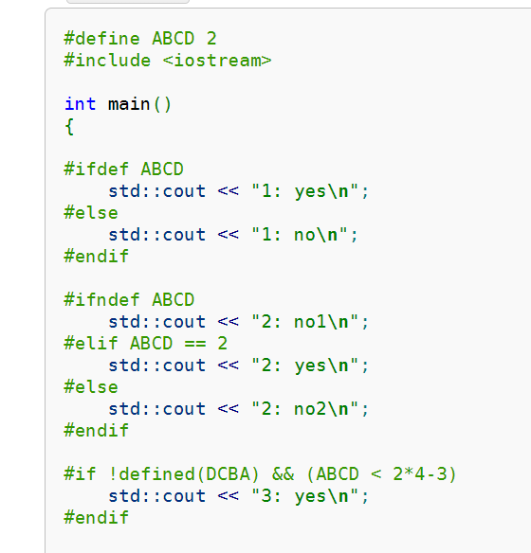
Examples - conditionality

Slide 7
Variadic macros
Variadic macros are function-like macros that contain a variable number of arguments.
To use variadic macros, the ellipsis(…) may be specified as the final formal argument in a macro definition, and the replacement identifier __VA_ARGS__ may be used in the definition to insert the extra arguments
__VA_ARGS__ is replaced by all of the arguments that match the ellipsis, including commas between them.
#define CHECK3(...) { printf(__VA_ARGS__); }

Slide 8
Stringizing operator (#)
The number-sign or "stringizing" operator (#) converts macro parameters to string literals without expanding the parameter definition.
It's used only with macros that take arguments.
If it precedes a formal parameter in the macro definition, the actual argument passed by the macro invocation is enclosed in quotation marks and treated as a string literal.
The string literal then replaces each occurrence of a combination of the stringizing operator and formal parameter within the macro definition.
#define stringer( x ) std::cout( #x "\n" )

Slide 9
Charizing operator (#@)
The charizing operator can be used only with arguments of macros. If #@ precedes a formal parameter in the definition of the macro, the actual argument is enclosed in single quotation marks and treated as a character when the macro is expanded.
#define makechar ( x ) #@x
a = makechar(b); ➔ a = 'b';

Slide 10
Token-pasting operator (##)
The double-number-sign or token-pasting operator (##), which is sometimes called the merging or combining operator, is used in both object-like and function-like macros.
It permits separate tokens to be joined into a single token, and therefore, can't be the first or last token in the macro definition.
#define paster( n ) enemy_##n
int paster(health) = 100; ➔ int enemy_health = 100;

Slide 11
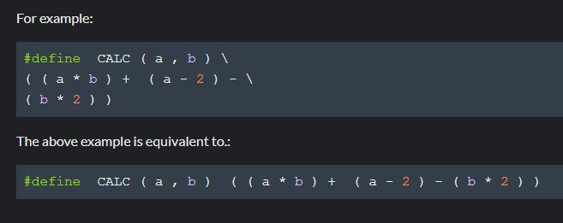
Line break (\)
The backslash character ('') is the line continuation character.
It must be the last character on a line.
The preprocessor joins lines ending with a line continuation character into a single line (for purposes of preprocessing and compilation).

Slide 12
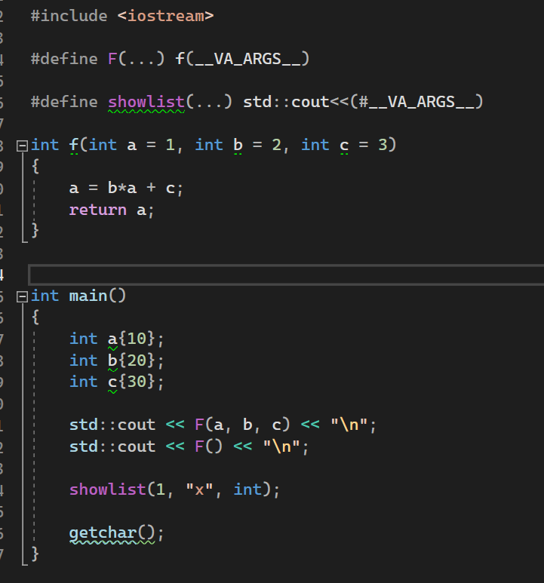
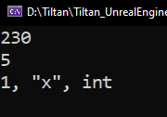
Examples – replacing preprocessors

Slide 13


Resources
https://en.cppreference.com/w/cpp/preprocessor
https://learn.microsoft.com/en-us/cpp/preprocessor/preprocessor?view=msvc-170

Slide 14
Thank you!
Best of luck!

