Slide 1

Unreal engine advnced
CPP Intermediate – Memory Management

Slide 2

The free store (heap)
Local variables go out of scope when the function ends
That’s not always what we want
The free store is for longer lived variables

Slide 3


Allocating memory
Create with “new”
Returns a pointer to the object or instance
Uses a constructor to initialize the object

Slide 4
Freeing memory
Tear down with “delete”
Uses the destructor to clean up the object

Slide 5
Allocating arrays
We need to add the square brackets [] after the type on the right-side of the expression

Slide 6
DEAllocating arrays
We need to call delete[]

Slide 7
Memory leaks
The objects created by new-expressions persist until the pointer returned by the new-expression is used in a matching delete-expression.
If the original value of pointer is lost, the object becomes unreachable and cannot be deallocated: a memory leak occurs.

Slide 8

Memory leaks
This may happen if the pointer is assigned to:

Slide 9
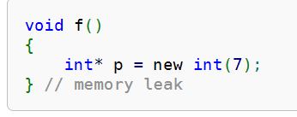
Memory leaks
or if the pointer goes out of scope:

Slide 10
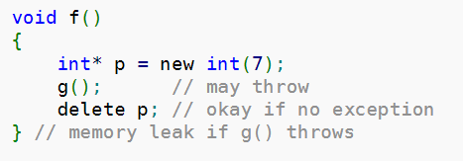
Memory leaks
or due to exception (not taught yet):

Slide 11

Resources
https://app.pluralsight.com/library/courses/cplusplus-fundamentals-c17/table-of-contents
https://en.cppreference.com/w/cpp/memory

Slide 12
Thank you!
Best of luck!

