Slide 1

CPP Beginners
CPP Intermediate – vector

Slide 2

Vector
Vectors are sequence containers representing arrays that can change in size at runtime.
Just like arrays, vectors use contiguous storage locations for their elements.
Internally, vectors use a dynamically allocated array to store their elements. This array may need to be reallocated in order to grow in size when new elements are inserted.

Slide 3
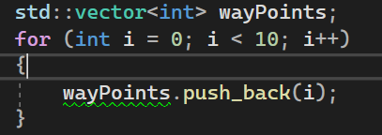
Common methods
std::vector::size (number of elements)
std::vector::push_back (like Add() in List)

Slide 4
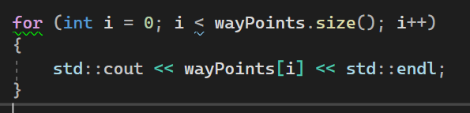
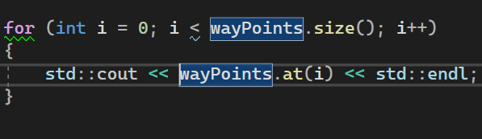
Common methods
[] operator (not safe – but faster)
std::vector::at (bounds check)

Slide 5
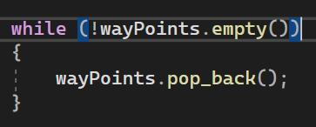
Common methods
std::vector::empty (returns true if vector is empty)
std::vector::pop_back (removes last element)

Slide 6


Common methods
std::vector::data (pointer to the internal array)
std::vector::clear (remove all elements)

Slide 7


Resources
https://cplusplus.com/reference/vector/vector/
https://en.cppreference.com/w/cpp/container/vector
Plural sight – “C++ beyond the basics” – Kate Gregory

Slide 8
Thank you!
Best of luck!

