Slide 2
What is shackspace?
Yet another hackerspace.

Slide 3
What is shackspace?
Yet another hackerspace.
(except that it's in snobby Stuttgart!)

Slide 4
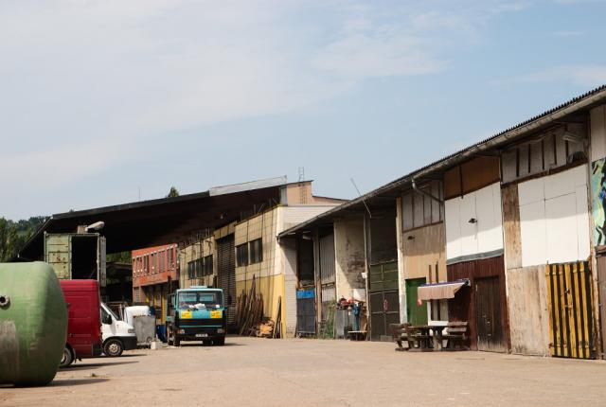
What is shackspace?

Slide 5
What's special about shackspace?
Founded mid February 2010.
23 [sic] founding members.
Status quo: ~85 members.

Slide 6
What's special about shackspace?
Founded mid February 2010.
23 [sic] founding members.
Status quo: ~85 members.
We've seen rapid growth!

Slide 7
How did that happen?
At least 80 tech-centric groups in Stuttgart.
Very few of them have their own space.

Slide 8
How did that happen?
At least 80 tech-centric groups in Stuttgart.
Very few of them have their own space.
A bar is no place for { hw, sw } hacking, talks, etc!

Slide 9
So.... what's happening?
Education for all age groups.
Talks and presentations.
Space for your projects.
Microcontroller Forum Stuttgart.
Space for events.

Slide 10
The usual madness

Slide 11
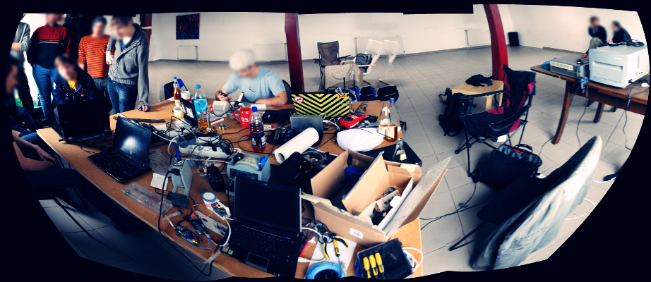
The usual madness

Slide 12
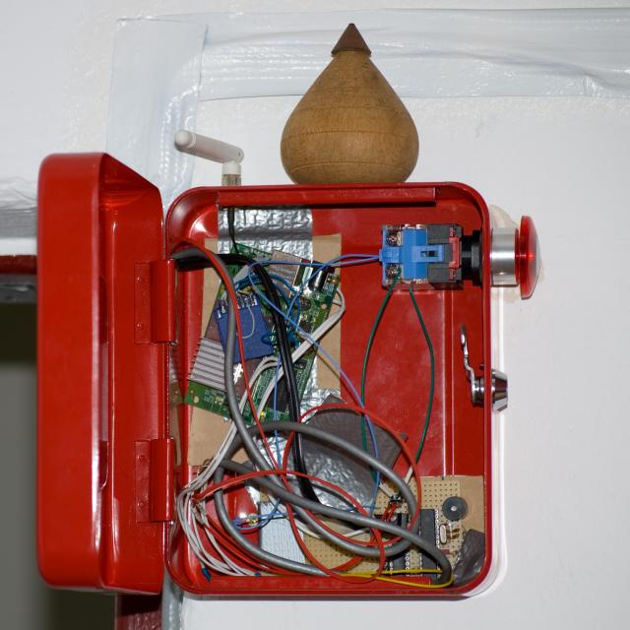
The usual madness

Slide 13
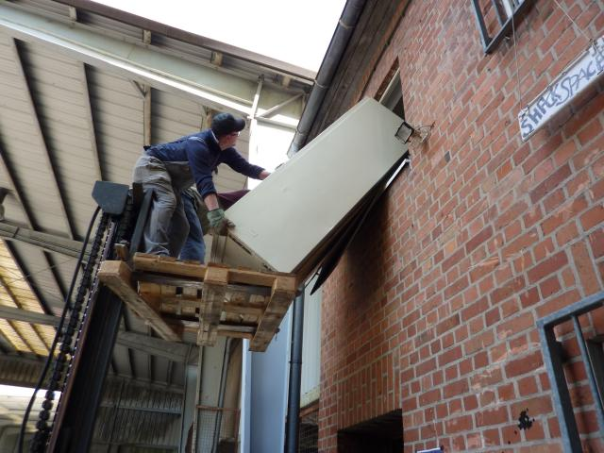
The usual madness

Slide 14
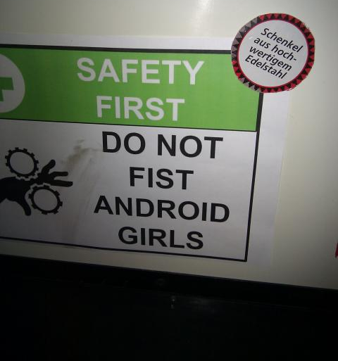
The usual madness

Slide 15
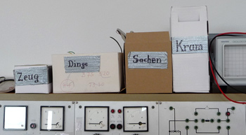
The usual madness

Slide 16
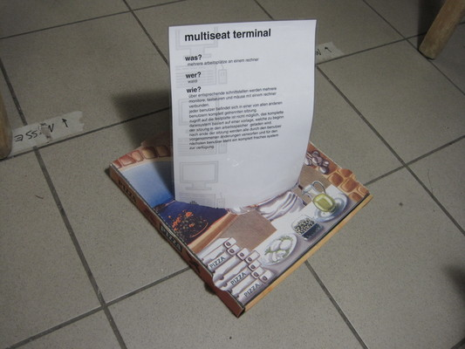
The usual madness

Slide 17
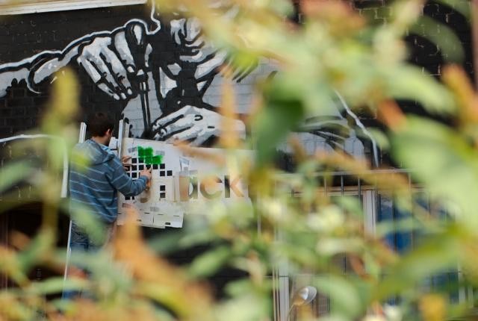
The usual madness

Slide 18
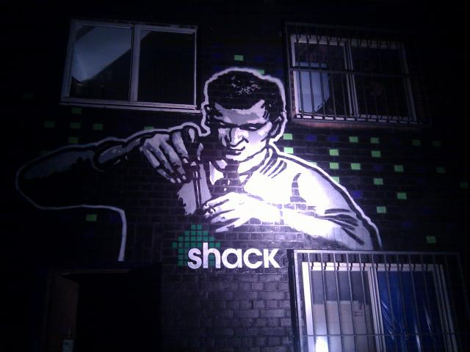
The usual madness

Slide 19
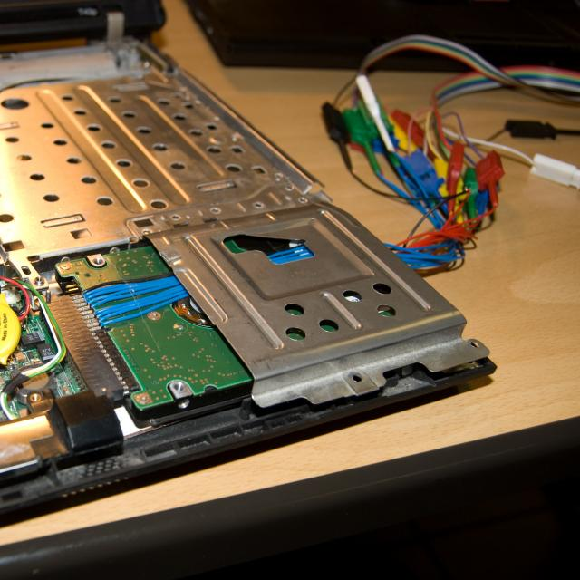
The usual madness

Slide 20
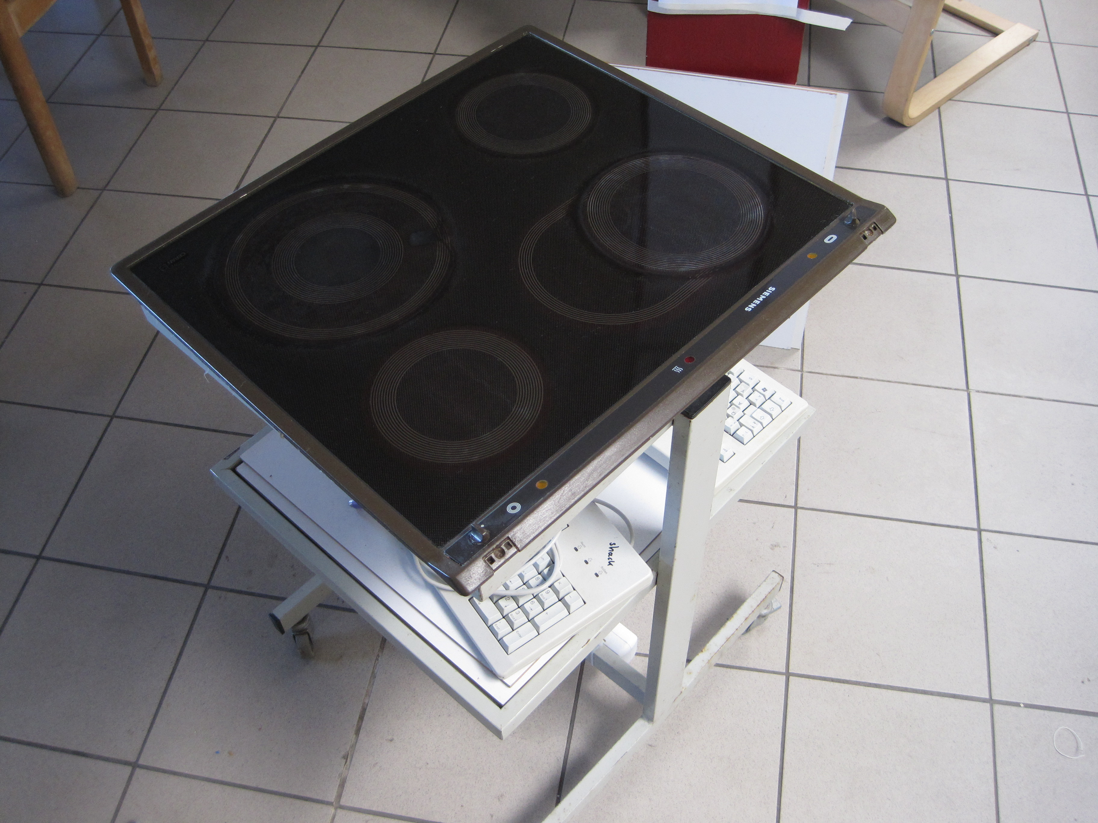
The usual madness

Slide 21
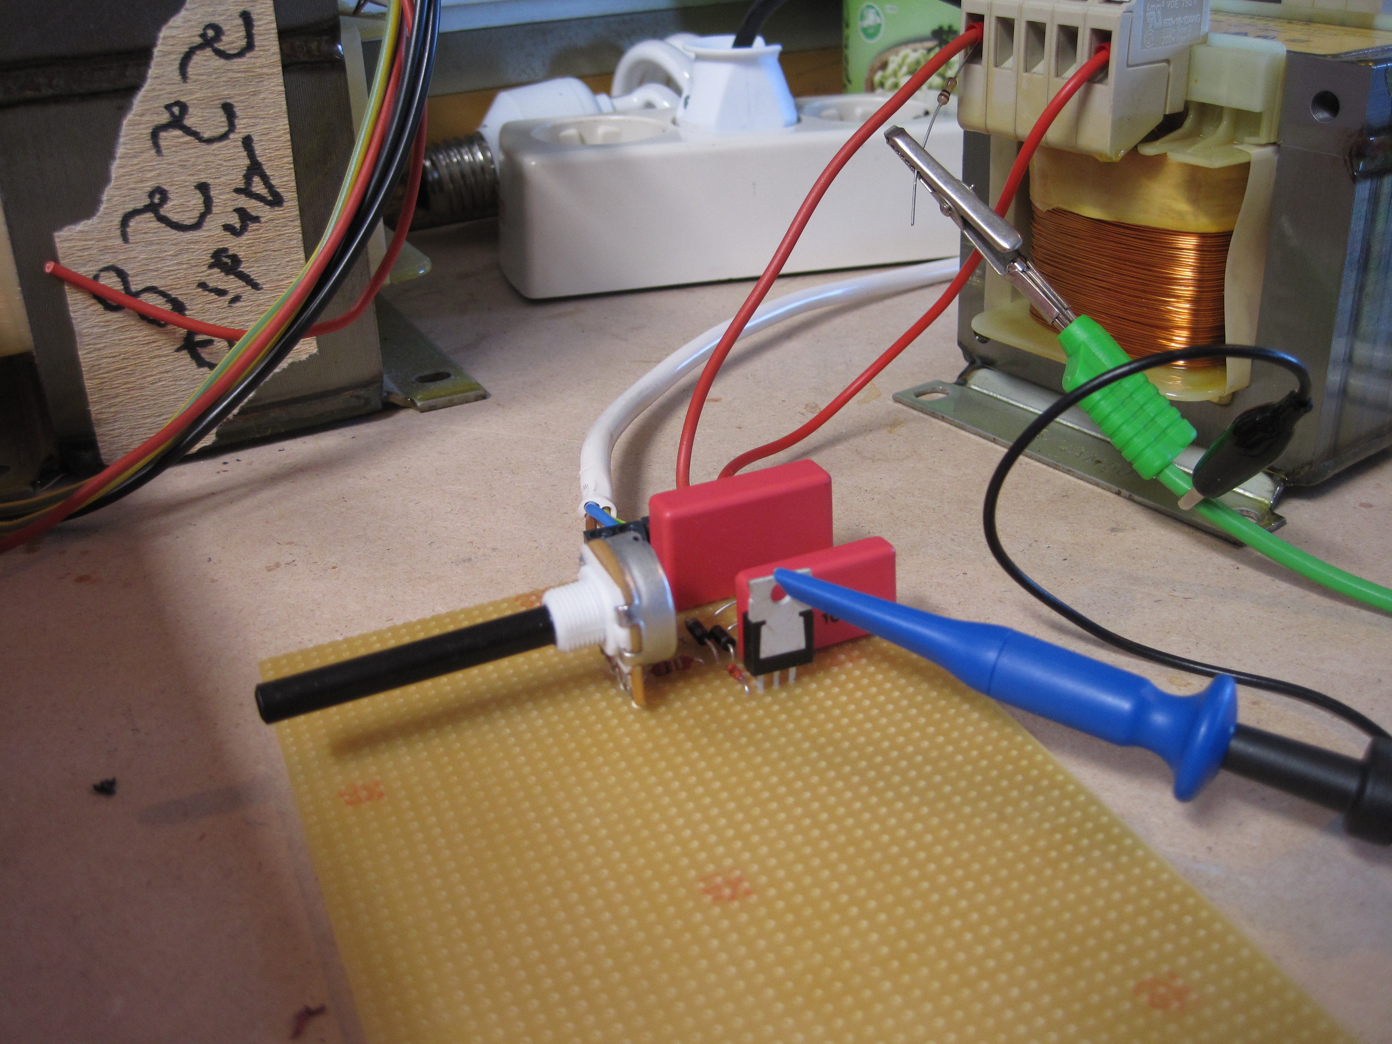
The usual madness

Slide 22
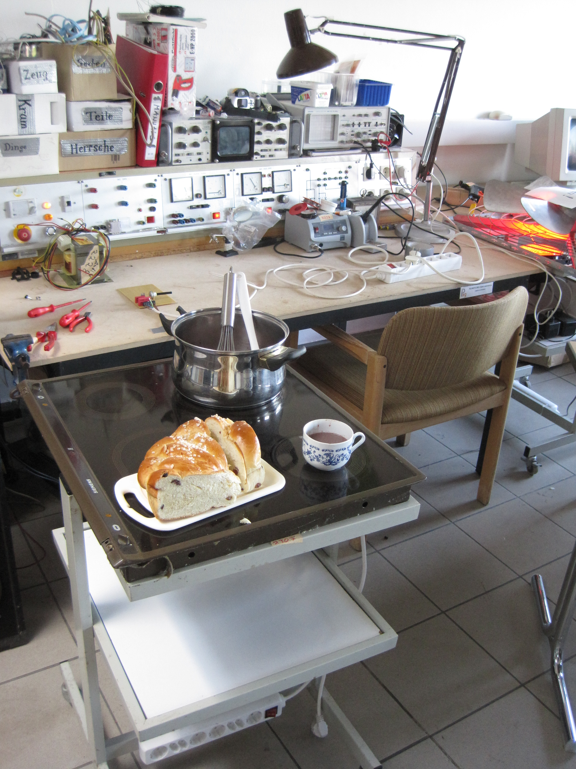
The usual madness

Slide 23
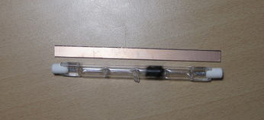
The usual madness

Slide 24
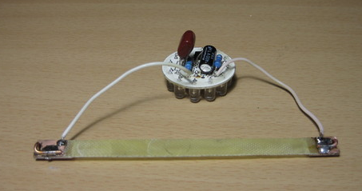
The usual madness

Slide 25
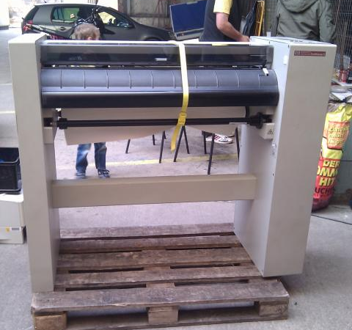
The usual madness

Slide 26
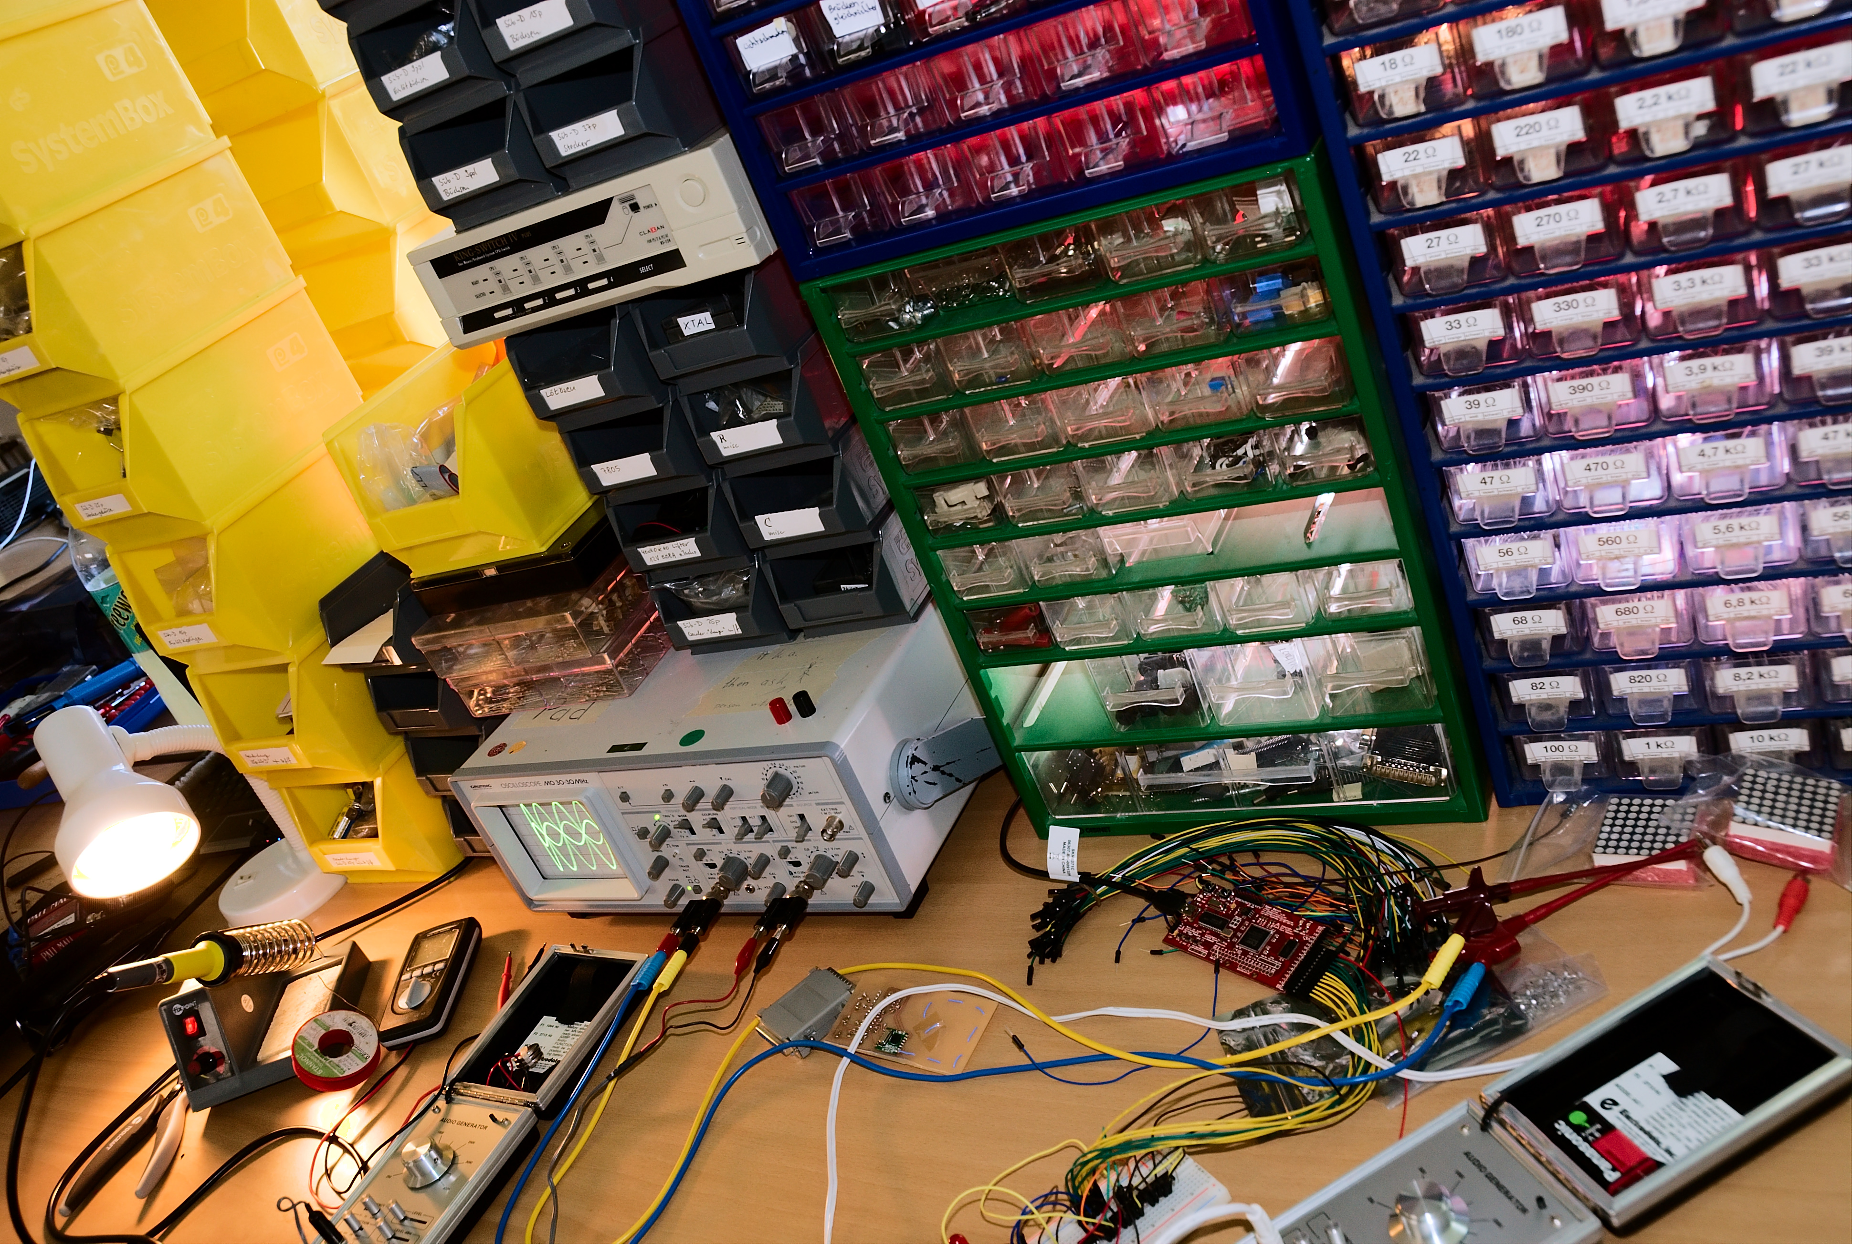
The usual madness

Slide 27
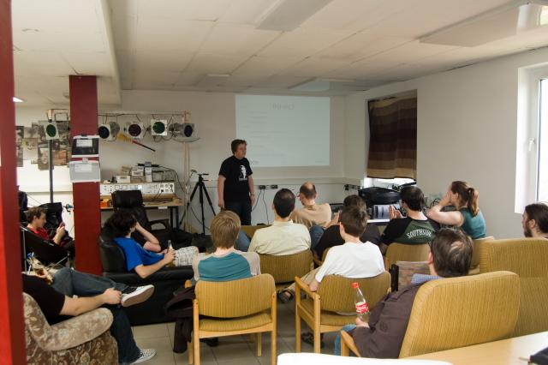
The usual madness

Slide 28
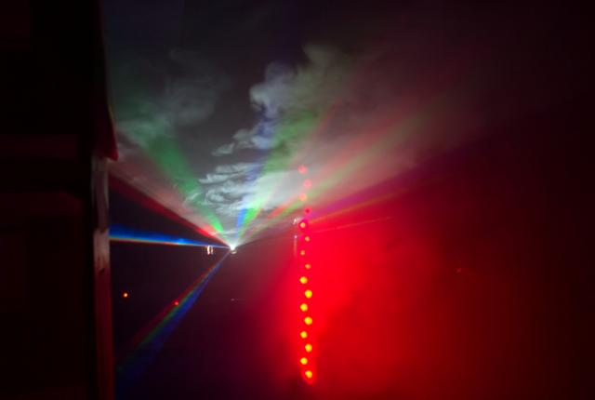
The usual madness

Slide 29
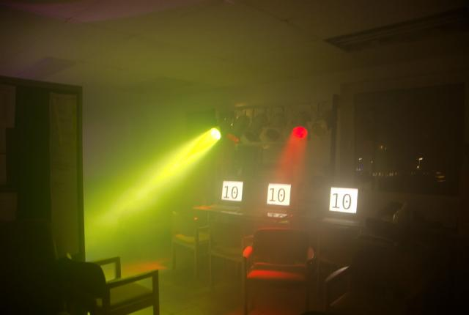
The usual madness

Slide 30
Arbitrary misquote
Goodbye and thanks for all the fish.
:-(

Slide 31
ONOEZ!
Everything you've just seen is going to end March 2011.

Slide 32
ONOEZ!
Our lease got terminated because of the controversial Stuttgart 21 trainstation project.
We have to find a new, bigger space.

Slide 33
ONOEZ!
Our lease got terminated because of the controversial Stuttgart 21 trainstation project.
We have to find a new, bigger space.
By February 2011.

Slide 34
Shameless plug
Become a member.
Donate something!
Got space? Tell us!

Slide 35
Shameless plug
rescue.shackspace.de

Slide 36
hadez@shackspace.de
@hdznrrd
DECT 4202
GSM 9202
shackspace.de

