Slide 2
Closing Event
Altes aus dem FF
Fair warning: inside jokes ahead

Slide 3
Value for Money
Your moneyz plox.
We now accept Bitcoin
No Dogecoin.

Slide 4
Tickets

Slide 5
T-Shirts

Slide 6
Angel T-Shirts

Slide 7
Zipper Hoodies

Slide 8
Container

Slide 9
Font Selection
Comic Sans
Comic Neue

Slide 10
Creative Workarounds
Cancelled days 1
Invitations sent ~400
“Missed” invitations ~10
Compliance events 1
Complaints about compliance 2

Slide 11
Party Stats
Equipment 2.3 trucks
Police officers in front of building 2
Police officers inside building 0
Time to hide sports equipment 0.1 s
Noise level (inside) >9000
Noise level (outside) 95 dB
Noise level (after police) 25 dB
shutdown -h now 3 am

Slide 12
Security Meltdown
Incidents taken kEHr of 5
Uptime 105 +/-2 %
Neighbors of orga member
responsible for mandatory
internet reboot 1

Slide 13
Infrastructure
Wifi networks open on day 0 600
Active Wifi clients on Saturday 261
Unique wifi clients by Saturday 381
Time to IPv6 3 days
Time all wifi APs were up 3 minutes

Slide 14
Infrastructure
Network equipment redundancy 100 %
Warning signs per door 9
ARP entries 569
DHCP leases 1500
Most boring host name “iPad”
Worst attenuation (fiber) 5 dB

Slide 15
Infrastructure
Time to cash register 11 hours
Cash register travel count 3
Nights of debugging 1
Network config changes 10+
Open heart surgery 1

Slide 16
“Infrastructure”
Proximity to Ukrainian Govt 1.5 octets
Free services there telnet
ftp
http
ptp
upnp
printer
drifts.net

Slide 17
Infra “structure”
Time to ENOSOAP 0.7 days
Time to ENOPAPER 3.7643 days
Hackers sleeping in weird places 2
Hackers sleeping at wired places 42
Slides with misleading accuracy 1

Slide 18
Angels
Registered and arrived 111
Active 77
Crew >23

Slide 19
Angel hours
Angels w/ tracked time 84
Angels >10h 23
Top tracked 42 h
Total workloads done 42 shitloads

Slide 20
Food & Drink
Cold cuts 180 kg
BAANAAANAAA!!1 90 kg
Bread 80 kg
Mate bottles KIA 7
Havana Club bottles 55
Chain length to secure mate fridge 50 m
OBAI tubes workshopped ~300
Hotdogs served on Good Friday 64

Slide 21
CERT
Emergencies 2
CERT members to fix cut finger 4

Slide 22
NOC Tools
Baseball bats 1
Hatchets 1

Slide 23
NOC Killcount
4
8
15
16
23
42

Slide 24
POC Math
Extensions 163
Active extensions 124
  DECT 100
  SIP 17

Slide 25
Trivia
Game playable on projector s Solitaire
Glasses fillable with 1 tin of ravioli 2
Trivia list loss count 3

Slide 26
Talks, Talks, Talks
Talks given 60+
Talks canceled 3
Talks canceled (b/c TWI) 1.3
Bunnies delivered to cash desk 1
Buns eaten 2^6
Puns beaten way to man

Slide 27
y

Slide 28
Movie News
Recent deaths on Game of Thrones S04E03
Your welcome

Slide 29
Sport News: Competitive Drinking
UBNT engineers 2
Jaegermeister bottles 7
Vodka bottles 1
Beers several
UBNT engineers back next day 0
Collateral damage 1

Slide 30
Sport News: Applied Security
Worst password 0000
Worst service door lock none
Wild Nyan-cat in natural habitat 1

Slide 31
Lost & Found
At the cash desk
also, the game.

Slide 32
One hegg, two hegg, next hegg

Slide 33
Support
Engel, Erzengel & CERT
Vortragende
Selfnet
Wau Holland Stiftung
AKK & Norman
POC & VOC
Ubiquiti
Netquarter
Nepustil
Viprinet
Boels
Thomas Piehler & Ulrich Escher
muzy & jiska
Supporter Ticket Club
getDigital
7Siebe
Akademischer Chor der Univeersitaet Stuttgart
Team C4sh
CCCS
shackspace
Kulturhaus Arena
COC, TOC, FOC

Slide 34
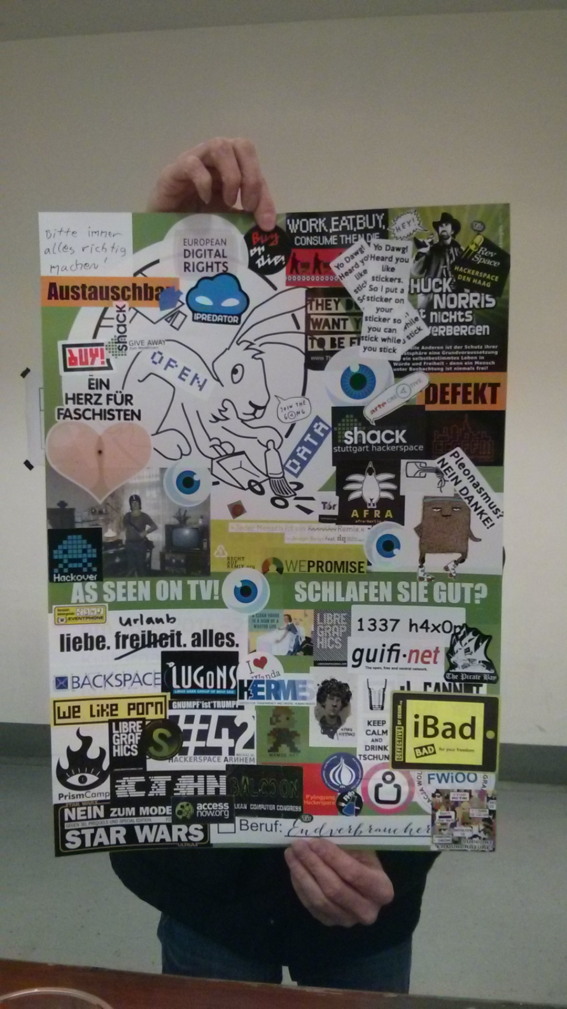

Slide 35
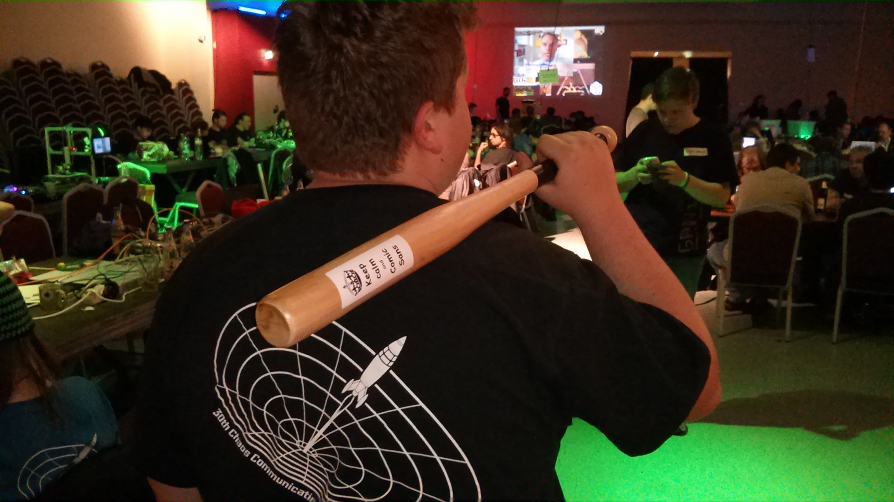

Slide 36
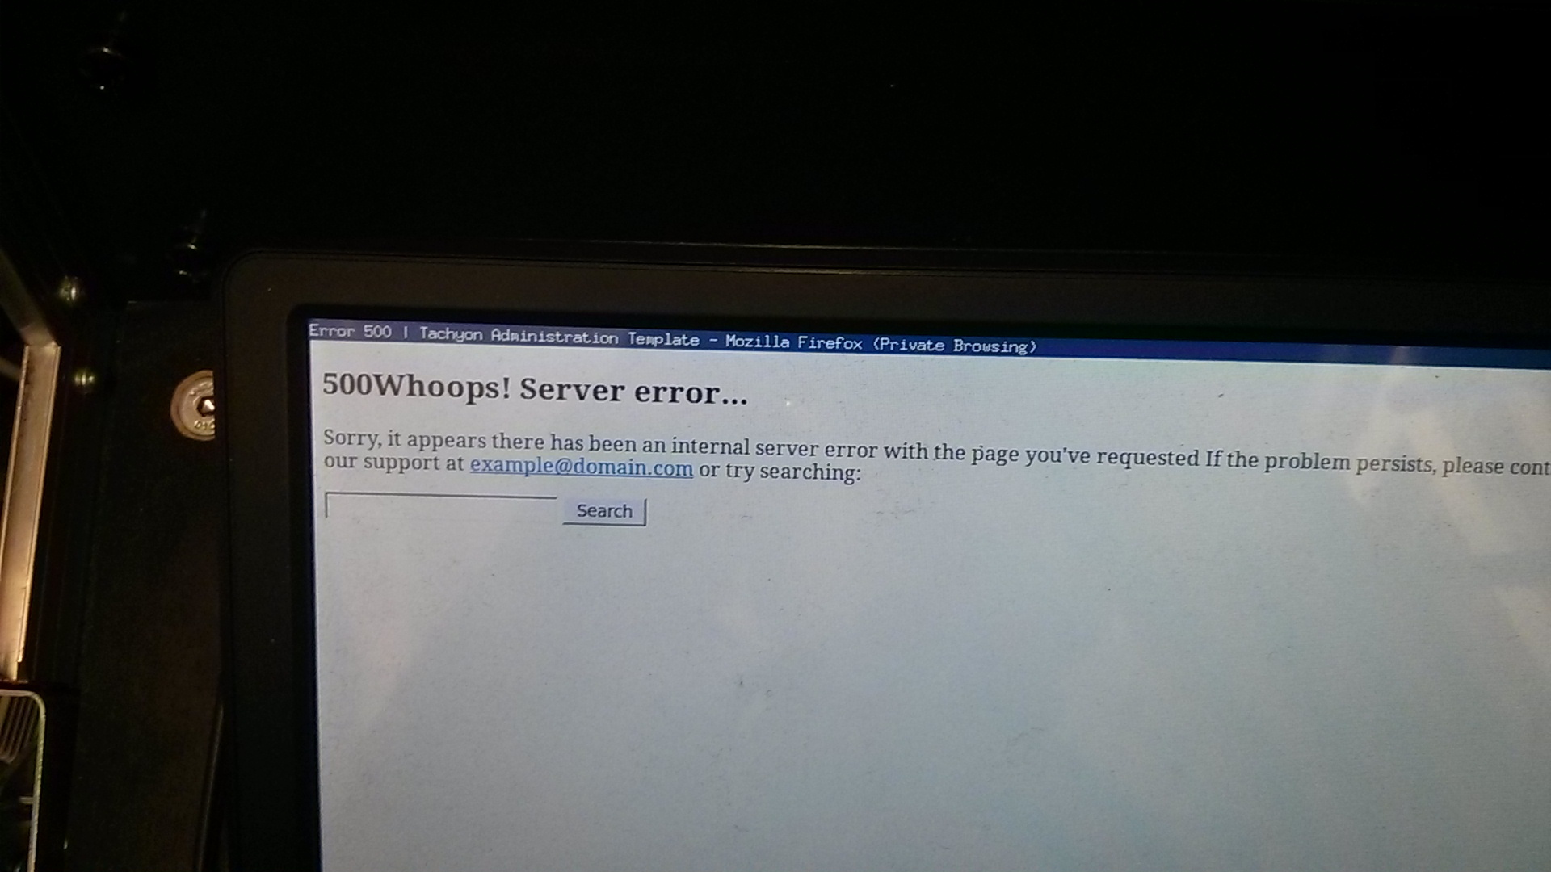

Slide 37
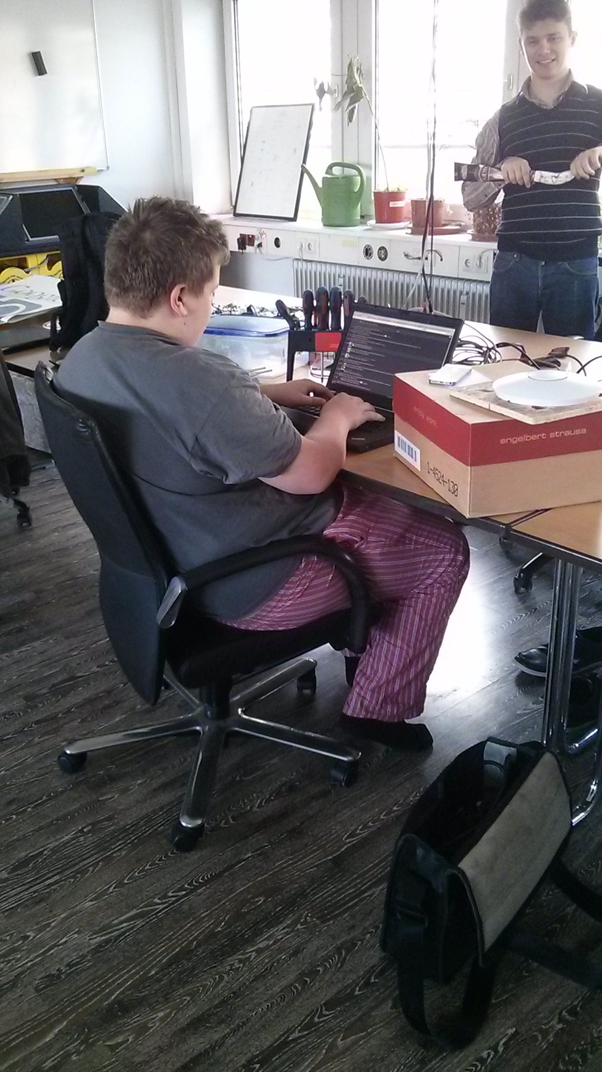

Slide 38
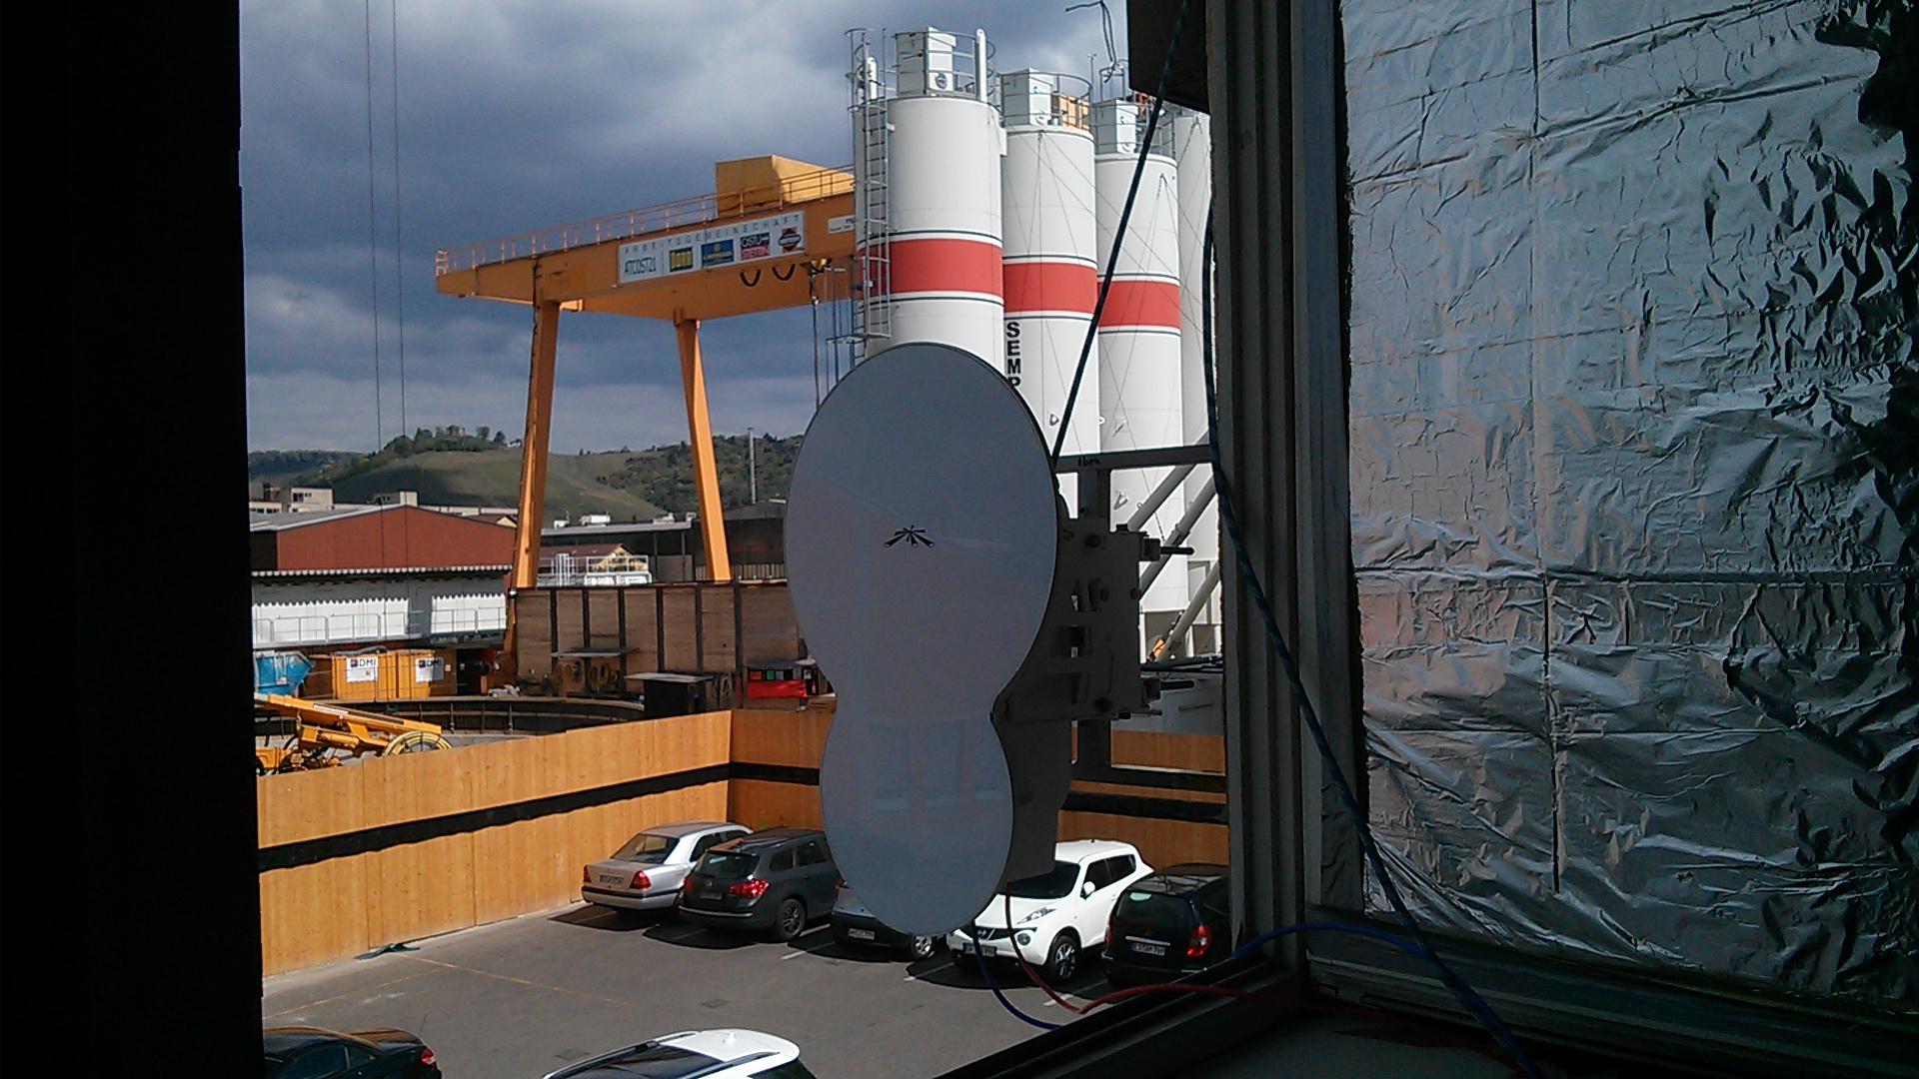

Slide 39
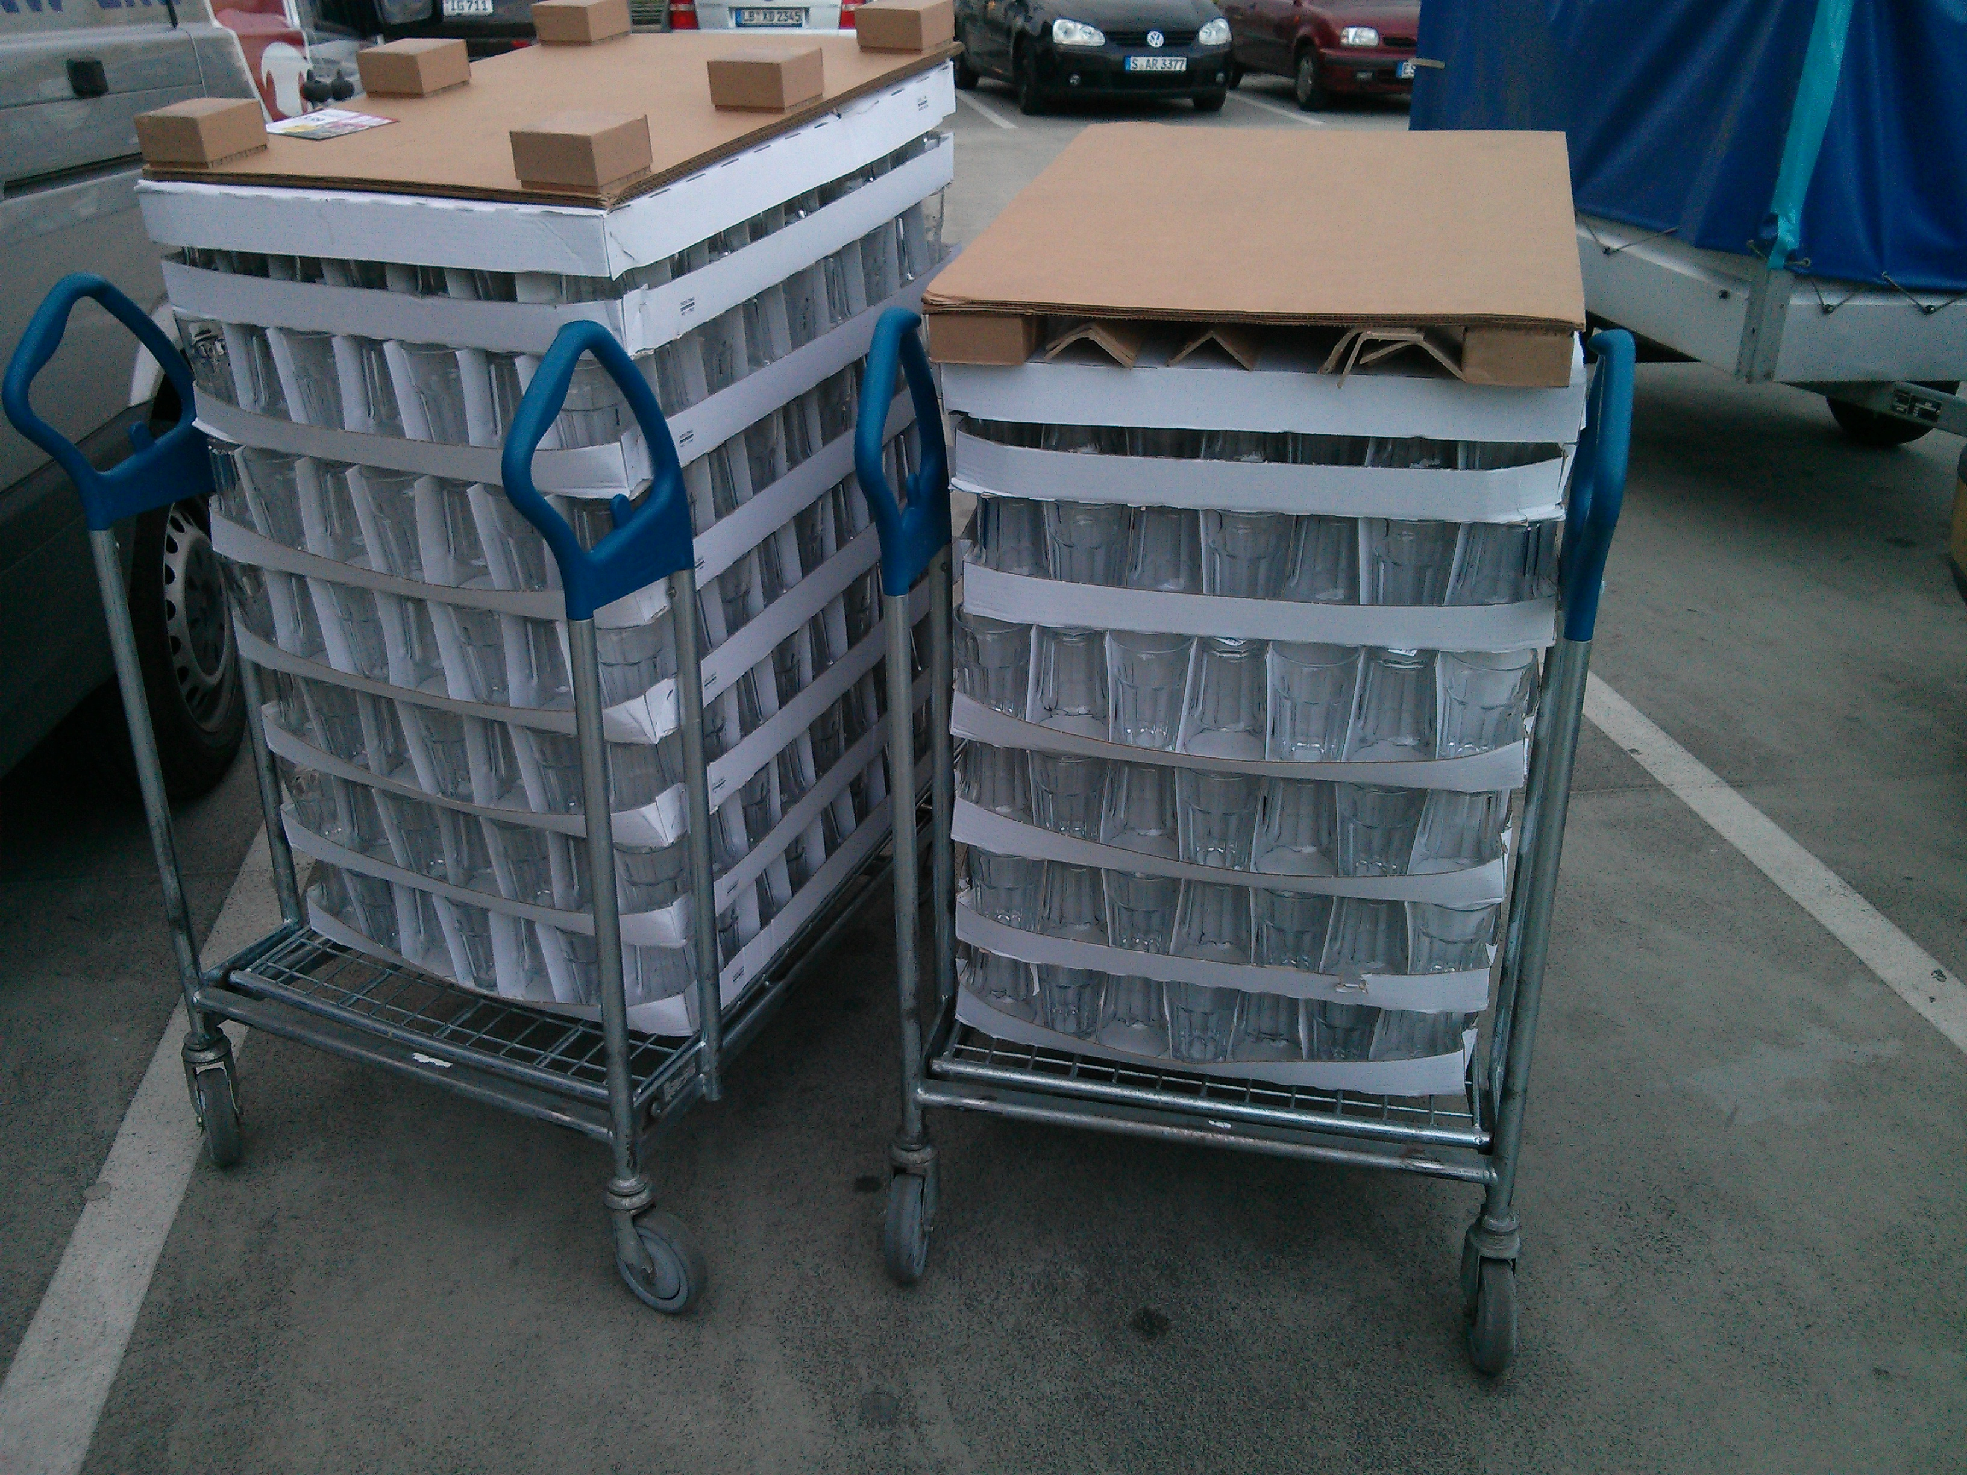

Slide 40
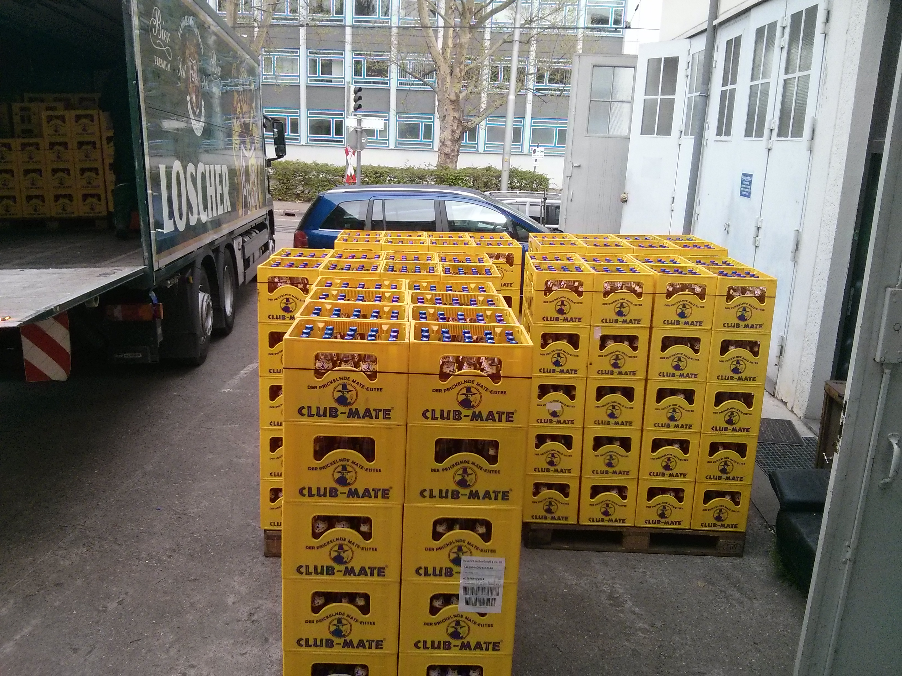

Slide 41
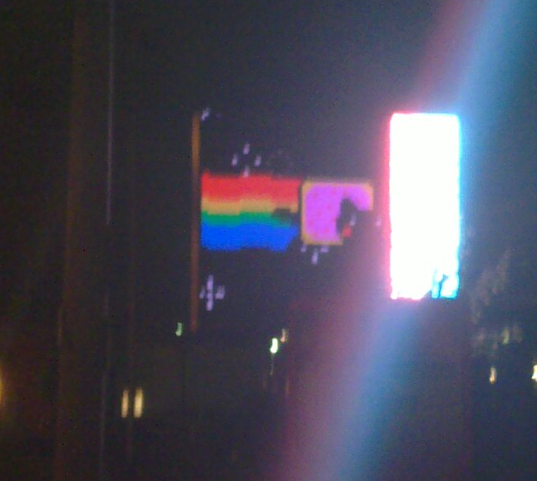

Slide 42


