Slide 2


Slide 3
← imagine this is me

Slide 4
Wats dat?
Packstation
  A “service” by DHL used widely in Germany
  Basically a P/O box
  Send DHL (and only DHL) packets to a packstation
  Pick it up whenever you want

Slide 5
How Does it Work?
Packstation lets you login with
  Magstripe + PIN
  Card Number + PIN

Slide 6
How Does it Work?
Packstation lets you login with
  Magstripe + PIN
  Card Number + PIN ← teh awesome!

Slide 7
A Little History
Signed up for Packstation
Used it plenty (→ Amazon <3)
Lost my card T_T
Used just the number & PIN to log in :3
But “suddenly” …

Slide 8
A Little History
Signed up for Packstation
Used it plenty (→ Amazon <3)
Lost my card T_T
Used just the number & PIN to log in :3
But “suddenly” …

Slide 9
A Little History
Signed up for Packstation
Used it plenty (→ Amazon <3)
Lost my card T_T
Used just the number & PIN to log in :3
But “suddenly” …

Slide 10

A Little History
… card required for login!!1

Slide 11

A Little History
Okay, not so suddenly... who reads mail anyway

Slide 12
A Little History
Okay, not so suddenly... who reads mail anyway

Slide 13
A Little History
Called Packstation support
Raged
…
No profit (claimed it protects from phishing)
But got a new card

Slide 14
A Little History
Called Packstation support
Raged
…
No profit (claimed it protects from phishing)
But got a new card

Slide 15
A Little History
Called Packstation support
Raged
…
No profit (claimed it protects from phishing)
But got a new card
Same number … and pin …

Slide 16

A Little History
Called Packstation support
Raged
…
No profit (claimed it protects from phishing)
But got a new card
Same number … and pin …

Slide 18


Slide 19
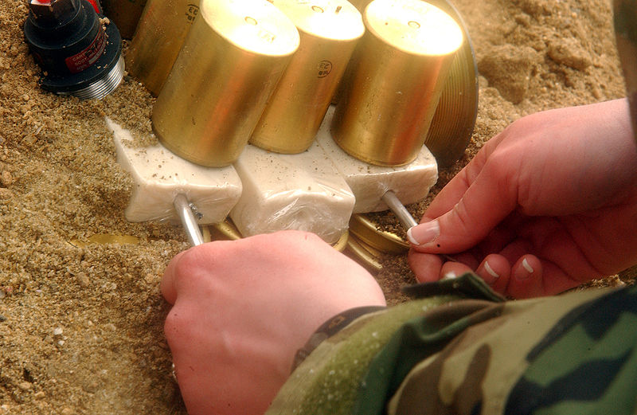
How to Read a Magstripe
When in doubt... C4!

Slide 20
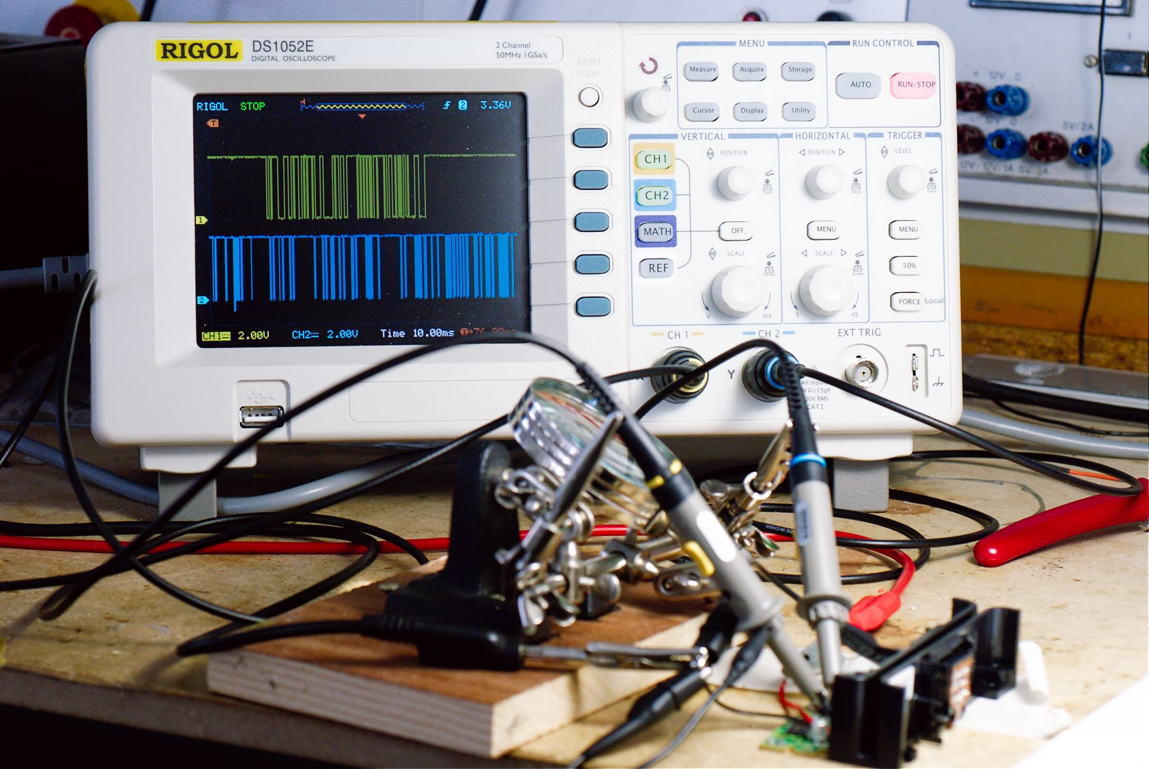
How to Read a Magstripe
When in doubt... SCOPE!

Slide 21
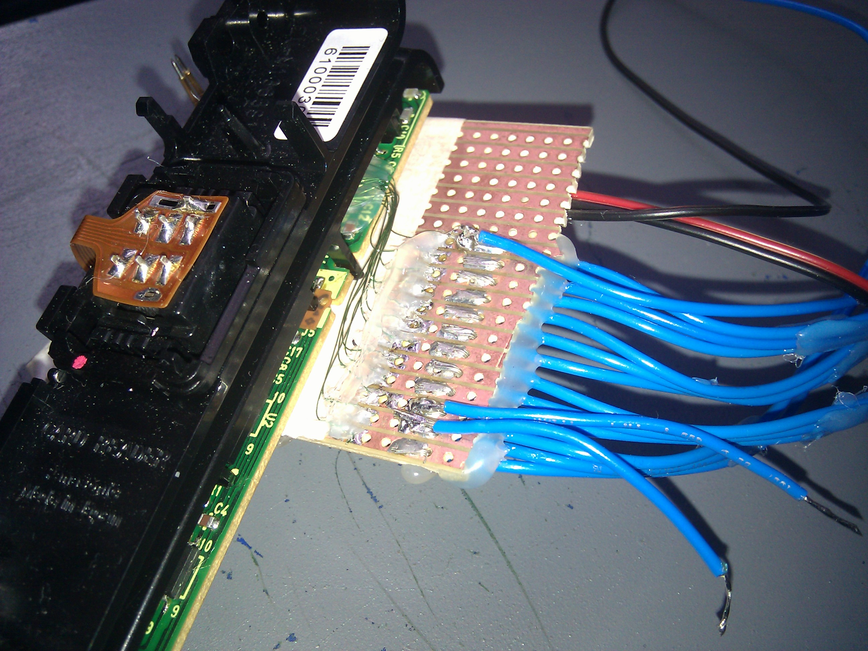
How to Read a Magstripe
Just for blog-creds: Hook it up to an Arduino

Slide 22
How to Read a Magstripe
Or maybe not...
Turns out it's too slow for this kind of reader :(

Slide 23
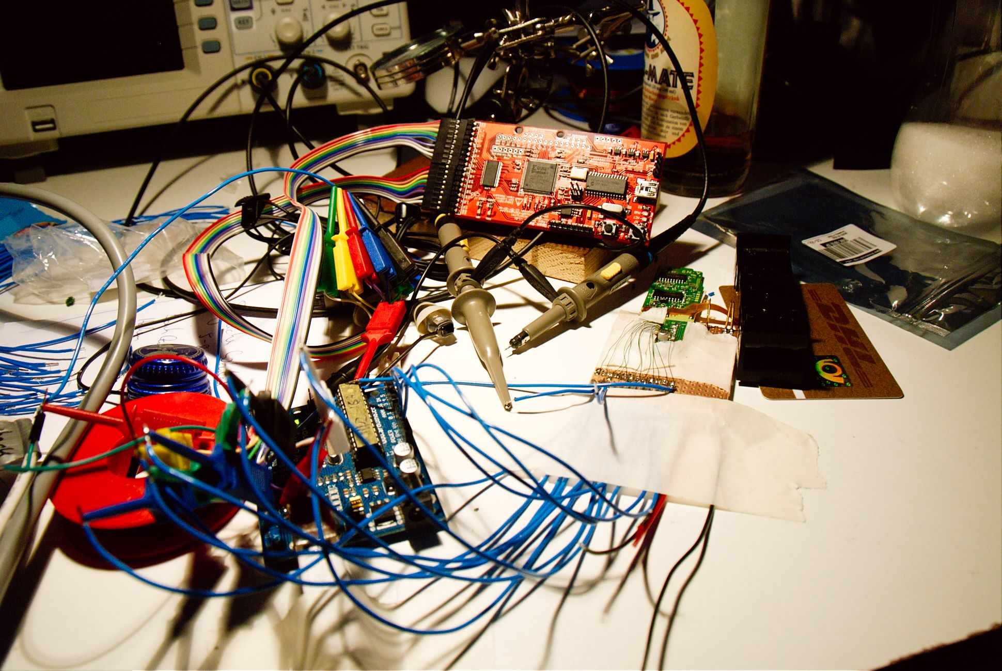

How to Read a Magstripe
OpenBench Logic Sniffer!

Slide 24
What's on That Thing?

Slide 25
What's on That Thing?
*drumroll*

Slide 26

What's on That Thing?
#$%&ing plaintext!

Slide 27
The Actual Data
Track 1: Your Name
Track 2: Your Card ID
Track 3: 005900000000000000000000

Slide 28
The Actual Data
Track 1: Your Name
Track 2: Your Card ID
Track 3: 0059000…
Get it from: your shipping address

Slide 29
The Actual Data
Track 1: Your Name
Track 2: Your Card ID
Track 3: 0059000…
Get it from: your shipping address (again)

Slide 30
The Actual Data
Track 1: Your Name
Track 2: Your Card ID
Track 3: 0059000…
Get it from: nowhere. Always the same.

Slide 31

The Actual Data
Track 1: Your Name
Track 2: Your Card ID
Track 3: 0059000…
Get it from: nowhere. Always the same.

Slide 32
Using a Logic Sniffer
Pro
  Very versatile
  Let's you grab plenty of channels
  +5 offense against hardware
Contra
  Not really practical :(
  Doesn't actually write cards :(((

Slide 33
Using a Logic Sniffer
Pro
  Very versatile
  Let's you grab plenty of channels
  +5 offense against hardware
Contra
  Not really practical :(
  Doesn't actually write cards :(((

Slide 34
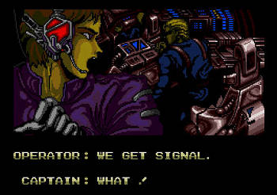
But... Proof of Concept, Baby!

Slide 35
So now I have to get a proper writer.

Slide 36
Toys and Stuff
Turns out writers are expensive :(
Around 250, 500,... 1000 EUR

Slide 37
Toys and Stuff
Turns out writers are expensive :(
Around 250, 500,... 1000 EUR
All writers? Nah...

Slide 38
Toys and Stuff
Turns out writers are expensive :(
Around 250, 500,... 1000 EUR
All writers? Nah...
China to the rescue!

Slide 39
150 EUR later...

Slide 40
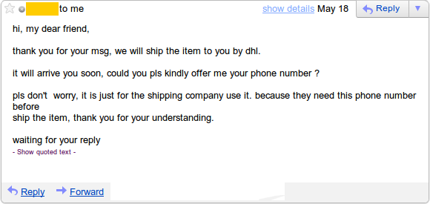

Slide 44


Slide 45
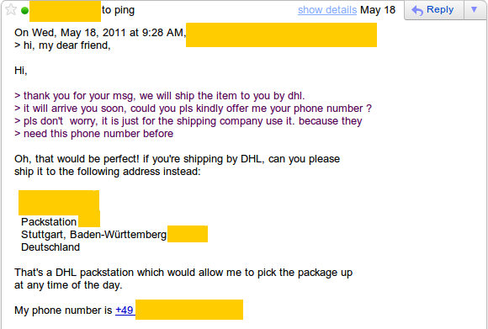

Slide 46
What Now?
For minute, let's assume we're phishing.
This is, after all, what using the card should protect you against.

Slide 47
What Now?
For minute, let's assume we're phishing.
This is, after all, what using the card should protect you against.

Slide 48

What Now?
For minute, let's assume we're phishing.
This is, after all, what using the card should protect you against.

Slide 49
What we Need
A name
A number
Another number
A PIN

Slide 50
What we Need
A name got it! (address)
A number
Another number
A PIN

Slide 51
What we Need
A name got it! (address)
A number got it! (address)
Another number
A PIN

Slide 52
What we Need
A name got it! (address)
A number got it! (address)
Another number got it! (always the same)
A PIN

Slide 53
What we Need
A name got it! (address)
A number got it! (address)
Another number got it! (always the same)
A PIN got it! (remember, phishing)

Slide 54
Let's get to Work!
Phish some! (I'll just phish myself)
Clone^W backup a card. (my own)
…
Profit

Slide 55
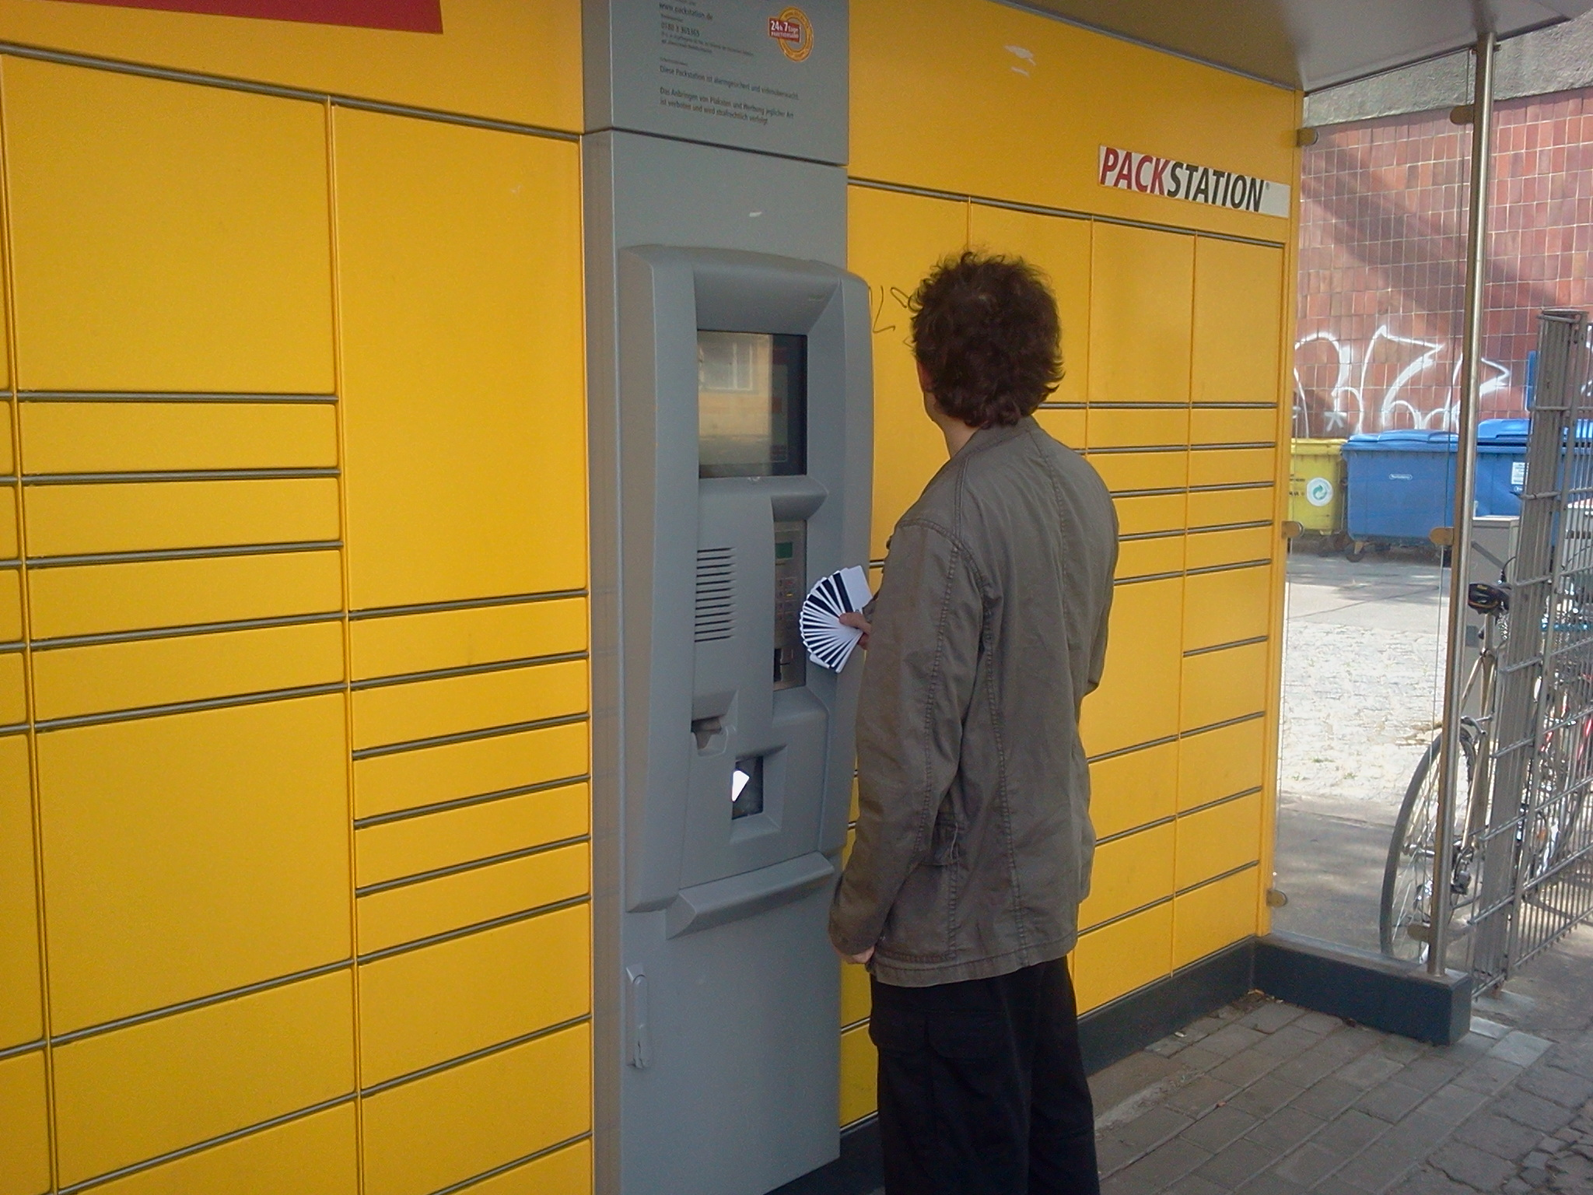

Slide 56
Results
The name field is totally irrelevant

Slide 57
Results
The name field is totally irrelevant
  … says Bobby Tables

Slide 58
Results
The name field is totally irrelevant
  … says Bobby Tables
Modifying track 3 doesn't do a thing

Slide 59
Results
The name field is totally irrelevant
  … says Bobby Tables
Modifying track 3 doesn't do a thing
Number + PIN is checked online

Slide 60
Results
The name field is totally irrelevant
  … says Bobby Tables
Modifying track 3 doesn't do a thing
Number + PIN is checked online
  Packstation keeps greeting me with my full name

Slide 61

Results
The name field is totally irrelevant
  … says Bobby Tables
Modifying track 3 doesn't do a thing
Number + PIN is checked online
  Packstation keeps greeting me with my full name

Slide 62
What now?
Added security?

Slide 63
What now?
Added security?
  Nil, Null, Nada

Slide 64
What now?
Added security?
  Nil, Null, Nada
  It's actually worse! → False sense of security!

Slide 65
What now?
Added security?
  Nil, Null, Nada
  It's actually worse! → False sense of security!
If you're smart enough to phish…

Slide 66
What now?
Added security?
  Nil, Null, Nada
  It's actually worse! → False sense of security!
If you're smart enough to phish…
  … you're smart enough to clone a card.

Slide 67
What now?
Added security?
  Nil, Null, Nada
  It's actually worse! → False sense of security!
If you're smart enough to phish…
  … you're smart enough to clone a card.
  Costs: 150 EUR → nothing

Slide 68


Slide 69
Meta
Thanks
  @momorientes - for the Pollin card reader
  @dop3j0e – logic sniffer and perl foo
Contact
  hadez@shackspace.de
  @hdznrrd

