Slide 1

CAR RENTING PORTAL
DBMS MINIPROJECT
Presented By-DESHWANTH S

Slide 2
Agenda
1
2
3
4
5
Introduction
Objectives
Software
Required
Schema
Diagram
ER
Diagram

Slide 3

Introduction AND ABSTRACT
Provide cars for rent
Range from compact class to S class cars
User can book a car sitting at home and car will be delivered
As per user requirements he/she can rent a car
It is a platform where people can use the available cars for their personal works paying some amount of rent

Slide 4
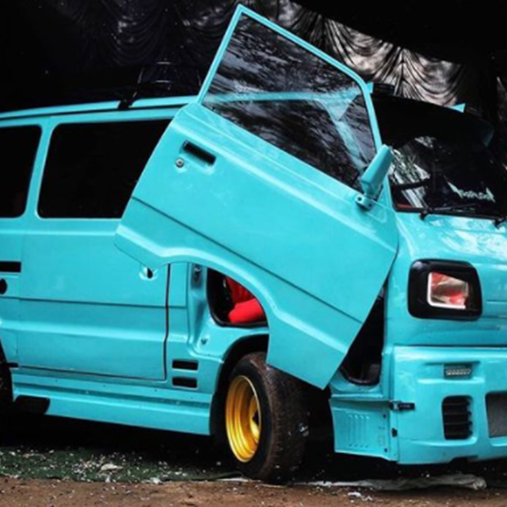
Objectives AND PROBLEM FORMULATION
Provide cars to people who require it temporarily
If their cars under repair and need a car they rent
As per user requirements he/she can rent a car
It is a platform where people can use the available cars for their personal works paying some amount of rent

Slide 5
Software Requirements
Front-end | HTML | CSS
Back-end | PHP
Database | SQL
Connectivity | XAMPP

Slide 6
SCHEMA DIAGRAM
ADMIN
ID | USERNAME | PASSWD
BOOKING
ID | BKNO | MAIL | VHCID | FRMDT | TODT | STATUS | MSSG | PSTDT
BRANDS
ID | BNDNAME
SUBSCRIBERS
ID | EMAIL | PSTDT
USERS
ID | FNAM | LNAM | EMAIL | PWD | CNTC | ADDRS | CITY | CNTRY | REGDT
VEHICLES
ID | NAME | BRAND | PRICE | FUEL | SEATS | YEAR | OVRVW | GEARSY | IMG

Slide 7
ER DIAGRAM
ID
NAME
USENM
ADMIN
ID
CNTNO
NAME
PWD
EMAIL
USER
BKNO
ACCESS
BRND
CHOOSE
FRMDT
PWD
ADDR
TODT
PRICE
VEHICLE
BOOKING
SEATS
EMAIL
FUEL
BRANDS
YEAR
STATUS
CARNM
ID
SELECT
SUBSCRIBER
BRDNME
ID
PSTDT
EMAIL

Slide 8
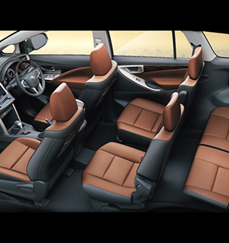
Thank you
Deshwanth S

