Slide 1
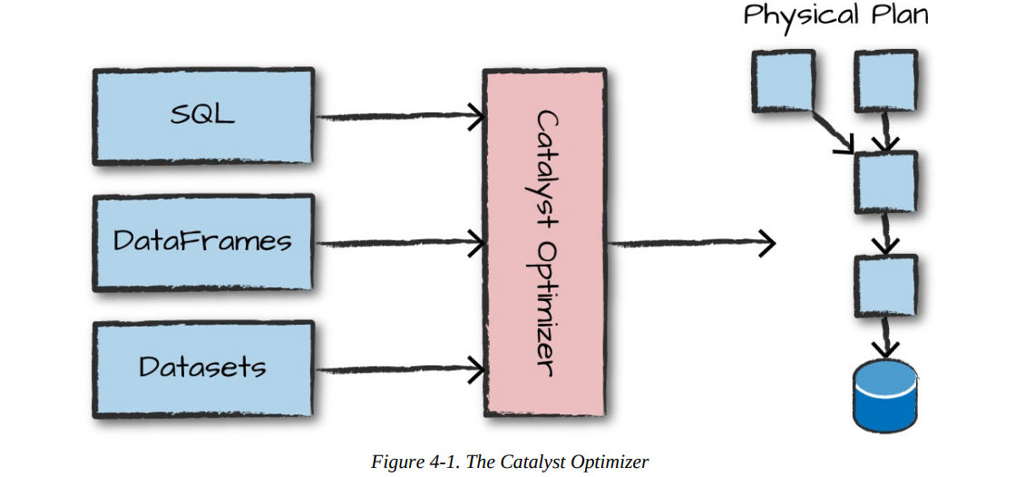

Slide 2
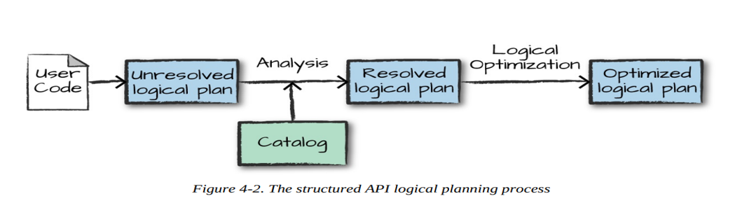
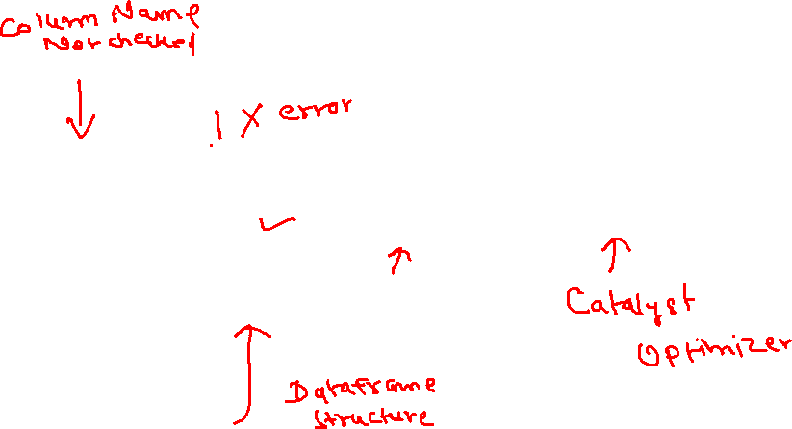

Slide 3
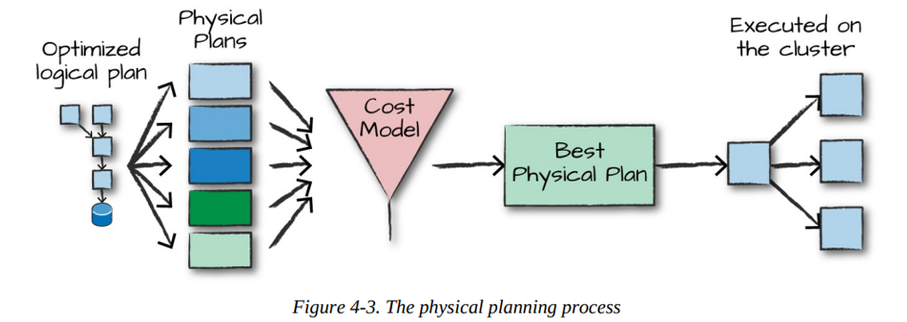
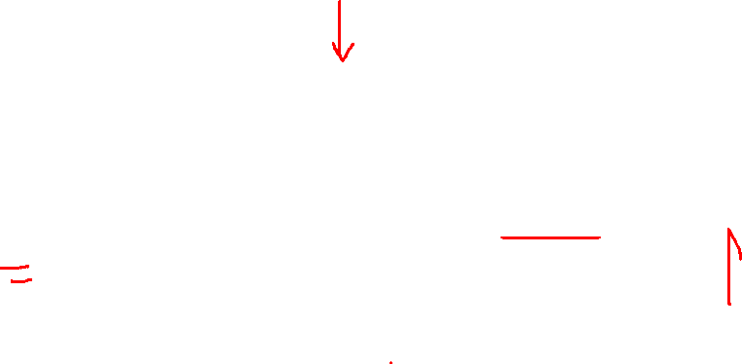

Slide 4
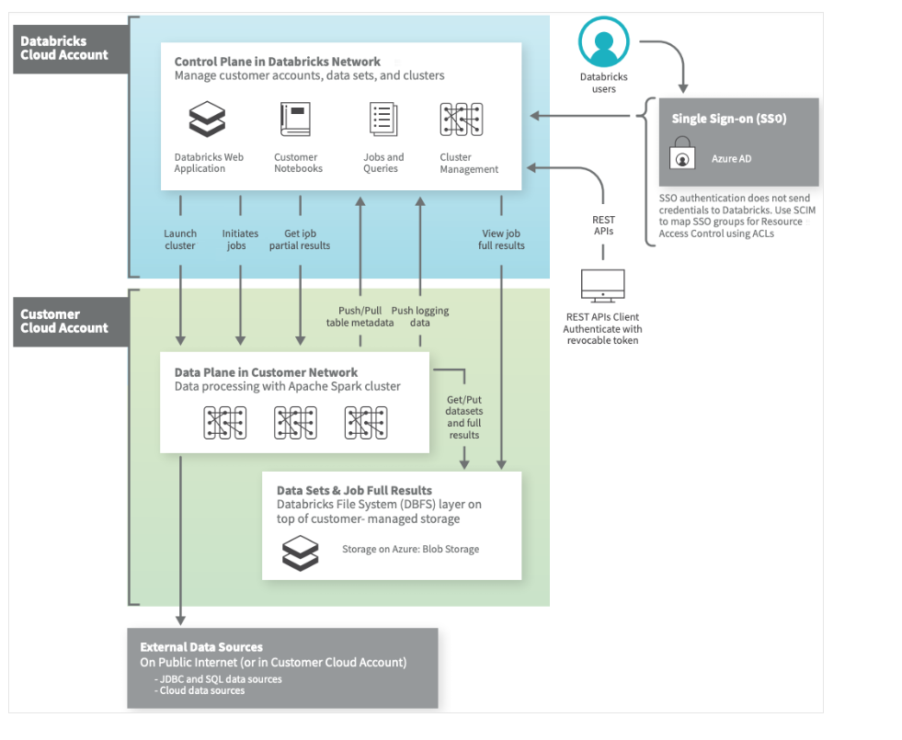

Slide 5
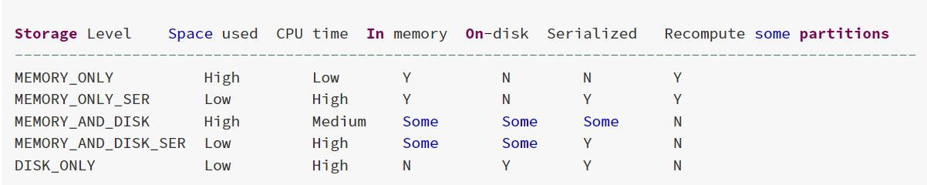

Slide 6
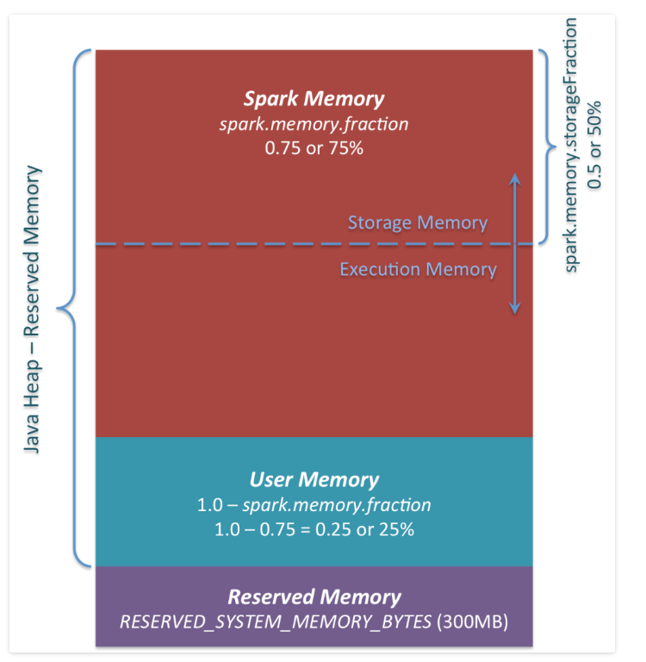

Slide 7
if you don’t give Spark executor at least 1.5 * Reserved Memory = 450MB heap, it will fail with “please use larger heap size” error message.
User Memory.: (“Java Heap” – “Reserved Memory”) * (1.0 – spark.memory.fraction), which is by default equal to (“Java Heap” – 300MB) * 0.25. For example, with 4GB heap you would have 949MB of User Memory. And again, this is the User Memory and its completely up to you what would be stored in this RAM and how, Spark makes completely no accounting on what you do there and whether you respect this boundary or not. Not respecting this boundary in your code might cause OOM error.

Slide 8
Spark Memory : Finally, this is the memory pool managed by Apache Spark. Its size can be calculated as (“Java Heap” – “Reserved Memory”) * spark.memory.fraction, and with Spark 1.6.0 defaults it gives us (“Java Heap” – 300MB) * 0.75. For example, with 4GB heap this pool would be 2847MB in size.

Slide 9
spark.memory.storageFraction: This whole pool is split into 2 regions – Storage Memory and Execution Memory, and the boundary between them is set by spark.memory.storageFraction parameter, which defaults to 0.5. The advantage of this new memory management scheme is that this boundary is not static, and in case of memory pressure the boundary would be moved, i.e. one region would grow by borrowing space from another one. I

Slide 10
Storage Memory. This pool is used for both storing Apache Spark cached data and for temporary space serialized data. Also all the “broadcast” variables are stored there as cached blocks.
Execution Memory. This pool is used for storing the objects required during the execution of Spark tasks. For example, it is used to store shuffle intermediate buffer on the Map side in memory, also it is used to store hash table for hash aggregation step. This pool also supports spilling on disk if not enough memory is available, but the blocks from this pool cannot be forcefully evicted by other threads (tasks).

Slide 11
Spark Memory Management | Distributed Systems Architecture (0x0fff.com)

Slide 12
Adaptive Query Execution Features
Reducing Post-shuffle Partitions. (Dynamially coalesce partition)
Switching Join Strategies to broadcast Join (Dynamically check size)
Optimizing Skew Join ( By splitting the skewed one based some threshold like size>256 MB and 5* times the average size)

Slide 13
Spark Resource Allocation
Static Allocation
Dynamic Allocation (You can enable it explicitly)

