Slide 1

Hotel Management System
Database Mini Project using Microsoft SQL Server — demonstrating practical implementation of database design, normalization, SQL Server concepts, and real-world hotel operations management. The system helps manage essential hotel activities such as room reservations, guest records, check-ins and check-outs, billing, and occupancy tracking in a structured way. It is important because it shows how a well-designed database can improve accuracy, reduce manual work, and support efficient day-to-day hotel operations.

Slide 2
Introduction & Project Objectives
What Is This Project?
Core Objectives
The Hotel Management System is a database management project developed using Microsoft SQL Server. It manages hotel operations by maintaining records for customers, room bookings, reservations, room categories, and payments — simplifying hotel management through structured database design techniques.
Handle customer details, room information, reservations, and payment records efficiently
Reduce data redundancy through normalization techniques
Implement CRUD operations, transactions, views, triggers, and functions
Ensure data consistency using primary keys and foreign key relationships

Slide 3
Technologies & Database Overview
Microsoft SQL Server
SQL Server Management Studio
Primary database management system used for creating and managing all database objects, tables, and operations.
SSMS is used for query execution, database administration, and testing all SQL operations.
dbdiagram.io
Database Name
Used to design the ER Diagram, visually representing the database structure and table relationships.
The database is named HotelManagementSystem and contains all tables, constraints, functions, views, triggers, indexes, and transactions.

Slide 4
Modules of the System
Customer Management
Room Category
Room Management
Stores customer information including name, phone number, email, and address.
Manages different categories of rooms and their pricing information.
Maintains room details and availability status across the hotel.
Reservation Management
Payment Management
Handles customer bookings, check-in dates, check-out dates, and reservation status.
Stores payment details related to customer reservations.

Slide 5
Database Tables
The HotelManagementSystem database consists of five core tables, each with a primary key for unique record identification and foreign keys to maintain referential integrity across the system.
Table
Primary Key
Key Attributes
Foreign Key
Customers
CustomerID
FullName, Phone, Email, Address
—
RoomCategory
CategoryID
CategoryName, PricePerNight
—
Rooms
RoomID
RoomNumber, Status
CategoryID → RoomCategory
Reservations
ReservationID
CheckInDate, CheckOutDate, ReservationStatus
CustomerID → Customers, RoomID → Rooms
Payments
PaymentID
Amount, PaymentDate, PaymentMethod
ReservationID → Reservations

Slide 6
ER Diagram & Table Relationships
The ER Diagram visually represents the database structure, showing all entities, attributes, primary keys, foreign keys, and relationships. Cardinality symbols indicate relationship types: 0..1 represents zero or one occurrence, while * represents many occurrences.
RoomCategory → Rooms
Customers → Reservations
One room category can contain multiple rooms (one-to-many).
One customer can make multiple reservations over time.
Rooms → Reservations
Reservations → Payments
One room can appear in multiple reservations across different time periods.
One reservation can contain associated payment details.

Slide 7
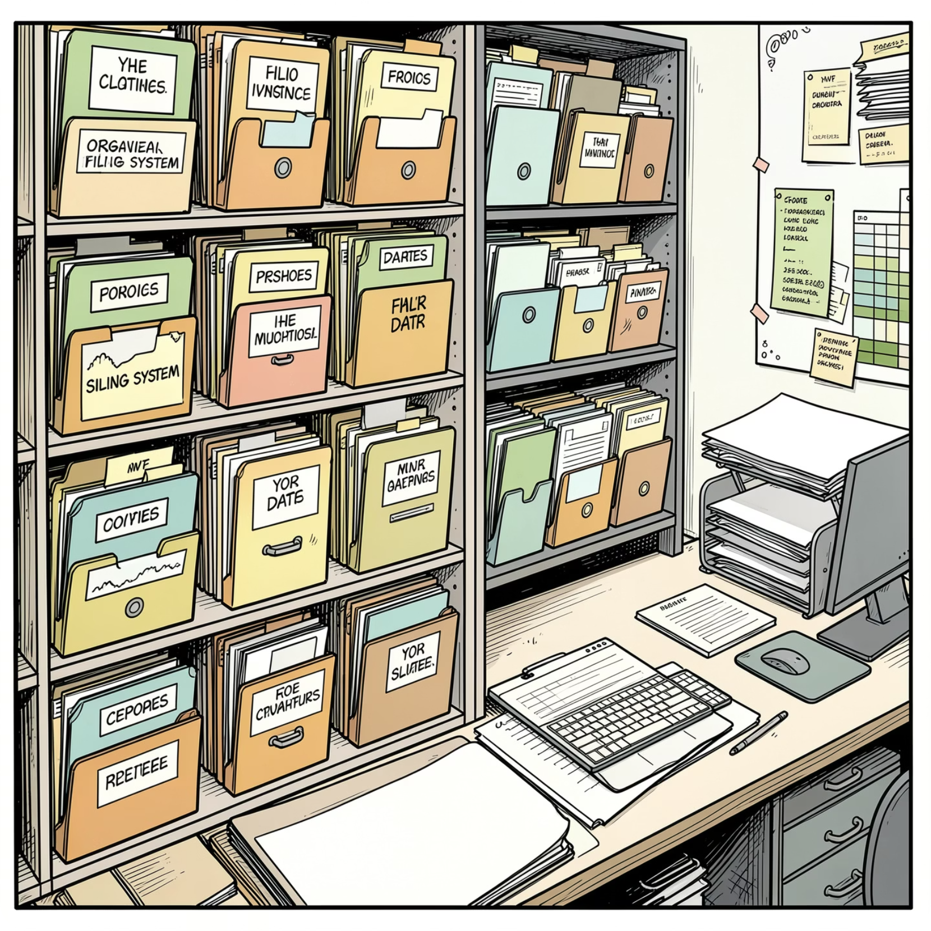
Normalization
Why Normalize?
Normalization techniques are used to reduce redundancy and improve data consistency throughout the database. The Hotel Management System follows all three normal forms to ensure a clean, efficient schema.
1
1NF — First Normal Form
Ensures atomic values and eliminates repeating groups across all tables.
2
2NF — Second Normal Form
All non-key attributes fully depend on the primary key.
3
3NF — Third Normal Form
Removes transitive dependencies. Room category details and pricing are stored separately in RoomCategory instead of being repeated in the Rooms table, improving maintainability and preventing duplicate data.

Slide 8





SQL Concepts & Advanced Features
The project uses several SQL Server concepts to implement database operations effectively. DDL commands (CREATE, ALTER, DROP) create and manage database objects. DML commands (INSERT, UPDATE, DELETE, SELECT) manipulate data. DCL commands (GRANT, REVOKE) control user permissions. TCL commands (COMMIT, ROLLBACK) manage transactions and maintain data consistency.
Functions
Views
Triggers
Scalar and table-valued functions simplify query execution and perform reusable operations, reducing complexity and improving reusability.
Views simplify complex queries, provide abstraction over tables, improve readability, and enhance security by restricting direct table access.
Automatically execute actions on INSERT, UPDATE, or DELETE operations to maintain data consistency and validate conditions.
Indexes
Transactions
Clustered and non-clustered indexes improve query performance and speed up data retrieval operations across the database.
BEGIN TRANSACTION, COMMIT, and ROLLBACK ensure database changes are either fully completed or completely rolled back in case of failures.

Slide 9

Project Execution Flow
DB Creation
Insert Sample Data
Create Logic & Indexes
Run Tests & Output
The project execution follows a structured sequence — beginning with database and table creation using DDL scripts, followed by sample data insertion via DML commands. Functions, views, triggers, and indexes are then created to enhance functionality. Transactions are implemented to demonstrate data consistency management, and finally, queries are executed to test the system and generate outputs.
Advantages
Future Enhancements
Reduces manual work in hotel operations
Primary & foreign keys ensure referential integrity
Normalization reduces data redundancy
Indexes improve query performance
Better organization and easier maintenance
Online booking system integration
Admin dashboard & authentication system
ASP.NET Core frontend application
Staff management module
Payment gateway integration

Slide 10

Conclusion
The Hotel Management System successfully demonstrates the practical implementation of Microsoft SQL Server concepts through a real-world mini project — including normalization, relationships, functions, views, triggers, indexes, and transactions to create an efficient and scalable hotel reservation system.
5
Core Tables
Customers, RoomCategory, Rooms, Reservations, and Payments
3
Normal Forms
1NF, 2NF, and 3NF applied to eliminate redundancy
4
SQL Command Types
DDL, DML, DCL, and TCL commands implemented
5
Advanced Features
Functions, Views, Triggers, Indexes, and Transactions

