Slide 1
SVN

Slide 2
The SVN Book
http://svnbook.red-bean.com/nightly/en/svn-book.pdf
  Read Chapter 1!!!

Slide 3
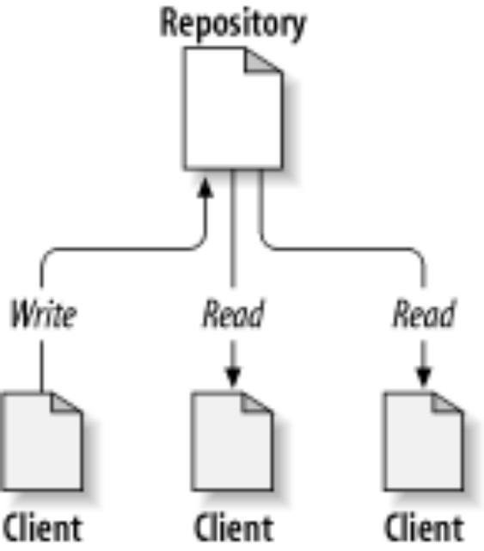
Local Workspaces for a Virtual
File System
Figure 1.1. A typical client/server system
From http://svnbook.red-bean.com/nightly/en/svn-book.pdf, pg 23

Slide 4
Storing Authentication
When you checkout from stu (ssh), svn will attempt to store authentication tokens so you won’t need to give username/password information again.
This is stored in .subversion/auth/svn.simple

Slide 5
svn commands
svn co (checkout)
svn add
svn commit
svn update
svn rm (remove)
svn mv (move)
svn cp (copy)

Slide 6
Checking Out
svn co http://group0X.stu.encs.concordia.ca/svn
This will create a directory called svn (your workspace)
This directory will contain all projects in your repository

Slide 7
Checking Out (2)
You don’t need to check out everything at once!
svn co http://group0X.stu.encs.concordia.ca/svn/390
This will create a 390 directory with the 390 project.

Slide 8
Add and Remove
Add/remove files/directories
History is not discarded on removal
Nothing actually changes till you commit!

Slide 9
Committing
svn commit from a workspace will commit all changes.
Conflicts will prompt messages.
Either all changes will go through, or none will

