Slide 1


Auto-Sunlight Solar Panel Detector and Door Lock

Slide 2
Introduction
In this project we have designed a smart home , Auto Sunlight detector through Solar Panel and intruder locking system using Arduino system in which solar panel will automatically rotate towards the ray of sunlight and converts solar energy in to electrical energy then stores it whereas the door lock will allow only registered member of the family.
Then its supplies the stored energy to the home appliances through the Arduino which is further controlled by Arduinodriod application.

Slide 3
Principle
The main concept behind the project using Arduino is to get sunrays from all the possible directions and generate electrical energy from source of light and Intruder security.
Process:
It first receive the sunlight from respective directions and stores it then it supplies the stored energy to the home appliances then the stored energy which is being utilised will displayed on the led screen.
The solar panel will follow the root of the sunlight by the help of ultrasonic sensor .
For the Security purpose we are using ultrasonic Sensor which will detect the huaman being through face recognisation.

Slide 4
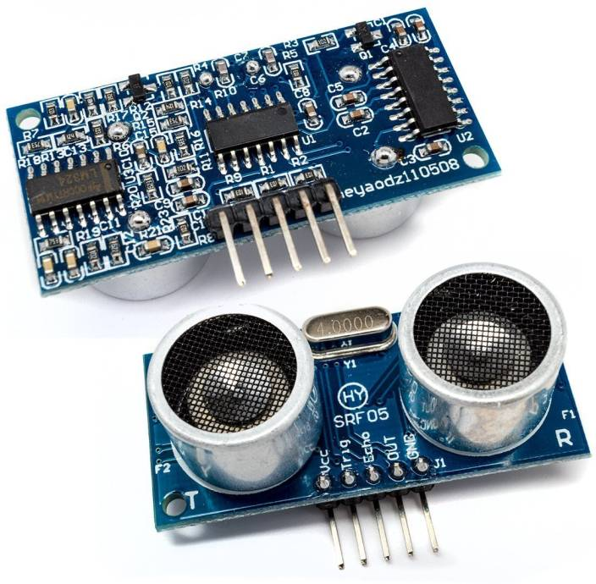
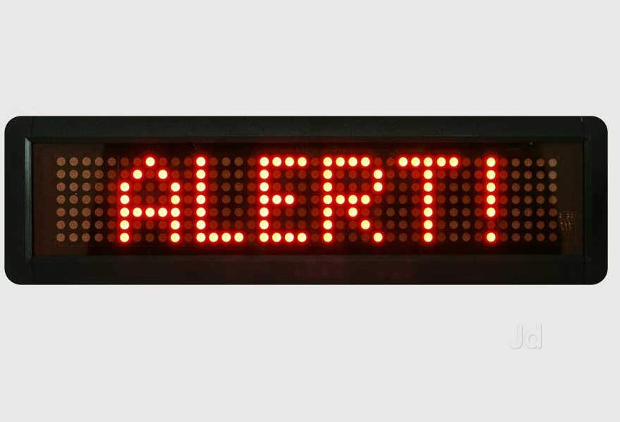
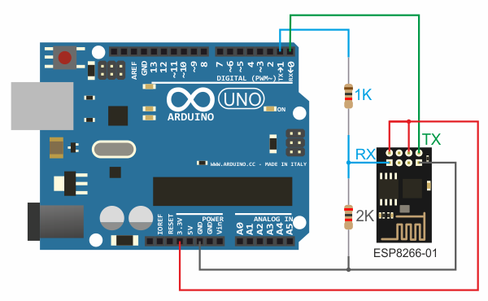
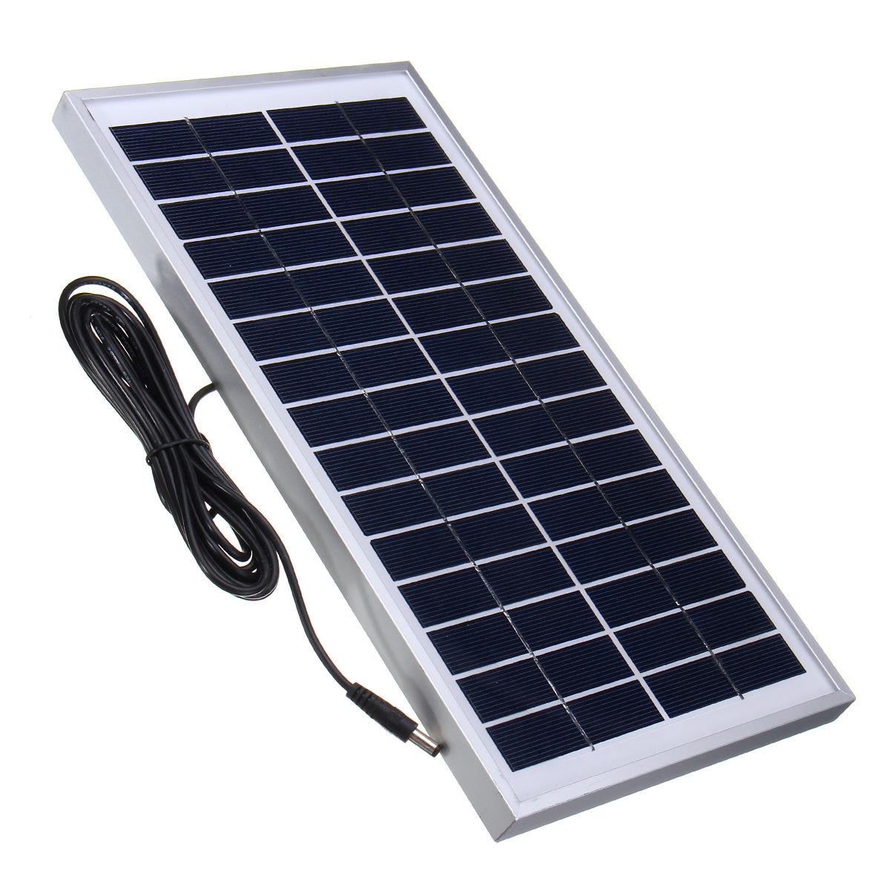
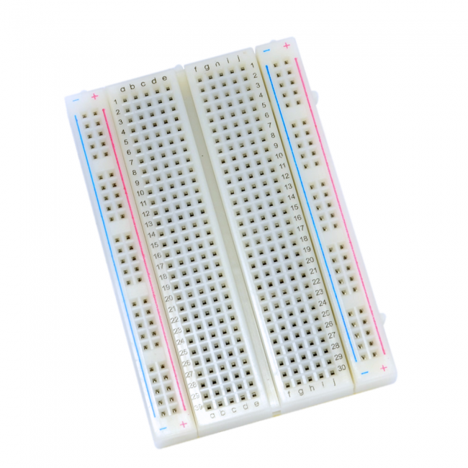
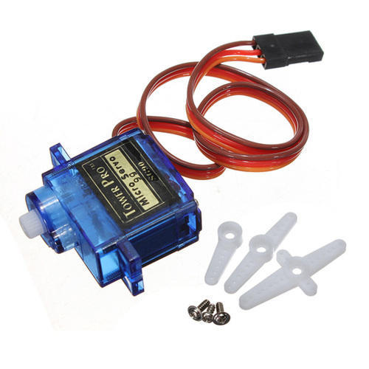
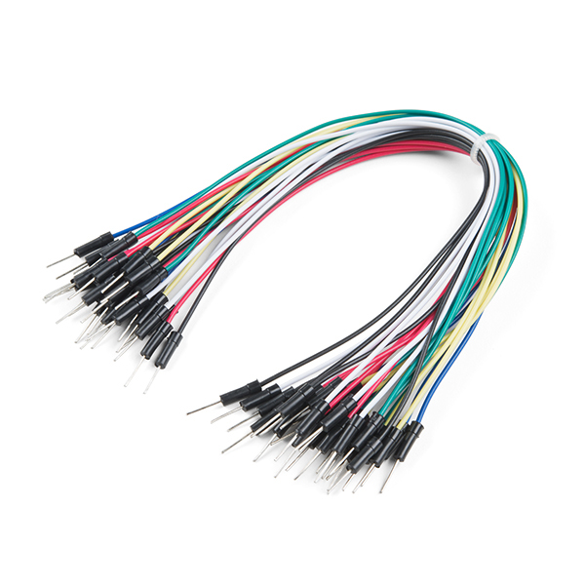
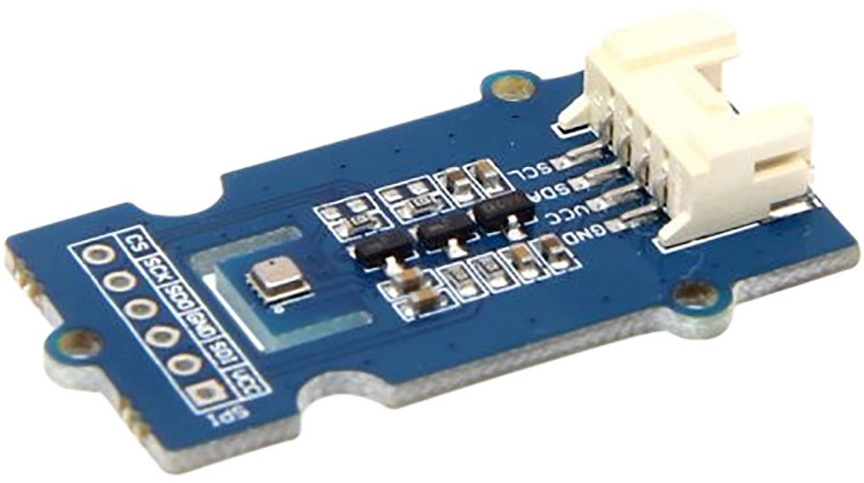
H/W and S/W Required
Solar Panel.
Ultrasonic Sensor.
Arduino UNO.
Battery and Holder.
Jumper Cable.
Bread Board.
Wooden Platform.
LED’s.
LED Display.
Temperature Sensor.
Groove Sunlight Sensor.

Slide 5
Implemetation
Source Code.
Servo motor for rotation of Solar Plate.
Groove Temperature sensor.
Ultra Sonic sensor to detect the human appearance.
E-mail / message will be send if any intruder will enter the house.
INTEGRATED CODE IS USED FOR ALL THE COMPONENTS.

Slide 6
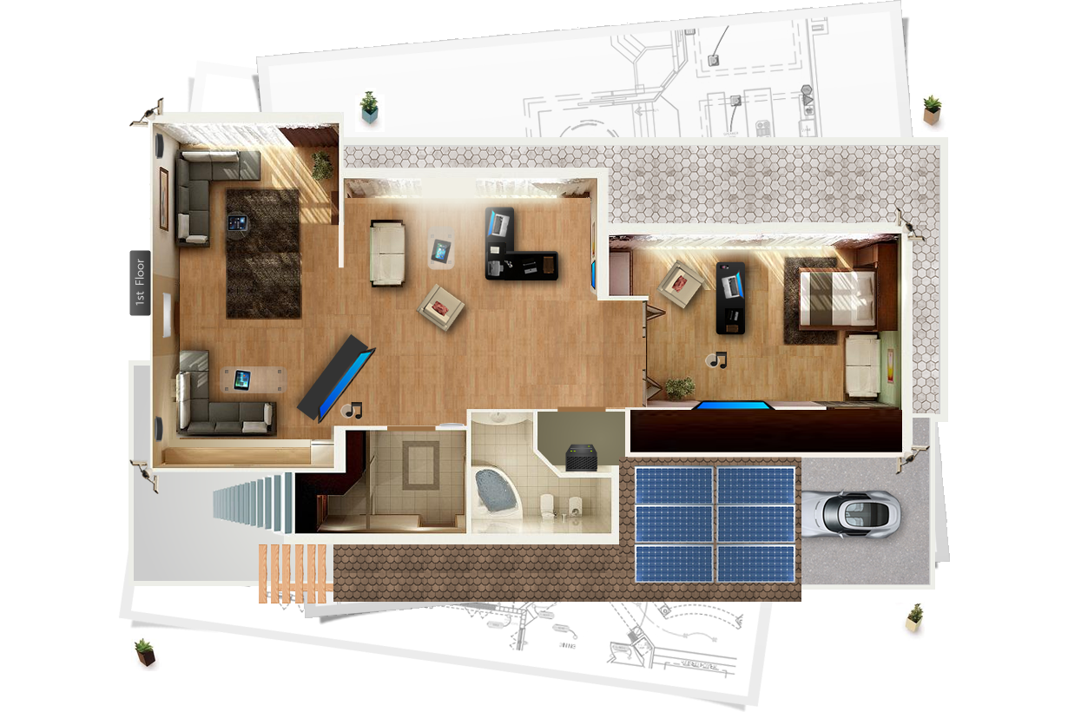
OutMap.

Slide 7
FLOWCHART
Sunlight
Solar Plate
(Energy will stored)
Energy Supplied
When Arduinodriod is on
When Arduinodroid is off
Energy Supplied to the Appliances
Controlled By Arduinodriod App

Slide 8
THANK YOU
TEAM MEMBERS:
Shadab Ali (CSE – 3)
KHUSHI SRIVASTAVA (IT – 1)
SAKSHAM MAHESHWARI (IT -2)
SAURABH KUMAR (CSE -3)

