Slide 1
TEAM NAME : SIMPLIFERS
MEMBER1 : SAIRAJ SAWANT
MEMBER2 : SHADAB SHAIKH

Slide 2
PROBLEM STATEMENT
1. Analyze student’s mental health using given dataset.
2. Generate useful and productive statistics for Government and NGO

Slide 3
OUR APPROACH
1.Student’s mental health can be recognise with its IQScore,
HADS Score, Current Education ,Peer Pressure, habits, past history
2. State’s improvement Progess can be tracked using SuicideVictimData

Slide 4
CURRENT SITUATION
1. About 800,000 people commit suicide worldwide every year,
of these 135,000 (17%) are residents of India, a nation with 17.5%
of world population

Slide 5
HEATMAP OF SUICIDE COUNT IN INDIA

Slide 6
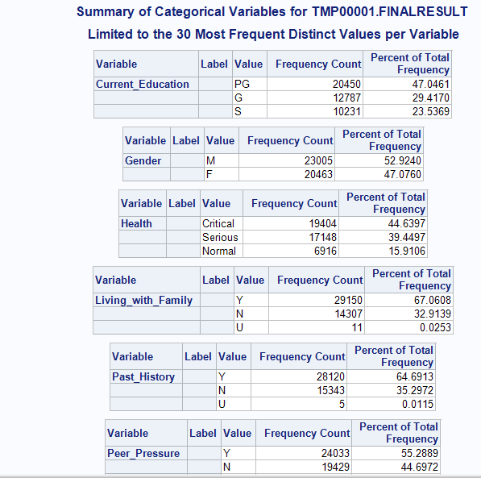
DESCRIPTIVE STATISTICS ON TRACKING STUDENT’S MENTAL HEALTH

Slide 7
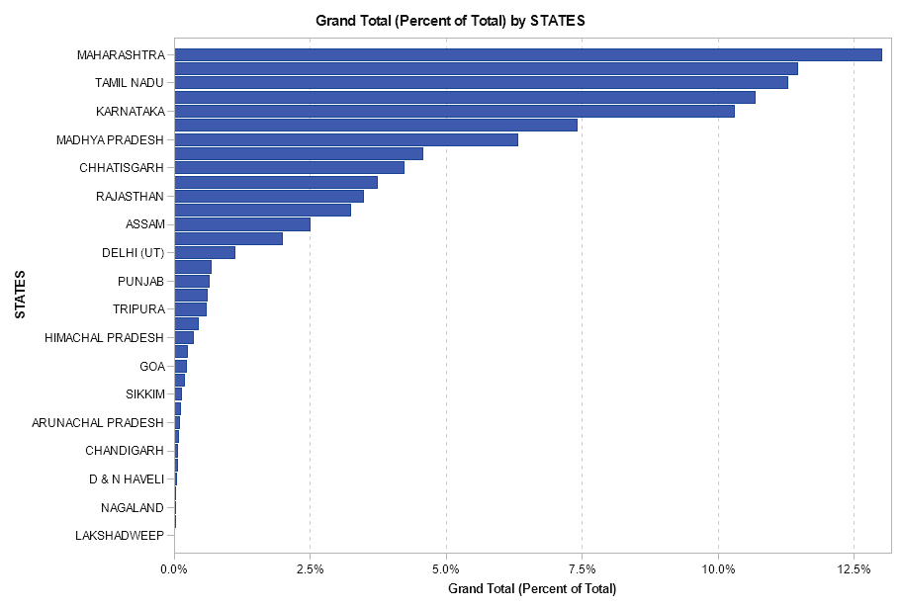
DESCRIPTIVE STATISTICS ON STUDENT SUICIDE VICTIM DATA

Slide 8
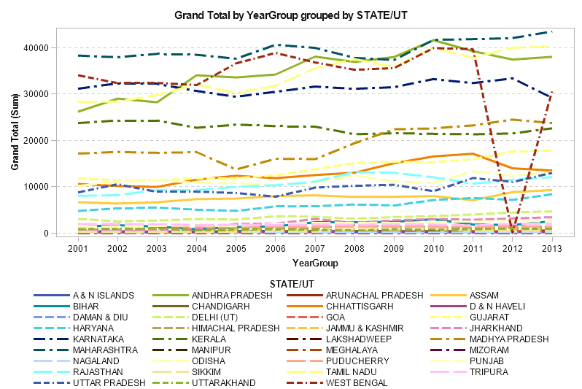

Slide 9
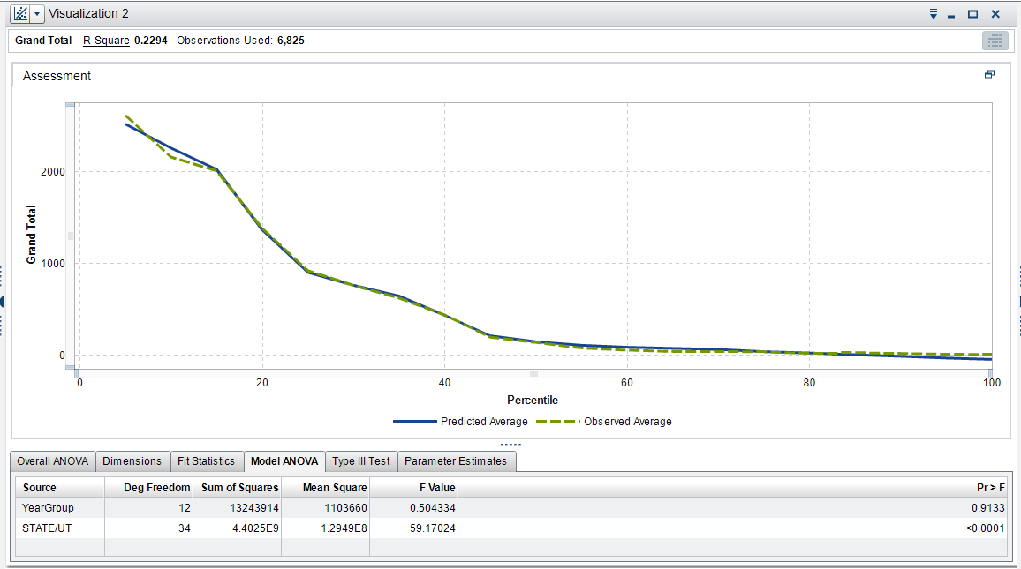
PREDICTIVE STATISTICS ON STUDENT SUICIDE VICTIM DATA

Slide 10
CONCLUSION
1.Government schemes must be implemented keeping in mind the
target age group and their respective type
2.Educational settings like schools and colleges offer unique opportunity
for effective implementation of interventions

