Slide 1
AGRIBOT: A GENERATIVE AI-POWERED MULTILINGUAL SYSTEM FOR SUSTAINABLE FERTILIZER RECOMMENDATIONS
PIP4004 University Project
Review-1
Batch Number: CSE-G12
Roll Number | Student Name
20211CSE0214 | SHASHANK S N
20211CSE0212 | SHADAKSHARI D
20211CSE0197 | SRIHARI A S
20211CSE0183 | ABHIN K M
Under the Supervision of,
Dr. JOSEPH MICHAEL JERARD V
Professor
School of Computer Science and Engineering
Presidency University
Name of the Program: Computer Science And Engineering
Name of the HOD: Dr. Asif Mohammed
Name of the Program Project Coordinator: Mr. Amarnath J L
Name of the School Project Coordinators: Dr. Abdul Khadar A

Slide 2
Introduction
The Need for Sustainable Fertilizer Use in Indian Agriculture:
High Fertilizer Consumption: In 2022, India's fertilizer use was 193.2 kg per hectare of arable land, significantly higher than the world average of 133.2 kg per hectare.
Environmental Impact: Excessive fertilizer application has led to soil degradation and water contamination, adversely affecting long-term agricultural productivity.
Economic Challenges for Farmers: Over-reliance on chemical fertilizers increases production costs, burdening farmers financially and making agriculture less sustainable.
Generative AI and Its Application in Sustainable Agriculture
What is Generative AI?: Generative AI refers to algorithms that can generate new content or predictions by learning patterns from large datasets.
Precision Agriculture: By analysing vast amounts of agricultural data, generative AI can provide tailored recommendations for fertilizer application, optimizing nutrient use and enhancing crop yields.
Real-World Applications: In regions like Kenya, AI-powered tools have been deployed to offer personalized farming advice, leading to increased productivity and sustainable farming practices.
Integrating generative AI into Indian agriculture holds the promise of promoting sustainable fertilizer use, improving crop yields, and ensuring environmental conservation.

Slide 3
Literature Review
SL NO | Title of the paper and year | Authors | Methodology used | Advantage | Disadvantage
1 | Deep Neural Network-Driven Nitrogen Fertilizer Recommendation: A Machine Learning-Based Method For Paddy Soil And Crop Analysis Using Leaf Imaging. Year: 2022 | Lakshmi Kalyani N, Bhanu Prakash Kolla. | Uses a Convolutional Neural Network (CNN) to analyze leaf images for nitrogen fertilizer recommendations. | Provides precise fertilizer recommendations by analyzing visual leaf characteristics. | Requires a large dataset of labeled leaf images for effective training.
2 | Optimizing Fertilizer Usage in Agriculture with AI-Driven Recommendations. Year: 2022 | Prof. Jayarani, Prof. Channa Basava, Prof. Nagaraj C, Prof. Kusuma Latha D. | Implements Random Forest and XGBoost to optimize fertilizer usage based on soil and weather data. | Enhances efficiency in fertilizer application, potentially reducing costs. | Performance depends on the quality and diversity of input data.
3 | Multi-Criteria Agriculture Recommendation System Using Machine Learning for Crop and Fertilizers Prediction. Year: 2022 | Krupa Patel, Hiren B. Patel. | Uses Decision Trees and K-Nearest Neighbors (KNN) for multi-criteria crop and fertilizer recommendations. | Considers multiple factors for holistic recommendations. | Feature selection and weighting multiple criteria accurately can be complex.
4 | A SWAT-based Reinforcement Learning Framework for Crop Management. Year: 2023 | Malvern Madondo, Muneeza Azmat, Kelsey Dipietro, et al. | Applies Reinforcement Learning (Deep Q-Networks - DQN) for crop management in a SWAT-based system. | Learns optimal management strategies over time. | Requires extensive training and computational power.
5 | CropGym: a Reinforcement Learning Environment for Crop Management. Year: 2023 | Hiske Overweg, Herman N. C. Berghuijs, Ioannis N. Athanasiadis. | Uses Proximal Policy Optimization (PPO) and Advantage Actor-Critic (A2C) in the CropGym reinforcement learning environment. | Simulates real-world conditions to improve decision-making. | Needs substantial data for training and validation.

Slide 4
Literature Review
SL NO | Title of the paper and year | Authors | Methodology used | Advantage | Disadvantage
6 | Application of Machine Learning in Agriculture: Recent Trends and Future Research Avenues. Year: 2023 | Aashu, Kanchan Rajwar, Millie Pant, Kusum Deep. | Surveys applications of Support Vector Machines (SVM), Neural Networks, and Ensemble Learning in agriculture. | Highlights diverse AI applications for various agricultural challenges. | Lacks implementation details for real-world deployment.
7 | Artificial Intelligence and Machine Learning in Agriculture. Year: 2023 | Y. M. Abubakar, et al. | Uses Deep Neural Networks (DNN) and Transfer Learning for AI-based agricultural predictions. | Achieves high accuracy in predictive tasks. | Requires large, well-labelled datasets for effectiveness.
8 | Machine Learning for Sustainable Agriculture. Year: 2020 | B. P. K. Chinnappan, et al. | Uses Gradient Boosting and Random Forest for sustainable agriculture predictions. | Balances accuracy and interpretability. | Can be computationally intensive.
9 | Machine Learning and Artificial Intelligence in Agriculture: A Survey Year: 2020 | P. P. Dahiya, et al. | Uses K-Means Clustering and Principal Component Analysis (PCA) for AI-based soil classification and crop suitability. | Improves efficiency in land and crop allocation. | Requires domain expertise to interpret results.
10 | Data-Driven Decision Support for Crop Management Using Machine Learning. Year: 2019 | S. K. Kuriakose, et al. | Uses Long Short-Term Memory (LSTM) and ARIMA for time-series forecasting in crop yield prediction. | Improves accuracy of yield predictions over time. | Sensitive to missing or noisy data.

Slide 5
Existing method Drawback
Generalized Recommendations – Traditional fertilizer suggestions do not account for real-time soil and weather conditions, leading to inefficiencies.
Lack of Adaptive AI Integration – Existing systems do not leverage Generative AI for adaptive and personalized recommendations.
Limited Farmer Interaction – Conventional methods lack an interactive chatbot for continuous guidance and learning.
Overuse of Chemical Fertilizers – Current practices often lead to excessive fertilizer application, degrading soil health over time.

Slide 6
Objectives
Optimize Fertilizer Use – Provide precise, data-driven fertilizer recommendations for sustainable farming.
Enhance Soil Health – Prevent overuse of fertilizers and maintain long-term soil fertility.
Leverage Generative AI – Utilize AI to analyse soil, crop, and weather data for accurate suggestions.
Improve Farmer Decision-Making – Offer an interactive chatbot for real-time continuous guidance and support.

Slide 7
Proposed Method
Data Collection - Gather soil composition, crop type, and environmental data from user inputs and existing agricultural datasets.
Feature Engineering & Analysis - Extract key parameters (soil pH, nitrogen, phosphorus, potassium levels) and prepare data for AI-based recommendation.
Generative AI Model Implementation- Leverage GPT-4 for real-time fertilizer recommendations based on analysed data.
Chatbot Integration - Enable an AI-powered chatbot for interactive guidance and follow-up queries from users.
Result Interpretation & User Feedback - Display recommendations through an intuitive UI and refine responses based on user interactions.

Slide 8
Modules
User Input Module - Collects soil type, pH level, nitrogen, phosphorus, potassium content, and crop type from users.
Fertilizer Recommendation Module - Utilizes GPT-4 to generate optimal fertilizer suggestions based on soil and crop data.
Chatbot Interaction Module - Provides a conversational AI assistant for follow-up queries and additional farming advice.
Result Display Module - Presents AI-generated recommendations in a user-friendly format through the web interface.

Slide 9
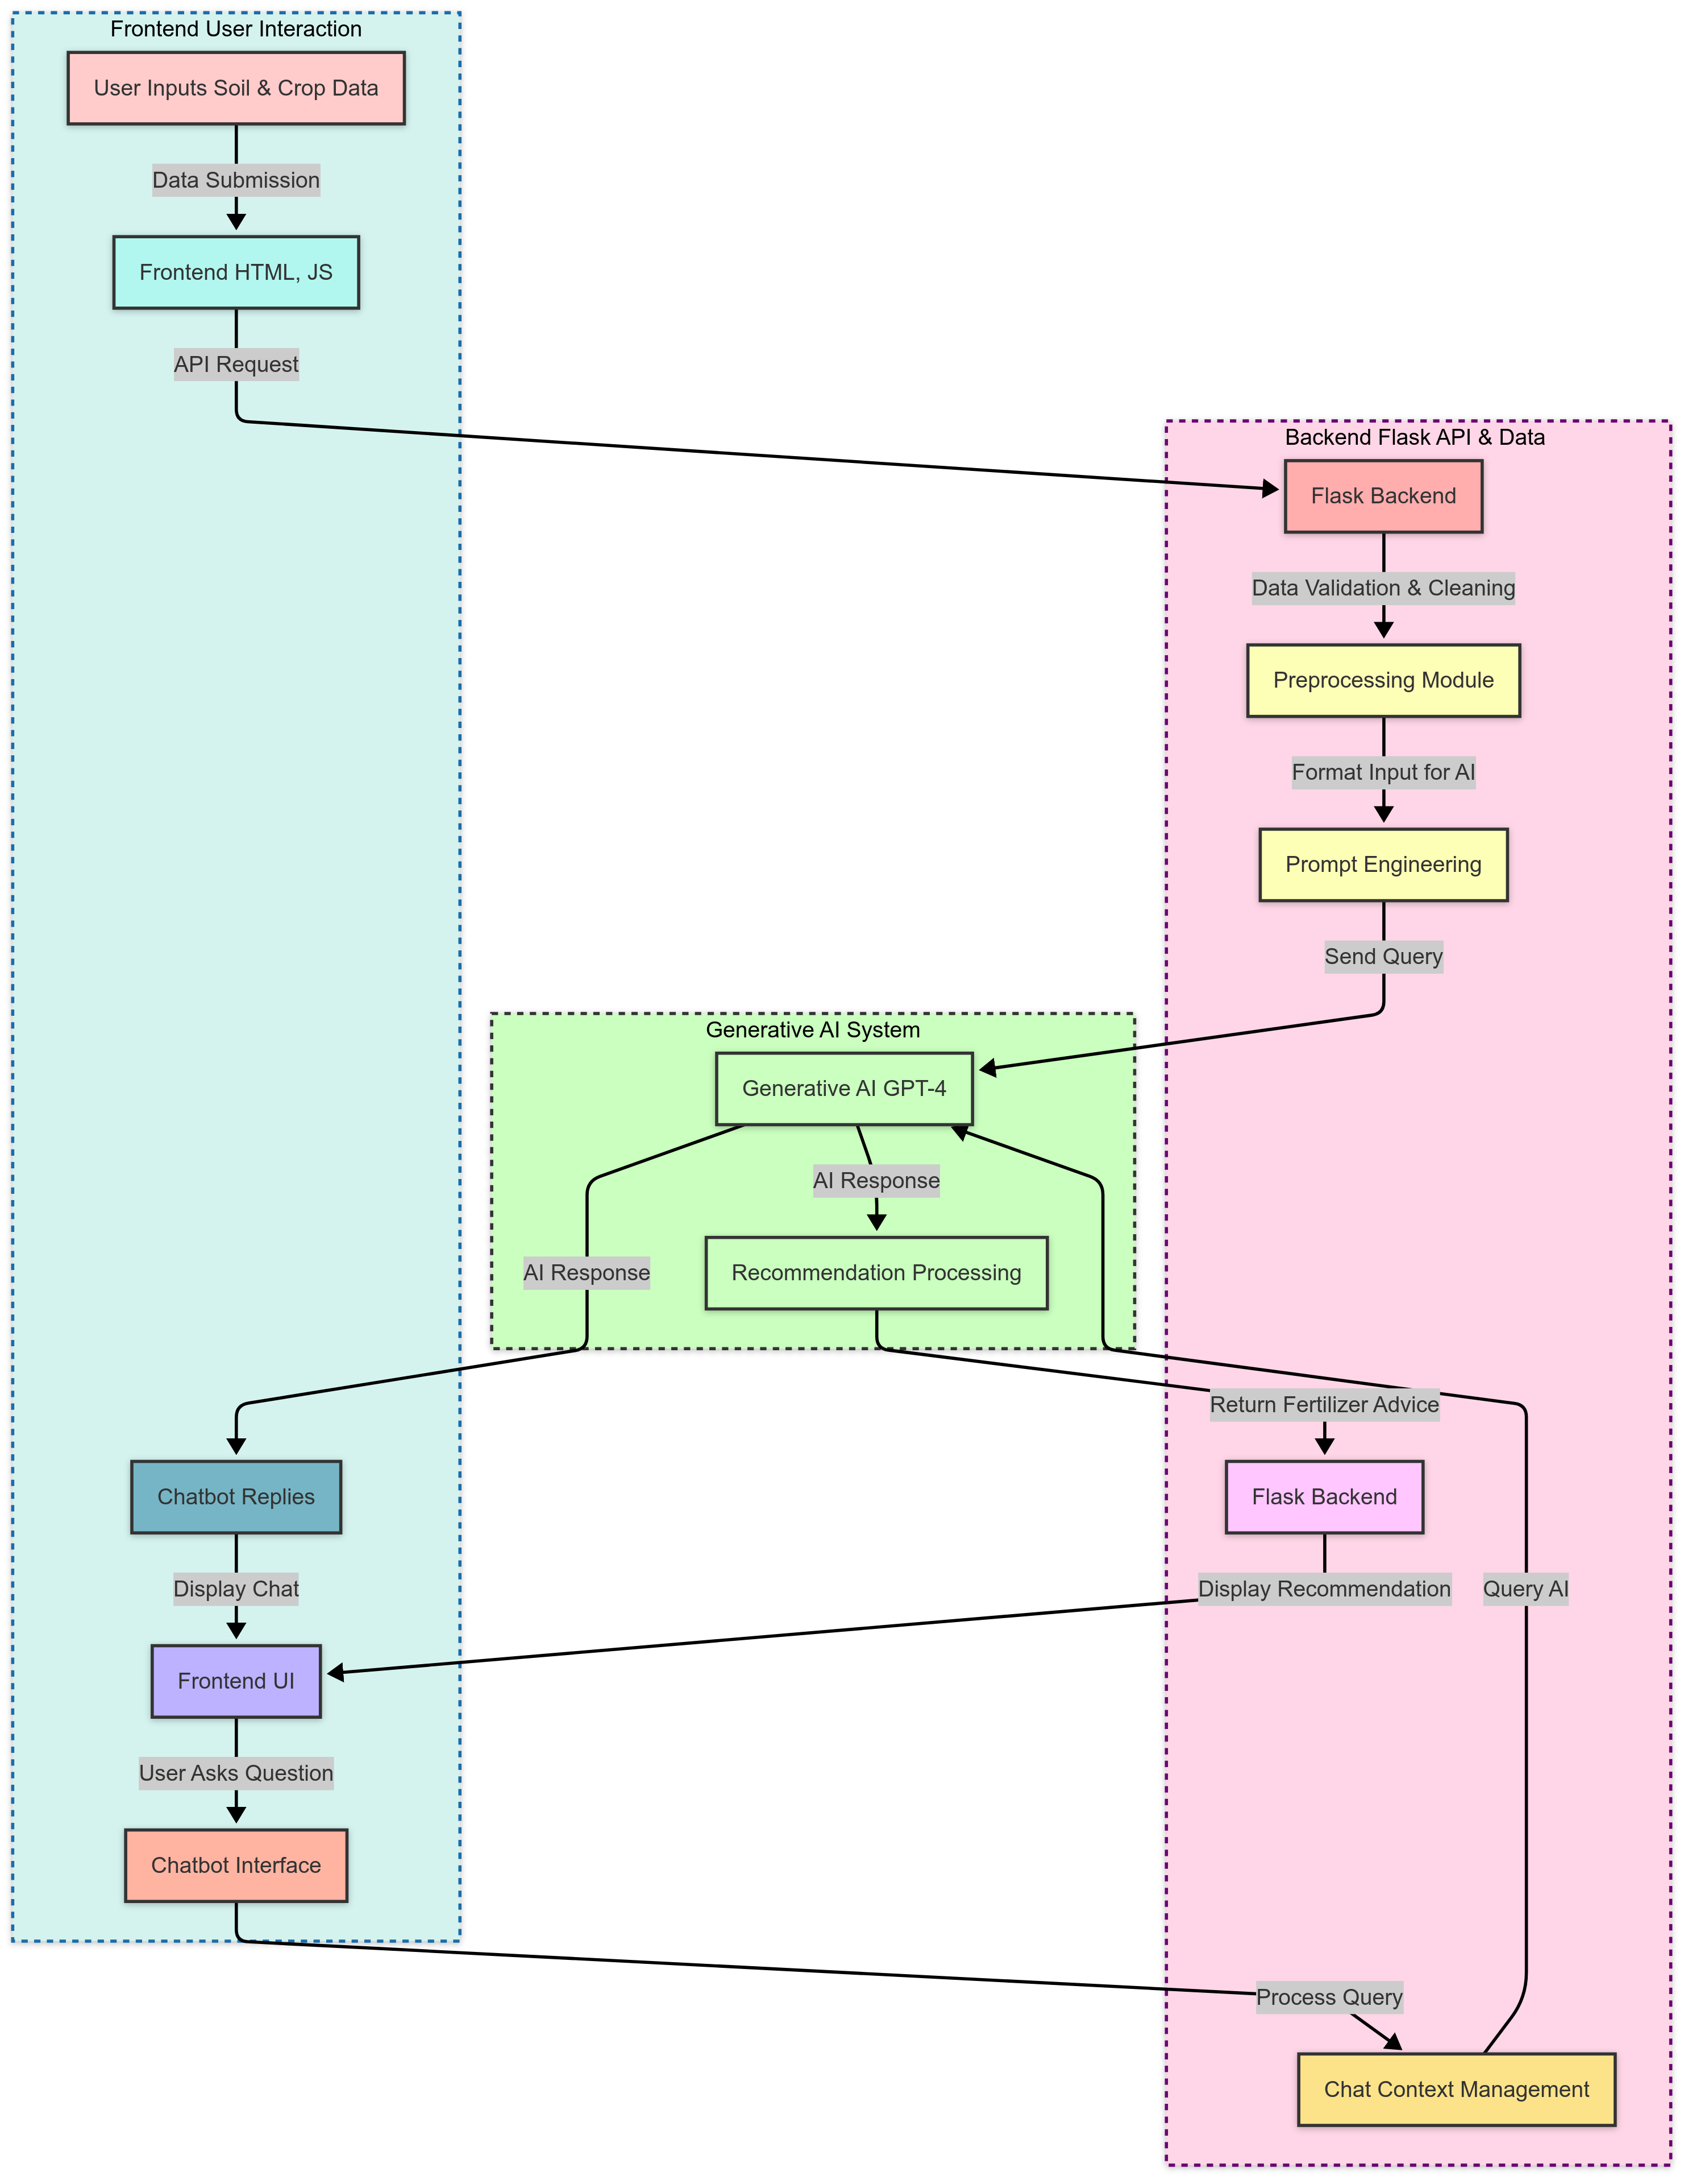
Architecture
User inputs soil and crop data, which is processed by the frontend and sent to the backend.
The backend validates, cleans, and formats data before querying Generative AI (GPT-4) for fertilizer recommendations.
AI-generated recommendations are processed and sent back to the frontend for display and user interaction.
A chatbot enables continued user engagement, managing context and querying AI for follow-up questions.

Slide 10
Software components
Frontend (User Interface) - Developed using HTML, CSS, JavaScript for a responsive and interactive UI.
Backend (Server-Side Processing) - Implemented with Flask (Python) to handle requests and process inputs.
AI Model (Generative AI - GPT-4) - Provides intelligent fertilizer recommendations and chatbot responses.
API Integration - Uses OpenAI API to generate fertilizer advice and assist users through chatbot interaction.
Hosting & Version Control - The website is hosted through GitHub Pages, ensuring seamless deployment and version control.
Integrated Development Environment (IDE) - Visual Studio Code for coding and testing models.

Slide 11
Timeline of Project
Feb-2025
Mar-2025
Apr-2025
May-2025
Phase 01
01-Feb-2025 To 02-Mar-2025
Phase 02
03-Mar-2025 To 21-Apr-2025
Phase 03
22-Apr-2025 To 10–May-2025
Project Planning and Initial Setup
Core Development
Deployment and User Acceptance Testing

Slide 12
Expected Outcomes
Optimized Fertilizer Recommendations - AI-driven suggestions tailored to soil conditions and crop types for sustainable farming.
Intelligent Chatbot Assistance - Provides continuous guidance on fertilizer use and sustainable farming practices.
Data-Driven Decision Making - Helps farmers make informed choices by analysing soil and crop data effectively.
User-Friendly Web Application - A seamless, interactive platform accessible via GitHub-hosted website for easy recommendations.
Promotion of Sustainable Agriculture - Encourages eco-friendly farming practices by reducing excessive fertilizer use.

Slide 13
Conclusion
Efficient & Data-Driven Recommendations - AI-powered system optimizes fertilizer use, enhancing crop yield while ensuring soil health.
Interactive & User-Friendly Platform - A chatbot-integrated web application provides real-time, personalized farming assistance.
Towards Sustainable Agriculture - Reduces environmental impact by promoting precise and eco-friendly fertilizer application.

Slide 14
Pseudocode
PROGRAM SustainableFertilizerRecommendationSystem
// Global variables and initialization
DECLARE chatHistory AS LIST of MESSAGES
INITIALIZE chatHistory with AgriBot system message
// Main application functions
FUNCTION initializeApplication()
setupFormValidation()
setupChatInterface()
END FUNCTION
FUNCTION getRecommendation()
// Collect input values
soilType = getValue("soilType")
pHLevel = getValue("pHLevel")
nitrogen = getValue("nitrogen")
phosphorus = getValue("phosphorus")
potassium = getValue("potassium")
cropType = getValue("cropType")
rainfall = getValue("rainfall")
temperature = getValue("temperature")
language = getValue("language")
// Validate inputs
IF any required field is empty THEN
DISPLAY error message
RETURN
END IF
// Create query and process
query = "Recommend optimal fertilizer for [cropType] in [soilType] soil with pH [pHLevel],
nitrogen [nitrogen], phosphorus [phosphorus], potassium [potassium],
rainfall [rainfall] cm, temperature [temperature]°C, ensuring sustainability.
Translate to [language]."
ADD {role: "user", content: query} TO chatHistory
response = fetchGPTResponse(language)
IF response is valid THEN
DISPLAY results
ADD {role: "assistant", content: response} TO chatHistory
END IF
END FUNCTION

Slide 15
Pseudocode
FUNCTION sendMessage()
userInput = getValue("chatInput")
selectedLanguage = getValue("language")
IF userInput is empty THEN RETURN
ADD user message to chat display
query = userInput + " (Translate to [selectedLanguage].)"
ADD {role: "user", content: query} TO chatHistory
response = fetchGPTResponse(selectedLanguage)
ADD bot message with response to chat display
ADD {role: "assistant", content: response} TO chatHistory
CLEAR chat input field
END FUNCTION
FUNCTION fetchGPTResponse(language)
TRY
requestBody = {
model: "gpt-4",
messages: chatHistory
}
response = MAKE POST REQUEST to "https://api.openai.com/v1/chat/completions"
WITH headers {
"Content-Type": "application/json",
"Authorization": "Bearer [API_KEY]"
}
AND body requestBody
data = PARSE JSON from response
RETURN data.choices[0].message.content
CATCH error
LOG error
RETURN "An error occurred. Please try again later."
END TRY
END FUNCTION
// Helper function
FUNCTION getValue(elementId)
RETURN value of element with ID elementId
END FUNCTION
// Start application
initializeApplication()
END PROGRAM

Slide 16
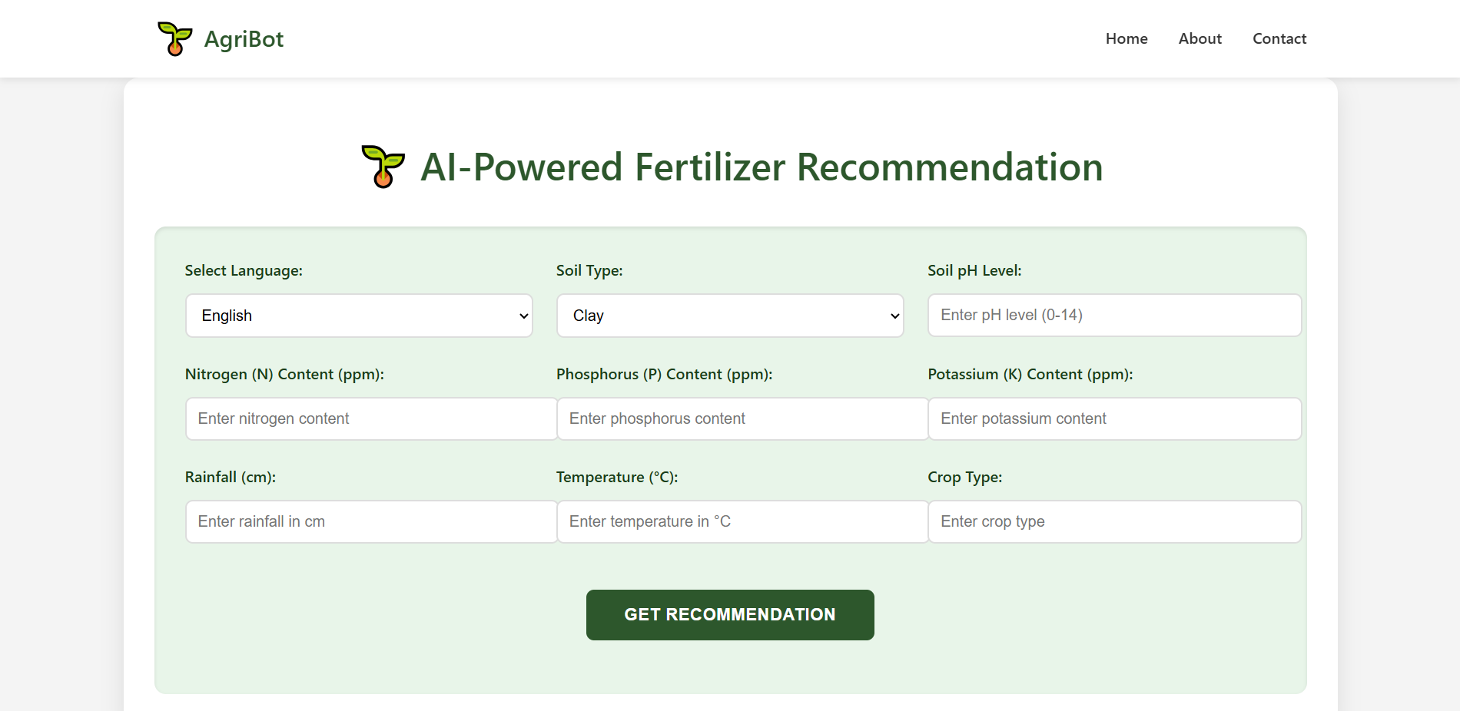
Screenshots

Slide 17
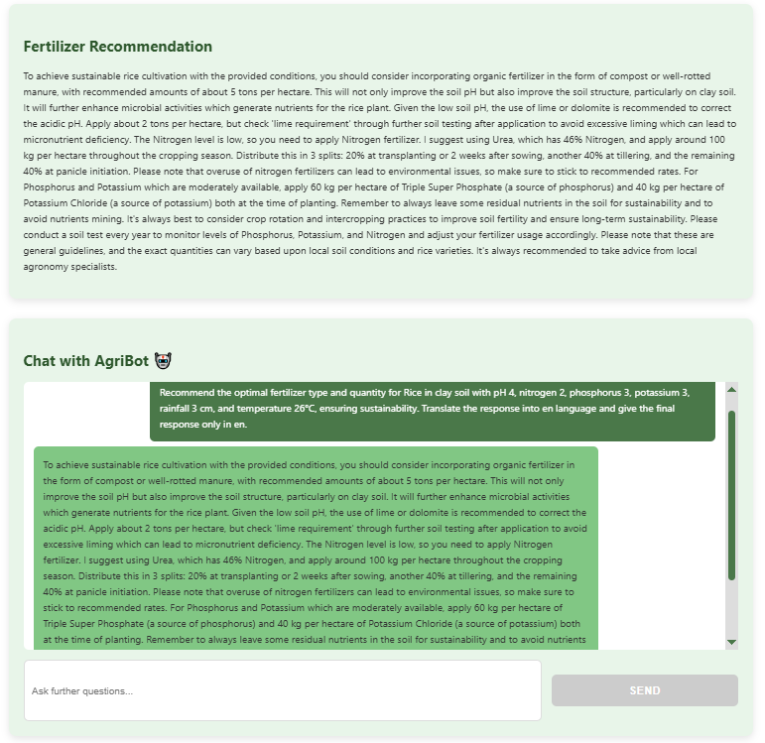
Screenshots

Slide 18
Github Link
AGRIBOT: A GENERATIVE AI-POWERED MULTILINGUAL SYSTEM FOR SUSTAINABLE FERTILIZER RECOMMENDATIONS
GitHub Link

Slide 19
References
Lakshmi Kalyani N, Bhanu Prakash Kolla (2022). "Deep Neural Network-Driven Nitrogen Fertilizer Recommendation: A Machine Learning-Based Method For Paddy Soil And Crop Analysis Using Leaf Imaging". DOI: 10.70135/seejph.vi.2762
Prof. Jayarani, Prof. Channa Basava, Prof. Nagaraj C, Prof. Kusuma Latha D (2022). "Optimizing Fertilizer Usage in Agriculture with AI-Driven Recommendations". DOI: 10.0805/Jbse.2024577123
Krupa Patel, Hiren B. Patel (2022). "Multi-Criteria Agriculture Recommendation System Using Machine Learning for Crop and Fertilizers Prediction". DOI: 10.12944/CARJ.11.1.12
Malvern Madondo, Muneeza Azmat, Kelsey Dipietro, et al. (2023). "A SWAT-based Reinforcement Learning Framework for Crop Management". DOI: 10.1109/seejph.vi.2762
Hiske Overweg, Herman N. C. Berghuijs, Ioannis N. Athanasiadis (2023). "CropGym: a Reinforcement Learning Environment for Crop Management". DOI: 10.1109/seejph.vi.2762
Aashu, Kanchan Rajwar, Millie Pant, Kusum Deep (2023). "Application of Machine Learning in Agriculture: Recent Trends and Future Research Avenues". DOI: 10.1109/seejph.vi.2762
Y. M. Abubakar, et al. (2023). "Artificial Intelligence and Machine Learning in Agriculture". DOI: 10.1109/seejph.vi.2762
B. P. K. Chinnappan, et al. (2020). "Machine Learning for Sustainable Agriculture". DOI: 10.1007/s13593-020-00611-0
P. P. Dahiya, et al. (2020). "Machine Learning and Artificial Intelligence in Agriculture: A Survey". DOI: 10.1109/9123756
S. K. Kuriakose, et al. (2019). "Data-Driven Decision Support for Crop Management Using Machine Learning". DOI: 10.1016/j.agsy.2019.03.016

Slide 20
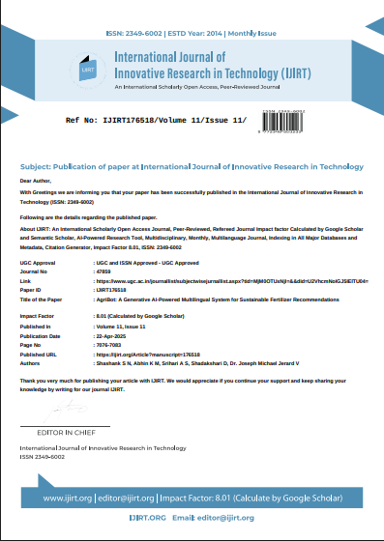
Publication Details
Letter of Confirmation for Publication
Paper Publication Link:
AGRIBOT: A GENERATIVE AI-POWERED MULTILINGUAL SYSTEM FOR SUSTAINABLE FERTILIZER RECOMMENDATIONS

Slide 21
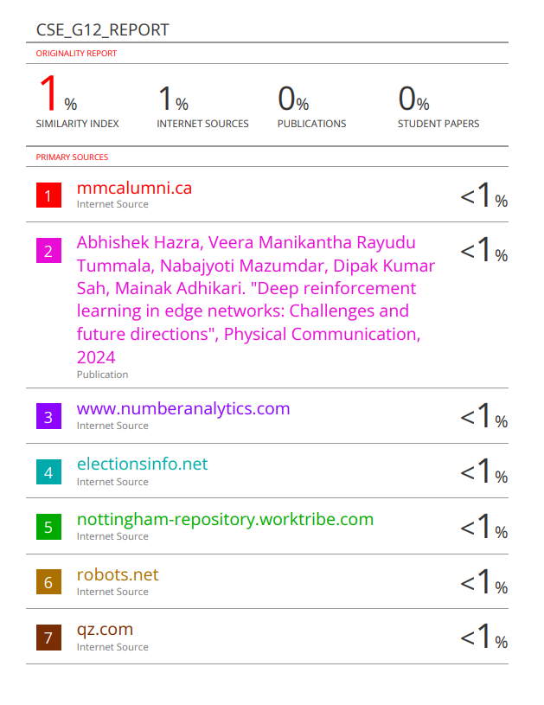
Similarity Index
Plagiarism Report

Slide 22
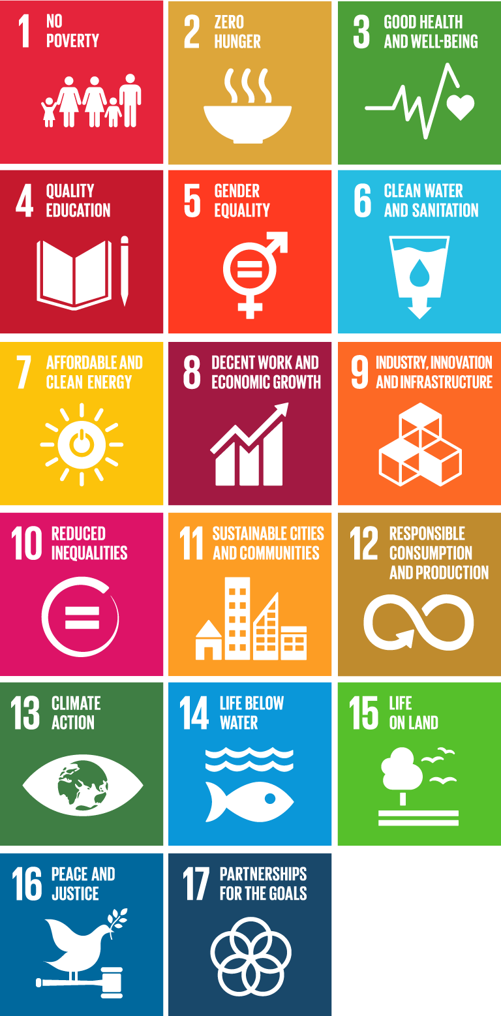
Project work mapping with SDG
Goal 2: Zero Hunger - Promotes sustainable agricultural practices by optimizing fertilizer recommendations, ensuring higher crop yields and food security.
Goal 12: Responsible Consumption and Production - Encourages efficient fertilizer use, reducing waste and minimizing environmental damage through data-driven recommendations.
Goal 13: Climate Action - Reduces harmful environmental impacts by optimizing fertilizer application, lowering greenhouse gas emissions from agricultural activities.
Goal 15: Life on Land - Prevents soil degradation and promotes biodiversity conservation by recommending eco-friendly and sustainable fertilizer practices.

Slide 23
Thank You

