Slide 1
Redux
State management tool for javascript applications

Slide 2
Learning objectives:
Complete understanding of the structure of Redux
Understanding Why Redux is important
In depth understanding of all pillars of Redux
-Store
-Action
-Reducer

Slide 3
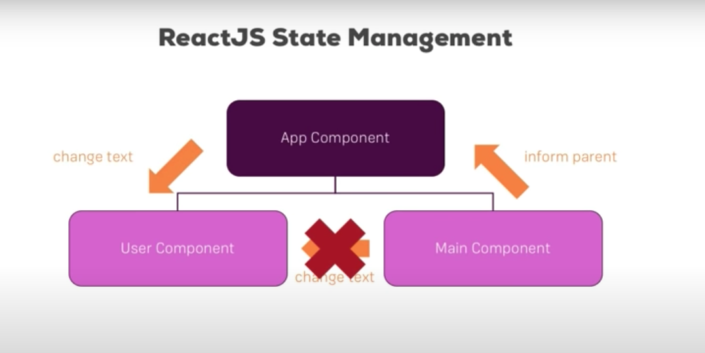
What is Redux?

Slide 4
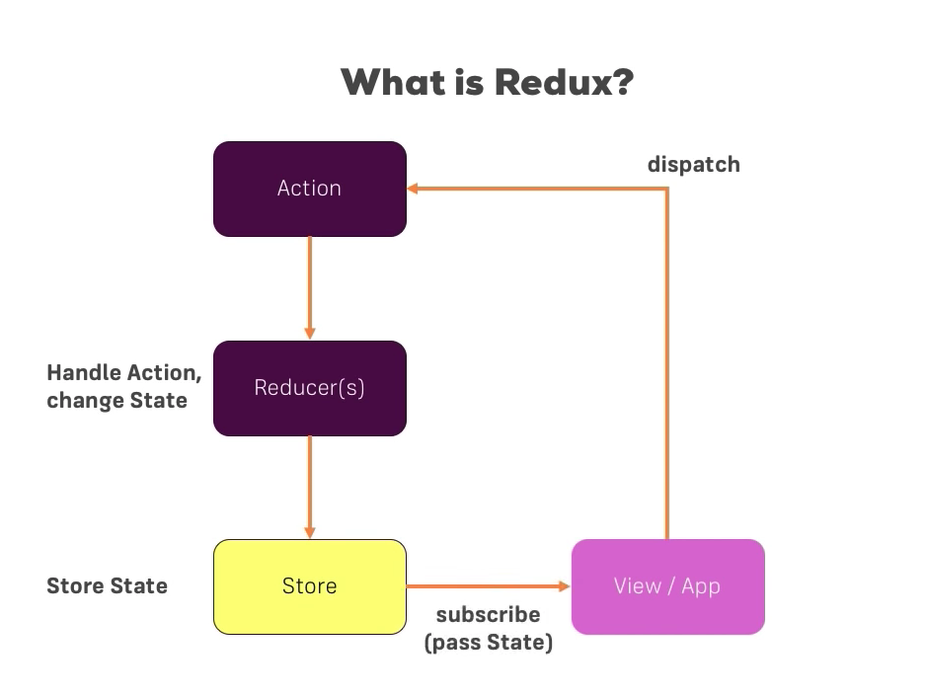
What is Redux:

Slide 5
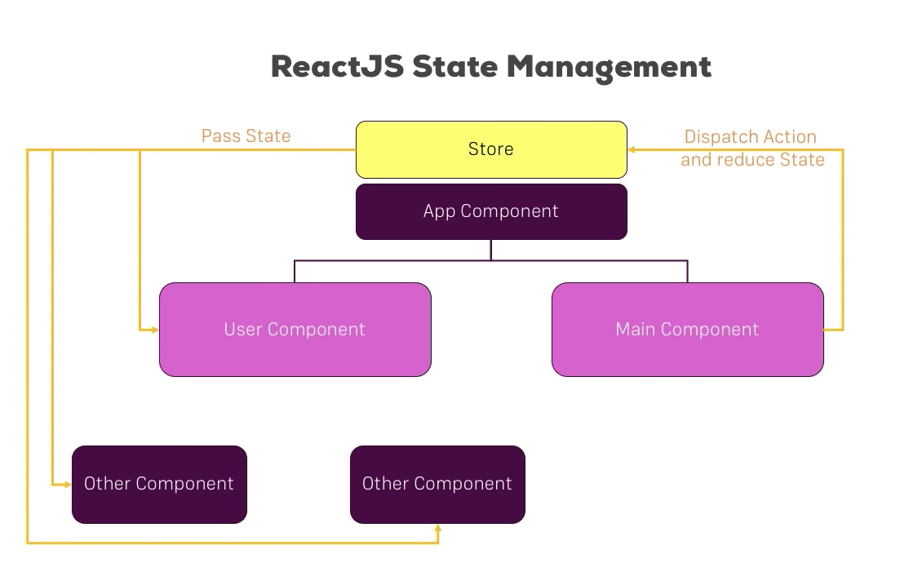
Why Redux

Slide 6
Why Redux?
State transfer between components is pretty messy in React since it is hard to keep track of which component the data is coming from. It becomes really complicated if users are working with a large number of states within an application.
Redux solves the state transfer problem by storing all of the states in a single place called a store. So, managing and transferring states becomes easier as all the states are stored in the same convenient store. Every component in the application can then directly access the required state from that store.

Slide 7
Pillars of Redux :
Store:
A store is an object that holds the application's state tree.
There should only be a single store in a Redux app, as the composition happens at the reducer level.

Slide 8
Pillars of Redux:
2. Action
An action is a plain object that represents an intention to change the state. They must have a property to indicate the type of action to be carried out.
Actions are payloads of information that send data from your application to your store.
Any data, whether from UI events or network callbacks, needs to eventually be dispatched as actions.
Actions must have a type field, indicating the type of action being performed.

Slide 9
Pillars of Redux:
3. Reducer:
Reducers are pure functions that specify how the application's state changes in response to actions sent to the store.
Actions only describe what happened, not how the application's state changes.
A reducer is a function that accepts the current state and action, and returns a new state with the action performed.
combineReducers() utility can be used to combine all the reducers in the app into a single index reducer which makes maintainability much easier.

Slide 10
Pros
1.There is always one source of truth, the store. Thus, there is no confusion about how to sync the current state with actions and other parts of the application.
2.The code is easier to maintain because it has a predictable outcome and strict structure.
3.Redux makes coding more consistent due to more stringent code organization procedures
4.It’s very useful, especially during the initial render, making for better user experience and search engine optimization.
5.Developers can track everything going on in the app in real-time—from actions to state changes

Slide 11
Cons
1.Since it has no encapsulation, any component can access data, which may potentially cause security issues
2.Some parts of the code are just boilerplate. However, these parts have to be incorporated with no alteration, and this restricts the design
3.As the state is immutable in Redux, the reducer updates the state by returning a new state every time which can cause excessive use of memory

Slide 12
Any questions?
Redux presentation by :
Shadan Behzadian

