Slide 1

MONKEYPOX DETECTION USING DEEP LEARNING APPROACH
UNDER THE SUPERVISON OF:
Prof MOHD AMJAD
DEPARTMENT OF COMPUTER ENGG,
FACULTY OF ENGG & TECHNOLOGY,
JAMIA MILLIA ISLAMIA,
NEW DELHI - 110025
SUBMITED BY:
SHADAN PARVEZ
21MCS017
M-Tech 4th sem
4 May 2023

Slide 2

content
Introduction
Problem statement
Dataset
Augmented data
Parameters used in augmentation
Splitting data
Techniques used
Design of experiment
Comparing all models
Result
Conclusion
Future work

Slide 3
Introduction
What is Monkeypox?
Monkeypox is a rare viral infection that is caused by the monkeypox virus. It is similar to smallpox. It is found mainly in remote parts of Central and West Africa, where it is spread from animals to humans. It is a zoonotic disease, meaning it can be spread from animals to humans.
The virus is spread mainly through contact with an infected animal, such as a monkey, squirrel, rat, or prairie dog. It can also be spread from person to person, through contact with an infected person’s skin, clothing, or bedding.

Slide 4
Problem statement
Monkeypox is considered dangerous due to its infectiousness, potential to cause serious symptoms, and ability to spread quickly in areas with weak health systems.
The objective is that we need an automated diagnostic system that can accurately and quickly detect monkeypox by analyzing images of skin lesions. Our Model can help to automate the diagnostic process and reduce the need for human involvement, potentially leading to faster diagnoses.
Manual diagnosis of skin diseases by visiting and consulting dermatologists is time consuming and costly.
Need of domain expertise for differentiate between monkeypox and other.

Slide 5
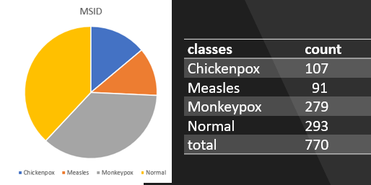
Dataset
The dataset, known as the Monkeypox Skin Images Dataset (MSID), comprises four classes: Monkeypox, Chickenpox, Measles, and Normal. The Chickenpox class contains 107 images, the Measles class has 91 images, the Monkeypox class includes 279 images, and the Normal class consists of 293 images as shown below.

Slide 6
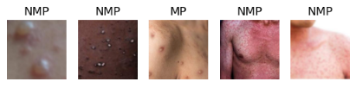
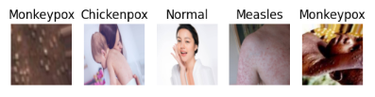
Augmented Data
Here we applied augmentation techniques to increase no of samples.
Binary dataset | Multiclass Dataset
we combined the measles, chickenpox, and normal images into a single class called "non-monkeypox.“ To increase the diversity and size of the dataset, we employed augmentation techniques, resulting in the generation of 1439 monkeypox images (MP) and 1764 non-monkeypox images (NMP). | we already had four distinct classes. To enhance the dataset and account for class imbalances, we performed data augmentation by generating 1000 augmented images for each class. This process aimed to increase the variability and robustness of the dataset, providing a more comprehensive representation of the different skin conditions present in the MSID

Slide 7
Parameters used in augmentation
ImageDataGenerator is used for data augmentation, which involves generating new training images by applying various transformations to existing images. Data augmentation parameters are
Rotation Range: Images can be rotated within a specified range (here, 20 degrees) to create variations in orientation.
Width and Height Shift Range: The images can be horizontally and vertically shifted within a given range (here, 0.1) to introduce translations in the data.
Shear Range: The shear transformation applies a skewing effect to the images within the defined range (here, 0.2), resulting in distorted shapes.
Zoom Range: The images can be randomly zoomed in or out within the specified range (here, 0.2), adding scale variations to the data.
Horizontal Flip: Images can be horizontally flipped, which helps to diversify the dataset by reflecting images.
Fill Mode: This determines how the missing pixels will be filled after applying transformations. 'Nearest' filling mode uses the closest pixel values.

Slide 8
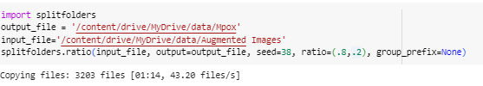
Splitting dataset
Before splitting our augmented data, we used the shuffling method to ensure that our model would become more generic. Shuffling the data helps to eliminate any inherent order or bias that might be present in the dataset. By randomly rearranging the augmented samples, we prevent the model from relying on any specific sequence or pattern during training.
This approach allows our model to learn more robust and generalized representations, making it better equipped to handle unseen or new data we followed a specific data-splitting procedure to prepare our dataset for training and validation. After generating augmented images from MSID, we partitioned the data into a ratio of 8:2, meaning that 80% of the data was allocated for training, while the remaining 20% was set aside for validation purposes.

Slide 9
Techniques used
Reduce LR On Plateau is a technique commonly used in training deep learning models to dynamically adjust the learning rate during the training process. It is a learning rate scheduler that monitors a specified metric, such as validation loss or accuracy and reduces the learning rate when the monitored metric stops improving
Early Stopping is a technique used during the training of machine learning models to prevent overfitting and determine the optimal stopping point based on a monitored metric. It allows the training process to automatically stop when the monitored metric no longer improves, thus avoiding unnecessary computations and potentially saving time.
Dropout It involves randomly "dropping out" a fraction of the neurons (units) in a layer during training, effectively forcing the model to learn more robust and generalized representations.

Slide 10
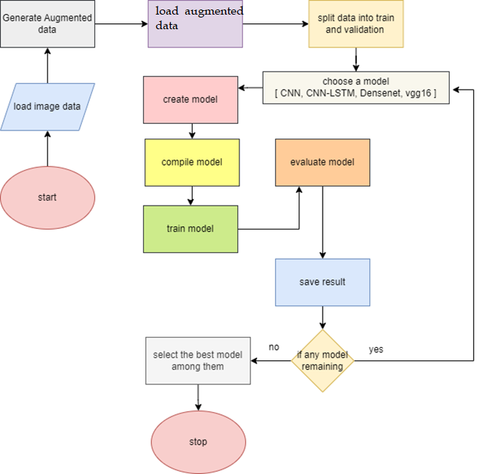
Design of Experiment
Step 1 : First we start loading images from the device
Step 2: now generate augmented images from the original image
Step 3: split the data into two parts test and validation
Step 4: create a model from our list of model
step 5: set hyperparameters of the model then compile our model
Step 6: now train our model on the given train data
Step 7: evaluate our model on the given validation data
Step 8: save the result
Step 9: if any model is remaining in our model list select another model and go to Step 3
Else we going to step 10
Step 10: select the best model among them
Step 11: stop

Slide 11
Result
Model | Trainable parameter | Non-trainable parameter | Total parameter | Val-accuracy
VGG16 | 21,156,033 | 0 | 21,156,033 | 96
DenseNet121 | 22,231,681 | 83,648 | 22,315,329 | 99
CNN | 7,870,209 | 7104 | 7,877,313 | 96
LSTM-CNN | 6,317,537 | 0 | 6,317,537 | 95

Slide 12
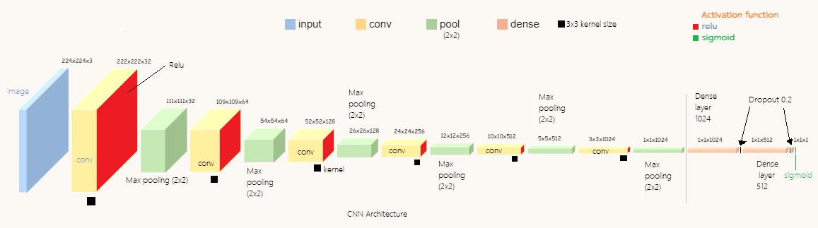
CNN Architecture

Slide 13
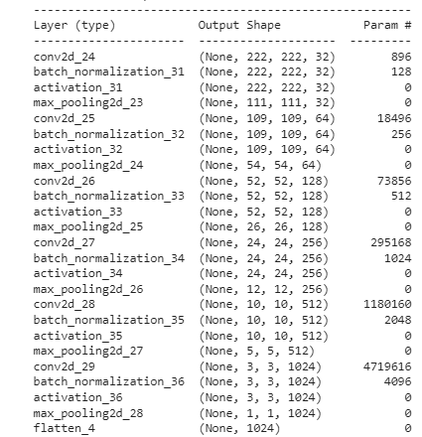
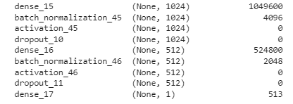

Model summary

Slide 14
CNN architecture code breakdown
First we create a function name as create_cnn_model() that takes three parameters as input: input_shape (default is (224, 224, 3) which means that the input images are 224x224 pixels with 3 color channels), num_classes (default is 1 which means it's a binary classification problem), reg_strength (default is 0.01 which controls the strength of L2 regularization applied to the model parameters), and act (default is 'relu' which specifies the activation function to be used in the model).
The first layer in the model is a 2D convolutional layer with 32 filters and a filter size of 3x3. The input_shape parameter is specified to define the shape of the input image. This is followed by batch normalization and the specified activation function. Max pooling is applied to the output of this layer to downsample the feature maps.
Next, there are 5 blocks of convolutional layers with increasing numbers of filters (64, 128, 256, 512, and 1024) each followed by batch normalization, activation function, and max pooling. These layers are used for feature extraction from the input image.
After the convolutional layers, the feature maps are flattened into a 1D vector and fed into the classifier, which consists of two fully connected (dense) layers with 1024 and 512 units respectively, followed by batch normalization, activation function, and dropout (20% dropout rate). The final layer is a dense layer with a single unit and a sigmoid activation function that produces the binary classification output.

Slide 15
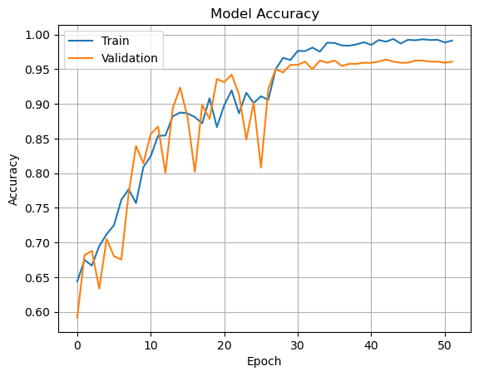
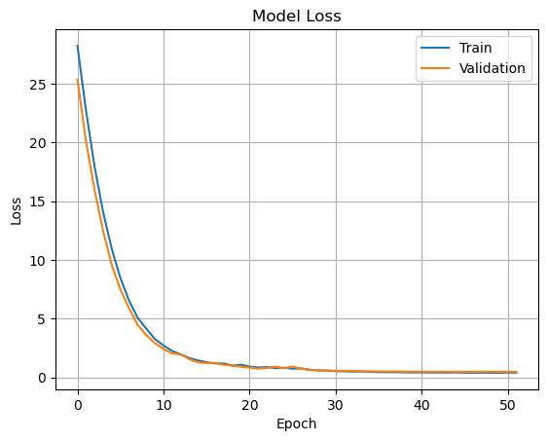
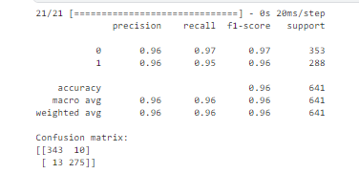
Model: CNN

Slide 16
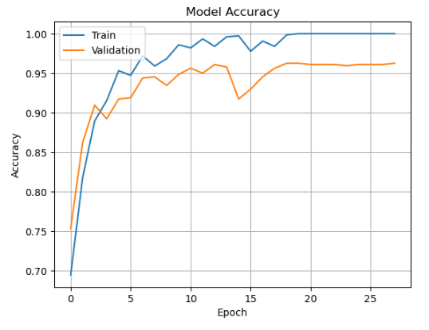
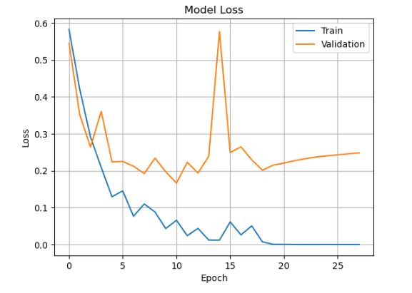
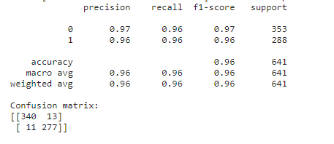
Model: VGG16

Slide 17
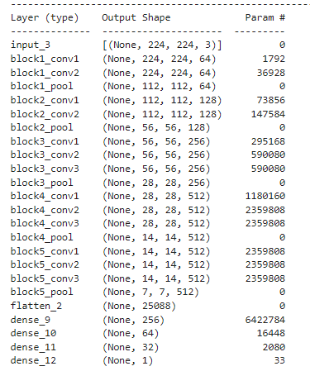

VGG16

Slide 18
VGG16 architecture code breakdown
The VGG16 model is loaded from the Keras library with pre-trained weights on the ImageNet dataset. include_top=False indicates that the top fully connected layers of the model are not included, which means that we can add our own layers on top of the model.
A Flatten layer is added to the output of the VGG16 model. This layer flattens the output of the VGG16 model into a 1-dimensional vector, which can then be fed into a fully connected layer.
Three fully connected layers are added with 256, 64, and 32 neurons respectively, and with a ReLU activation function. These layers will learn to classify the input images based on the features extracted by the VGG16 model.
A final fully connected layer with 4 neurons and a softmax activation function is added to the model. This layer will output the predicted probabilities for each of the 4 possible classes.
The Model function is used to define the input and output of the model. The input is set to be the same as the input of the VGG16 model (i.e., an image with dimensions of 224x224x3), and the output is set to be the output of the final fully connected layer.

Slide 19
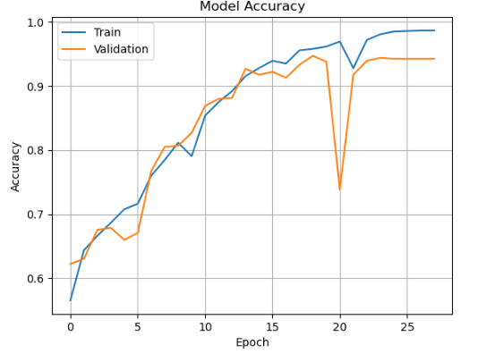
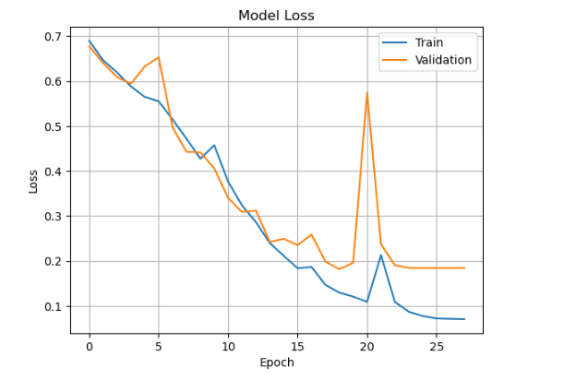
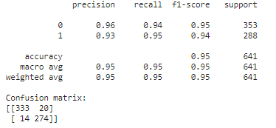
CNN-LSTM

Slide 20
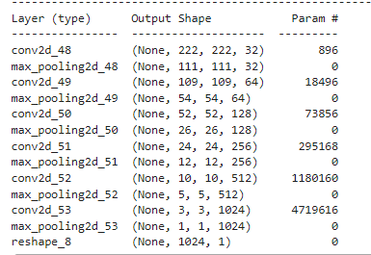
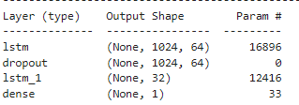
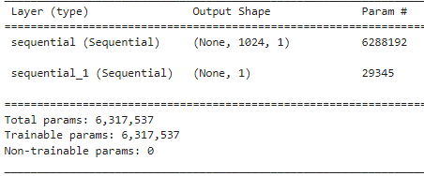
Layers in CNN-LSTM

Slide 21
CNN-LSTM architecture code breakdown
First, a Sequential model object is created and assigned to the variable cnn_model. This model will be used to perform feature extraction on each image in the sequence.
Several 2D convolutional layers with increasing number of filters are added to the cnn_model. Each convolutional layer is followed by a max pooling layer, which reduces the spatial dimension of the feature maps produced by the convolutional layers.
After the convolutional layers, a reshape layer is added to the cnn_model to flatten the output of the CNN to a 2D tensor that can be input to the LSTM network.
Next, a new Sequential model object is created and assigned to the variable lstm_model. This model will learn the temporal dependencies between the images in the sequence.
The lstm_model contains two LSTM layers with 64 and 32 units respectively, followed by a dense layer with a softmax activation function that produces a probability distribution over the four output categories.
Finally, the cnn_model and lstm_model are combined into a single Sequential model object called model. This is done by adding the cnn_model as the first layer of the model and the lstm_model as the second layer.

Slide 22
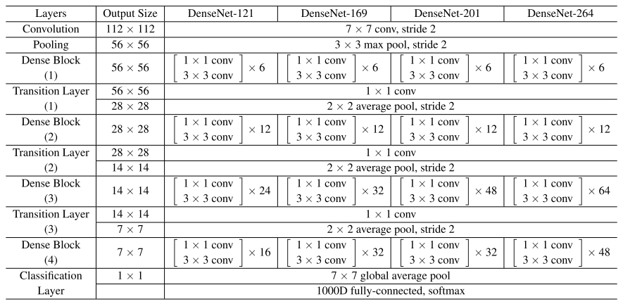
Densenet121 Architecture

Slide 23
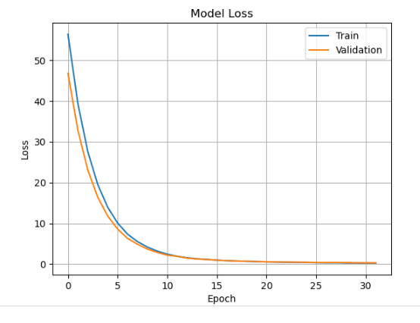
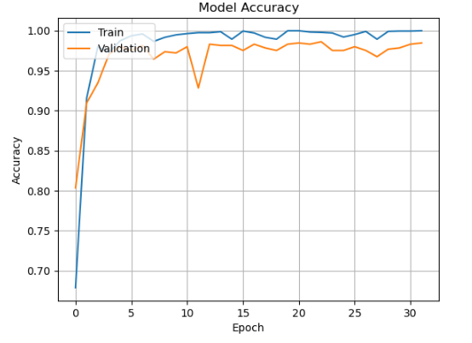
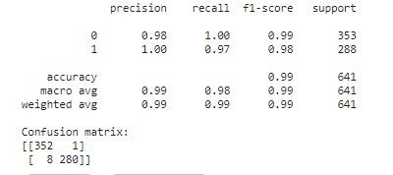

Dense net121

Slide 24
Dense net121

Slide 25
Dense net121

Slide 26
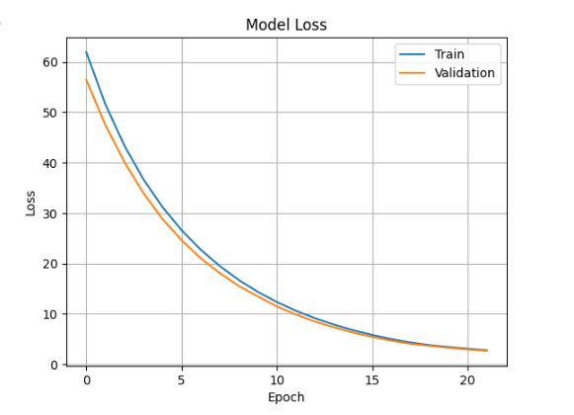
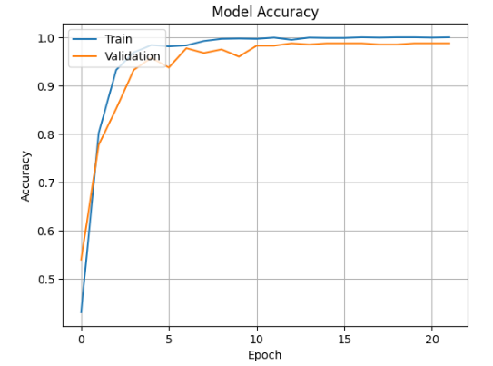
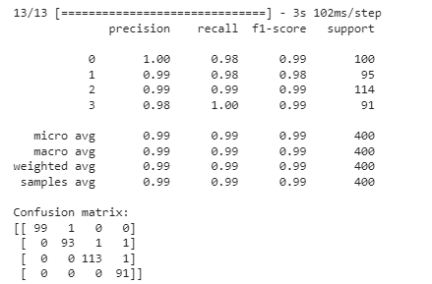
Dense Net121
We are currently evaluating the performance of a Dense Net model with four classes, and the results show a high accuracy of 99%.

Slide 27
Densenet121
The architecture of DenseNet121 is composed of 121 layers, with a total of around 8 million parameters.
It consists of several dense blocks, each of which contains a series of convolutional layers with a fixed number of filters.
These convolutional layers are followed by batch normalization and ReLU activation functions.
The output of each dense block is then fed into a transition layer, which performs down-sampling and reduces the
number of channels. The down-sampling is performed using a 1x1 convolutional layer followed by average pooling
with a stride of 2.
The final output of the network is obtained by passing the output of the last dense block through a global average
pooling layer followed by a fully connected layer and a softmax activation function. This architecture is designed for
image classification tasks and has been shown to achieve state-of-the-art performance on several benchmark datasets,
such as ImageNet.
One of the key advantages of DenseNet121 is its parameter efficiency. By using densely connected layers,
it reduces the number of parameters required to achieve a given level of accuracy compared to other architectures.
This makes it more computationally efficient and easier to train, especially when dealing with limited amounts of data.
Overall, DenseNet121 is a powerful architecture that has proven to be effective in a wide range of computer vision tasks.

Slide 28
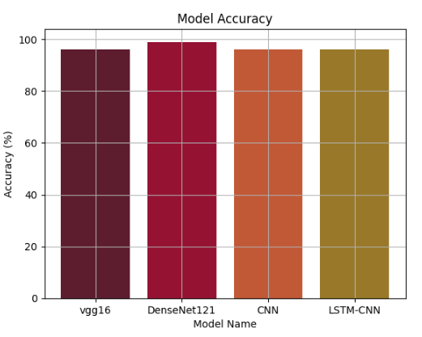
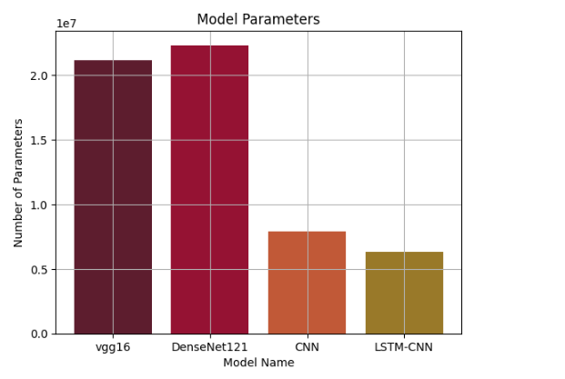
Comparing all models

Slide 29
Conclusion
The work involved training and evaluating different deep learning models on a monkeypox dataset. The models that were evaluated were VGG16, DenseNet121, CNN, and LSTM-CNN.
The first model, VGG16, had a total of 21,156,033 parameters and achieved an accuracy of 96% on the task. This means that the model was able to correctly classify 96% of the inputs it was given. The VGG16 model is a widely used deep neural network architecture for image recognition tasks and has been shown to be effective on a variety of datasets.
The second model, DenseNet121, had a total of 22,315,329 parameters and achieved an accuracy of 99% on the same task. This means that the model was able to achieve a very high level of accuracy and is likely a good choice for this particular task.
The third and fourth models, CNN and LSTM-CNN, had fewer parameters (7,877,313 and 6,317,537, respectively) but achieved the same level of accuracy as the VGG16 model (96%). This suggests that these models may be more efficient or have other advantages over VGG16, such as faster training times or lower memory requirements.
Overall, the work involved evaluating multiple deep learning models on monkeypox dataset and selecting the best-performing models based on accuracy and other factors such as model complexity and computational requirements.
The results suggest that DenseNet121 may be the most accurate model for this classification, but the other models also performed well and may be suitable for other applications or use cases.

Slide 30
Comparative Analysis: Experimental Results vs. Previous Research
Binary classification | Base paper | Experiment result
Paper title | Human Monkeypox Classification from Skin Lesion Images with Deep Pre-trained Network using Mobile Application
Description | the proposed method considers monkeypox detection as a binary classifcation problem. Thus, the last layers have been modifed in accordance with the proposed task. The networks have been trained to classify the images monkeypox vs. non-monkeypox. The best performances were achieved with MobileNetv2 and EfcientNetb0 in 60 epochs. | DenseNet121, had a total of 22,315,329 parameters, CNN and LSTM-CNN, had fewer parameters (7,877,313 and 6,317,537, respectively)
Result | MobileNetv2 which showed best performance in terms of accuracy as 91.11% | DenseNet121 achieved an accuracy of 99% CNN achieved an accuracy of 96%

Slide 31
Comparative Analysis: Experimental Results vs. Previous Research
Multiclass classification | Base paper | Experiment result
Paper title | MonkeypoxHybridNet: A hybrid deep convolutional neural network model for monkeypox disease detection
Description | Monkeypox HybridNet has three different deepCNNmodels.TheyareResNet50,VGG19, and InceptionV3. The image input size is (224,224,3). It is wide spread and used in CNN models. First, the input image goes parallel to ResNet40, VGG19, andInceptionV3 models. Next, the outputs of the three models are fatted and collected. after this stage, the information goes to the dense layer. Finally, with dropout layer, the class is determined | DenseNet121, had a total of 22,315,329 parameters
Result | MonkeypoxHybridNet gives 0.842 accuracy | DenseNet121 achieved an accuracy of 99%

Slide 32
Future Work
We can refine and modify our other models to achieve DenseNet121 accuracy.
Add more images to our dataset

Slide 33
Thank you

