Slide 1
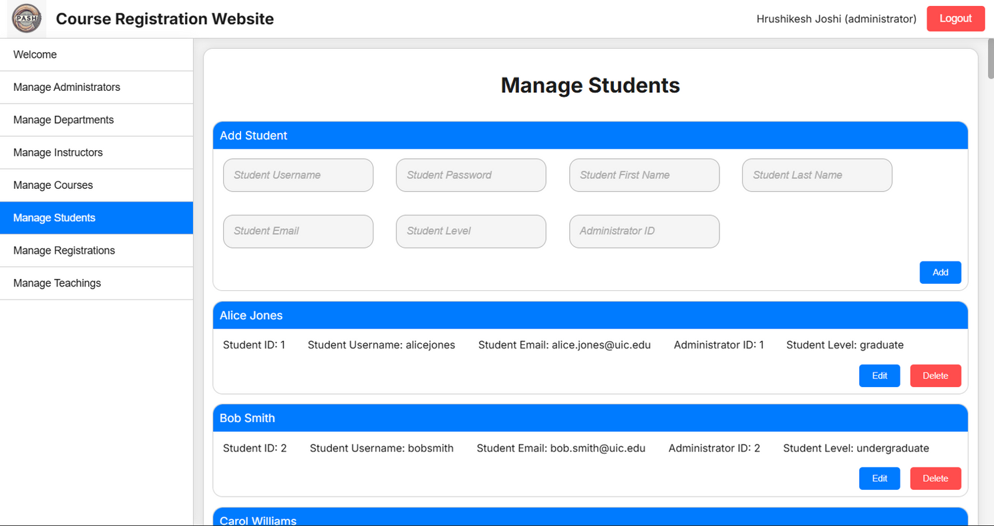
Course Registration Website
By:
Hrushikesh Joshi
Ayush Shah
Samuel Haddad
Pradnya Sonawane

Slide 2
Table of Contents
1
4
7
Problem Statement
Relational Schema
Application Demo
2
5
Requirements
Frontend
3
6
ER Diagram
Backend

Slide 3

Problem Statement
To build a course registration system in which the application will have two different roles, students and administrators. Administrators will be able to add and delete courses being offered, change / set the buildings in which the courses will be held, and set/change the instructors to whom the courses are being taught. Students will be able to register for courses (if available) and build schedules for themselves, representing the courses they have registered for in that upcoming semester. Both roles will be able to find out the availability of classes (i.e., if a class is full or still has spots available) and see a list of all courses offered

Slide 4
Requirements
Data Requirements:
Admins
Students
Courses
Instructors
Departments
Store their UIN, name, email, user_id, and password
Store their UIN, name, email, user_id, password, level (Freshman, Senior, etc), and the Courses they are taking (multivalued attribute)
Store their course_id, name, location, timing, instruction_method, department, instructor, credits, and availability
Store their UIN, name, email, department, and course they are teaching
Store their deptartment_id, name, and their department head

Slide 5
Application Requirements:
Admins
Students
Both
Able to add and delete to all any data in the database, mainly courses, departments, instructors, and courses students are registered for
Able to register themselves for available courses (courses with seats)
View their student info (current and past courses taken)
Search for a course being offered and find the prerequisites for that course
Admins and Students are able to see all courses being offered

Slide 6
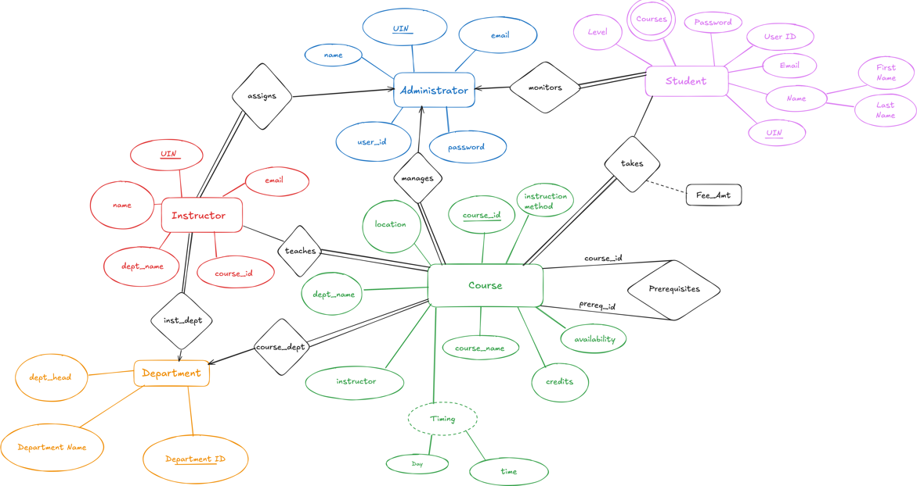
ER Diagram

Slide 7
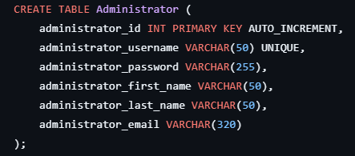
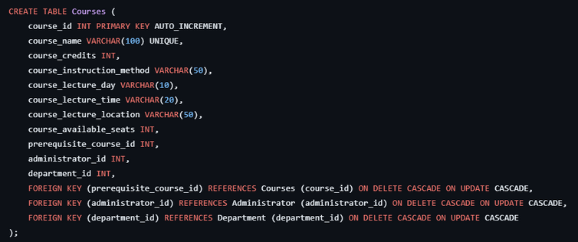
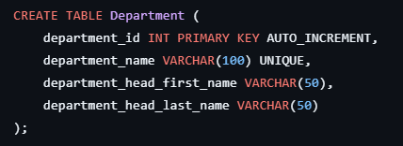
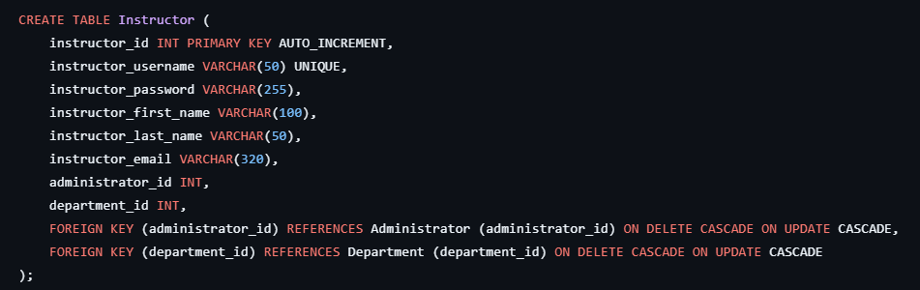
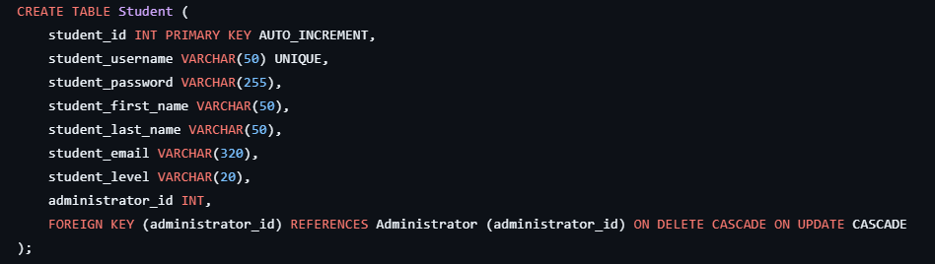
Relational Schema

Slide 8
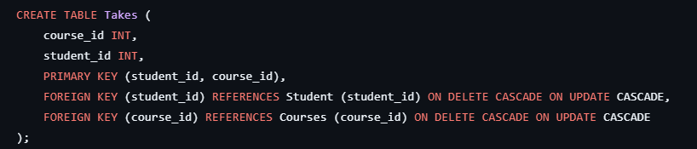
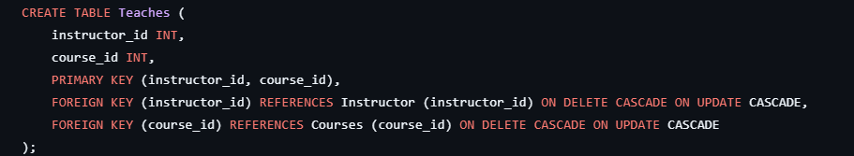
Junction Tables

Slide 9

Front End

Slide 10

Backend

Slide 11

Database

Slide 12
Application Demo

Slide 13
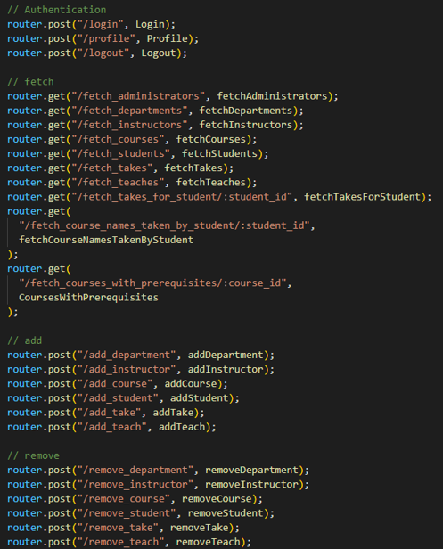
Backend API

Slide 14
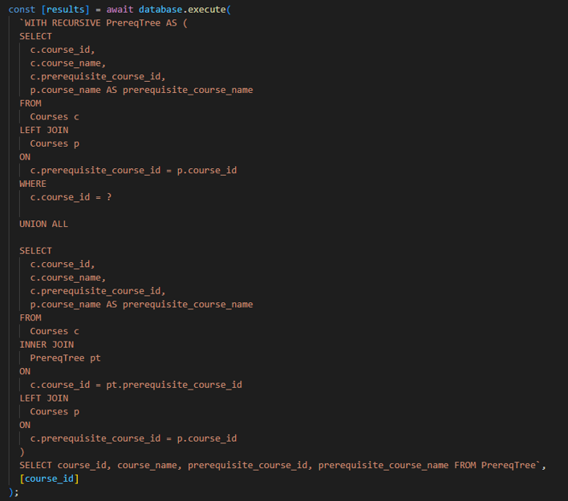
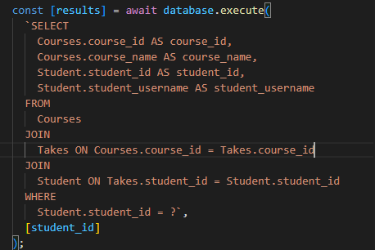
Queries Supported
We have given our longest and most complicated recursive query here:
Our backend has a lot of join queries like these:

Slide 15
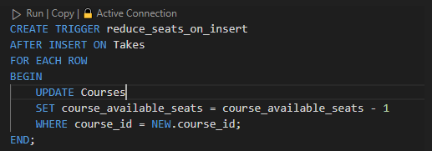
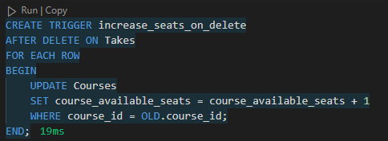
SQL Triggers

Slide 16
Thank You !!!

