Slide 1


Integrated Banking System
Location: Talwade,Pune

Slide 2
Integrated Banking System
Statement
The IBS (Integrated Banking System) is going to be a web application to offer various banking services online.
Team Members
Sharad Soni
Manvi Singh
Kali Prasad
Mukul Maheshwari
Priyanka Jain

Slide 3

Integrated Banking System
Use Case 6: Investment Management
Consumer can view current Gold, Silver Prices and Mutual Fund Plans.
Consumer can buy/sell Gold and Silver.
Consumer can deposit and withdraw from Mutual Funds.
Consumer can view their Investments.
Bank representative can update/remove Mutual Fund plans.
Bank representative can update Gold and Silver Prices.

Slide 4
Scope
In Scope:
All the requirements are fulfilled.
Out Scope:
Customer cannot withdraw his/her Mutual Fund Investments partially.

Slide 5
Assumptions
All measurements are in grams.
All the transactions take place in Rupee currency.
The Bank representative can update Gold/Silver price once in a day.
The price of one unit of a Mutual fund is determined by bank representative in a particular mutual fund plan.
Customer can only withdraw his/her complete investment from a particular mutual fund.
In case of premature withdraw of a SIP plan, 5% fine is levied on total amount.

Slide 6

Functions of A Customer
Buy/Sell Gold
Buy/Sell Silver
Invest/Withdraw Mutual Funds
View Investments
View Gold/Silver Price
View Mutual Fund Plans
View My Transactions
Link New Account
Customer

Slide 7

Functions of Bank Representative
Manage Gold Price
Manage Silver Price
Update Mutual Fund plans
Add Mutual Fund plans
Bank Representative

Slide 8
Additions in this Sprint
Bank Representative can add a SIP Mutual fund plan.
Bank Representative can update SIP/Direct status of a Mutual Fund plan.
Bank Representative can update Minimum investment for a Mutual Fund plan.
Customer can invest in mutual funds through SIP (Frequency, Opening Date).

Slide 9
Thank You

Slide 10
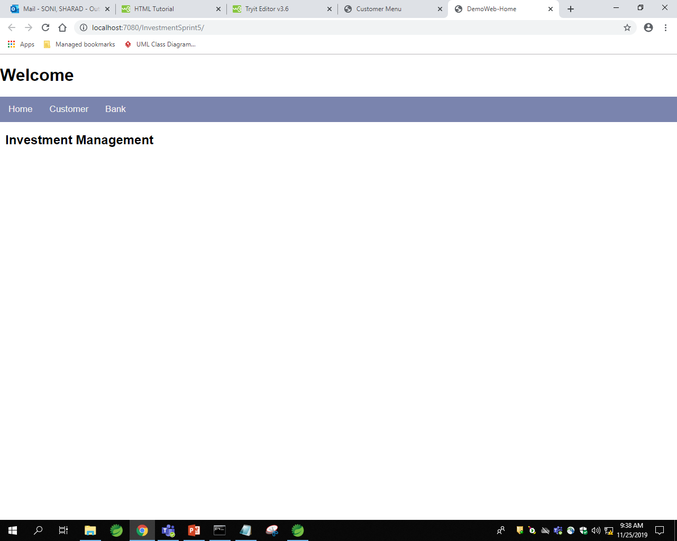
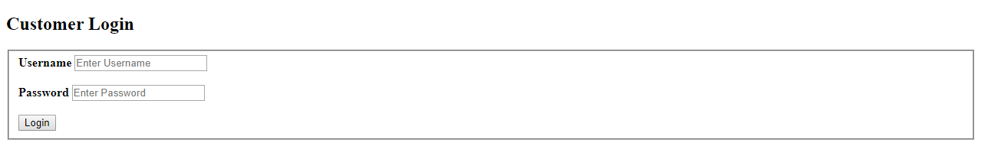
Main Dashboard & Login pages

Slide 12
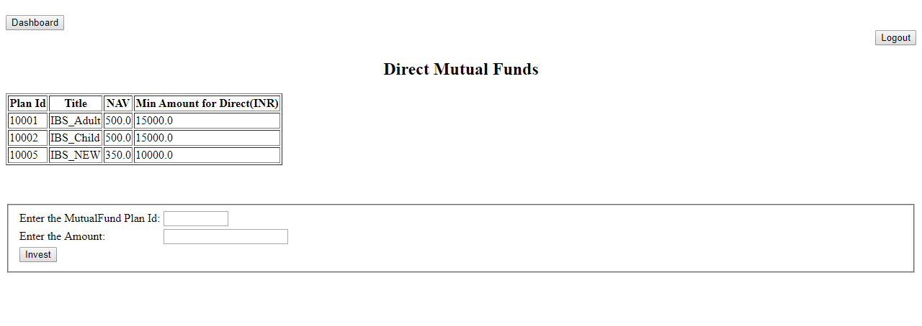
Direct Mutual Funds

Slide 13
Changes Suggested in Last Sprint
1. All the View Methods must be one side and the rest on the other side of the UI.
2. The balance must be shown after completion of each transaction.
3. An option to add other account when the balance is lesser than transaction amount.
4. An option to view the current price/plans in the bank representative menu.
5. A submenu for Gold/Silver/ Mutual Funds.
6. To Display the net asset value of any current asset possessed by the customer.

Slide 14
New Functionality : Invest in MF directly or with SIP
NAV
Direct_Status
SIP_Status
Min_direct_Amount
Min_SIP_Amount
Mutual Funds:
Add
Update
SIP
Direct

Slide 15
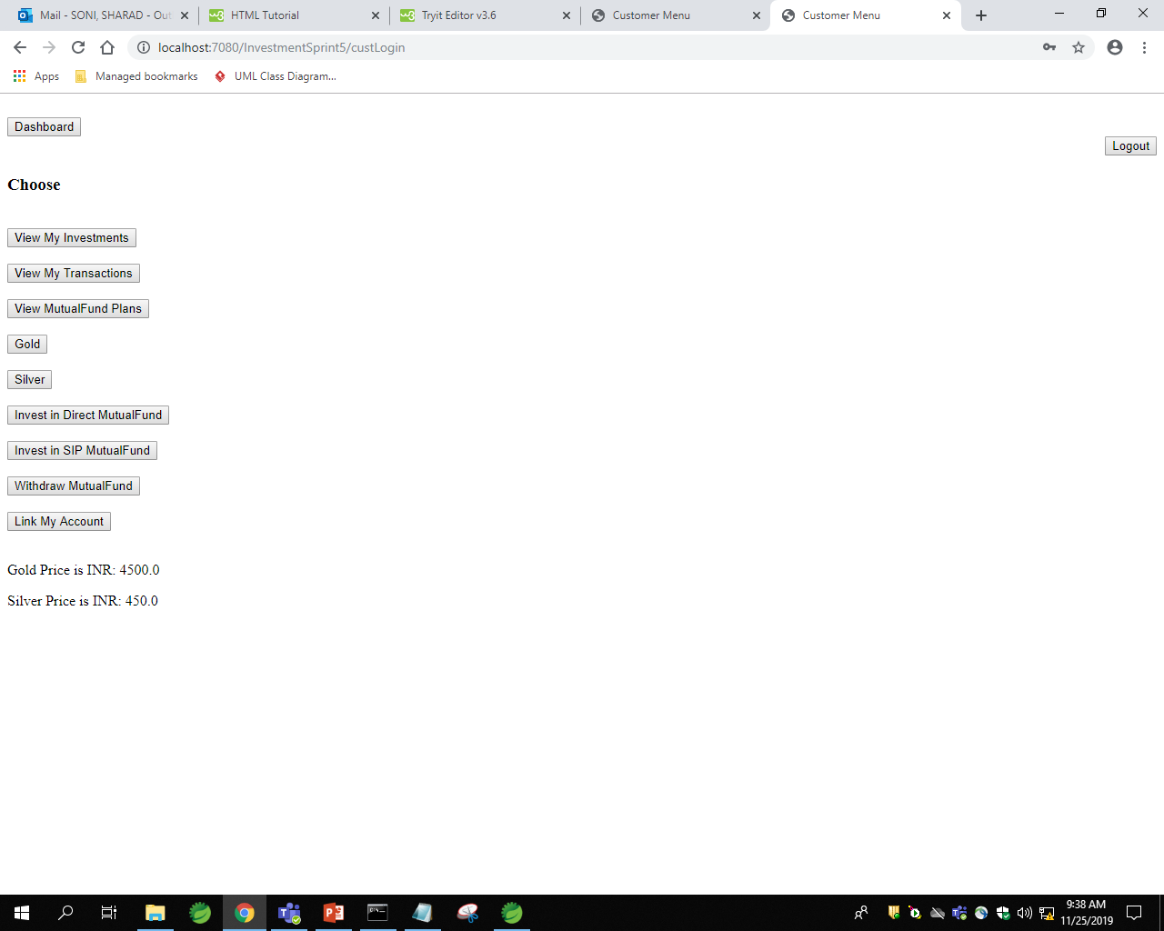
Customer Menu

Slide 16
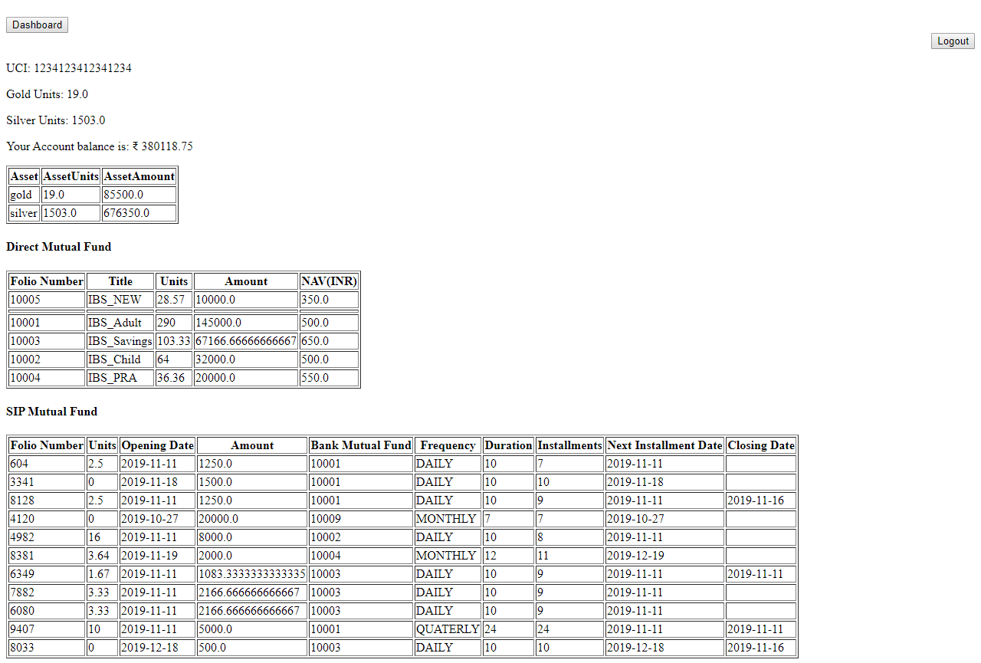
View My Investments(Customer)

Slide 17
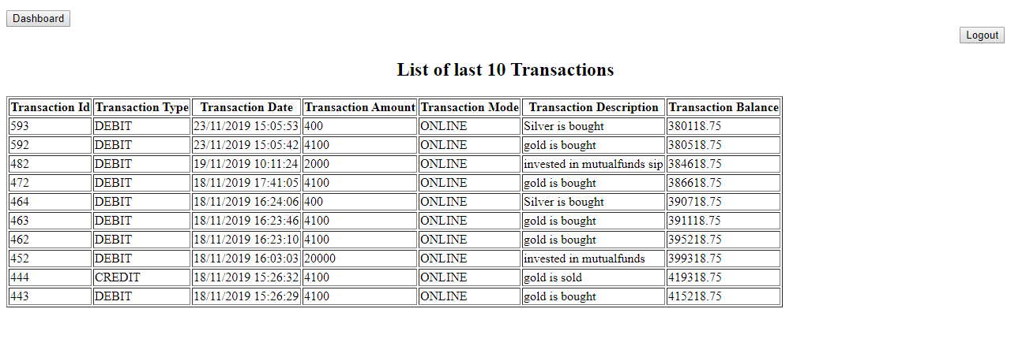
View My Transaction

Slide 18
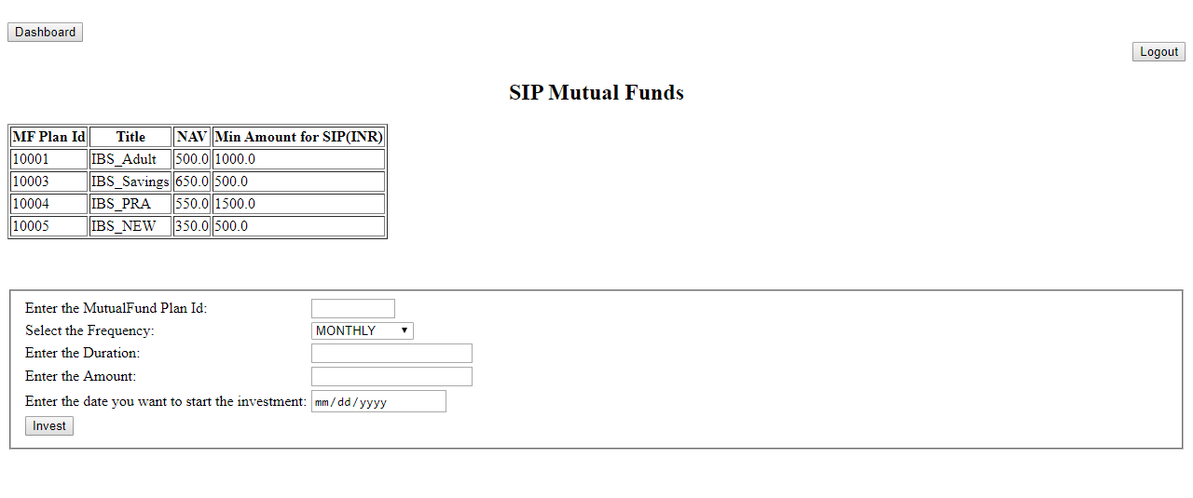
SIP Mutual Funds

Slide 19
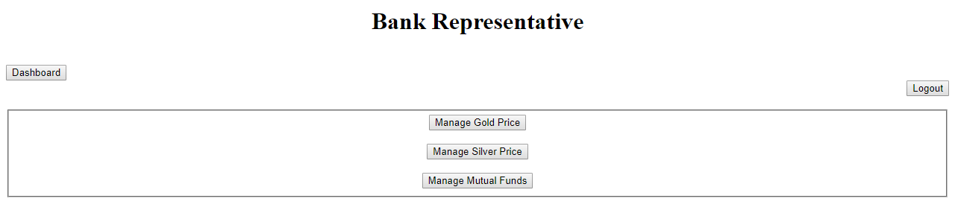
Bank Representative Menu

Slide 20
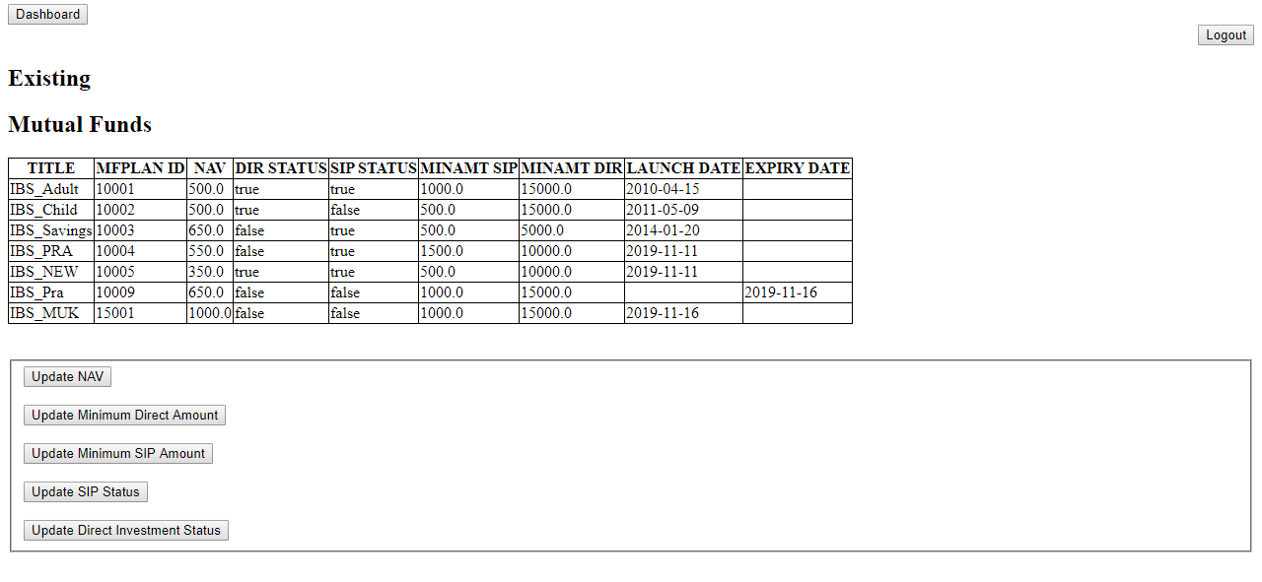
Update Mutual Fund menu

Slide 21
Thank You

Slide 22
Bank Representative UI
Bank Representative UI
Update Gold Price
Update Silver Price
Update Mutual Funds
Bank Representative UI
View Gold Price
Update Gold Price
View Silver Price
Update Silver Price
View Mutual Funds
Update Mutual Funds

Slide 23
New Functionality : Switch Account
Account 1
UCI
Account 2
Account 3

Slide 25
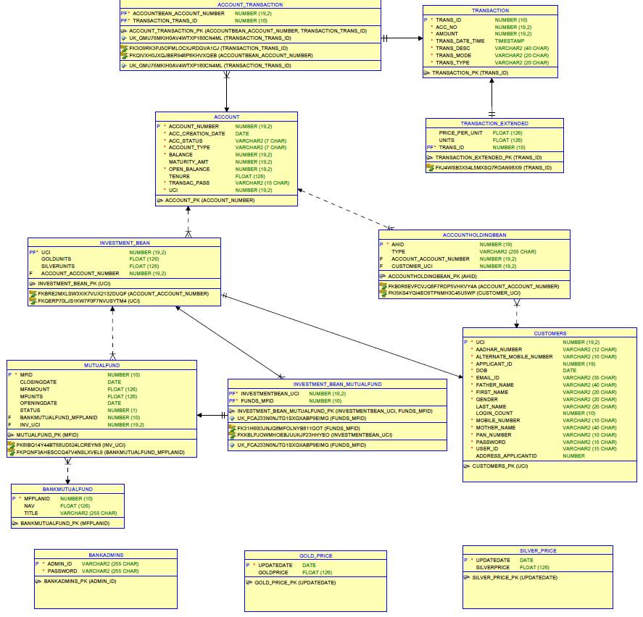
Schema Diagram

Slide 26
Schema Diagram
Customer
PK:UCI
Aadhar Number
Alternate Mobile Number
Applicant ID
DOB
Email_ID
First Name
Gender
Mobile Number
Pan_number
User_ID
Address ApplicantID
Customers

Slide 27
Integrated Banking System

Slide 28
Transactions Table
Transaction Table
Transaction_ID | Trans_date | Description | Amount | Trans_type | Account_no |Trans_mode
--------------- ------------- ----------- ---------- ----------- ------------ -----------
--------------- ------------- ----------- ---------- ----------- ------------ -----------
--------------- ------------- ----------- ---------- ----------- ------------ -----------
--------------- ------------- ----------- ---------- ----------- ------------ -----------
--------------- ------------- ----------- ---------- ----------- ------------ -----------
--------------- ------------- ----------- ---------- ----------- ------------ -----------
Upto 50 transactions per page

