Slide 1


Integrated Banking System
Location: Talwade,Pune

Slide 2
Integrated Banking System
Statement
The IBS (Integrated Banking System) is going to be a web application to offer various banking services online.
Team Members
Sharad Soni
Manvi Singh
Kali Prasad
Mukul Maheshwari
Priyanka Jain

Slide 3

Integrated Banking System
Use Case 6: Investment Management
Consumers can choose to invest in gold, silver and mutual funds.
Consumers must be able to view the current gold/silver price as on date.
Consumers must be able to see various mutual funds plans offered on IBS.
Bank representative shall be constantly updating the mutual funds plans.
Consumer can purchase gold or silver or deposit in mutual funds.
Consumer can sell gold or silver or withdraw from mutual funds.

Slide 4
Scope
In Scope:
All the requirements are fulfilled.
Out Scope:
No option to invest in SIP (Systematic Investment Plan).

Slide 5
Assumptions
All measurements are in grams.
All the transactions take place in Rupee currency.
The price of one unit of a Mutual fund is determined by bank representative in a particular mutual fund plan.
Customer can withdraw his/her complete investment from a particular mutual fund.
Bank representative cannot delete existing mutual fund plans.

Slide 6

Functions of A Customer
Buy/Sell Gold
Buy/Sell Silver
Invest/Withdraw Mutual Funds
View Investments
View Gold/Silver Price
View Mutual Fund Plans
View My Transactions
Link New Account
Customer

Slide 7

Functions of Bank Representative
Updates Gold Price
Updates Silver Price
Add Mutual Fund plans
Update NAV
Bank Representative

Slide 8
Changes Suggested in Last Sprint
1. A line between rows and column names
2. Linking with other use cases
3. Proper formatting in Mutual Fund Table
4. Transaction date-time format ( no need of seconds in output)

Slide 9
Table Format
Column 1
Column 2
Column 1
Column 2
Option 1
Option 2
Option 3
Option 4
Option 5
Option 1
Option 2
Option 3
Option 4
Option 5
Option 1
Option 2
Option 3
Option 4
Option 5
Option 1
Option 2
Option 3
Option 4
Option 5

Slide 10
Linking Tables
Transaction_Bean
Transaction_type
Transaction_date_time
Transaction_desc
Transaction_amount
Units
Price_per_unit
Transaction
Transaction_extended
Trans_ID PK
Trans_date
Description
Amount
Trans_type
Account_no
Trans_mode
Trans_ID PK,FK
Units
Price_per_unit

Slide 11

Data Format
mfId
Nav
Opening date
Closing date
mfId
Nav
Opening date
Closing date

Slide 12
Time Date Format
Time Stamp Format
2019-01-01 14:59:48:456+01
Date Time
01/01/2019 14:29

Slide 13
Additions in this Sprint
Adding a new Bank Representative method to update NAV of existing plans.
Adding a new Customer method to link new account.

Slide 14
New Functionality : Update NAV
Profit for customer
NAV Increases
No Profit or Loss for Customer
NAV VALUE FIXED
Loss for customer
NAV Decreases

Slide 15
New Functionality : Switch Account
Account 1
UCI
Account 2
Account 3

Slide 16
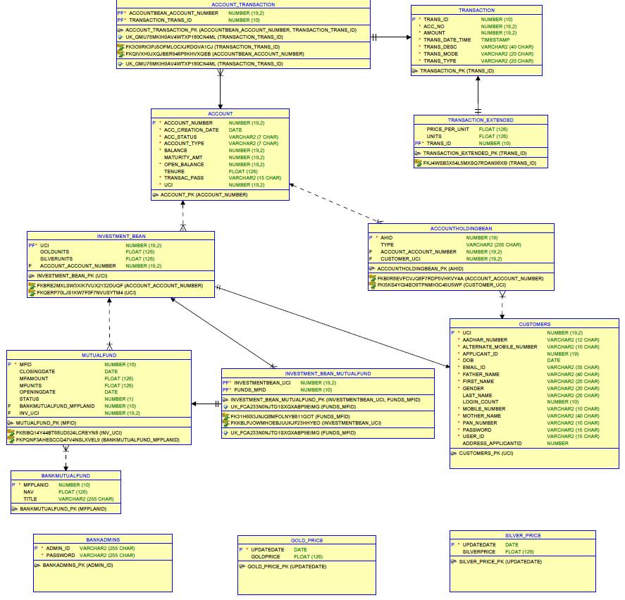
Schema Diagram

Slide 17
Thank You

Slide 18
Integrated Banking System

