Slide 1
Integrated Banking System
Location: Pune, Talwade

Slide 2
Integrated Banking System
Statement
The IBS (Integrated Banking System) is going to be a web application to offer various banking services online.
Team Members
Sharad Soni
Manvi Singh
Kali Prasad
Mukul Maheshwari
Priyanka Jain

Slide 3
Integrated Banking System
Use Case 6: Investment Management
Consumers can choose to invest in gold, silver and mutual funds.
Consumers must be able to view the current gold/silver price as on date.
Consumers must be able to see various mutual funds plans offered on IBS.
Bank representative shall be constantly updating the mutual funds plans.
Consumer can purchase gold or silver or deposit in mutual funds.
Consumer can sell gold or silver or withdraw from mutual funds.

Slide 4
Scope
In Scope:
All the requirements are fulfilled.
Out Scope:
No option to invest in SIP (Systematic Investment Plan).

Slide 5
Assumptions
All measurements are in grams.
All the transactions take place in Rupee currency.
The price of one unit of a Mutual fund is determined by bank representative.
Minimum amount to invest in all Mutual Funds is fixed by bank representative.

Slide 6

Buy/Sell Gold
Buy/Sell Silver
Invest/Withdraw Mutual Funds
View Investments
View Gold/Silver Price
View Mutual Fund Plans
Customer

Slide 7

Updates Gold Price
Updates Silver Price
Add Mutual Fund plans
Bank Representative

Slide 8
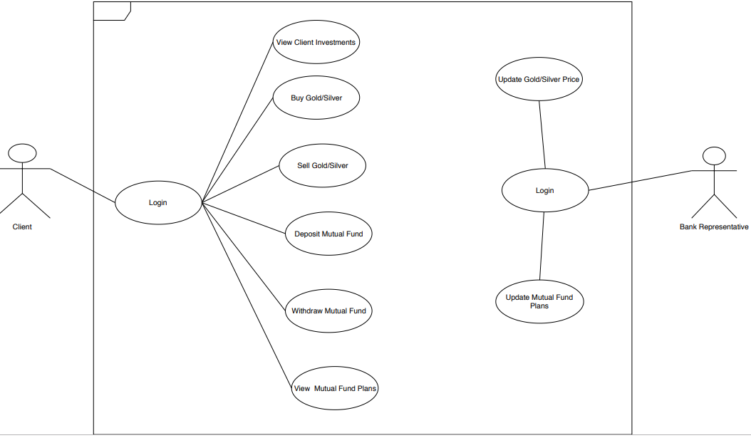
Use-Case Diagram
Header
First level
Second level
Third level
Fourth level
Fifth level

Slide 9
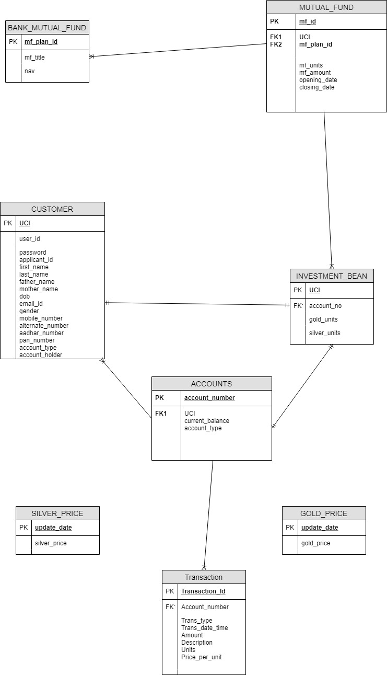
Entity Relations

Slide 10
Thank You

Slide 11
Title (Work for 1 or 2 lines of title)
Header
Header
Header
First level
Second level
Third level
Fourth level
Fifth level
First level
Second level
Third level
Fourth level
Fifth level
First level
Second level
Third level
Fourth level
Fifth level
Header
Insert bullet point
Insert bullet point
Insert bullet point
Insert bullet point

Slide 12
Title (Work for 1 or 2 lines of title)
Header
Header
Header
Insert bullet point
Insert bullet point
Insert bullet point
Insert bullet point
Insert bullet point
Insert bullet point
Insert bullet point
Insert bullet point
Insert bullet point
Insert bullet point
Insert bullet point
Insert bullet point

Slide 13
Title (Work for 1 or 2 lines of title)
Insert name Insert Title/Role
Insert bullet point
Insert bullet point
Insert bullet point
Insert bullet point
Insert name Insert Title/Role
Insert bullet point
Insert bullet point
Insert bullet point
Insert bullet point
Insert name Insert Title/Role
Insert bullet point
Insert bullet point
Insert bullet point
Insert bullet point
Insert name Insert Title/Role
Insert bullet point
Insert bullet point
Insert bullet point
Insert bullet point

Slide 14
Title (Work for 1 or 2 lines of title)
1
Subtitle
 | TEXT | TEXT | TEXT | TEXT | TEXT | TEXT | TEXT
TEXT | Text sample | Text sample | Text sample | Text sample | Text sample | Text sample | Text sample
TEXT | Text sample | Text sample | Text sample | Text sample | Text sample | Text sample | Text sample
TEXT | Text sample | Text sample | Text sample | Text sample | Text sample | Text sample | Text sample
TEXT | Text sample | Text sample | Text sample | Text sample | Text sample | Text sample | Text sample

Slide 15
Title (Work for 1 or 2 lines of title)
Click to insert chart title
Click to insert chart title
Click to insert text
Click to insert text

Slide 16
Title (Work for 1 or 2 lines of title)
1
2
3
4
5
6
7
8
9
10
11
12
Text sample
Text sample
Text sample
Text sample
Text sample
Text sample
Text sample
Text sample

Slide 17
Title (Work for 1 or 2 lines of title)
Click to insert chart title
Click to insert chart title

Slide 18
Title (Work for 1 or 2 lines of title)
Click to insert title
Click to insert title
Click to insert title
Click to insert title
Click to insert title
Click to insert bullet point
Click to insert bullet point
Click to insert bullet point
Click to insert bullet point
Click to insert bullet point
Click to insert bullet point
Click to insert bullet point
Click to insert bullet point
Click to insert bullet point
Click to insert bullet point
Click to insert bullet point
Click to insert bullet point
Click to insert bullet point
Click to insert bullet point
Click to insert bullet point

Slide 19
Title (Work for 1 or 2 lines of title)
XX%
XX%
XX%
XX%
Click to insert text
Click to insert text
Click to insert text
Click to insert text
XX%
Click to insert text

Slide 20
Title (Work for 1 or 2 lines of title)
Insert Group Name
Click to insert bullet point
Click to insert bullet point
Click to insert bullet point
Insert Group Name
Click to insert bullet point
Click to insert bullet point
Click to insert bullet point
Insert Group Name
Click to insert bullet point
Click to insert bullet point
Click to insert bullet point
Group Name
Click to insert text
Click to insert text
Click to insert text
Click to insert text
Click to insert text

Slide 21
Title (Work for 1 or 2 lines of title)
60%
50%
35%
Click to insert text
Click to insert text
Click to insert text
Click to insert bullet point
Click to insert bullet point
Click to insert bullet point
Click to insert bullet point
Click to insert bullet point
Click to insert bullet point
Click to insert bullet point
Click to insert bullet point
Click to insert bullet point

Slide 22
Click to insert title
Text
Text
Text
Click to insert bullet point
Click to insert bullet point
Click to insert bullet point
Click to insert bullet point
Click to insert bullet point
Click to insert bullet point
Click to insert bullet point
Click to insert bullet point
Click to insert bullet point

Slide 23
Click to insert title
Click to insert title
Photo
Click to insert bullet point
Click to insert bullet point
Click to insert bullet point
Click to insert bullet point
Click to insert bullet point
Click to insert bullet point
Click to insert title
Name
Click to insert bullet point
Click to insert bullet point
Click to insert bullet point
Text
Education
Text

Slide 24
Section break

Slide 25
Section break

Slide 28
Icons examples
Bulb
Arrows
Direction
Download
Star
Balance
Tools
Key
Vision
Home
Questions
Exclamation
Satisfaction
Music
Hourglass
Time
Speed
Power button
Lock
Unlock
Anti virus
Danger
Gravel
Search
Zoom
Target
Capability
Flexibility
Infinity
Puzzle

Slide 29
Graphic elements

