Slide 1
EL6463: Round Key Generation

Slide 2
RC5 Key Expansion
128-bit user key->26 round keys (each 32-bit)
  User Key->S[0], S[1]…, S[25]

Slide 3
Entity definition
ENTITY key_exp IS
PORT
(
clr, clk : STD_LOGIC; -- by default, it is input
key_in : STD_LOGIC;
ukey : STD_LOGIC_VECTOR(127 DOWNTO 0);
skey : OUT STD_LOGIC_VECTOR(31 DOWNTO 0);
key_rdy : OUT STD_LOGIC
);
END key_exp;

Slide 4
Signal declarations
SIGNAL a_reg : STD_LOGIC_VECTOR(31 DOWNTO 0);
SIGNAL b_reg : STD_LOGIC_VECTOR(31 DOWNTO 0);
SIGNAL a_tmp1 : STD_LOGIC_VECTOR(31 DOWNTO 0);
SIGNAL a_tmp2 : STD_LOGIC_VECTOR(31 DOWNTO 0);
SIGNAL ab_tmp : STD_LOGIC_VECTOR(31 DOWNTO 0);
SIGNAL b_tmp1 : STD_LOGIC_VECTOR(31 DOWNTO 0);
SIGNAL b_tmp2 : STD_LOGIC_VECTOR(31 DOWNTO 0);
SIGNAL l_arr : L_ARRAY;
SIGNAL s_arr_tmp: S_ARRAY;
SIGNAL i_cnt : INTEGER RANGE 0 TO 25; -- you can use std_logic_vector
SIGNAL j_cnt : INTEGER RANGE 0 TO 3; -- you can use std_logic_vector
SIGNAL k_cnt : INTEGER RANGE 0 TO 77; -- any better way?

Slide 5
Use of VHDL package
The definitions and declarations in a package can be shared by multiple VHDL models
LIBRARY IEEE;
USE IEEE.STD_LOGIC_1164.ALL;
USE WORK.RC5_PKG.ALL; -- include the package to your design
……
LIBRARY IEEE;
USE IEEE.STD_LOGIC_1164.ALL;
PACKAGE rc5_pkg IS
TYPE S_ARRAY IS ARRAY (0 TO 25) OF STD_LOGIC_VECTOR(31 DOWNTO 0);
TYPE L_ARRAY IS ARRAY (0 TO 3) OF STD_LOGIC_VECTOR(31 DOWNTO 0);
END rc5_pkg;

Slide 6
Round Key Generation
do 3*max(t, c); t=26, c=4
A = S[i] = (S[i] + A + B) <<< 3;
B = L[j] = (L[j] + A + B) <<< (A + B);
i = (i + 1) mod (t);
j = (j + 1) mod (c);
i=0;j=0;
do 78 times
{
A = S[i] = (S[i] + A + B) <<< 3;
B = L[j] = (L[j] + A + B) <<< (A + B);
i = (i + 1) mod 26;
j = (j + 1) mod 4;
}

Slide 7
Round key generation: Operation 1
-- it is not a data-dependent rotation!
A = S[i] = (S[i] + A + B) <<< 3;
a_tmp1<=s_arr_tmp(i_cnt)+a_reg+b_reg; -- not a good style!
-- <<<3
a_tmp2<=a_tmp1(28 DOWNTO 0) & a_tmp1(31 DOWNTO 29);

Slide 8
Round key generation: Operation 2
-- this is a data-dependent rotation!
B = L[j] = (L[j] + A + B) <<< (A + B);
ab_tmp<=a_tmp2+b_reg;
b_tmp1<=l_arr(j_cnt)+ab_tmp;
WITH ab_tmp(4 DOWNTO 0) SELECT
b_tmp2<=
b_tmp1(30 DOWNTO 0) & b_tmp1(31) WHEN "00001",
b_tmp1(29 DOWNTO 0) & b_tmp1(31 DOWNTO 30) WHEN "00010",
b_tmp1(28 DOWNTO 0) & b_tmp1(31 DOWNTO 29) WHEN "00011",
……
b_tmp1(0) & b_tmp1(31 DOWNTO 1) WHEN "11111",
b_tmp1 WHEN OTHERS;

Slide 9
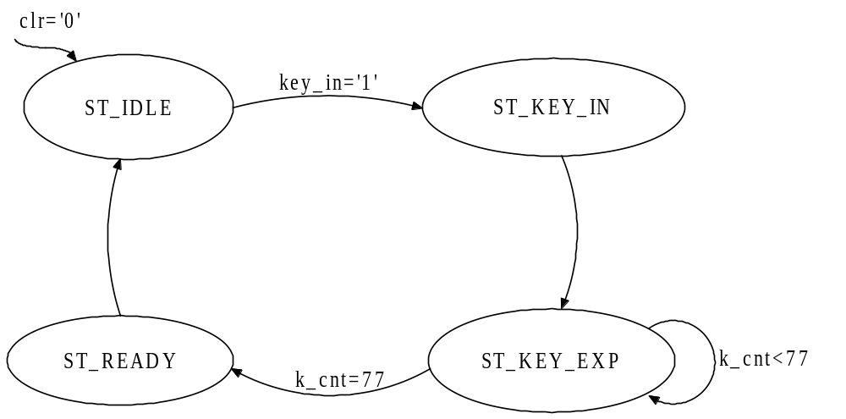
Round key generation: state m/c

Slide 10
Round key generation: state m/c
TYPE StateType IS (ST_IDLE, ST_KEY_INIT, ST_KEY_EXP, ST_READY);
SIGNAL state : StateType;
……
PROCESS(clr, clk)
BEGIN
IF(clr='0') THEN
state<=ST_IDLE;
ELSIF(clk'EVENT AND clk='1') THEN
CASE state IS
WHEN ST_IDLE | ST_READY=>
IF(key_in='1') THEN state<=ST_KEY_INIT; END IF;
WHEN ST_KEY_INIT=>
state<=ST_KEY_EXP;
WHEN ST_KEY_EXP=>
IF(k_cnt=77) THEN state<=ST_READY; END IF;
END CASE;
END IF;
END PROCESS;

Slide 11
A register and B register
-- A register
PROCESS(clr, clk) BEGIN
IF(clr='0') THEN
a_reg<=(OTHERS=>’0’);
ELSIF(clk'EVENT AND clk='1') THEN
IF(state=ST_KEY_EXP) THEN a_reg<=a_tmp2;
END IF;
END IF;
END PROCESS;
-- B register
PROCESS(clr, clk) BEGIN
IF(clr='0') THEN
b_reg<=(OTHERS=>’0’);
ELSIF(clk'EVENT AND clk='1') THEN
IF(state=ST_KEY_EXP) THEN b_reg<=b_tmp2;
END IF;
END IF;
END PROCESS;

Slide 12
Two arrays: S_ARRAY, L_ARRAY
and two counters
  i_cnt for S_ARRAY, j_cnt for L_ARRAY
i = (i + 1) mod (t);
j = (j + 1) mod (c);
PROCESS(clr, clk)
BEGIN
IF(clr='0') THEN i_cnt<=0;
ELSIF(clk'EVENT AND clk='1') THEN
IF(state=ST_KEY_EXP) THEN
IF(i_cnt=25) THEN i_cnt<=0;
ELSE i_cnt<=i_cnt+1;
END IF;
END IF;
END IF;
END PROCESS;
PROCESS(clr, clk)
BEGIN
IF(clr='0') THEN j_cnt<=0;
ELSIF(clk'EVENT AND clk='1') THEN
IF(state=ST_KEY_EXP) THEN
IF(j_cnt=3) THEN j_cnt<=0;
ELSE j_cnt<=j_cnt+1;
END IF;
END IF;
END IF;
END PROCESS;

Slide 13
Initialize S_ARRAY
S[0] = 0xB7E15163 (Pw)
for i=1 to 25 do S[i] = S[i-1]+ 0x9E3779B9 (Qw)
PROCESS(clr, clk)
BEGIN
IF(clr='0') THEN -- After system reset, S array is initialized with P and Q
s_arr_tmp(0)<= "10110111111000010101000101100011"; P_{w}
s_arr_tmp(1)<= "01010110000110001100101100011100"; Pw+ Qw
s_arr_tmp(2)<= "11110100010100000100010011010101"; Pw+ 2Qw
……
s_arr_tmp(25)<="00101011010011000011010001110100"; Pw+ 25Qw
ELSIF(clk'EVENT AND clk='1') THEN
IF(state=ST_KEY_EXP) THEN s_arr_tmp(i_cnt)<=a_tmp2;
END IF;
END IF;
END PROCESS;
skey<=s_arr_tmp(25);

Slide 14
L_ARRAY
PROCESS(clr, clk)
BEGIN
IF(clr=‘0’) THEN
FOR i IN 0 TO 3 LOOP
l_arr(i)<=(OTHERS=>'0');
END LOOP;
ELSIF(clk'EVENT AND clk='1') THEN
IF(state=ST_KEY_INIT) THEN
l_arr(0)<=ukey(31 DOWNTO 0);
l_arr(1)<=ukey(63 DOWNTO 32);
l_arr(2)<=ukey(95 DOWNTO 64);
l_arr(3)<=ukey(127 DOWNTO 96);
ELSIF(state=ST_KEY_EXP) THEN
l_arr(j_cnt)<=b_tmp2;
END IF;
END IF;
END PROCESS;
for i = b - 1 downto 0 do
L[i/u] = (L[i/u] <<< 8) + K[i];

Slide 15
Exercise
Finish RC5 key expansion model
Simulate RC5 key expansion VHDL model
  Functional Simulation using ModelSim
  Code debugging
Synthesize the Design
  Perform Timing Simulation
Understand following concepts/operations
  Package
  Data-independent rotate
  How to do initialization?

Slide 16
Functional Simulation
Create project folder
  C:\ee4313\proj4
Save your VHDL code in project folder
  rc5_pkg.vhd
  key_exp.vhd
Start ModelSim

Slide 17
Functional Simulation
In ModelSim console window, type following commands in sequence
With the given ukey (all 0’s), you should get the same skey (declared as ROM) for previous labs
cd {c:/ee4313/proj4}
vlib work
vcom rc5_pkg.vhd
vcom key_exp.vhd
vsim key_exp
view wave
add wave clr clk key_in ukey a_reg b_reg skey key_rdy
force clr 0 0, 1 200
force clk 0 0, 1 50 –repeat 100
force ukey 16#00000000000000000000000000000000 0
run 1500

Slide 18
FPGA Synthesis and Implementation
Start Xilinx Project Navigator
Create new project
  Project name: key_exp
  Device: Virtex->xcv1000->bg560->-4
Create timing simulation model
  key_exp_sim.vhd

Slide 19
Timing Simulation
Make sure timing simulation models are successfully generated
  key_exp_sim.vhd and key_exp_sim.sdf
Start ModelSim

Slide 20
Timing Simulation
In ModelSim console window, type in following commands in sequence
cd {c:/ee4313/proj4}
vlib work
vmap simprim c:/modeltech_5.6d/xilinx/simprim
vcom key_exp_sim.vhd
vsim -sdftyp /=c:/ee4313/proj4/key_exp_sim.sdf work.key_exp
view wave
add wave clr clk key_in ukey a_reg b_reg skey key_rdy
force clr 0 0, 1 200
force clk 0 0, 1 50 –repeat 100
force ukey 16#00000000000000000000000000000000 0
run 1500

