Slide 1
EL6463 – Structural Modeling
Structural Modeling

Slide 2
A Complete Design with All Three Modules
We designed three modules
  Key expansion, encryption, decryption
Put them together to implement RC5
  Now that we have completed RC5 encryption, RC5 decryption and Round key generation we can combine them together to have a complete working design.
  To easily connect the RC5 Encryption algorithm with the Round key Generation, we will need to bring out the skey to the top of the encryption algorithm and modify state machine to wait until it receives a valid skey (from the round key generation) before proceeding with encryption.

Slide 3
Structural Description
If lower level modules are all available, we can assemble them together at a higher level
  We define entities, then instantiate them as components
Use wires to interconnect components
Three concepts
  Define components: in a separate VHDL file
  Declare components: before the architecture
  Instantiate components: inside architecture

Slide 4
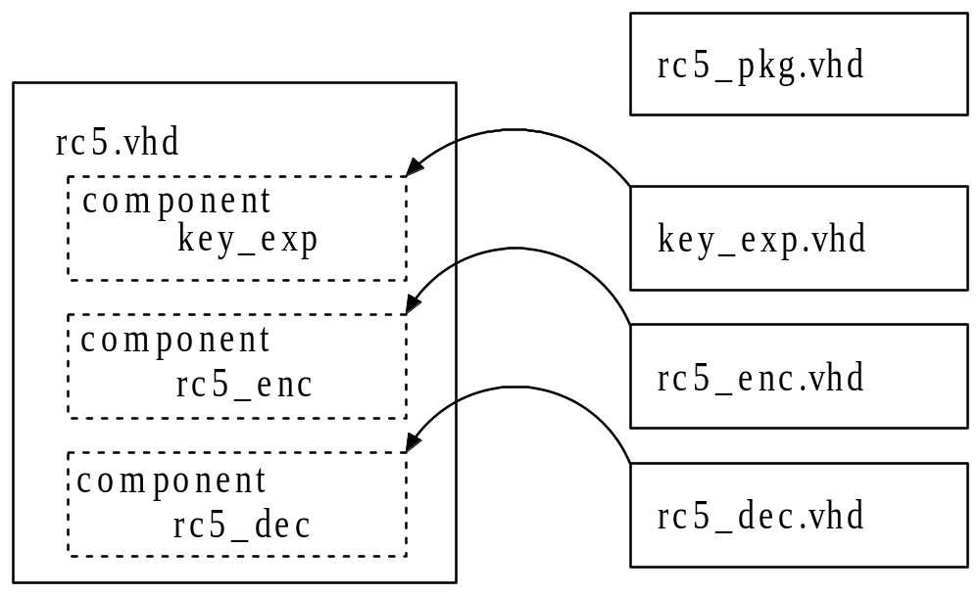
Instantiate Components
Map the components into a higher-level design
To connect all the blocks together we will create an RC5 vhdl file and declare three components (Encryption, Decryption, Round Key) and connect them together using signals for interconnect

Slide 5
Complete RC5 Port Map
A top level block diagram for the RC5 design is shown below
The enc input is used to change between encryption or decryption. The key_vld is used for when the key is valid and data_vld is used for when the data is valid.
enc
RC5
dout(31:0)
key(127:0)
data_rdy
key_vld
din(31:0)
data_vld

Slide 6
Modifications to RC5 Encryption
To easily connect the RC5 Encryption algorithm with the Round key Generation, we will need to bring out the skey to the top of the encryption algorithm and modify state machine to wait until it receives a valid skey (from the round key generation) before proceeding with encryption.
--RC5 state m/c
process(clr, clk)
begin
if(clr = '0') then
state<= ST_IDLE;
elsif (clk'EVENT and clk='1') then
case state is
when ST_IDLE =>
if(di_vld='1' and key_rdy='1') then
state <= ST_PRE_ROUND;
end if;
when ST_PRE_ROUND =>
state <= ST_ROUND_OP;
when ST_ROUND_OP =>
if (i_cnt="1100") then
state <= ST_READY;
end if;
when ST_READY =>
state <= ST_IDLE;
end case;
end if;
end process;
library IEEE;
use IEEE.STD_LOGIC_1164.ALL;
use IEEE.STD_LOGIC_ARITH.ALL;
use IEEE.STD_LOGIC_UNSIGNED.ALL;
USE WORK.rc5_pkg.ALL;
entity rc5_enc_full is
port ( clr, clk: in std_logic;
din: in std_logic_vector(63 downto 0);
dout: out std_logic_vector(63 downto 0);
di_vld: in std_logic;
key_rdy: in std_logic;
skey: in rom;
do_rdy: out std_logic);
end rc5_enc_full;

Slide 7
Define Entity
ENTITY rc5 IS
PORT
(
clr, clk : IN STD_LOGIC;
enc : IN STD_LOGIC; -- Encryption or decryption?
key_vld : IN STD_LOGIC; -- Indicate the input is user key
data_vld : IN STD_LOGIC; -- Indicate the input is user data
din : IN STD_LOGIC_VECTOR(63 downto 0);
dout : OUT STD_LOGIC_VECTOR(63 downto 0);
data_rdy : OUT STD_LOGIC -- Indicate the output data is ready
);
END rc5;

Slide 8
Declare Components
You can declare components in the same design file or in a separate package file
-- End of ENTITY
-- Internal signal definitions
-- Component declaration
-- Start of ARCHITECTURE
……
PACKAGE rc5_pkg IS
-- Type definitions for S_ARRAY and L_ARRAY
-- Component declaration
COMPONENT rc5_key -- Key expansion module
PORT(
clr, clk : IN STD_LOGIC;
key_vld : IN STD_LOGIC;
key : IN STD_LOGIC_VECTOR(127 DOWNTO 0);
skey : OUT ROM;

Slide 9
Declare Components
key_rdy : OUT STD_LOGIC);
END COMPONENT;
COMPONENT rc5_enc -- Encryption module
PORT(
clr, clk : IN STD_LOGIC;
key_rdy : IN STD_LOGIC;
di_vld : IN STD_LOGIC
din : IN STD_LOGIC_VECTOR(63 DOWNTO 0);
skey : IN ROM;
dout : OUT STD_LOGIC_VECTOR(63 DOWNTO 0);
do_rdy : OUT STD_LOGIC)
END COMPONENT;
COMPONENT rc5_dec -- Decryption module
……
END rc5_pkg;

Slide 10
Instantiate Components
Map the components into a higher-level design

Slide 11
Instantiate Components
Instantiate components in the architecture
ARCHITECTURE struct OF rc5 IS -- Structural description
signal skey: rom;
signal key_rdy: std_logic;
signal dout_enc: std_logic_vector(63 downto 0);
signal dout_dec: std_logic_vector(63 downto 0);
signal dec_rdy: std_logic;
signal enc_rdy: std_logic;
U1: rc5_key PORT MAP(clr=>clr, clk=>clk, key_vld=>key_rdy, key=>key, skey=>skey, key_rdy=>key_rdy);
U2: rc5_enc PORT MAP(clr=>clr, clk=>clk, di_vld=>key_rdy, din=>din, skey=>skey, dout=>dout_enc,
do_rdy=>enc_rdy);
U3: rc5_dec PORT MAP(clr=>clr, clk=>clk, di_vld=>key_rdy, din=>din, skey=>skey, dout=>dout_dec,
do_rdy=>dec_rdy);
WITH enc SELECT
dout<=dout_enc WHEN ‘1’,
dout_dec WHEN OTHERS;
WITH enc SELECT
data_rdy<=enc_rdy WHEN ‘1’,
dec_rdy WHEN OTHERS;
END struct;

Slide 12
Instantiate Components - Explained
Three components are declared, rc5_enc, rc5_dec, and rc5_key and are exactly the same as the entities used for their respective designs.
The architecture declares these three components and connects them together using signals. The syntax used is to first identify the component that is being instantiated using a keyword, in this case “u1”, followed by the entity name for the component being instantiated. Then the keyword “port map” is used, followed by a list of signals to connect to the entity of the component. The signals in the design are connected to the components entity by the “=>” symbol. The name in front of the “=>” is the entity of the component and the name inback of the “=>” is what this port is connected to.
For Example, When we are connecting the RC5 encryption “do_rdy” port to the top level enc_rdy, we use the following syntax in to component instantiation: do_rdy=>enc_rdy.
We use the enc signal to define which set of outputs to use, that is, if we are performing encryption or decryption.
NOTE: The design performs both encryption and decryption in parallel with each other and just selects the desired output using the enc signal to select between them.

Slide 13
A Complete RC5 Module
It works, but we can make it better
  Encryption and decryption modules are similar, could we combine them together?
  The maximum frequency is too low, could we do any better?
  We must wait for 12 rounds – low throughput! How to improve it?
Don’t worry, you are not required to finish these three tasks for now

Slide 14
Exercise
Finish RC5 module
Simulate both encryption and decryption
  Functional Simulation using ModelSim
  Code debugging
Synthesize the Design
  Perform Timing Simulation
Understand following concepts/operations
  Component declaration and instantiation
  How to control the data flows between the modules?

