Slide 1
Netflix and TV
Shawn Cavazos, Edward Michaud, Amara Hamadache
06/16/2021

Slide 2
The ETL Process
Extract
Transform
Load
We took the data from the existing Netflix template and located a compatible dataset from Kaggle that included the ratings of the shows
Locating the shared column of ‘Title’ allowed an easy assimilation of the data to be joined through pgAdmin 4 using SQL.
Loaded the combined table into a Pandas data frame in order to further organize the data and create visualizations.

Slide 3
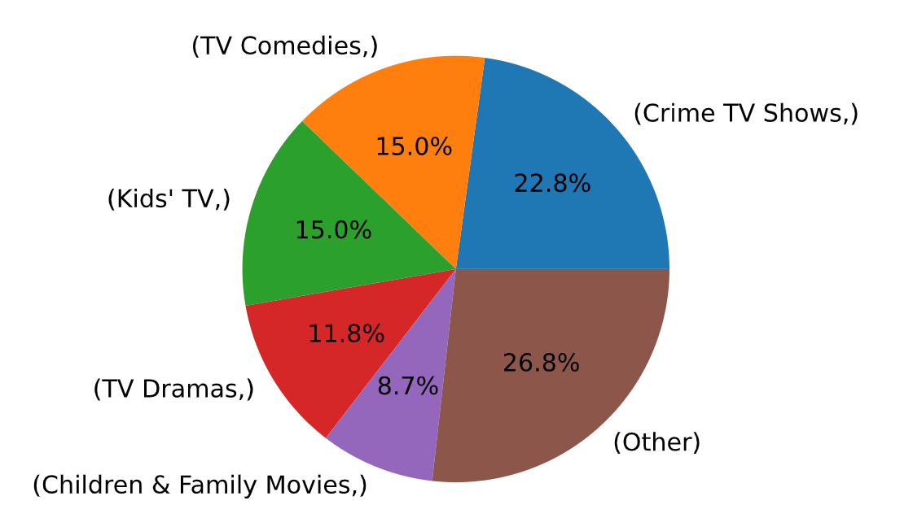
Movies and Shows Galore
From 2014 to today, there have been more movies and shows that have been added to Netflix.
Many shows are Crimes, Comedy, and Kids shows.
There were many other categories that had very few entries and was combined in another category.

Slide 4
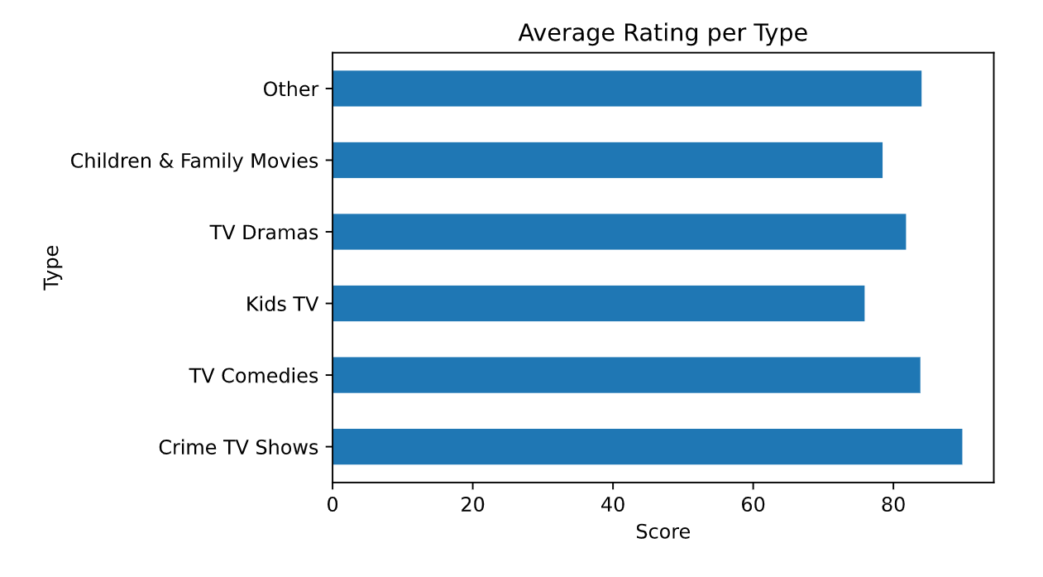
Ratings Across the Board
Despite some shows, like Crime, are prevalent, they have a different ratings.
Kid show ratings are the lowest rated despite being he 3rd highest number of shows distributed in the platform.
There were some shows that were very highly rated, like classic series, but because there have been very few shows, they have been categorized with “other,” bringing down its rating.

Slide 5
Conclusion
While Netflix is primarily used in the data, opinions from Kaggle was also taken to account.
It shows many shows on Netflix are Crime shows and is amongst the most popular. Perhaps it may be easy for audiences to understand what is going on and the suspense it may hold.

