Slide 1

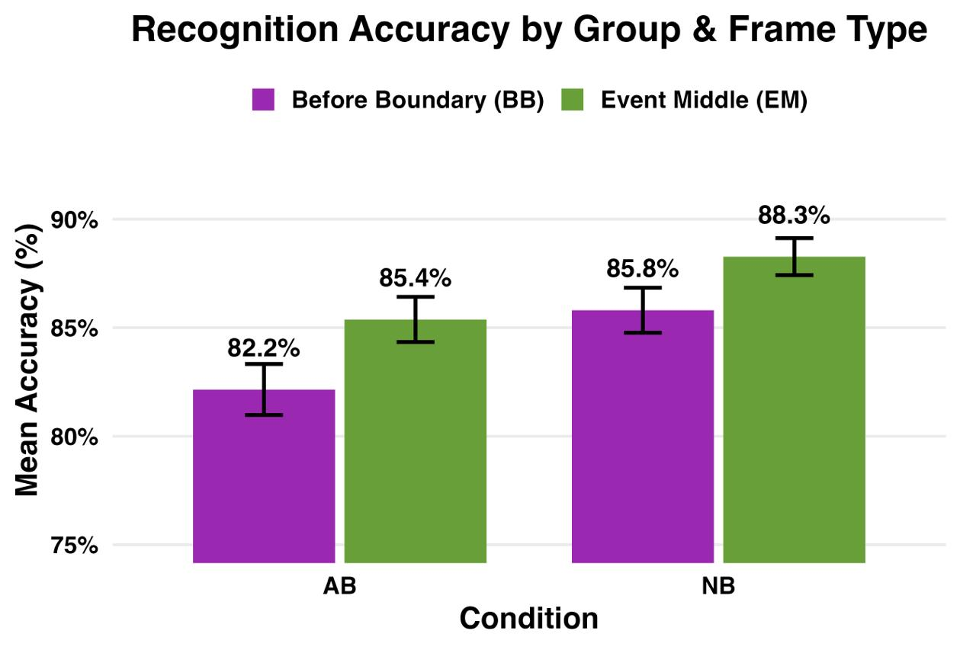
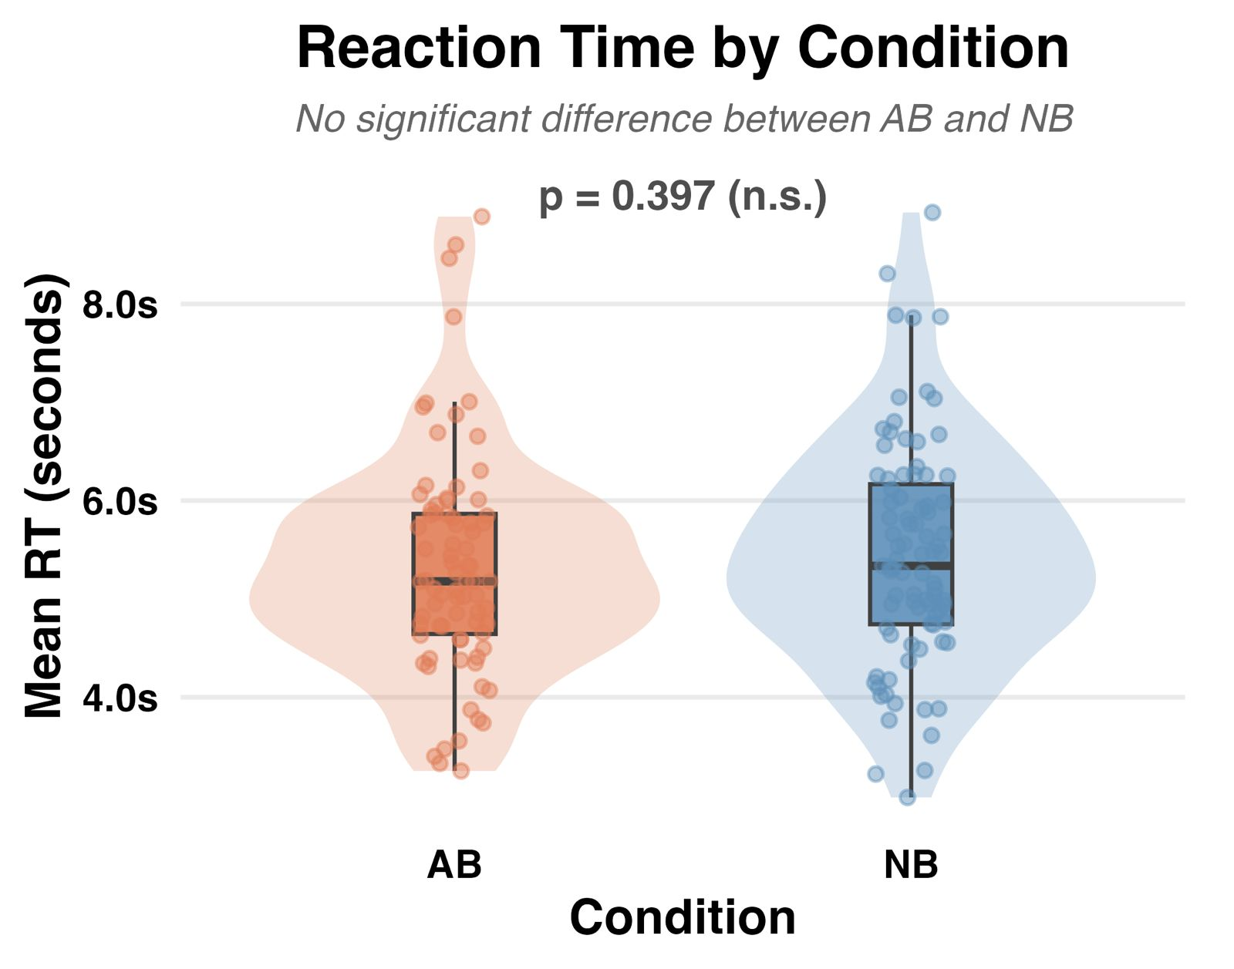
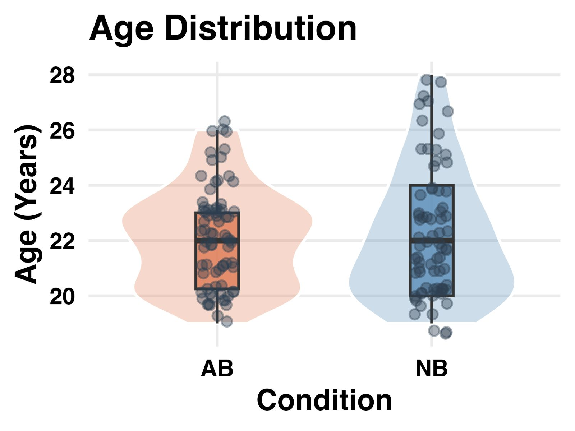
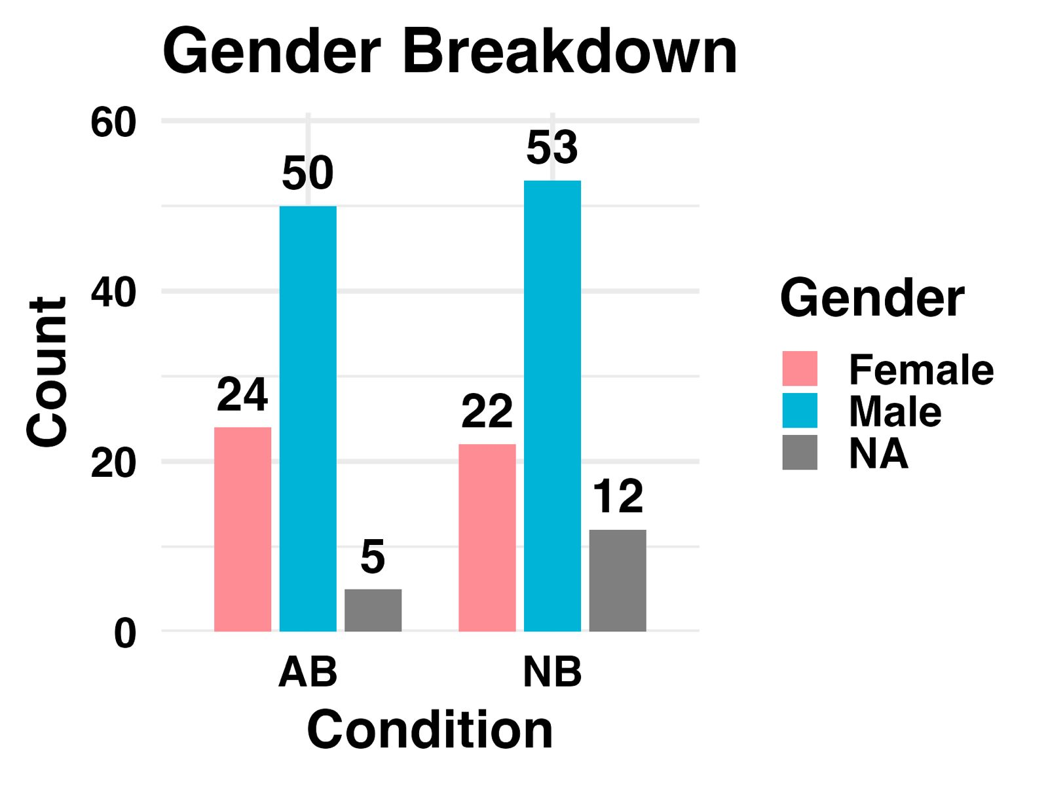
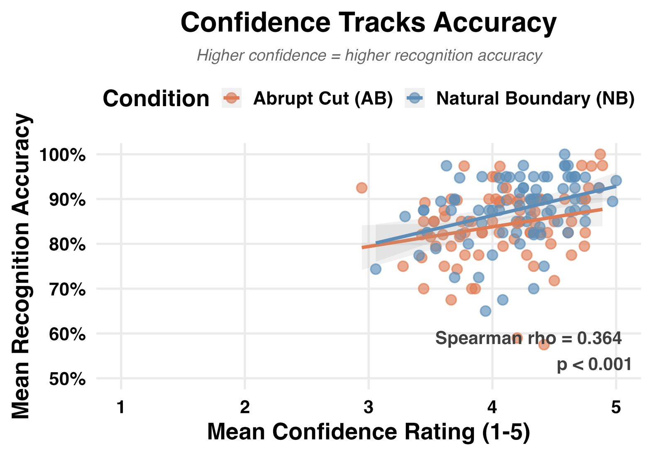
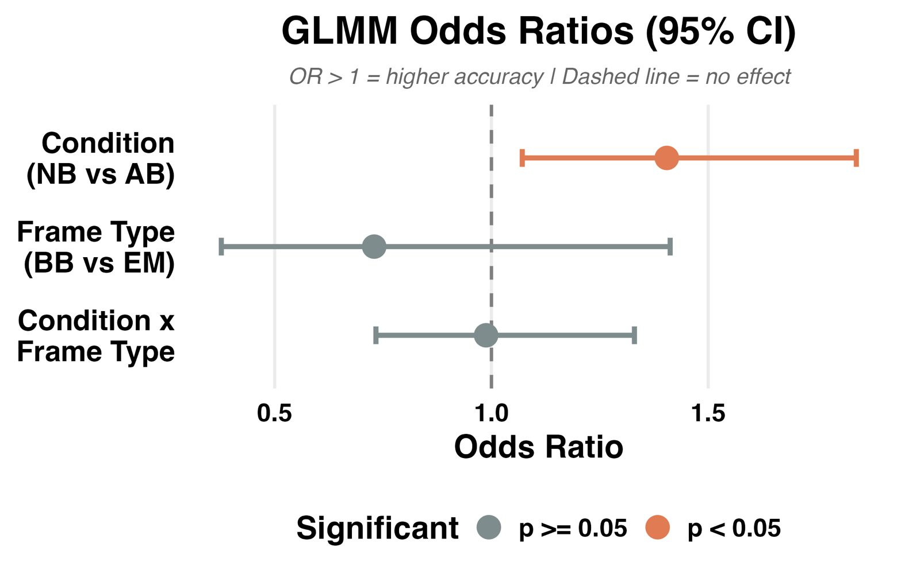
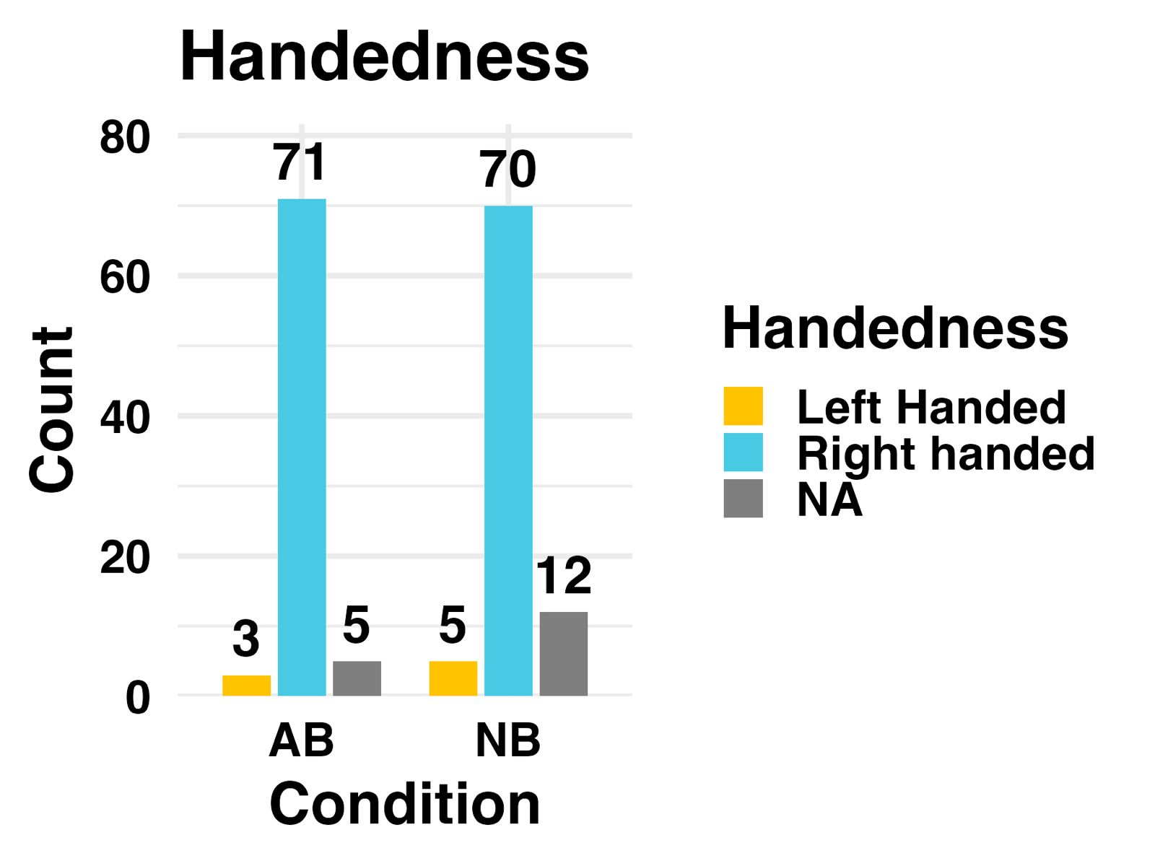
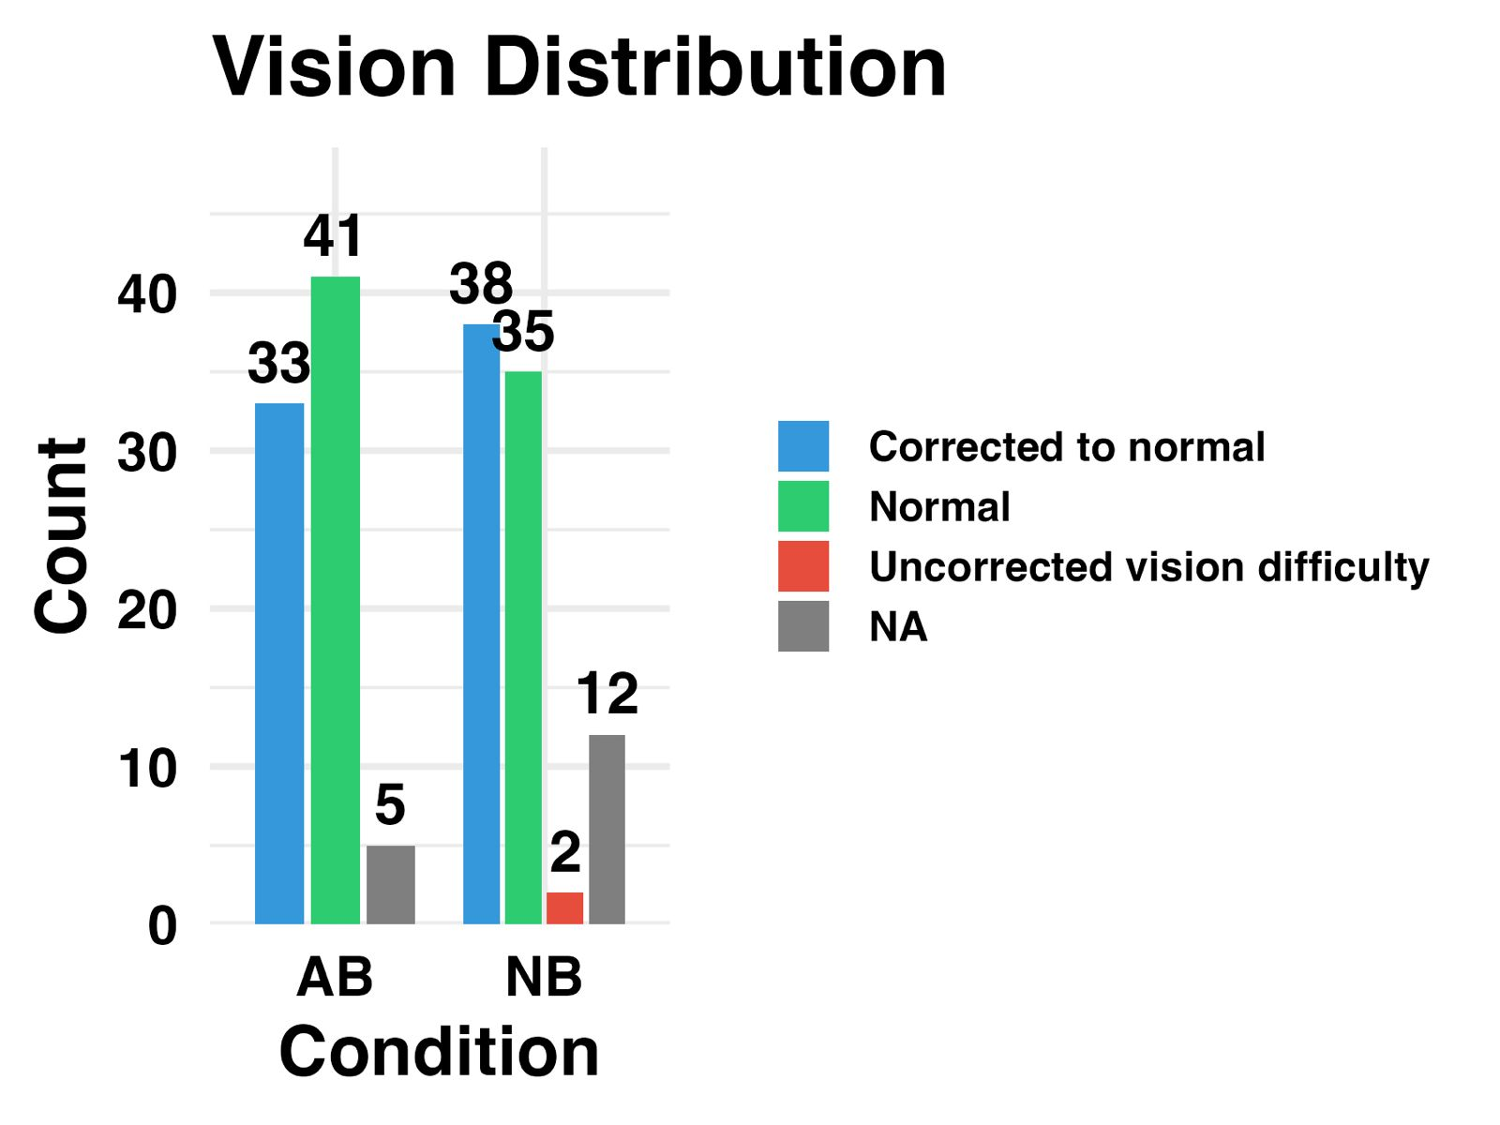
Cutting it Short: Narrative Incompleteness Impairs Recognition
BRSM
POSTER PRESENTATION
SPRING 2026
ABSTRACT
RESULTS
CONCLUSION & FUTURE WORK
Theory: Event Segmentation Theory proposes that episodic memory is organized into discrete events separated by boundaries (Zacks et al., 2007).
The Gap: While natural boundaries are known to enhance memory, it is unclear if artificial boundaries (abrupt film cuts) trigger the same updates (Cutting et al., 2012).
Consistent with this, memory is enhanced for information encountered at natural boundaries, with boundary-presented objects recognized more accurately than those within ongoing events (Swallow et al., 2009)
Recognition Accuracy & Reaction Times across groups (Mann Whitney U):
NB showed higher recognition accuracy than AB (87.0% vs 83.8%, p = 0.0027).
No statistically significant difference in Reaction Times (RTs) between the two groups was observed (p = 0.3969).
Impact of Event Boundaries (Mann Whitney U):
Recognition accuracy for BB frames was significantly higher in the NB group compared to the AB group (85.5% vs 82.2%, p = 0.0123).
Recognition accuracy for EM frames was also significantly higher in the NB group compared to the AB group (88.3% vs 85.4%, p = 0.0097).
Condition × Target Type Interaction (Binomial GLMM):
Results show no specific interaction (p = 0.936) between where a frame was located and the type of cut used. This indicates that abrupt cuts create an overall memory deficit that affects the entire experience, not just the frames closest to the cut.
Metacognitive Sensitivity (Spearman Correlation):
Participants' confidence ratings significantly tracked their accuracy (Spearman ρ = 0.39, p < 0.001), indicating that participants were aware of when they remembered correctly, regardless of condition.
Natural transitions enhance memory: Recognition was significantly higher under NB viewing, supporting Event Segmentation Theory. natural boundaries help consolidate event models into long-term memory.
Abrupt cuts cause broad disruption: The null interaction suggests abrupt cuts do not only impair memory near the cut. They disrupt encoding of the entire surrounding event.
Memory awareness remained intact: Despite the accuracy drop in the AB group, confidence ratings reliably tracked recognition performance. Abrupt cuts impair what is remembered, but not how well people judge their own memory.
Future studies could investigate individual differences in media consumption. Do frequent viewers of fast-paced content (like TikTok or Action Movies) show a smaller 'Abrupt-Cut Penalty' due to increased perceptual familiarity with rapid editing?
METHODOLOGY
Participants: 184 IIIT-H students, 166 retained after vigilance-check exclusions.
Experimental Groups: Participants viewed 40 clips ending naturally (NB) or interrupted 1–5s before a consensus event boundary (AB).
Recognition Task: A 2AFC task requiring participants to identify previously seen frames (Target) vs. unseen frames (Lure) from the same video.
Frame Types: Targets were sampled from two locations: Before-Boundary (BB) and Event-Middle (EM).
Metrics: Recorded trial-level Accuracy, Reaction Times, and Confidence (5-point scale).
CONTRIBUTIONS
Souradeep: Built the data cleaning pipeline, conducted Shapiro-Wilk tests to determine normality, generated QQ plots, conducted the Binomial GLMM and Likelihood Ratio Tests to test interaction.
Srinjoy: Applied RT outlier filtering, executed Mann Whitney U tests comparing recognition accuracy between AB and NB groups and generated visualizations related to RT and Accuracy.
Surjit: Conducted demographic analysis to verify group balance. Generated exploratory plots for visualizing normality. Analyzed Confidence-Accuracy association through Spearman correlation models.
DEMOGRAPHICS
GLMM Predicted Accuracy: Interaction Analysis
REFERENCES
Zacks et al. (2007), Foundation (EST)
Swallow et al. (2009), Boundary-memory advantage
Schwan & Garsoffky (2004), Cognitive impact of movie cuts
Fleming et al. (2010), Metacognitive awareness
Author names: Souradeep Das, Srinjoy Sengupta, Surjit Mandal – “The Outliers”he
emails:
Email ID: souradeep.das@students.iiit.ac.in

