Slide 1


SMART DOORBELL

Slide 2
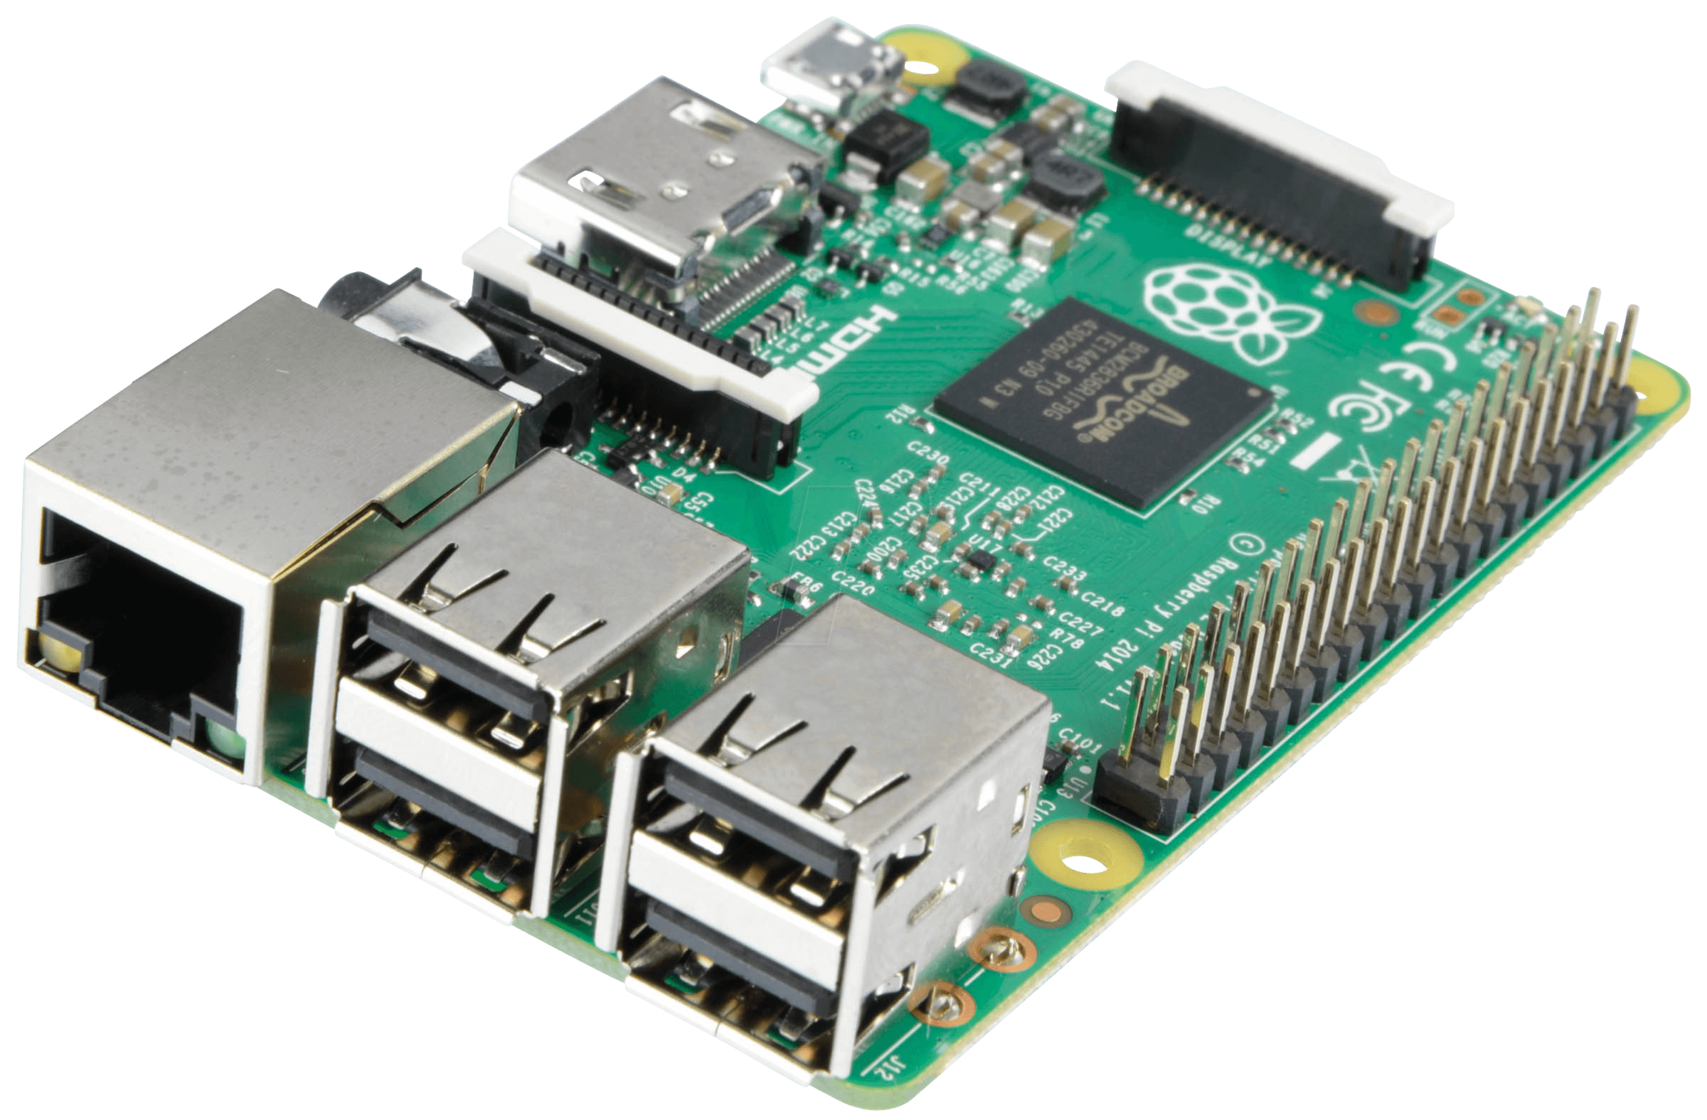
Raspberry Pi

Slide 3

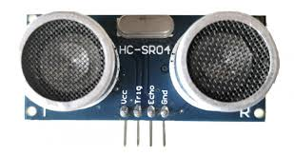
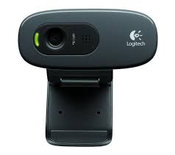
Materials :-
1) RaspBerry Pi 3
2) UltraSonic Sensor
3) Jumper Wires
4) Usb WebCam

Slide 4
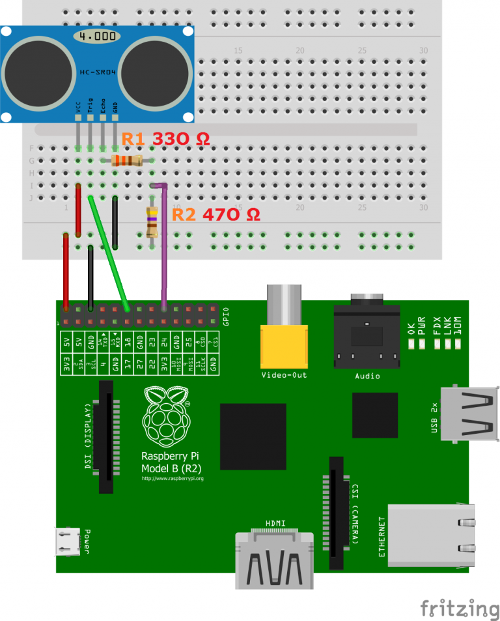
Circuit :-
UltraSonic Motion Sensor – Raspberry Connection
Vcc – 5v
Echo - GPIO23
Trig – GPIO18
Ground - Ground

Slide 5
Code Source :-
https://github.com/shadevil3003/SmartDoorBell
https://tutorials-raspberrypi.com/raspberry-pi-ultrasonic-sensor-hc-sr04/
https://maker.pro/raspberry-pi/projects/how-to-create-a-telegram-bot-with-a-raspberry-pi

Slide 6
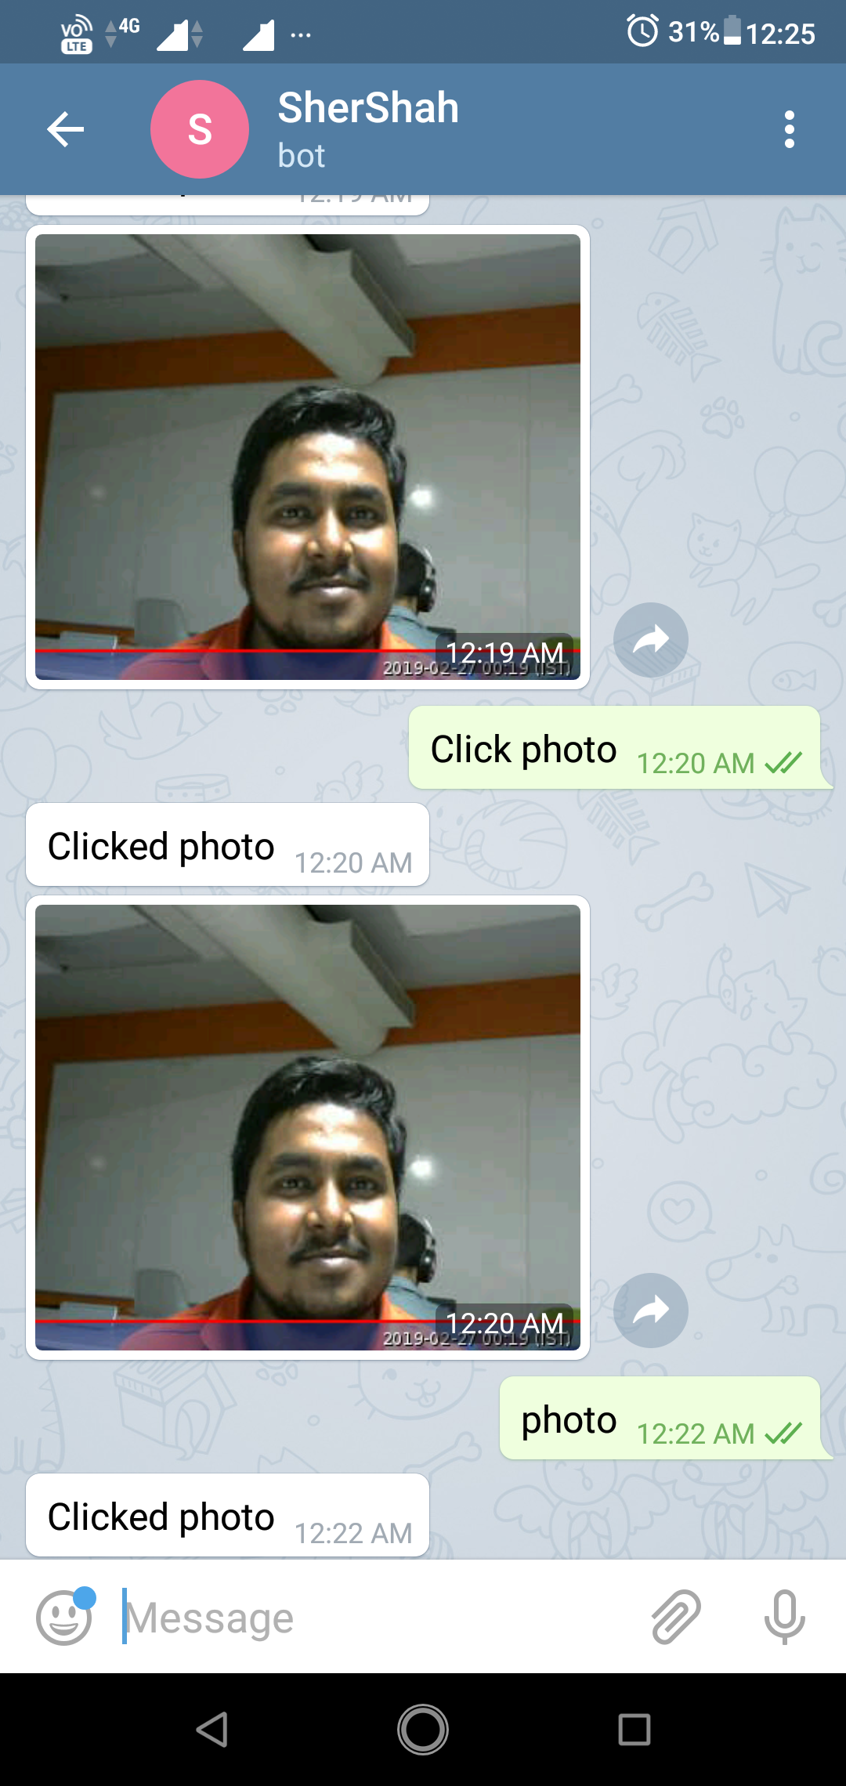
Output:-

