Slide 1
Are NBFNet's Path Explanations Actually Faithful?
A deletion, edit and neuromodulation audit of a frozen ULTRA checkpoint
Shadi Khodagholi
CAP 6938 AI Knowledge Systems, Research Track, UCF
github.com/shadi97kh/nbfnet-path-faithfulness
Notes:
Good morning. My project asks one question: are NBFNet's path explanations actually faithful? Instead of reading the explanation, I test it. I delete and edit edges in the graph and watch what the model does.

Slide 2
What this project does
Query: Samuel R. Delany -[religion]-> ? NBFNet answers: atheism (p = 0.51)
Samuel R. Delany
Virginia Woolf
atheism
NBFNet's own explanation: its top path, read off the gradient of the score
influenced by
religion
1
Ask the model
2
Change the graph
3
Run it again
its answer and NBFNet's explanation paths
delete the paths, keep only them, reroute them, or turn a relation down
the same frozen model: did the answer move? Compare with random edges
A gradient says what happens if an edge changes a little. Faithfulness asks what happens when the edge is gone.
Notes:
Here is what the project does. Take a knowledge graph query: which religion does Samuel Delany hold? NBFNet answers atheism, and it explains itself with a path: Delany was influenced by Virginia Woolf, and Woolf was an atheist. Paths like this are the main reason to use a path model instead of an embedding. But are they really what the model used?
The path comes from a gradient, and a gradient only says what happens if an edge changes a little. So I test it in three steps. One, I ask the model for its answer and its paths. Two, I change the graph: I delete the paths, keep only them, reroute them, or turn a relation down. Three, I run the same frozen model again and check whether the answer moved, compared with deleting random edges.

Slide 3
Where this sits in the course, and the research-track plan
Course topics
Research-track requirements
2
Knowledge graphs
NBFNet inside ULTRA, the knowledge graph foundation model, is the method audited
Requirement | How this project meets it
Improve a method | Fix the message direction; rank with integrated gradients
One variable at a time | Explanation code, attribution rule, checkpoint, seen vs held-out graph
Ablation | Integration steps: 16, 32, 64
Control | The same number of random edges, every query
Error analysis | Queries the graph answers with one reverse lookup
8
Knowledge editing
Hase et al.: where a method locates a fact does not predict what editing it does. Deleting an edge is an exact edit
IR
Ranking metrics
nDCG and top-1 from the retrieval lectures score the explanation as a ranked list
Notes:
The project sits on two course topics. Topic 2, knowledge graphs: the model is NBFNet inside ULTRA, the knowledge graph foundation model. Topic 8, knowledge editing: Hase and colleagues showed that where a method locates a fact does not predict what editing it does. Deleting an edge is a knowledge edit, and on a graph it is exact. I also score the rankings with nDCG, from the retrieval lectures.
For the research track, I improve the method one variable at a time: the message direction, the attribution rule, the checkpoint, and seen versus unseen graphs. The ablation is the number of integration steps, random edges are the control, and the error analysis looks at queries the graph answers with a single lookup.

Slide 4
Five interventions on the graph, each with a control
A
Read the explanation
Call NBFNet's own visualize(): 20 candidate paths, ranked by gradient
B
Delete each path
Delete the 20 paths one at a time: does the ranking match the real effect?
C
Delete the top five
Delete them together, or keep only them: is the shortlist load-bearing?
D
Reroute the last hop
Point the top path at another entity: does the answer follow?
E
Turn a relation down
Scale one relation type from 1 to 0, like a dose: does the gradient predict it?
Nothing is trained or approximated: every condition edits real edges and reruns the frozen checkpoint. Control: as many random edges.
Notes:
There are five conditions. A records what NBFNet's own visualize function claims. B deletes each of its twenty candidate paths, one at a time. C deletes the top five together, or keeps only them. D points the last hop of the top path at another entity. E turns a whole relation type down, like a dose.
Nothing is trained or approximated. Every condition edits real edges and reruns the frozen checkpoint, and every result has a control: the same number of random edges.

Slide 5
The benchmark: four graphs, 800 queries, 15,447 deletions
4
800
15,447
2
graphs, 2 seen in training, 2 held out
queries, 200 per graph, fixed random order
single-path deletions, plus joint deletions and rewires
checkpoints: ultra_4g and the ULTRA paper's 3g
Graph | In training mix | Test triples scored | MRR here | ULTRA paper | Paper's own checkpoint, here
WN18RR | yes | 3,134 | 0.484 | 0.480
FB15k-237 | yes | 2,000 | 0.371 | 0.368
CoDEx-S | no | 1,828 | 0.464 | 0.472 | 0.472
NELL23k | no | 4,952 | 0.258 | 0.239 | 0.241
Link prediction reproduced with ULTRA's own evaluation code, filtered MRR. A query is kept when the model ranks the right answer in its top ten.
Notes:
The benchmark has four graphs. WN18RR and FB15k-237 were in the checkpoint's training mix; CoDEx-S and NELL23k were not. First I reproduce link prediction with ULTRA's own evaluation code. The MRRs are in line with the ULTRA paper, and the paper's own checkpoint gives exactly 0.472 on CoDEx-S.
Then 800 queries, 200 per graph, drawn in a random order that was fixed before anything was measured, so nothing is picked by hand. That gives 15,447 single-path deletions, plus the joint deletions, controls and rewires, on two checkpoints.

Slide 6
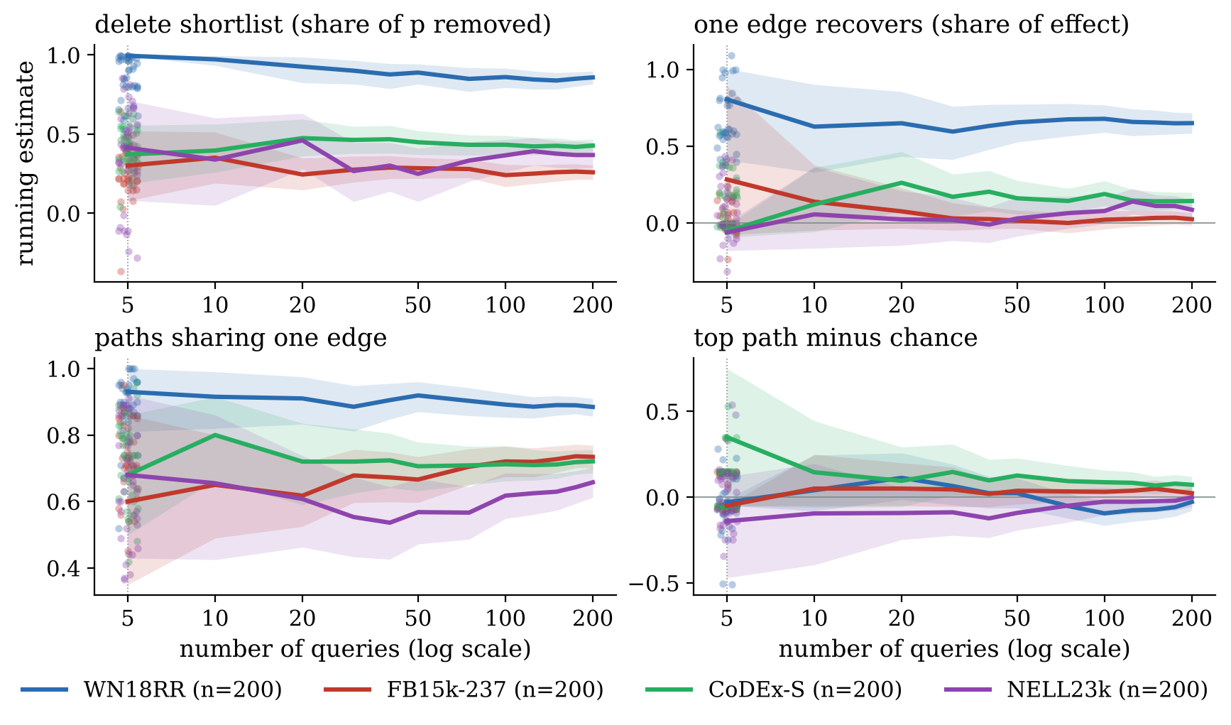
Is 200 queries per graph enough? The estimates settle
-0.51 to 0.33
what a 5-query study could report for the top path on WN18RR
±0.05
the 95% interval at 200 queries
Bands narrow like 1/sqrt(n). With 5 queries even the sign can be wrong.
Notes:
Is 200 queries per graph enough? I checked instead of assuming. Because the order was fixed in advance, the first n queries are an honest sample of size n. Each curve is the running estimate with its 95 percent band. The bands narrow like one over the square root of n, and the estimates settle.
A study with five queries could have reported anything from minus 0.51 to plus 0.33 for the top-path result on WN18RR. At full size the interval is plus or minus 0.05. With five queries you could get the sign wrong.

Slide 7
How the project runs: one Colab notebook
GitHub repository -> Open in Colab -> Runtime > Run all free CPU runtime, nothing to install by hand
1
Setup
2
Demo
3
Check
4
Figures
5
Long runs
Download the code, install ULTRA with its frozen checkpoint, load the model
Two runs on different queries, every intervention on the live model
Re-run recorded benchmark queries and compare every number with results/
Redraw every figure in the report and the talk from results/
The full benchmark: 800 queries on 4 graphs. Switched off by default
about 3 min, before class
under 1 min, live
under 1 min, live
under 1 min
about a day on CPU
Every result in the report is in results/, one line per query, so any of it can be checked by re-running that query.
Notes:
This is how the project runs. Everything is in one Colab notebook, opened from the GitHub repository, on a free CPU runtime. Step one downloads the code, installs ULTRA with its frozen checkpoint, and loads the model. I ran that before class. Step two is the demo. Step three re-runs the first queries of the recorded benchmark and checks every number against the saved results. Step four redraws every figure in the report and the talk from the saved results. Step five holds the long runs behind the report, about a day of CPU time. They are switched off, because their output is already in the repository. I will run steps two and three live now.

Slide 8
Live demo: three runs
Run 1
python -m pathfaith.demo --n 5 --seed 0
five queries on CoDEx-S, a graph the model never saw
Run 2
python -m pathfaith.demo --n 3 --seed 7
three different queries
Run 3
python -m pathfaith.run_experiment --n 5 ... then compare_runs
five recorded benchmark queries, checked against results/
For each query, every line is a fresh forward pass on an edited graph:
1
explanation
2
delete the paths
3
delete random edges (control)
4
reroute the last hop
5
turn the relation down
Each run ends with a count: queries attempted, completed, failed. Run 3 ends with how many reproduce the record.
Notes:
Here is the live run, three times. Run one is five queries on CoDEx-S, a graph the checkpoint never saw, with real Wikidata names. Run two is three different queries from another seed. Run three re-runs five queries of the recorded benchmark and compares them with the saved results.
[Switch to Colab. Start the three cells one after another so they queue. Talk through query 1 of run 1 as written in the live demo section of the notes, then point at the count at the end of each run.]

Slide 9
Result 1: the shortlist is load-bearing, random edges are not
Share of the answer's probability removed
100%
The gradient points at edges the model depends on
on all four graphs
86%
80%
60%
43%
40%
37%
A warning
Keeping only the explanation raises p on 37% of FB15k-237 queries: rival answers lose support too. Not a fair sufficiency test.
26%
20%
0%
0%
0%
0.7%
0%
WN18RR
FB15k-237
CoDEx-S
NELL23k
Delete the top 5 paths
Delete as many random edges
Notes:
The first result goes the method's way. Deleting the top five paths removes 86 percent of the answer's probability on WN18RR, 26 percent on FB15k-237, 43 percent on CoDEx-S and 37 percent on NELL23k. Deleting the same number of random edges removes essentially nothing. So the gradient does point at a part of the graph the model depends on.
One warning: keeping only the explanation is not a fair sufficiency test, because the rival answers lose their support too. The answer's probability actually goes up on 37 percent of FB15k-237 queries.

Slide 10
Result 2: the order inside the shortlist means very little
Kendall's tau, method's order vs measured effect (1 = faithful)
1.0
25% vs 28%
0.8
WN18RR: the top path is the most damaging one, against a random pick
0.6
0.4
Topic 8, one domain over
Where a method locates something does not predict what changing it does (Hase et al.)
0.2
0.05
0.08
0.04
0.0
-0.01
-0.2
WN18RR
FB15k-237
CoDEx-S
NELL23k
Notes:
The second result: the order inside the shortlist means very little. If the ranking were faithful, Kendall's tau between the method's order and the measured effect would be close to one. As released it is minus 0.01 on WN18RR, 0.05 on FB15k-237, 0.08 on CoDEx-S and 0.04 on NELL23k.
On WN18RR the top path is the most damaging one 25 percent of the time, where a random pick gets 28. This is the Topic 8 result again: locating is not explaining.

Slide 11
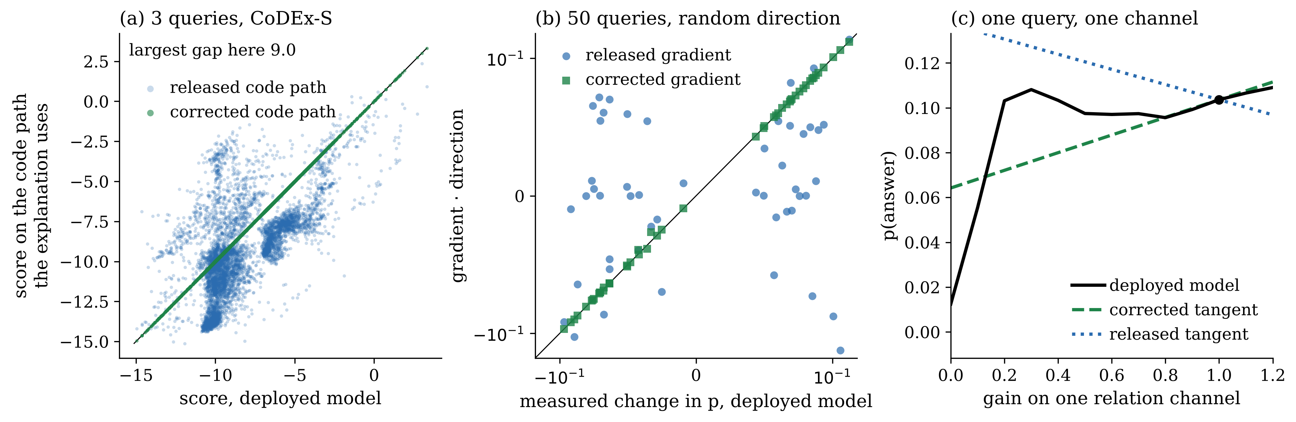
Finding: the explanation differentiates a different model
10.5 logits
21 of 50
0.7%
largest score gap over all queries checked: the explanation's code vs the deployed model
random directions where the released gradient has the wrong sign
median error after the fix: run visualize() on the reversed graph
Notes:
When I tried to improve the ranking with integrated gradients, the numbers did not add up. They must sum to the total change in probability, and with the released gradient they missed by 63 percent. That led me to a bug. The fast kernel the model uses for predictions sends each message one way along an edge. When a gradient is needed, the code switches to a generic layer that sends it the other way. So the explanation is the gradient of a different model.
On the left, that model's scores are up to 9 logits from the real ones on these queries, and up to 10.5 over all the queries I checked. In the middle, the released gradient has the wrong sign on 21 of 50 random directions. On the right, its slope points the wrong way. Running the explanation on the reversed graph fixes it: the error drops to 0.7 percent.

Slide 12
Improving the method, one variable at a time
Kendall's tau with the measured effect (1 = faithful)
1.0
+0.18 to +0.31
0.8
gain in tau from integrated gradients, on the same queries
0.6
0.49
0.45
0.43
0.4
0.27
0.2
0.15
0.18
0.10
ULTRA paper's own checkpoint
MRR 0.472 on CoDEx-S, as published; tau 0.18 and 0.11 after the fix, the same picture
0.08
0.05
0.08
0.04
0.0
-0.01
-0.2
WN18RR
FB15k-237
CoDEx-S
NELL23k
As released
Direction fixed
Integrated gradients
Notes:
Now I improve the method, one variable at a time. Blue is the explanation as released. Green is the direction fix: it raises Kendall's tau by about a tenth on every graph. Orange is integrated gradients, re-ranking the same candidate paths: tau rises to between 0.27 and 0.49.
I also reran everything on the ULTRA paper's own checkpoint, which reproduces the paper's MRR, and it gives the same picture as the green bars. So the bug explains part of the problem and integrated gradients help most, but even the best ranking is far from one.

Slide 13
Ablation: the gain does not depend on the integration steps
Integration steps | Completeness error (median) | Kendall's tau
16 | 15% | 0.467
32 | 11% | 0.472
64 | 5% | 0.456
0.90
Kendall's tau between the 16-step and 64-step orders
More steps make the integral exact; the ranking stays where it was. The improvement is real, not an artifact of a coarse integral.
First 50 CoDEx-S queries. Completeness: the attributions should sum to the total change in probability.
Notes:
Integrated gradients approximate an integral, so I ablated its one setting, the number of steps, on 50 CoDEx-S queries. With 16 steps the attributions miss their own sum by 15 percent; with 64 steps, by 5 percent. But the ranking does not change: tau stays at about 0.47, and the 16-step and 64-step orders agree with a tau of 0.9. So the improvement is real, not an artifact of a coarse integral.

Slide 14
Result 3 and error analysis: one edge or many?
65%
2.5%
Error analysis: the reverse fact is already in the graph
sociology
sociologist
WN18RR: one shared edge does this much of what deleting all 5 paths does
FB15k-237: there the paths really are different routes
query: sociology -[related form]-> ?
the graph already has: sociologist -[related form]-> sociology
88% of WN18RR paths run through one shared edge.
57.5% of WN18RR queries
Same output, two different situations
Several independent pieces of evidence, or one edge written out five times: nothing in the explanation says which.
have their reverse fact in the graph. One lookup answers them, but the output writes it out as several longer paths.
Notes:
Third: is the list many explanations, or one written out many times? On WN18RR, 88 percent of the listed paths go through one shared edge, and deleting that single edge does 65 percent of what deleting all five paths does. On FB15k-237 it does only 2.5 percent: there the paths really are different routes.
The error analysis explains why. On WN18RR, nearly 58 percent of queries already have the reverse fact in the graph. Asked what sociology is related to, the model answers sociologist, because the graph says sociologist is related to sociology. One lookup answers the question, but the output writes it out as several longer paths. The explanation looks the same either way.

Slide 15
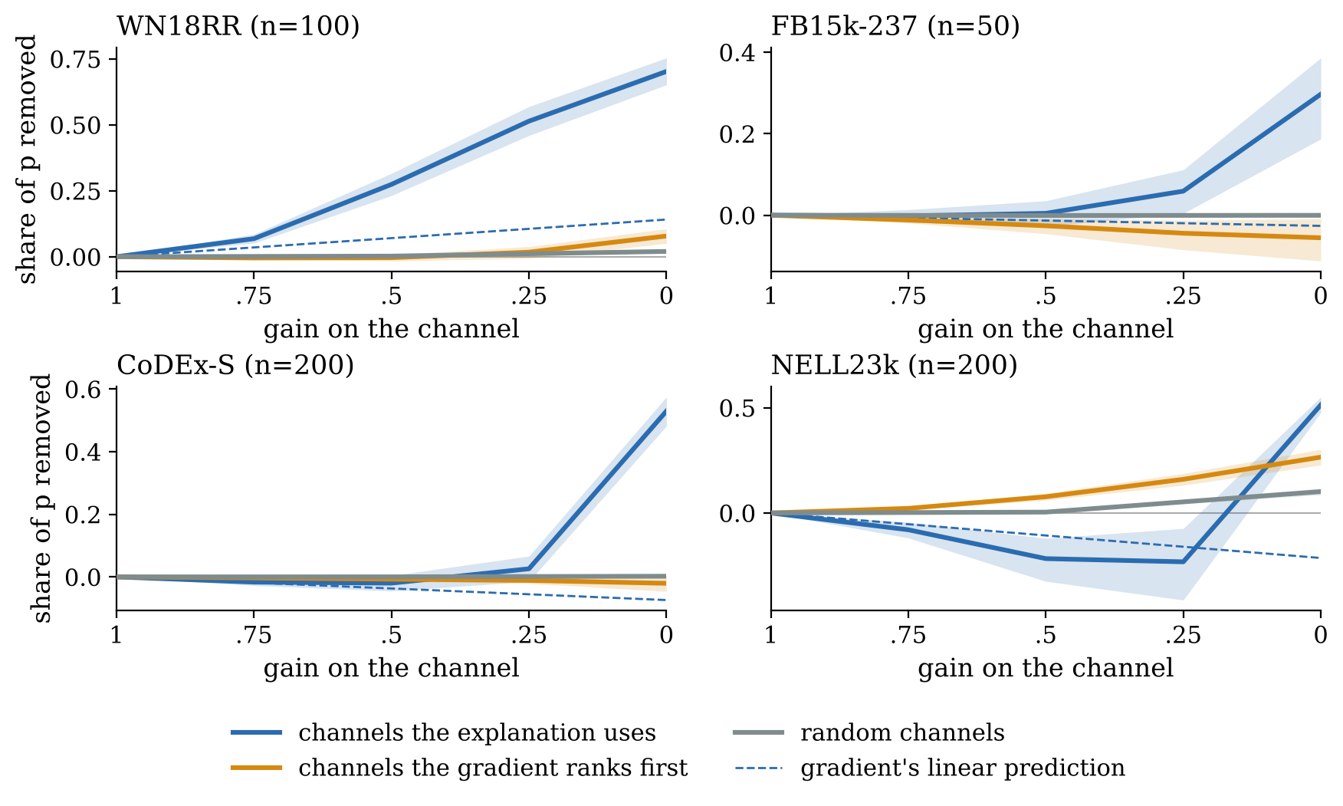
Relation channels act as switches, which a gradient cannot see
Neuromodulation idea
Bull et al., NeurIPS 2025: one relation vector scales every edge of its type, like a broadcast gain
19%
of a channel's effect is present at half gain on CoDEx-S, for channels that matter (a straight line gives 50%)
61%
right sign from the gradient at full gain, close to a coin flip
Notes:
Last experiment, after a NeurIPS 2025 paper by Bull and colleagues on neuromodulation, where a few broadcast signals scale many connections at once. ULTRA has the same structure: one vector per relation type scales every message along edges of that type. So I treat each relation type as a channel and turn its gain from one down to zero, like a dose.
Silencing the strongest channel the explanation uses removes 90 percent of the answer's probability on CoDEx-S, while a random channel removes almost nothing. But the blue curves stay flat until the gain is near zero. For the channels that matter, only 19 percent of the effect is there at half gain, where a straight line would give 50. They act like switches, not dials. A gradient is a slope at full gain, so it misses this, and it gets the sign right only 61 percent of the time.

Slide 16
Multiple successful runs: every number reproduces
1
2
3
Fresh clone of GitHub
Re-ran recorded queries of every stage: released and corrected benchmark, channels, integrated gradients, direction check. Most gaps exactly 0, the largest 5e-7.
Colab, from the GitHub badge
Ran end to end on a free CPU runtime: 10 of 10 benchmark queries and 200 of 200 channel queries reproduce the records, within 5e-5.
Live demo, two seeds
Seed 0 (5 queries) and seed 7 (3 queries): 8 of 8 complete every intervention, plus 2 of 2 on WN18RR.
Code, results and the Colab notebook: github.com/shadi97kh/nbfnet-path-faithfulness
Notes:
Beyond the live runs: from a fresh clone of the repository on another machine, every re-run matched the record, most of them to the last digit. The Colab notebook, opened from GitHub, ran end to end and reproduced all 200 recorded channel queries. And the demo has completed every query, on both seeds and on WordNet.

Slide 17
The method localises. Localising is not explaining
Contributions
For anyone using these explanations
1
A deletion benchmark: 4 graphs, 800 queries, 15,447 deletions, sized by a reliability check
Reverse the graph before calling visualize()
Rank paths with integrated gradients
Check the busiest edge with one deletion
Print how many distinct edges the paths really use
2
A bug in the released explanation code, verified three ways, and a fix
3
Two measured improvements, the fix and integrated gradients; neither makes it faithful
4
A relation-level dose test: channels act as switches
Thank you. Questions?
Notes:
To sum up. NBFNet's explanation localises: it finds edges the model depends on, on all four graphs, against a control that never moves. But localising is not explaining. As released, it differentiates the wrong model. Fixed, and even with integrated gradients, it ranks paths only loosely, and it cannot tell several pieces of evidence from one lookup written out many times.
My contributions are a large deletion benchmark, a bug with a fix, two measured improvements, and the channel test. For anyone using these explanations: reverse the graph before calling visualize, rank with integrated gradients, and check the busiest edge with one deletion. Thank you. I am happy to take questions.

Slide 18
Backup: limitations
One model family: NBFNet inside ULTRA, on four graphs and two checkpoints
Smaller runs on the seen graphs: corrected FB15k-237 100 queries; integrated gradients 100 (WN18RR) and 50 (FB15k-237); channels 100 and 50
NBFNet's PyTorch Geometric release has the same code pattern as the bug; read, not run
Integrated gradients are approximate: 5% completeness error at 64 steps
The reverse-fact queries are real WordNet facts, not leakage: the test edge itself is never in the graph
Notes:
Backup slide, only if asked about limitations. I tested one model family, on four graphs and two checkpoints. Some runs on the seen graphs are smaller: the corrected benchmark on FB15k-237 has 100 queries, and integrated gradients 100 on WN18RR and 50 on FB15k-237. NBFNet's PyTorch Geometric release has the same code pattern as the bug, but I read it and did not run it. And integrated gradients are approximate, 5 percent off at 64 steps.

