Slide 1
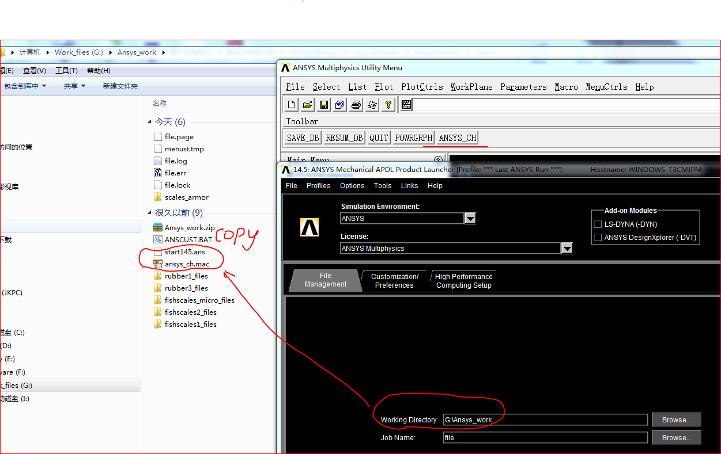
You should rename the file
start145.ans if you use different version

Slide 2
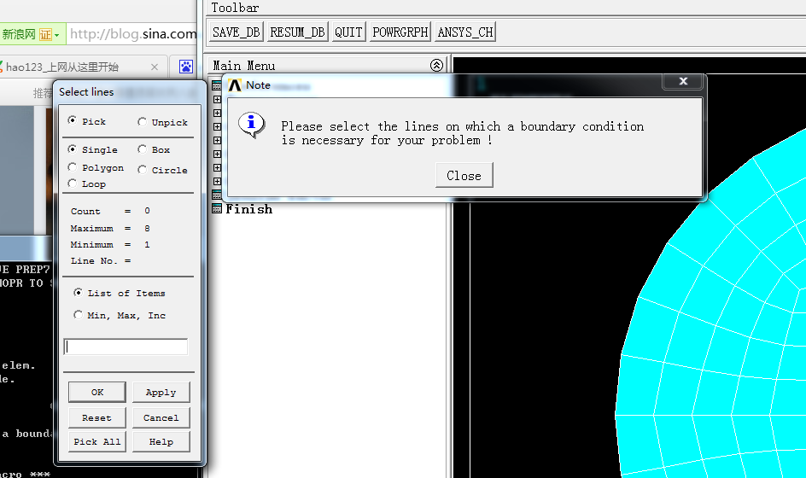

Slide 3

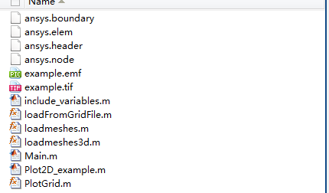
Copy these files as follows to PlotGrid，and using loadmeshes (‘Filename’) to load the ansys mesh。Please check the eamples ——Plot2D_example, Plot3D_example.
PlotGrid

Slide 4
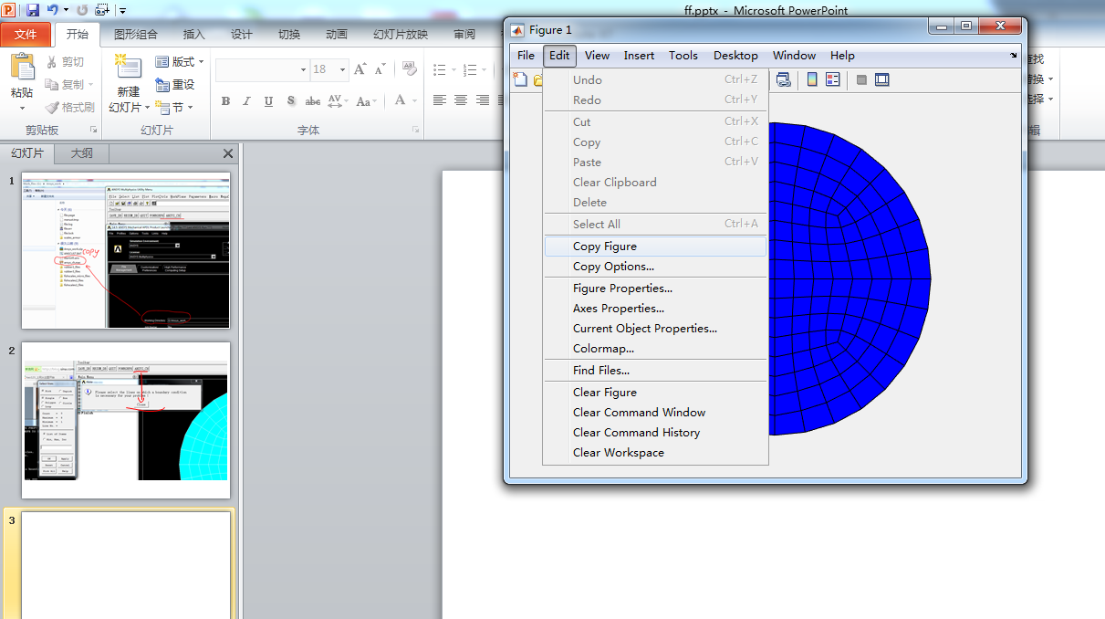

Slide 5
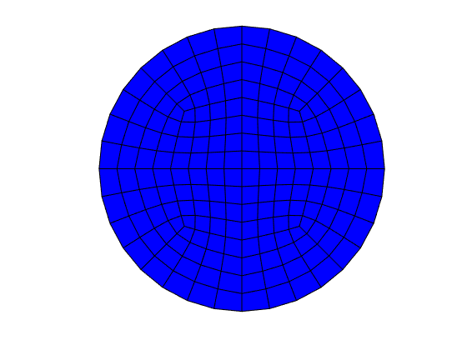
2D example

Slide 6
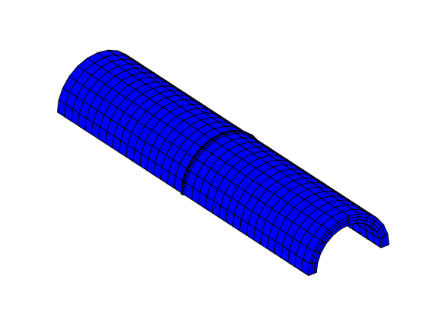
3D example

