Slide 1
Direction additions — Geo ranking maps and Feature coefficients
Four one-at-a-time cardinal-neighbor LSOA additions (N / E / S / W).
Geo: top-20 LSOAs by |SMILE coefficient|, ranks labelled on the map.
Feature: top-10 predictors as sized rectangles with rank, name, and |coefficient|.

Slide 2
ATT stability — four direction additions
Addition | Added LSOA | Branch | Top-k Jaccard | |coef| Spearman | Pred. Spearman | Accepted | Extra rank | In top-20
North | E01012953 023A | Feature | 1.000 | 0.996 | 1.000 | Yes | — | —
North | E01012953 023A | Geo | 0.905 | 0.998 | 1.000 | Yes | 162 | No
East | E01013094 029A | Feature | 1.000 | 0.996 | 1.000 | Yes | — | —
East | E01013094 029A | Geo | 0.905 | 0.998 | 1.000 | Yes | 143 | No
South | E01013009 034B | Feature | 1.000 | 0.993 | 1.000 | Yes | — | —
South | E01013009 034B | Geo | 0.905 | 0.999 | 1.000 | Yes | 85 | No
West | E01013112 025D | Feature | 1.000 | 0.996 | 1.000 | Yes | — | —
West | E01013112 025D | Geo | 0.905 | 0.999 | 1.000 | Yes | 30 | No
Mean | Four additions | Feature | 1.000 | 0.995 | 1.000 | 4/4 | — | —
Mean | Four additions | Geo | 0.905 | 0.999 | 1.000 | 4/4 | — | 0/4
Accepted if Hull-row prediction Spearman ≥ 0.99. Feature k=10, Geo k=20. Same SMILE seed (42) as the Hull-only baseline. Added LSOA is a real Geo player (fitted coefficient). One addition at a time. Models remain Hull-trained. Not causal.

Slide 3
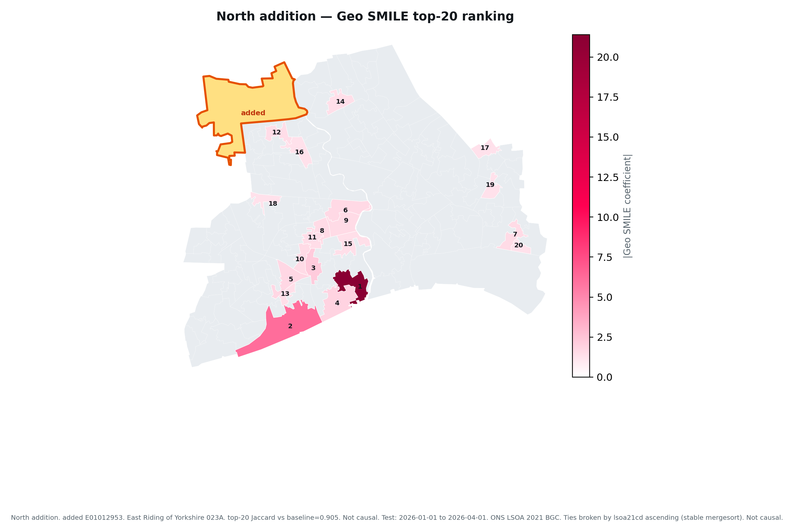
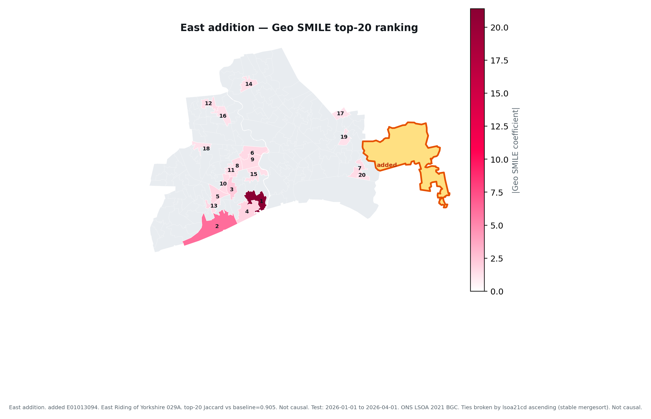
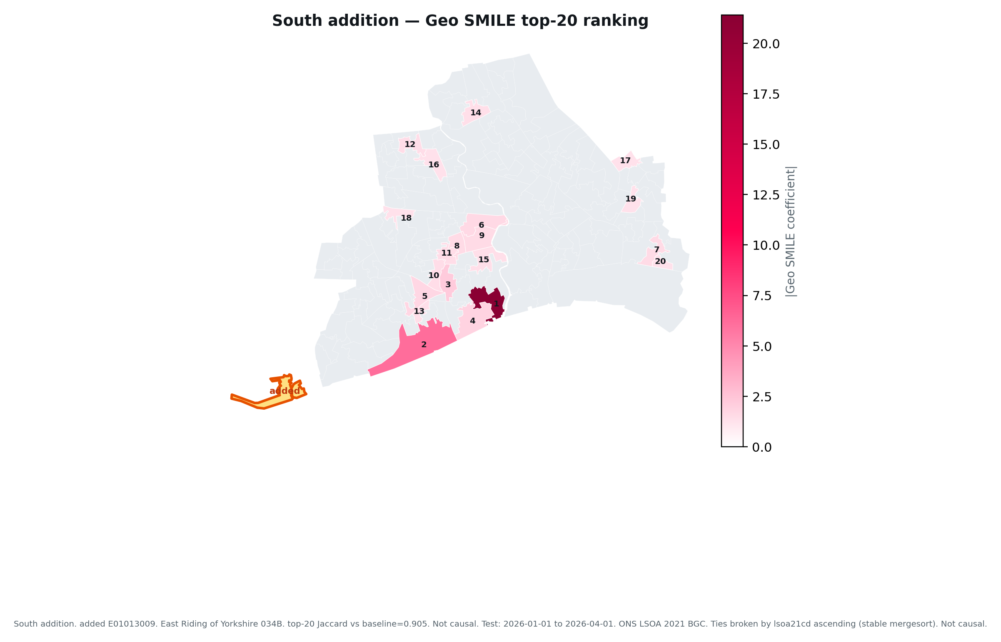
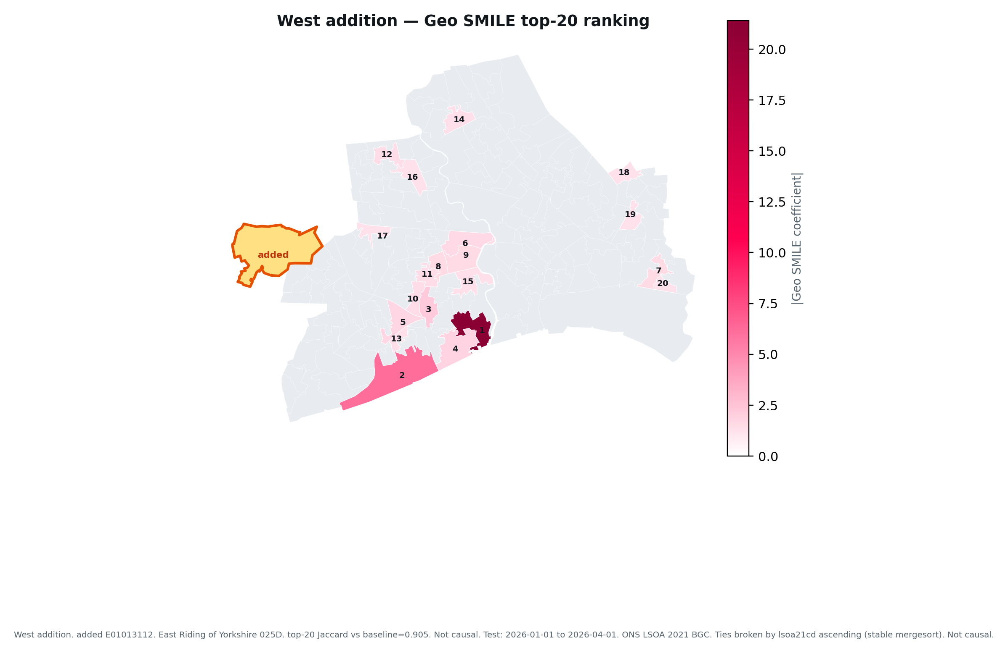
Geo SMILE top-20 ranking maps — all four direction additions

Slide 4
Direction 1 — North addition · E01012953 · East Riding of Yorkshire 023A — Geo top-20 ranking · extra rank 162 (out of top-20)
Coloured LSOAs are the 20 most important by |Geo SMILE coefficient|. Numbers on the map are ranks 1–20. Not causal.

Slide 5
Direction 2 — East addition · E01013094 · East Riding of Yorkshire 029A — Geo top-20 ranking · extra rank 143 (out of top-20)
Coloured LSOAs are the 20 most important by |Geo SMILE coefficient|. Numbers on the map are ranks 1–20. Not causal.

Slide 6
Direction 3 — South addition · E01013009 · East Riding of Yorkshire 034B — Geo top-20 ranking · extra rank 85 (out of top-20)
Coloured LSOAs are the 20 most important by |Geo SMILE coefficient|. Numbers on the map are ranks 1–20. Not causal.

Slide 7
Direction 4 — West addition · E01013112 · East Riding of Yorkshire 025D — Geo top-20 ranking · extra rank 30 (out of top-20)
Coloured LSOAs are the 20 most important by |Geo SMILE coefficient|. Numbers on the map are ranks 1–20. Not causal.

Slide 8
Feature top-10 — |SMILE coefficient| clusters (all four additions)
1. North
2. East
3. South
4. West
4. Long-term sic…
0.25
4. Long-term sic…
0.25
5. Owner occupie…
0.25
4. Long-term sic…
0.25
4. Long-term sic…
0.25
5. Owner occupie…
0.25
5. Owner occupie…
0.25
5. Owner occupie…
0.25
3. Unemployment %
0.49
3. Unemployment %
0.49
3. Unemployment %
0.48
3. Unemployment %
0.49
6. Crime lag 1
0.15
6. Crime lag 2
0.15
6. Crime lag 1
0.15
1. Crime roll mean 6
5.14
1. Crime roll mean 6
5.15
2. Crime roll me…
1.22
6. Crime lag 1
0.15
1. Crime roll mean 6
5.13
2. Crime roll me…
1.21
1. Crime roll mean 6
5.15
2. Crime roll me…
1.21
2. Crime roll me…
1.21
7. Crime lag 2
0.15
7. Crime lag 1
0.15
7. Crime lag 2
0.15
7. Crime lag 2
0.15
10. Older adult %
0.08
10. Older adult %
0.08
10. Older adult %
0.08
10. Older adult %
0.08
8. Private rente…
0.14
9. Social rented…
0.12
8. Private rente…
0.14
9. Social rented…
0.12
8. Private rente…
0.14
9. Social rented…
0.12
8. Private rente…
0.14
9. Social rented…
0.12
Box size encodes |SMILE coefficient| (shared scale across directions). Each box: rank, feature name, coefficient. Editable shapes — not an image. Not causal.

Slide 9
Direction 1 — North addition · E01012953 · East Riding of Yorkshire 023A — Feature top-10
5. Owner occupied %
0.25
4. Long-term sick %
0.25
1. Crime roll mean 6
5.14
3. Unemployment %
0.49
6. Crime lag 1
0.15
2. Crime roll mean 3
1.21
7. Crime lag 2
0.15
10. Older adult %
0.08
8. Private rented %
0.14
9. Social rented %
0.12
Each rectangle is an editable PowerPoint shape. Size = |SMILE coefficient|. Number on the box is the rank; value underneath is the coefficient. Not causal.

Slide 10
Direction 2 — East addition · E01013094 · East Riding of Yorkshire 029A — Feature top-10
4. Long-term sick %
0.25
5. Owner occupied %
0.25
3. Unemployment %
0.49
1. Crime roll mean 6
5.15
6. Crime lag 2
0.15
2. Crime roll mean 3
1.22
7. Crime lag 1
0.15
10. Older adult %
0.08
8. Private rented %
0.14
9. Social rented %
0.12
Each rectangle is an editable PowerPoint shape. Size = |SMILE coefficient|. Number on the box is the rank; value underneath is the coefficient. Not causal.

Slide 11
Direction 3 — South addition · E01013009 · East Riding of Yorkshire 034B — Feature top-10
4. Long-term sick %
0.25
5. Owner occupied %
0.25
3. Unemployment %
0.48
1. Crime roll mean 6
5.13
2. Crime roll mean 3
1.21
6. Crime lag 1
0.15
7. Crime lag 2
0.15
10. Older adult %
0.08
8. Private rented %
0.14
9. Social rented %
0.12
Each rectangle is an editable PowerPoint shape. Size = |SMILE coefficient|. Number on the box is the rank; value underneath is the coefficient. Not causal.

Slide 12
Direction 4 — West addition · E01013112 · East Riding of Yorkshire 025D — Feature top-10
5. Owner occupied %
0.25
4. Long-term sick %
0.25
3. Unemployment %
0.49
1. Crime roll mean 6
5.15
6. Crime lag 1
0.15
2. Crime roll mean 3
1.21
7. Crime lag 2
0.15
10. Older adult %
0.08
8. Private rented %
0.14
9. Social rented %
0.12
Each rectangle is an editable PowerPoint shape. Size = |SMILE coefficient|. Number on the box is the rank; value underneath is the coefficient. Not causal.

Slide 13
Feature category colour legend (one hue per category; darker = stronger |coef|)
Crime / temporal
Economic / labour & tenure
Social / demographic
Built environment / activity
Transport / accessibility
Environmental
Structural/control
Shade scale within each row: light (weaker |coef|) → dark (stronger |coef|).

