Slide 1
Feature attribution stability — schematic |coef| clusters (top-10)
Rep 1
Rep 2
Rep 3
Rep 4
Rep 5
Rep 6
4. Long-term sick %
0.37
4. Long-term sick %
0.38
4. Long-term sick %
0.37
4. Long-term sick %
0.37
4. Long-term sick %
0.37
5. Owner occupied %
0.25
4. Long-term sick %
0.37
5. Owner occupied %
0.25
5. Owner occupied %
0.25
5. Owner occupied %
0.25
5. Owner occupied %
0.25
3. Unemployment %
0.41
3. Unemployment %
0.41
3. Unemployment %
0.42
5. Owner occupied %
0.24
3. Unemployment %
0.40
3. Unemployment %
0.41
3. Unemployment %
0.41
6. Social rented %
0.19
6. Social rented %
0.19
6. Social rented %
0.19
6. Social rented %
0.20
1. Crime roll mean 6
5.07
1. Crime roll mean 6
5.07
6. Social rented %
0.19
1. Crime roll mean 6
5.05
1. Crime roll mean 6
5.04
2. Crime roll mean 3
1.28
6. Social rented %
0.20
1. Crime roll mean 6
5.03
2. Crime roll mean 3
1.29
2. Crime roll mean 3
1.29
2. Crime roll mean 3
1.28
1. Crime roll mean 6
5.01
2. Crime roll mean 3
1.27
2. Crime roll mean 3
1.28
7. Crime lag 2
0.15
7. Crime lag 2
0.15
7. Crime lag 2
0.14
7. Crime lag 2
0.15
7. Crime lag 2
0.15
7. Crime lag 2
0.15
10. Crime lag 1
0.11
10. Crime lag 1
0.12
10. Crime lag 1
0.12
10. Crime lag 1
0.12
10. Crime lag 1
0.11
10. Green space %
0.11
8. Private rented %
0.14
9. Nightlife density
0.13
8. Private rented %
0.14
9. Nightlife density
0.13
8. Private rented %
0.14
9. Nightlife density
0.13
8. Private rented %
0.14
9. Nightlife density
0.13
8. Private rented %
0.14
9. Nightlife density
0.13
8. Private rented %
0.14
9. Nightlife density
0.13
Rectangle size encodes |SMILE coefficient| (shared scale). Colours = top-10 by rank order (same palette in every rep); outline = remaining features. Editable shapes — not an image. Not causal.

Slide 2
direction 1
4. Long-term sick %
0.37
5. Owner occupied %
0.25
3. Unemployment %
0.41
1. Crime roll mean 6
5.07
6. Social rented %
0.19
2. Crime roll mean 3
1.29
7. Crime lag 2
0.15
10. Crime lag 1
0.11
8. Private rented %
0.14
9. Nightlife density
0.13

Slide 3
Rep 2
4. Long-term sick %
0.37
5. Owner occupied %
0.25
3. Unemployment %
0.41
1. Crime roll mean 6
5.07
6. Social rented %
0.19
2. Crime roll mean 3
1.29
7. Crime lag 2
0.15
10. Crime lag 1
0.11
8. Private rented %
0.14
9. Nightlife density
0.13

Slide 4
Rep 3
4. Long-term sick %
0.37
5. Owner occupied %
0.25
3. Unemployment %
0.41
1. Crime roll mean 6
5.05
6. Social rented %
0.19
2. Crime roll mean 3
1.27
7. Crime lag 2
0.15
10. Crime lag 1
0.11
8. Private rented %
0.14
9. Nightlife density
0.13

Slide 5
Rep 4
4. Long-term sick %
0.37
5. Owner occupied %
0.25
3. Unemployment %
0.42
1. Crime roll mean 6
5.04
6. Social rented %
0.19
2. Crime roll mean 3
1.28
7. Crime lag 2
0.15
10. Crime lag 1
0.12
8. Private rented %
0.14
9. Nightlife density
0.13

Slide 6
Rep 5
4. Long-term sick %
0.38
5. Owner occupied %
0.24
3. Unemployment %
0.40
1. Crime roll mean 6
5.01
6. Social rented %
0.20
2. Crime roll mean 3
1.27
7. Crime lag 2
0.15
10. Crime lag 1
0.12
8. Private rented %
0.14
9. Nightlife density
0.13

Slide 7
Rep 6
4. Long-term sick %
0.37
5. Owner occupied %
0.25
3. Unemployment %
0.41
1. Crime roll mean 6
5.03
6. Social rented %
0.20
2. Crime roll mean 3
1.28
7. Crime lag 2
0.14
10. Crime lag 1
0.12
8. Private rented %
0.14
9. Nightlife density
0.13

Slide 8
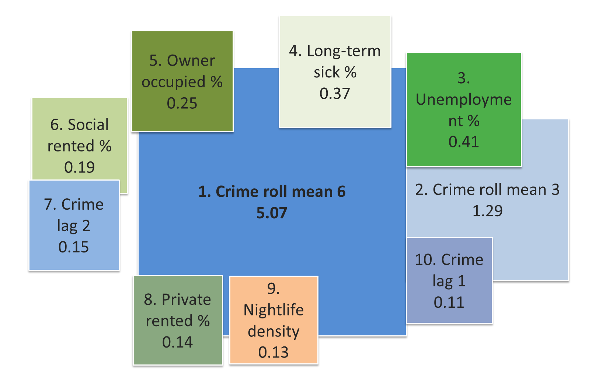
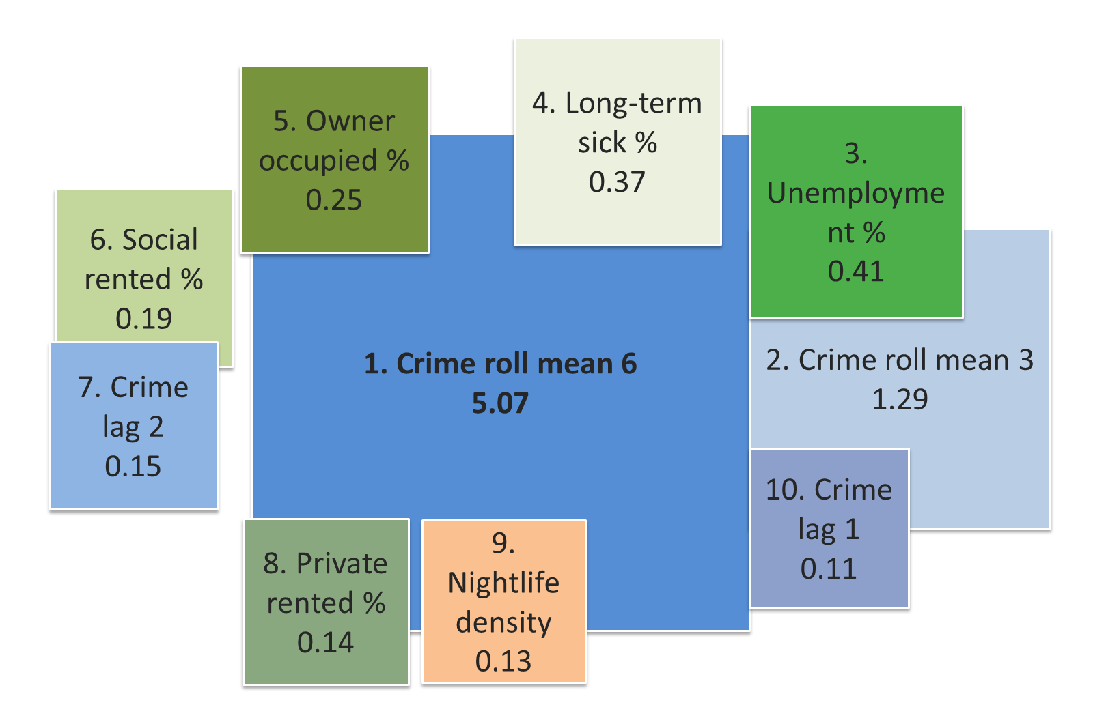
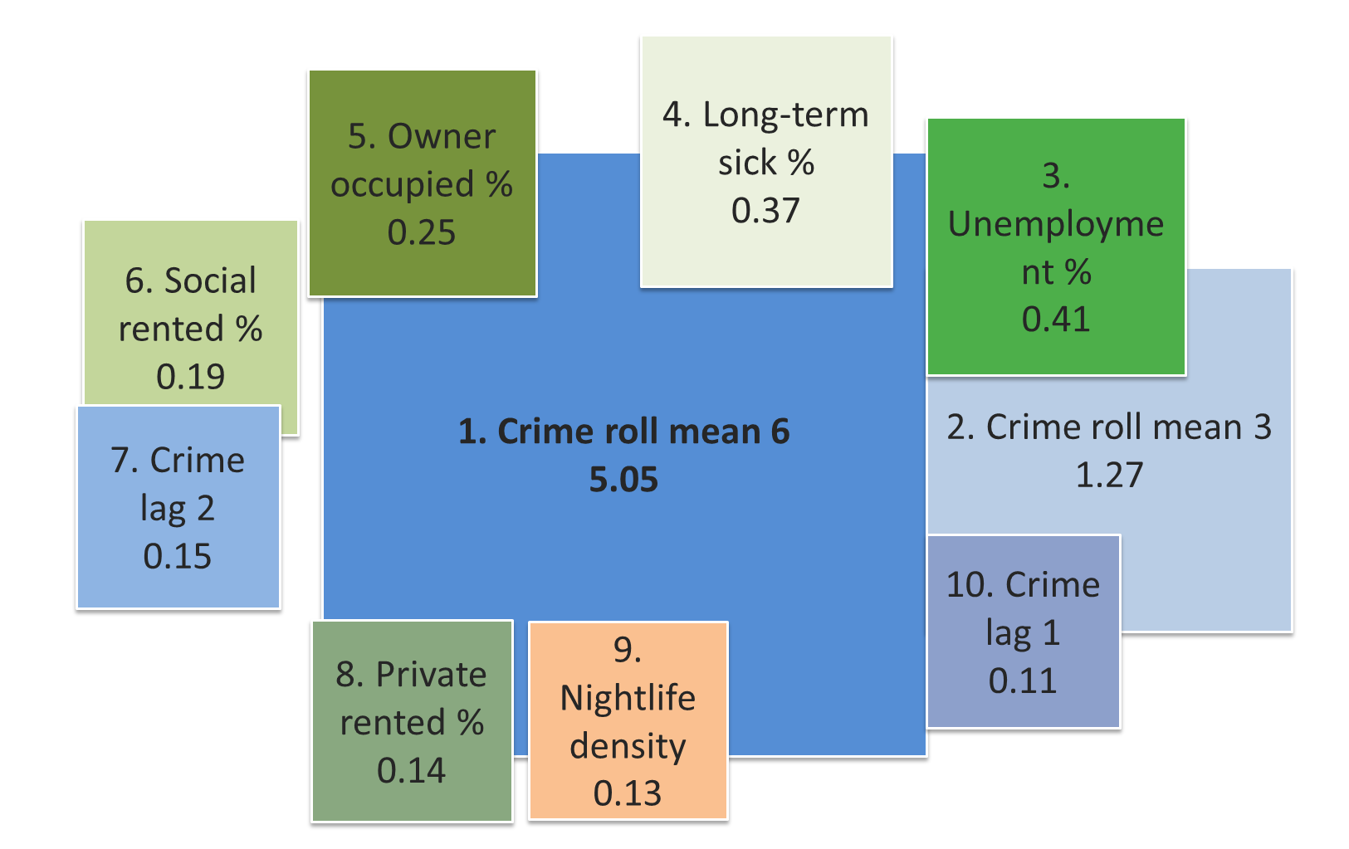
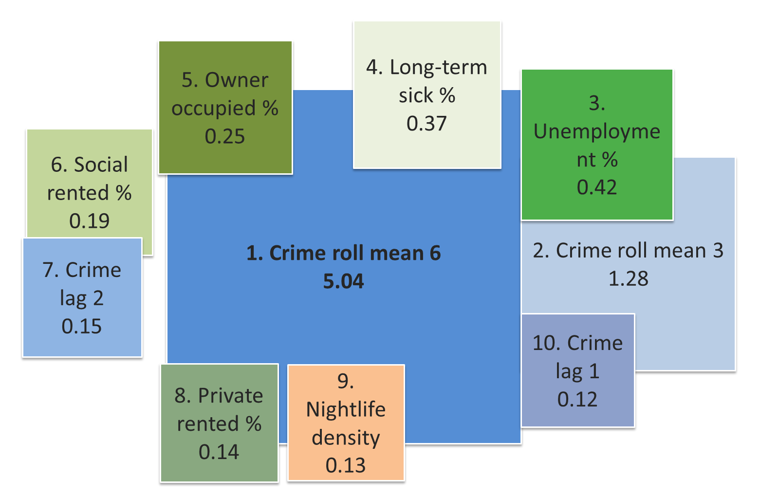


Feature attribution stability
Rep1
Rep2
Rep3
Rep4
Rep5
Rep6
Crim data
socioeconomic
Built Environmental

Slide 9
Feature attribution stability
Rep1
Rep2
Rep3
Rep4
Crim data
socioeconomic
Built Environmental

Slide 10
Rank colour legend (same order in every rep)
Rank 1: Crime roll mean 6 (|coef| example from Rep 1 = 5.066)
Rank 2: Crime roll mean 3 (|coef| example from Rep 1 = 1.290)
Rank 3: Unemployment % (|coef| example from Rep 1 = 0.411)
Rank 4: Long-term sick % (|coef| example from Rep 1 = 0.368)
Rank 5: Owner occupied % (|coef| example from Rep 1 = 0.247)
Rank 6: Social rented % (|coef| example from Rep 1 = 0.194)
Rank 7: Crime lag 2 (|coef| example from Rep 1 = 0.148)
Rank 8: Private rented % (|coef| example from Rep 1 = 0.140)
Rank 9: Nightlife density (|coef| example from Rep 1 = 0.128)
Rank 10: Crime lag 1 (|coef| example from Rep 1 = 0.111)

