Slide 1
COMP 232
Submitting Assignments
on the EAS

Slide 2
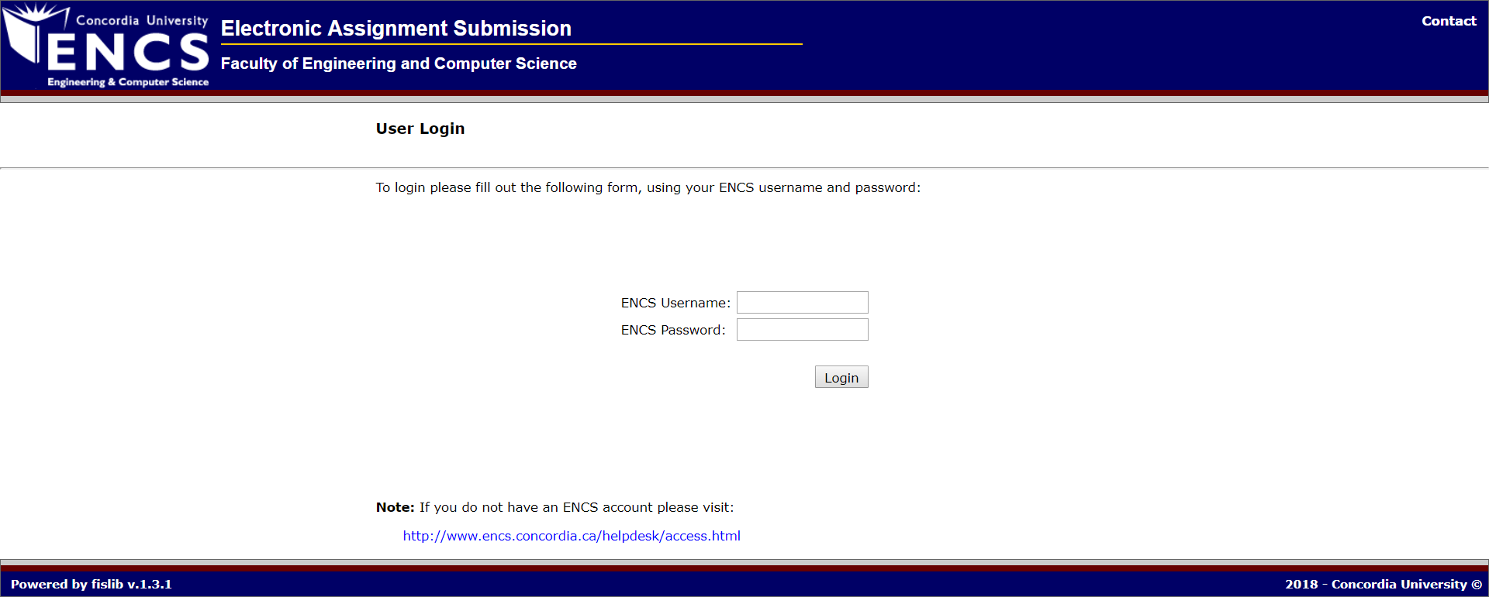
Step 1: Sign in to your ENCS account

Slide 3
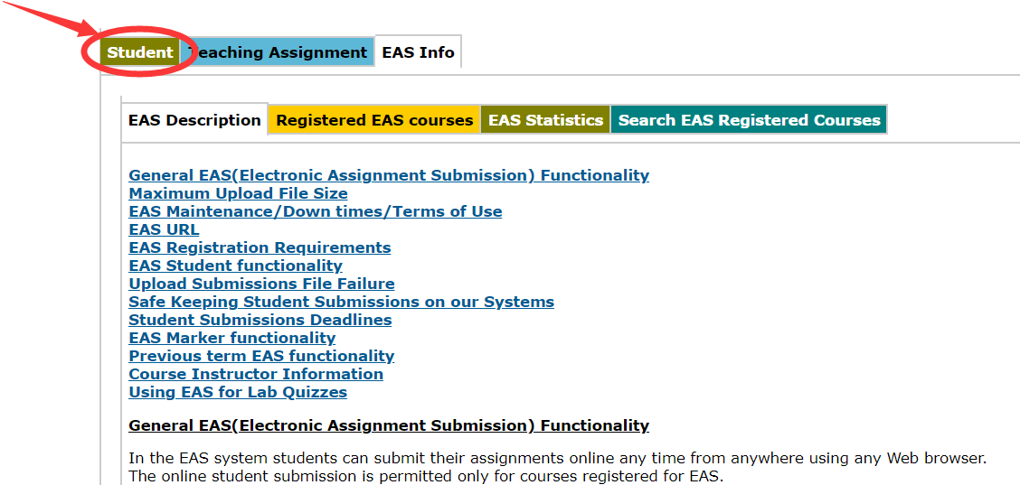
Step 2: Click “Student”

Slide 4
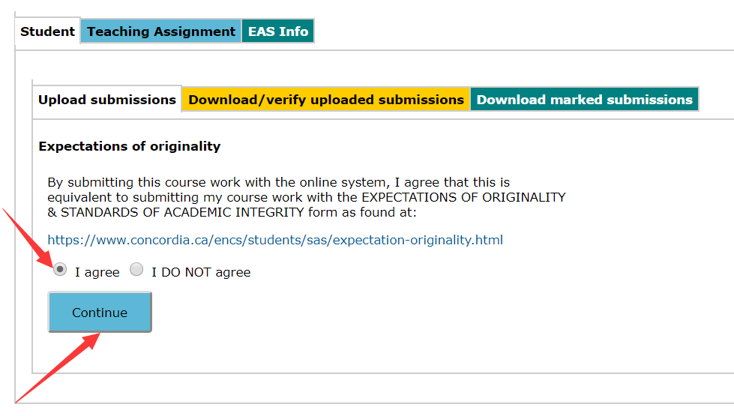
Step 3: Agree and continue

Slide 5
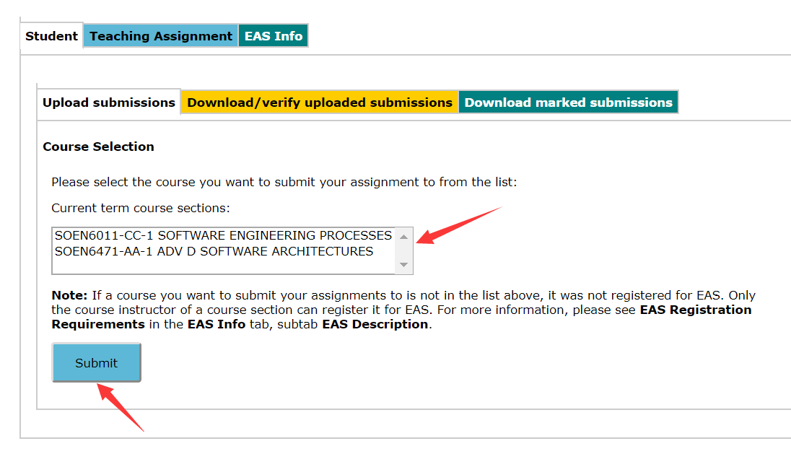
Step 4: Select course and submit

Slide 6
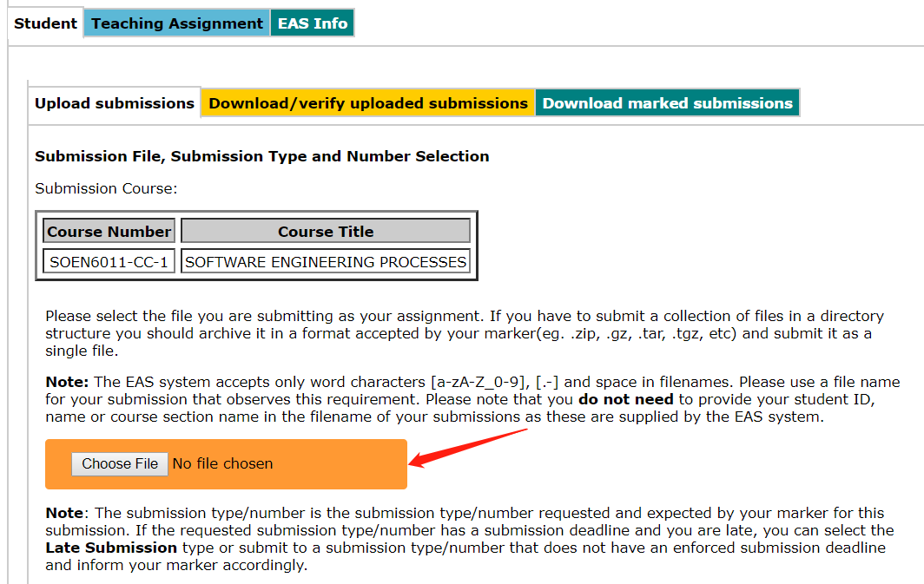
Step 5: Select and upload your file

Slide 7
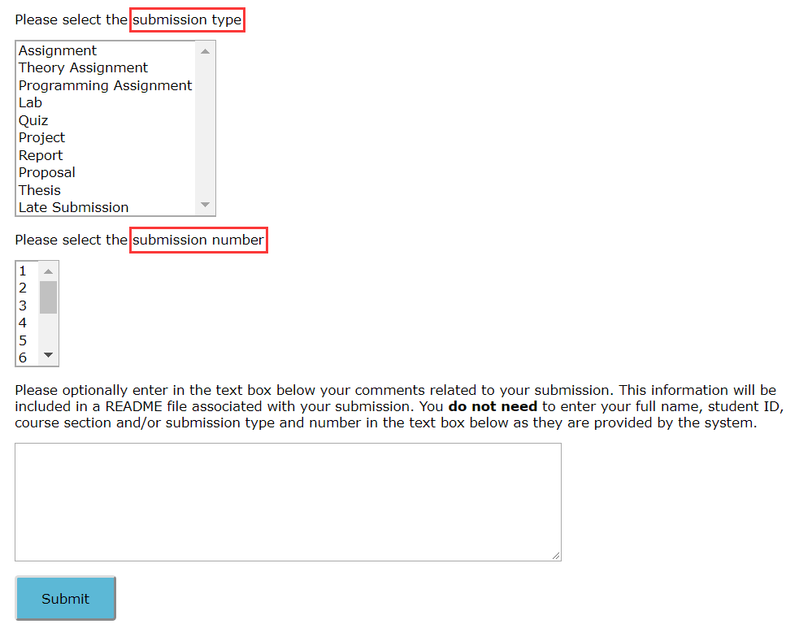
Step 6: Select submission type and number

Slide 8
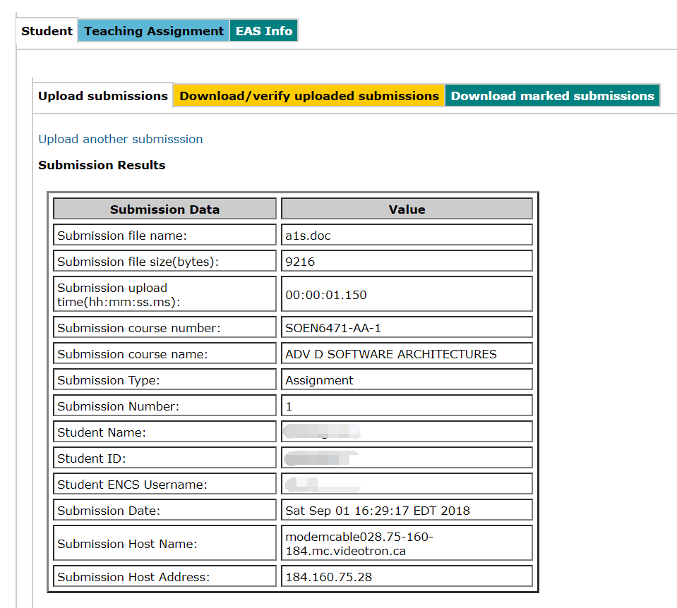
Step 7: Submission Results

Slide 9
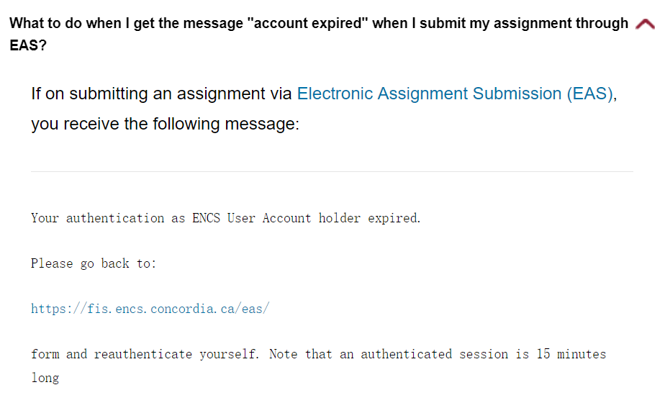
FAQ

