Slide 1
Pitchonix
Building the future
Notes:
Welcome and introduction. Start with a strong opening statement about Pitchonix. Briefly mention: what you do. Keep it under 30 seconds. Audience: investors.

Slide 2
The Problem
What challenge are we addressing?
Creating compelling presentations takes 10-20 hours per deck. Teams struggle with design, structure, and content quality.
Creating compelling presentations takes 10-20 hours per deck
Teams struggle with design
and content quality
Notes:
Describe the problem clearly and paint a vivid picture of the pain point. Emphasize the market gap and why this matters to investors. Reference: Creating compelling presentations takes 10-20 hours per deck. Teams struggle with design, structure,...

Slide 3
Our Solution
How we solve it
AI-powered platform that generates investor-ready presentations in minutes.
AI-powered platform that generates investor-ready presentations in minutes
Efficiency gains
Cost reduction
Better outcomes
Notes:
Present the solution clearly and emphasize the unique value proposition. Focus on benefits over features. Highlight what makes you different: 10x faster, AI-powered, professional quality guaranteed. Be ready to demo if appropriate.

Slide 4
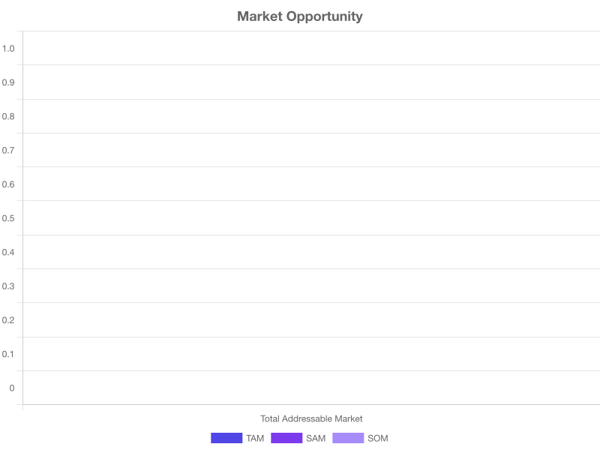
Market Opportunity
TAM • SAM • SOM
Notes:
Emphasize the market size and growth potential. Explain TAM/SAM/SOM clearly. Connect market trends to your solution. Reference industry: SaaS / Technology. Show confidence in addressable market opportunity.

Slide 5
Business Model
SaaS subscription
Notes:
Explain the business model clearly and demonstrate unit economics. Walk through pricing tiers if applicable. Show path to profitability. Emphasize scalability and margins.

Slide 6
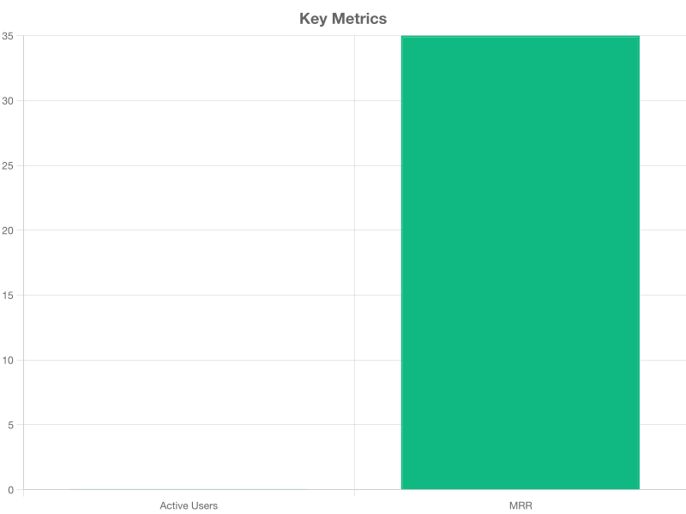
Traction & Metrics
Our progress so far
Notes:
Highlight key metrics and show momentum. Emphasize growth trajectory. Reference specific numbers and milestones. Show product-market fit validation.

Slide 7
The Team
Who we are
Jane Smith (CEO), John Doe (CTO), Sarah Johnson (CPO)
Notes:
Introduce key team members and highlight relevant experience. Emphasize why this team is uniquely positioned to execute. Mention advisors and notable backgrounds.

Slide 8
The Ask
$2M Seed Round
Notes:
Clear call to action: investment ask. Reiterate key investment thesis. Be specific about amount and use of funds. End with confidence and open for questions.

Slide 9
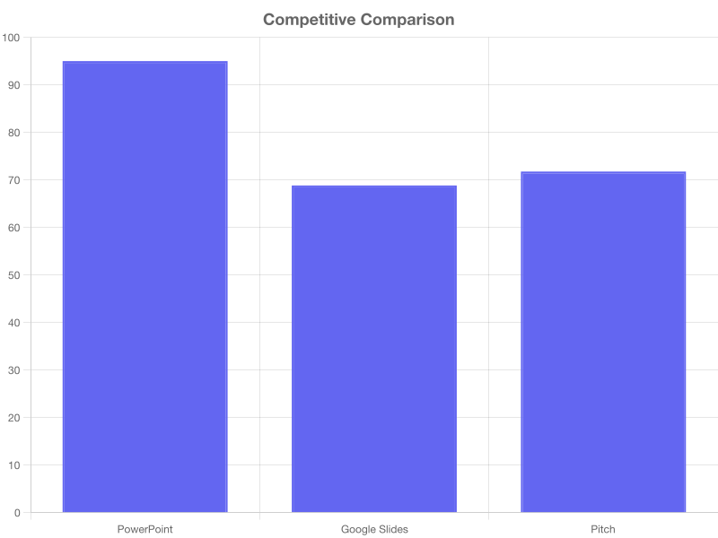
Competitive Landscape
Notes:
Acknowledge competition but emphasize your unique value. Show awareness of landscape. Highlight defensible advantages: 10x faster, AI-powered, professional quality guaranteed.

Slide 10
Product Roadmap
Q1: AI Enhancement, Q2: Collaboration, Q3: Analytics
Notes:
Show clear execution plan and vision for the future. Demonstrate thoughtful planning. Connect roadmap to market opportunities and customer needs.

