Slide 1

Submitted By : Shadil Ahmad
Reg. No. : 72510774
Programe : B-Tech(AI & DS)
Submitted To: Abhishek Sir

Slide 2
PYTHON
ASSIGNMENT NO.1

Slide 3
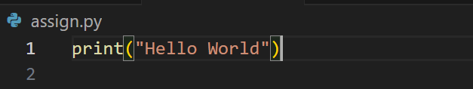
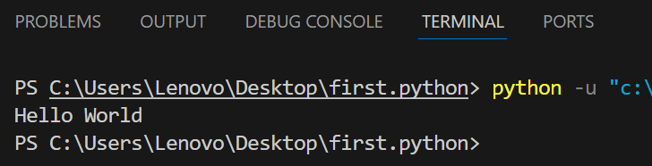
1.Write a python program that prints” Hello world!”. .input

Slide 4
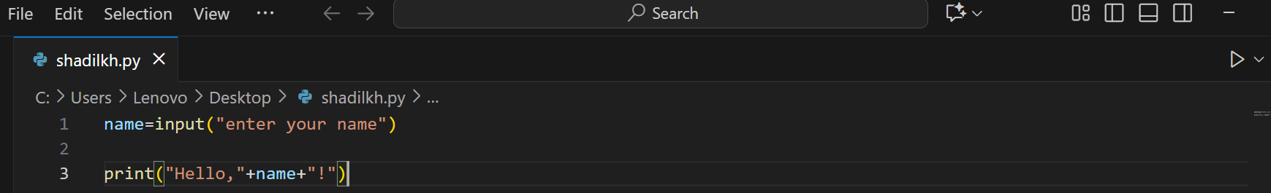
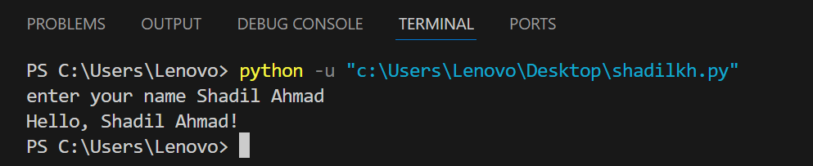
2.Take user’s name as input and print “Hello, < name>!” .input
.Output

Slide 5
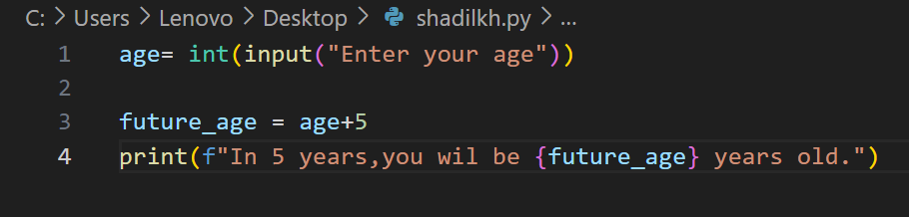
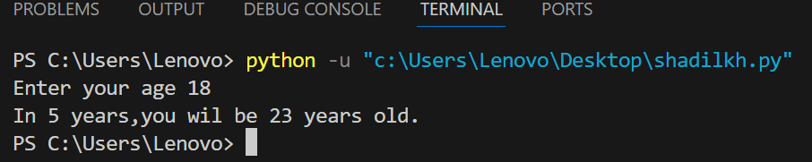
.3 Ask the user for their age and print how old they will be in 5 years.
.input
.output

Slide 6
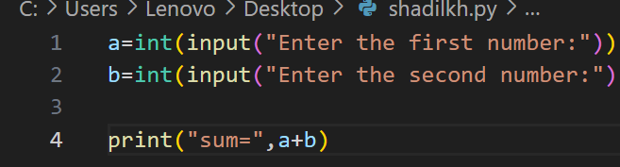
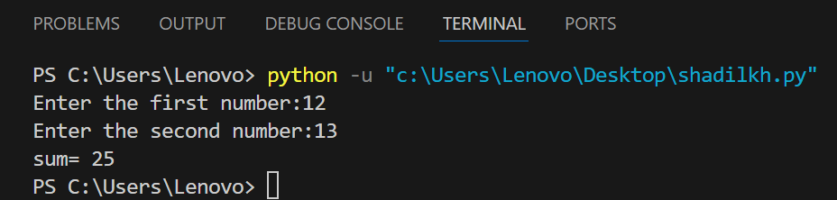
4.Take two numbers as input and print their sum
.input
.output

Slide 7
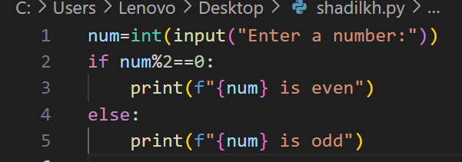
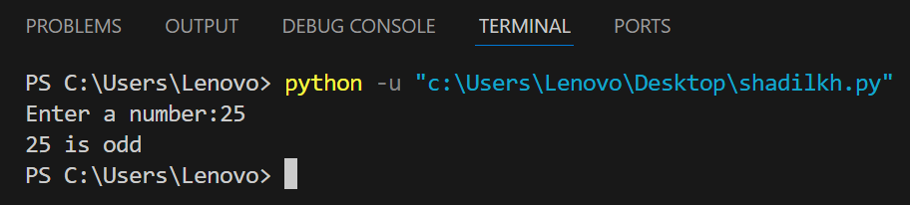
5.Ask the user for a number and print whether its even or odd
.input
.output

Slide 8

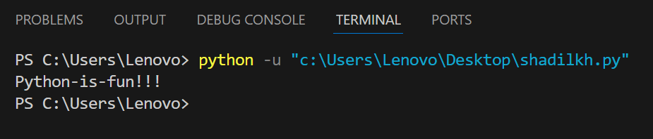
6.Use the sep and end parameters in print() to print “Python is fun” on one line.
.input
.output

Slide 9
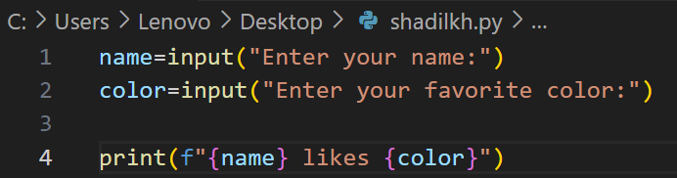
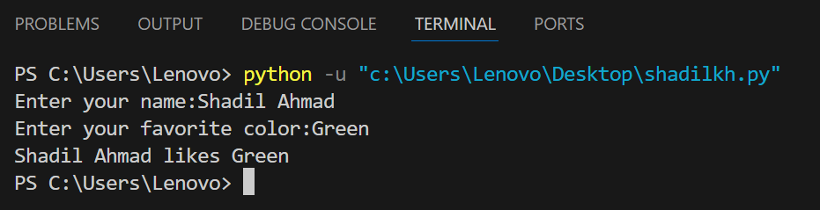
7.Write a program that takes the name of favorite colors of a users and print : ” Alice likes Blue “.
.input
.output

Slide 10
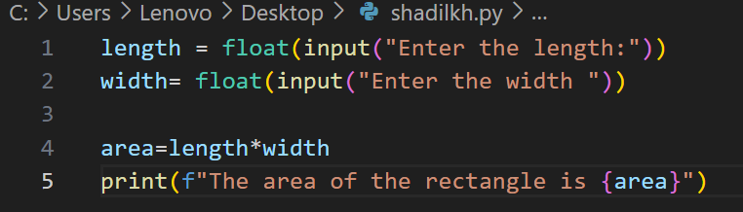
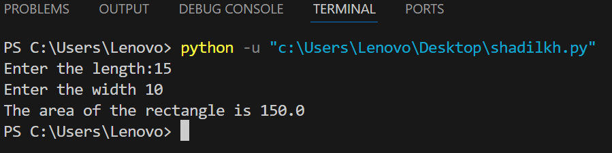
8.Use input the take the length and width of a rectangle and prints its area.
.input
.output

Slide 11
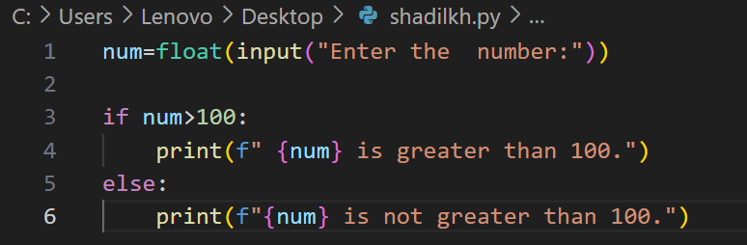
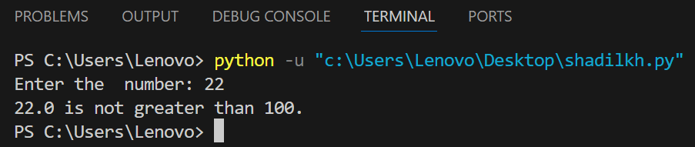
9.Accept a number using input and check whether it is greater than 100.
Input
Output

Slide 12
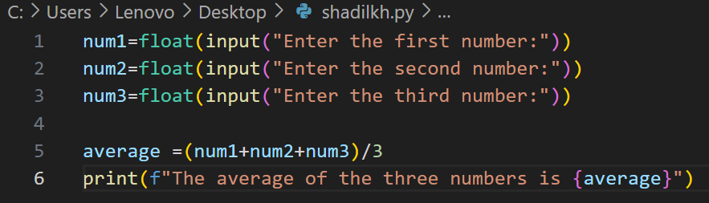
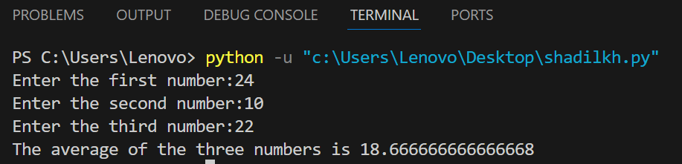
10. Use input to get 3 numbers and print their average.
Input
output

Slide 13
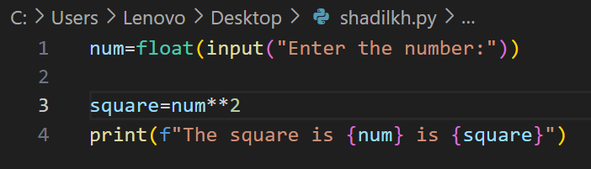
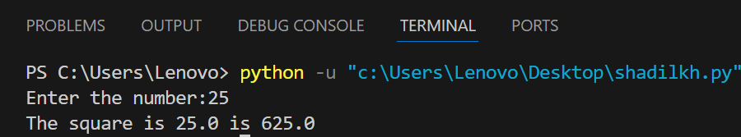
11.Accept an integer from the user and print its square.
Input
Output

Slide 14
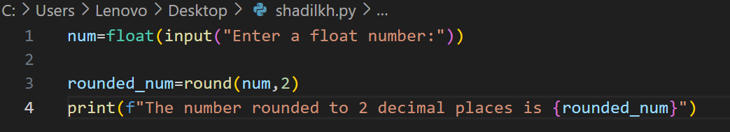
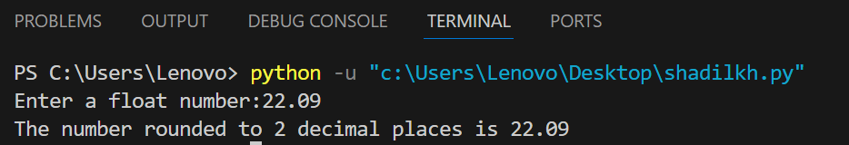
12.Accept a float number the user and round it to 2 decimal places.
Input
output

Slide 15
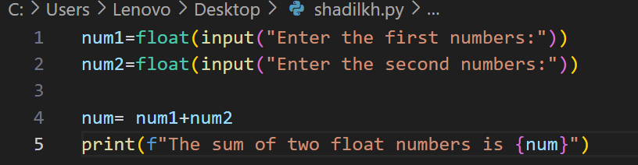
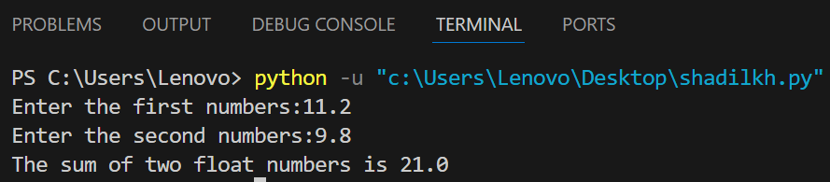
13.Add two float numbers and print the result.
Input
output

Slide 16
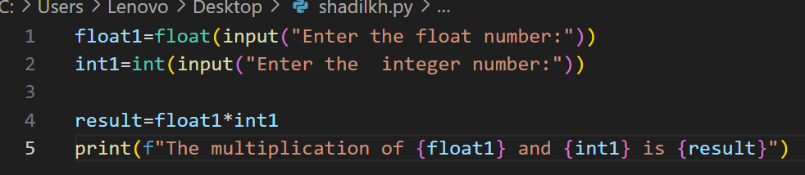
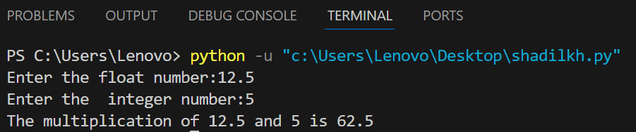
14.Multiply a float and integer and print the result.
Input
output

Slide 17
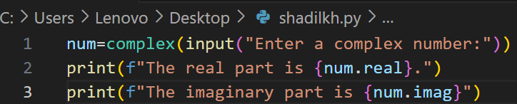
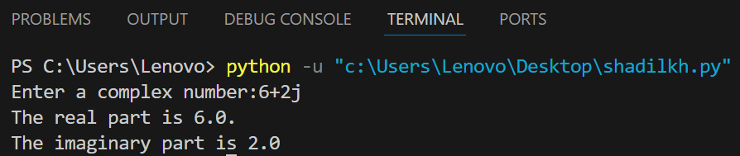
15.Accept the complex number and print its real and imaginary.
Input
Output

Slide 18
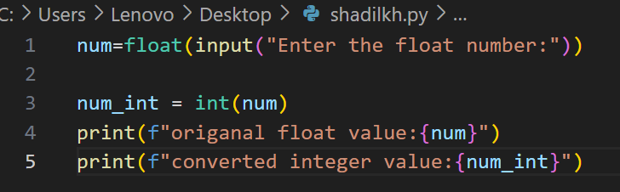
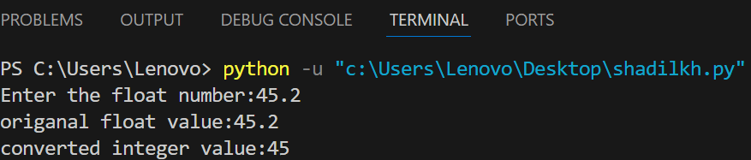
16.Convert a float to an integer and print both values.
.input
.output

Slide 19
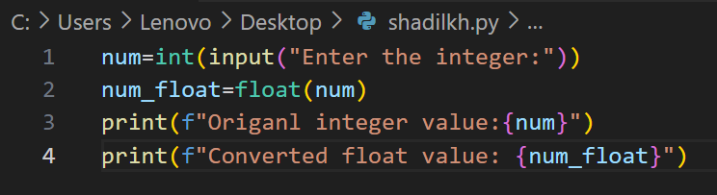
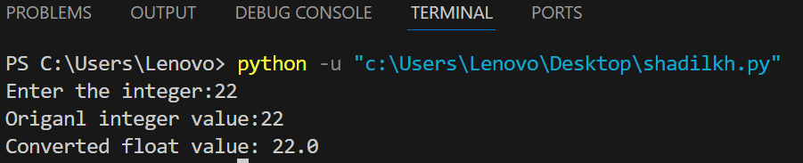
17.Convert an integer to float and print their both values.
Input
output

Slide 20
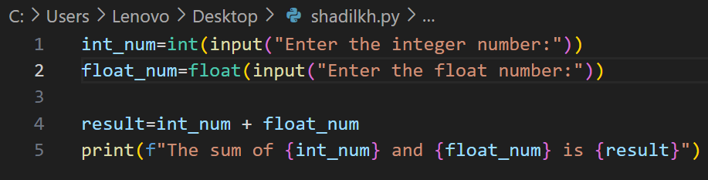
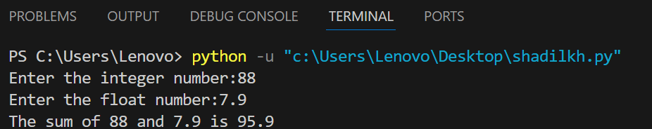
18.Accept two numbers(one integer , one float), and their print the result of integer + float
Input
Output

Slide 21
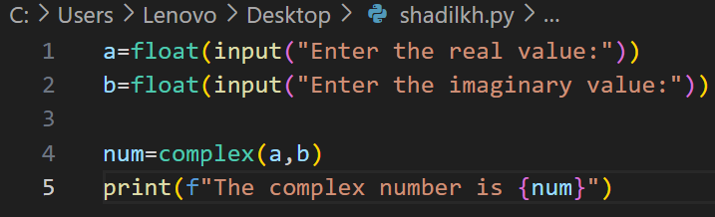
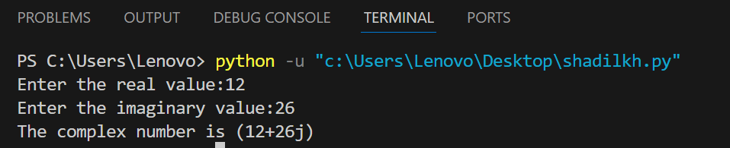
19.Create a complex number using complex (a , b) and print it.
Input
output

Slide 22
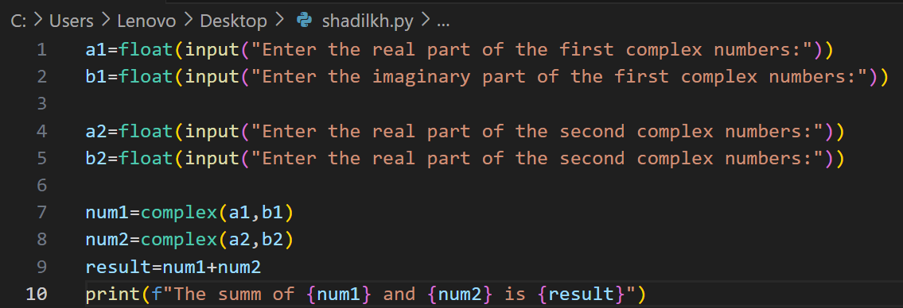
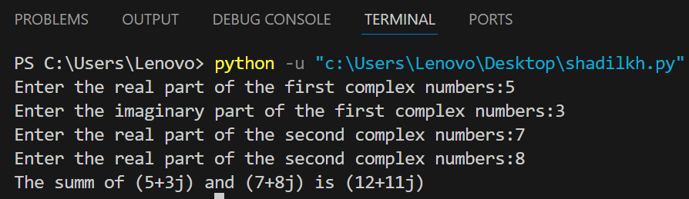
20.Add two complex numbers and print their result.
Input
output

Slide 23
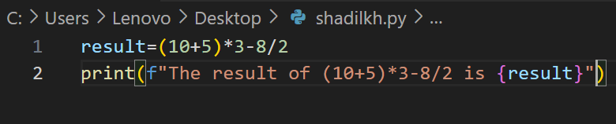
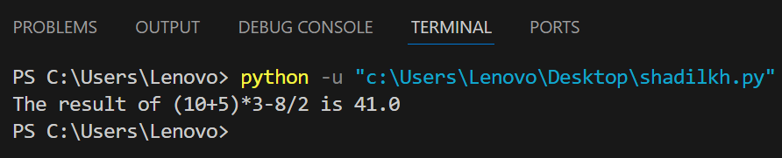
21.Use arithmetic operators to calculate ( 10 + 5) *3 – 8 / 2.
Input
output

Slide 24
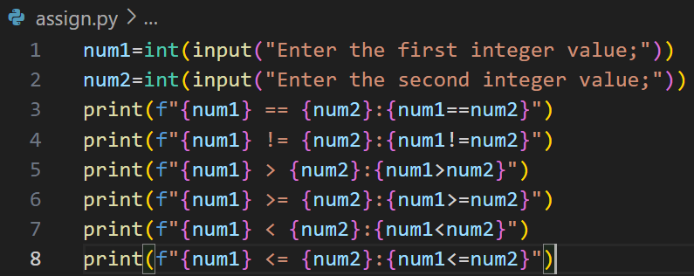
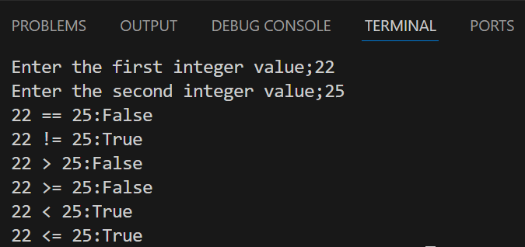
22.Compare two integer using all comparison operators.
Input
output

Slide 25
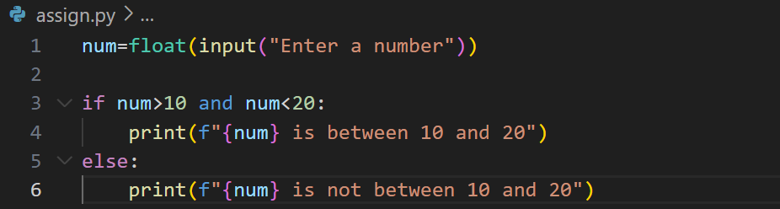
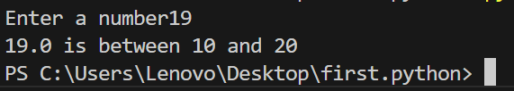
23.Use logical operators to check if a number is between 10 and 20.
Input
output

Slide 26
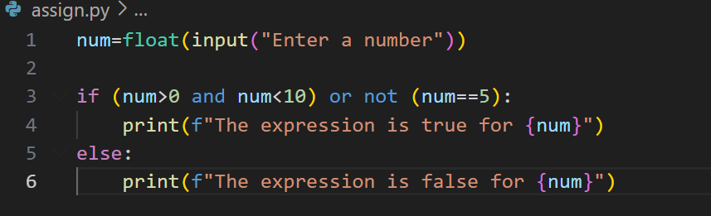
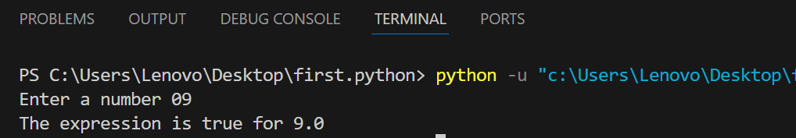
24.Use and, or, and, not in single expression.
Input
Output

Slide 27
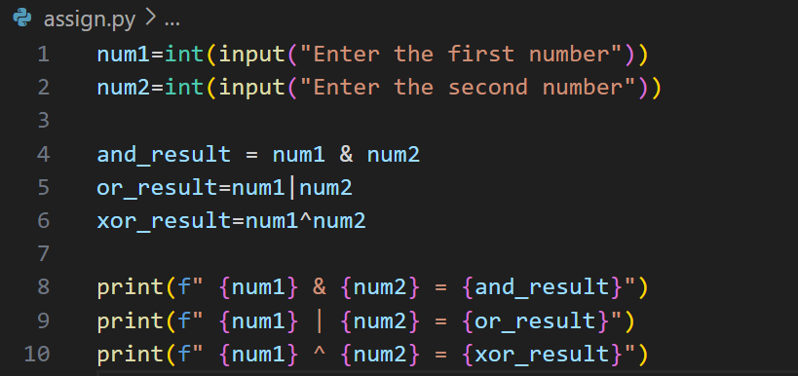
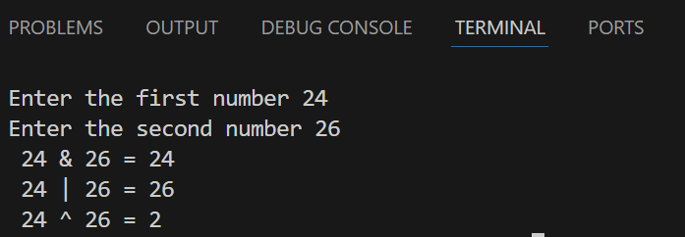
25.Use bitwise &, |, and ^ on two integers and print the result.
Input
output

Slide 28
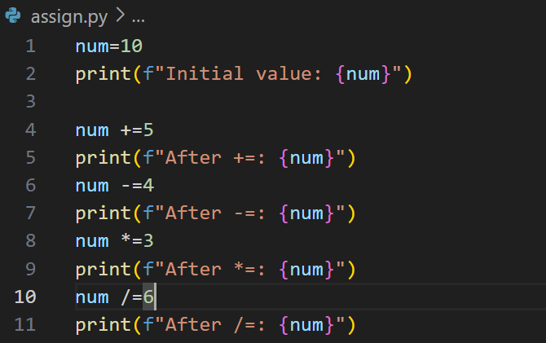

26.Use the assignment operators +=, -= , *=, /= and show results.
Input
output

Slide 29


27.Check if two variable point to the some object using is and in not.
Input
output

Slide 30


28.Check if a character exists in a string using in and not in.
Input
output

Slide 31


29.Use a combination of arithmetic and assignment operators to calculate the factorial of a number.
Input
output

Slide 32


30.Take 3 integer and determine which one is the largest using comparison operators.
Input
output

Slide 33


31.Create a truth table for A and B and A or B.
Input
output

Slide 34


32.Demonstrate short-circuit evaluation in logical operators.
Input
output

Slide 35


33.Use bitwise left and right shift operators.
Input
output

Slide 36


34.Use ternary operator to find the minimum of two numbers.
Input
output

Slide 37


35. Create a list of 5 integers and print the list
Input
output

Slide 38


36.Append an element to a list
Input
output

Slide 39


37.Insert an element at index 2 in a list
Input
output

Slide 40


38.Remove an element from a list by value and by index.
Input
output

Slide 41


39.Short a list of numbers in ascending and descending order.
Input
output

Slide 42


40.Find the sum and average of element in a list.
Input
output

Slide 43


41.Use list slicing to get every second element.
Input
output

Slide 44


42.Check if an element exists in a list
Input
output

Slide 45


43.Reverse a list using a slicing and using the reverse method.
Input
output

Slide 46


44.Create a nested list and access elements inside the inner.
Input
output

Slide 47


45.Create a tuple of 5 items and print it.
Input
output

Slide 48


46.Access the 3rd item of a tuple.
Input
output

Slide 49


47.Convert a list to a tuple and vice versa.
Input
output

Slide 50


48.Count the numbers of items in a tuple and observe the result.
Input
output

Slide 51


49.Try to change an item in a tuple and observe the result.
Input
output

Slide 52


50.Create a set with duplicate values and print it.
Input
output

Slide 53


51.Add an element to a set.
Input
output

Slide 54


52.Perform union ,intersection, and difference between two sets.
Input
output

Slide 55


53.Check if a value exists in a set.
.input
output

Slide 56


54.Remove an item from a set using remove and discard and explain the difference.
Input
output

Slide 57


55.Create a dictionary with 3 key – value pairs.
Input
output

Slide 58

56.Access and modify a value in a dictionary using its key
Input
output

Slide 59


57.Add new key – value to an pair to an existing dictionary.
Input
output

Slide 60


58.Iterate over a dictionary and print keys and values.
Input
output

Slide 61


59.Use a dictionary to store and display students names and their works.
Input
output

Slide 62
THANK YOU

