Slide 1
neo4j
NoSQL database
Graph database management system
CYPHER, a language to query the database
A visual interface with the neo4j browser + Bloom
https://sandbox.neo4j.com

Slide 2
Graph database
Can store any kind of data using a few concepts:
  Nodes: graph data records
  Relationships: connect nodes
  Properties( of nodes or relationships): named data values or attributes

Slide 3
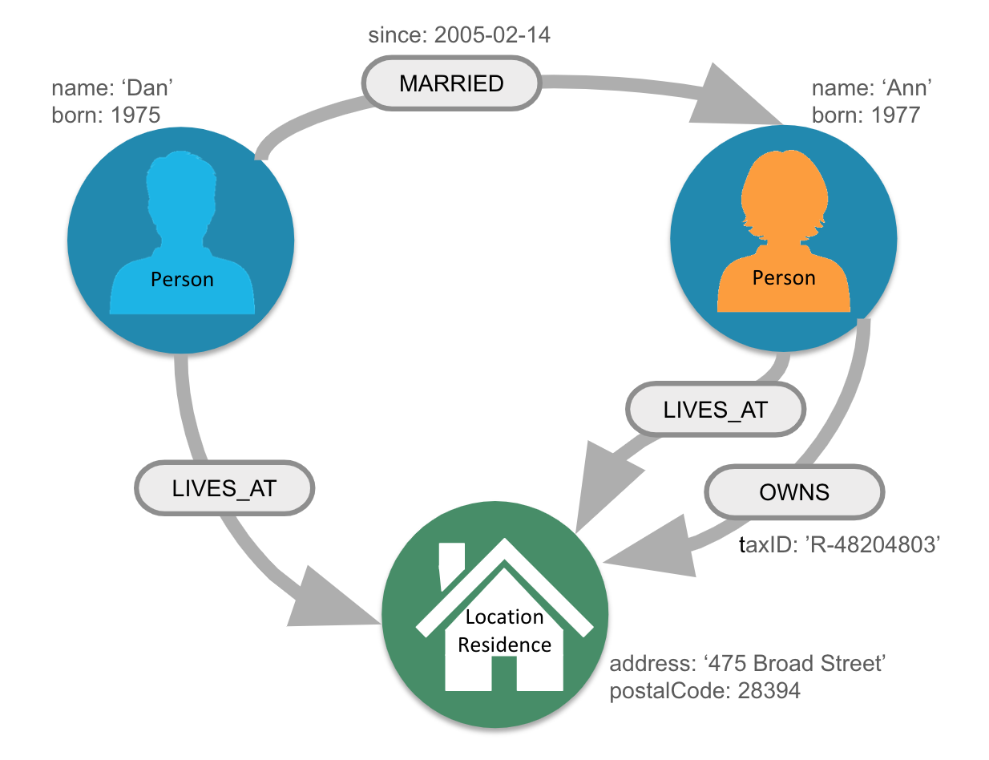

Slide 4
Further details
A graph database is an online database management system with Create, Read, Update and Delete (CRUD) operations working on a graph data model.
Unlike other databases, relationships take first priority in graph databases.

Slide 5
How to use neo4j
Install Neo4j Desktop (Appimage)
Neo4j Sandbox (online)
Web browser (Browser sync)

Slide 6
DB commands
:help commands // list of available commands
:help keys // keyboard shortcuts
:help match
:play start // getting started info
:play movie graph // run a mini tutorial

Slide 7
Nodes, Relations and properties
() // anonymous node not be referenced later in the query
(p) // variable p, a reference to a node used later
(:Person) // anonymous node of type/label Person
(p:Person) // p, a reference to a node of type Person
(p:Actor:Director) // p, a reference to a node of types Actor and Director
[:DIRECTED] // relation of type DIRECTED
MATCH (node1)-[:REL_TYPEA | :REL_TYPEB]->(node2) RETURN node1, node2
MATCH (p:Person)-[rel:ACTED_IN]->(m:Movie {title: 'The Matrix'}) RETURN p, rel, m // nodes of type “Movie” with property/attribute title='The Matrix'

Slide 8
match (n) return n
MATCH (x {name: "Tom Hanks"}) RETURN x
MATCH (p_list:Person) RETURN p_list.name ORDER BY p_list.name
MATCH (p_list:Person) RETURN p_list.name LIMIT 10
MATCH (nineties:Movie) WHERE nineties.released >= 1990 AND nineties.released < 2000 RETURN nineties.title
MATCH (cloudAtlas {title: "Cloud Atlas"})<-[:DIRECTED]-(directors) RETURN directors.name
MATCH (people:Person)-[relatedTo]-(:Movie {title: "Cloud Atlas"}) RETURN people.name, Type(relatedTo), relatedTo

Slide 9
More queries
Movies and actors up to 4 "hops" away from Kevin Bacon
MATCH (bacon:Person {name:"Kevin Bacon"})-[*1..2]-(x) RETURN DISTINCT x
Bacon path, the shortest path of any relationships to Meg Ryan
MATCH p=shortestPath((bacon:Person {name:"Kevin Bacon"})-[*]-(meg:Person {name:"Meg Ryan"})) RETURN p
CALL db.schema.visualization, CALL db.propertyKeys
https://neo4j.com/docs/cypher-refcard/current/
https://neo4j.com/graphacademy/online-training/v4/04-introneo-3-5-intro-cypher/

Slide 10
Showcase
Run Graph Data Science Algorithms
In addition to Cypher queries, you can also run graph algorithms in Neo4j, for example: path finding, centralities computation, community detection, etc. To this end, we need to activate Neo4j Graph Data Science Library.
https://neo4j.com/product/graph-data-science-library/
https://neo4j.com/docs/operations-manual/current/configuration/file-locations/

