Slide 1
IBNM Research Projects

Slide 2
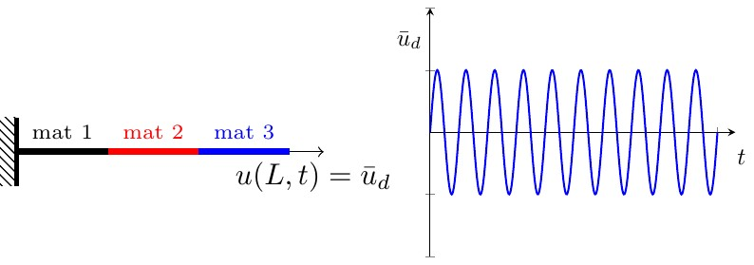
Damage fatigue computations for a very large number of cycles
Categories:
Mechanics of Materials,
Model Order Reduction
Shadi Alameddin
Mainak Bhattacharyya,
Amelie Fau
Udo Nackenhorst
in collaboration with David Neron and Pierre Ladeveze,
LMT Cachan, France
:: Prediction of fatigue life
Beyond the classical phenomenological approaches based on S-N curves, the goal of this project is to predict the evolution of damage using a thermodynamically consistent model.
Fig. 1 Bar under cyclic loading

Slide 3
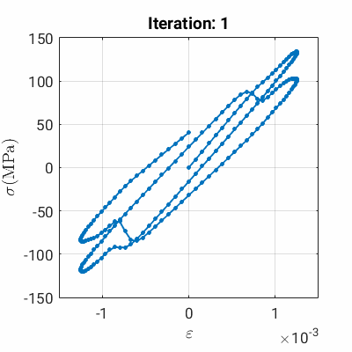
:: Model Order Reduction for damage simulations
Ductile damage is predicted in the LATIN framework, at every LATIN iteration:
- an approximation of the solution on the whole time-space domain is looked for,
- the mechanical equilibrium is solved as a linear problem.
This framework is beneficial to incorporate
model order reduction.
Fig. 2 Evolution of the stress-strain curve with the LATIN iterations
Title, Author

Slide 4
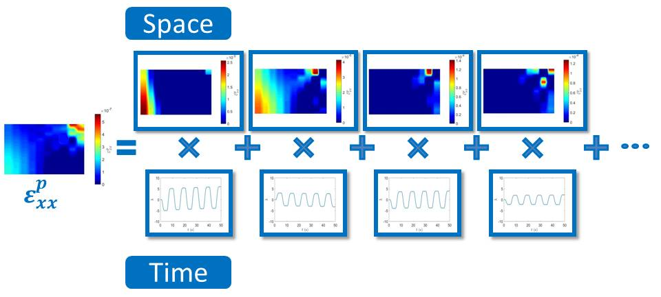
:: Model Order Reduction for damage simulations
The computational coast is reduced by using Proper Generalised Decomposition based on the assumption of a separable form of the different unknowns.
Fig. 3 Time and space functions approximating the evolution of the plastic strain
Title, Author

Slide 5


:: Model order reduction in time for fatigue computation
If one cycle is computed in 0.1 seconds, the computation for 10^9 cycles requires more than three years.
Inovative schemes for reducing the model in time are under development at ibnm.
Funded by:
>> To find further information please visitwww.ibnm.uni-hannover.de <<
Title, Author

