Slide 1

Football League Prediction Using Machine Learning
Mentor - Dr.Kusum Bharti
Team:
Aditya Verma-2016011
Gurpreet Singh-2016098
Shubham Dixit-2016255

Slide 2
INTRODUCTION
The Premier League (often referred to as the English Premier League (EPL) outside England) is the top level of the English Premier League. Contested by 20 clubs, it operates on a system of promotion and relegation with the English Premier League (EPL). The Premier League is the most-watched sports league in the world, broadcast in 212 territories to 643 million homes and a potential TV audience of 4.7 billion people.
There are 20 clubs in the Premier League. During the course of a season (from August to May) each club plays the others twice (a double round-robin system), once at their home stadium and once at that of their opponents', for 38 games. Teams receive three points for a win and one point for a draw.

Slide 3
No points are awarded for a loss. Teams are ranked by total points, then goal difference, and then goals scored. If still equal, teams are deemed to occupy the same position. If there is a tie for the championship, for relegation, or for qualification to other competitions, a play-off match at a neutral venue decides rank.

Slide 4
LITERATURE REVIEW
Maher’s Model (1982) :
In this model we give an attacking strength ɑ and a defensive strength 𝛃 and we can model the goals scored as poisson responsible variable whose mean will be the relative strength between the teams. Home Ground provides the advantage to the home team. This model sometimes under estimates and over estimates the goals depending on the number of goals scored.
Lee’s Model (1997) :
This model is mainly for the question “Is Manchester United really the best?”. This model matches with Maher’s model a bit but in this it doesn’t consider the strength and weakness, whereas, he simulates the season One Thousand Times, to see which team is the best in the Premier League.

Slide 5
Rue, Salvesen (2000) : In this model, they predicted and analysed football matches in a league. A bayesian approach was used in this model. They made a few assumptions like, superior team will be easy going on the inferior team. In this model if a team scores more than 5 goals, then it is considered to be 5. So, if the final score is 6-5, then it is considered as a 5-5 draw.
Owen’s Model (2011) : This is another Bayesian model which is dynamic and predicts the outcomes of the football matches. The approach is almost same as the above described one. The League which is predicted is Scottish Premier League. It predicts the strength of the teams by using previous year data, but if a team is promoted, the strength is not predictable. So he gives the first division team the strength of the team which it is replacing.
LITERATURE REVIEW

Slide 6
PROBLEM STATEMENT
The basic idea of the project is to predict the results of the English Premier league using the appropriate machine learning algorithms. It is very common to have a predictive analysis of any sport. And it is much more crucial to a game like Football as it is one of the most loved sport in the world.

Slide 7
PROPOSED METHODOLOGY
Dataset
A football match always has a Home team and an Away team(not considering world cup and friendly matches). Winner or Loser , anyone is decided by the number of goals they score. So from this, we will have Home Goals(FTHG) and Away Goals(FTAG). A Football match duration is 90 minutes with a half time break after the first 45 minutes. So it has a Full Time(FT) and Half Time(HT) time labels. Shots of home teams(HS) and Shots of away team(AS) are also present. Out of which few could be Shots on Target for home team(HST) and away team(AST). Yellow cards(Y) and Red Cards(R) are given for players who commit fouls(F). Corners(C) are taken when ball rolls from players leg to his/her own side last line.

Slide 8
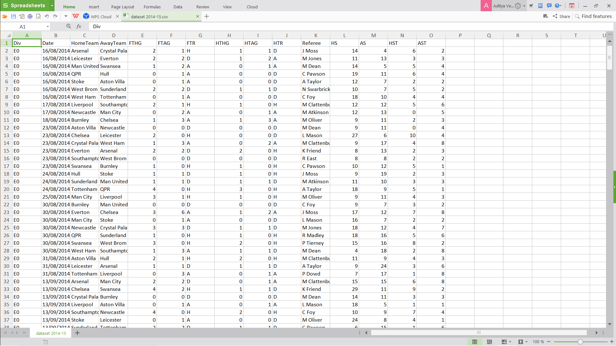

Slide 9
ALGORITHMS USED
K NEAREST NEIGHBOURS
LINEAR REGRESSION
RANDOM FOREST CLASSIFIER

Slide 10
INPUT
The dataset itself is the input for predicting the league table. However the prediction gets down to predicting a match result between two teams. Here below we provide the structure of the code and how it flows.

Slide 11
Python Libraries :
Pandas : We have used pandas for manipulating the data frames in which we have stored all the rows and columns of the dataset we have used. We have also used it for the preparation of new features in the dataset using the previous ones.
Numpy : We have used numpy for the support of multi dimensional arrays and matrices which we provide for the training and testing dataset.
Scikit-learn : This is the library from which we used all the functionalities of all the machine learning algorithms like K-Nearest Neighbours, Support Vector Machine, Random Forest Algorithm, Ensemble classifiers like Bagging and Boosting classifier.
Matplotlib : We have used Matplotlib for the data visualisation part. It helped us to learn the behaviour of different features with each other and make new assumptions on the available data.

Slide 12
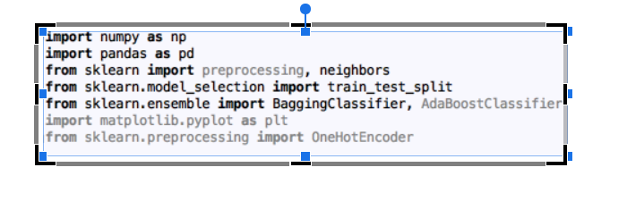

Slide 13
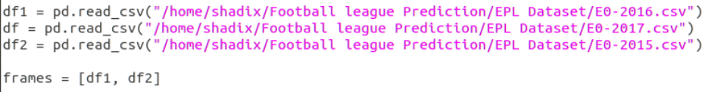

Reading data :
We then read the data from the csv files using pandas which has a method read_csv to which if we give the path of the csv file will read the data and store in rows and columns. We have dealt the problem of having many csv files by combining them into one using the concat method of the pandas dataframe where we pass the list of all data frames.

Slide 14
Cleaning Data :
Cleaning data implies that filling all the empty positions of the dataset with a particular value and changing the string values of the features into corresponding numerical values. We have used two ways for this out of which “kernel method”, we finalised one easy way. The first way is that we have written a handle_non_numerical_data which takes the dataframe as the argument and handles all the non-numerical data.The other way is that we have written a function cleandata which takes the dataframe as the argument and will handle just the features we are using in the dataset in-order to predict the final result.
User input :
We take the user input using the normal python functions and we use the pandas library again to segregate the particular match which was played by the teams which we are going to give as an input.

Slide 15
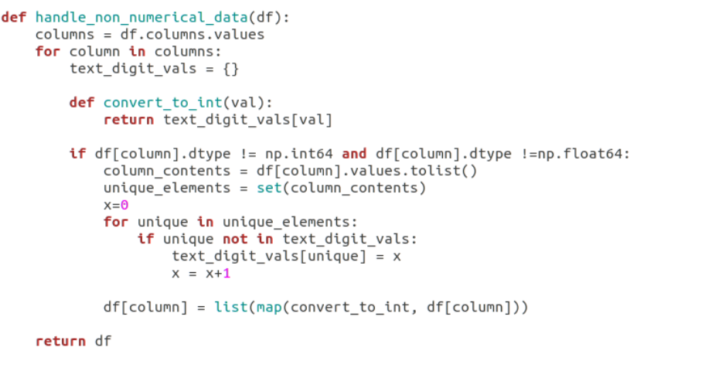
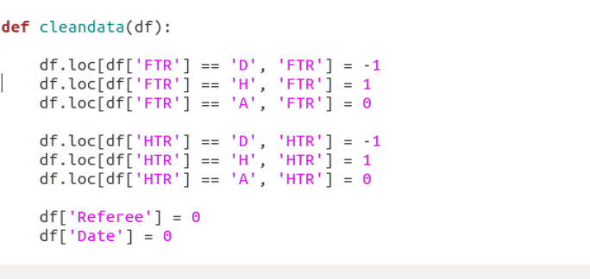

Slide 16
RESULTS
USING KNN :
1-The predicted table is the table of Premier League of the season 2017-18. According to the predicted result, the winner of that season was MAN UNITED with 105 points , where as originally too, Chelsea won with 100 points.
2-The final result is obtained using ensemble classifier bagged with KNN, with a final accuracy of 80-84 percent.
USING RANDOM FOREST CLASSIFIER :
4-According to the predicted result, the winner of that season was MAN UNITED with 100 points , where as originally too, Chelsea won with 100 points.
3-The final result is obtained using RANDOM FOREST CLASSIFIER, with a final accuracy of 94-97 percent.

Slide 17
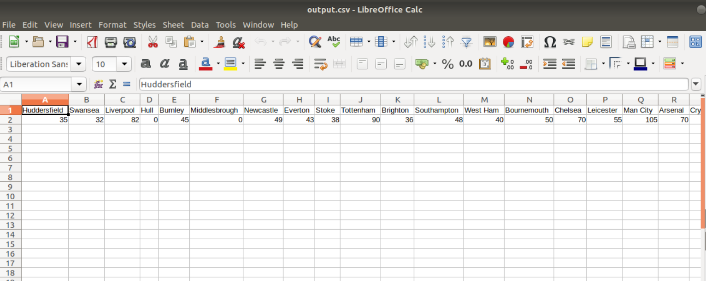
RESULTS
POINTS TABLE USING KNN ALGORITHM

Slide 18
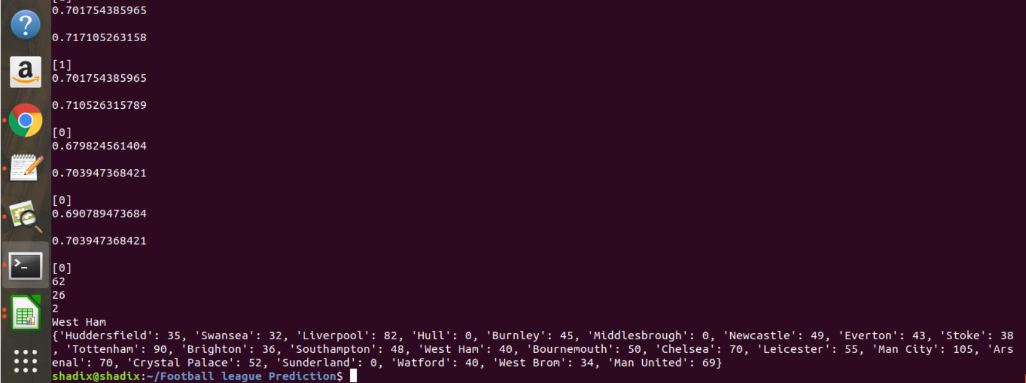
PREDICTED POINTS IN WHOLE LEAGUE

Slide 19
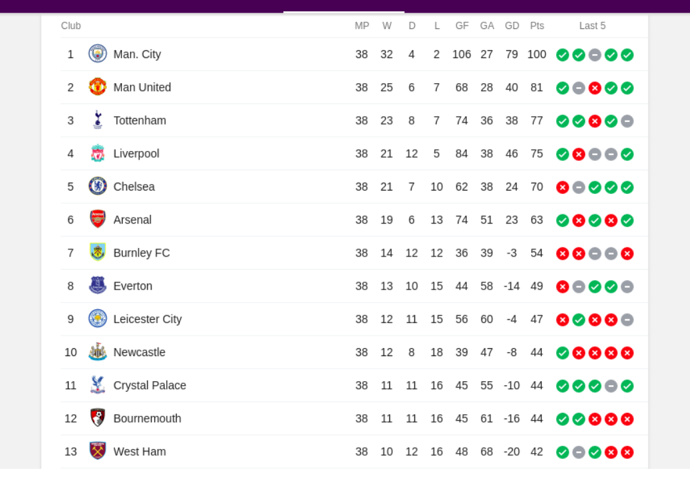
RESULT COMPARISON WITH ORIGINAL POINTS TABLE

Slide 20
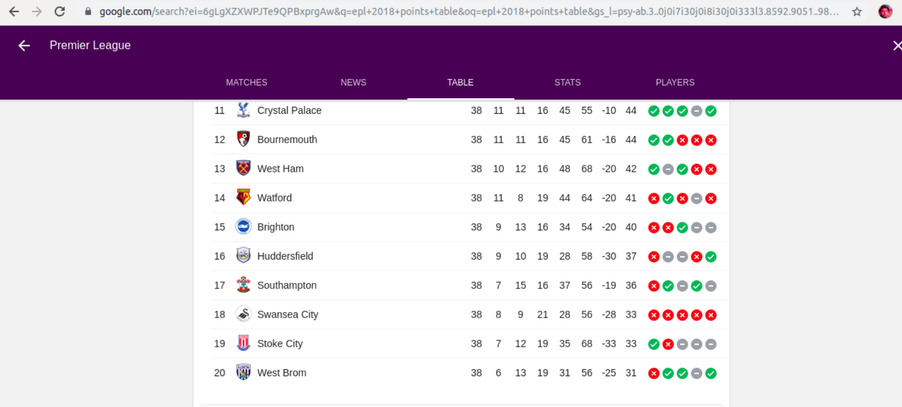

Slide 21
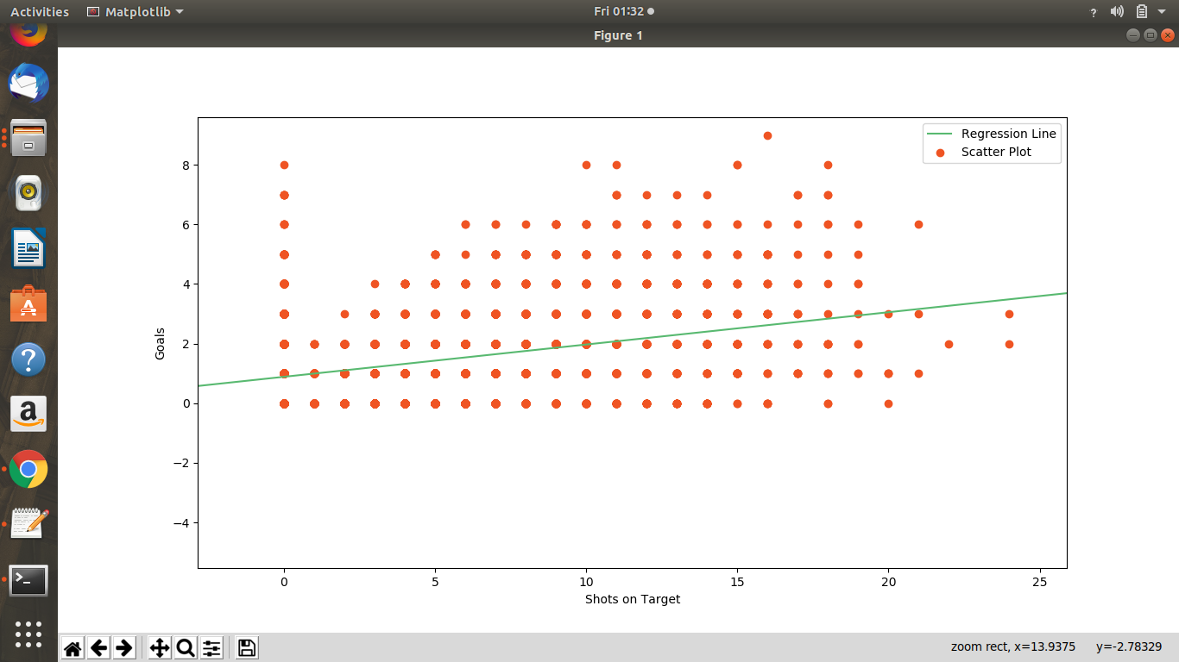
GRAPH ANALYSIS SHOTS ON TARGET VS GOALS

Slide 22
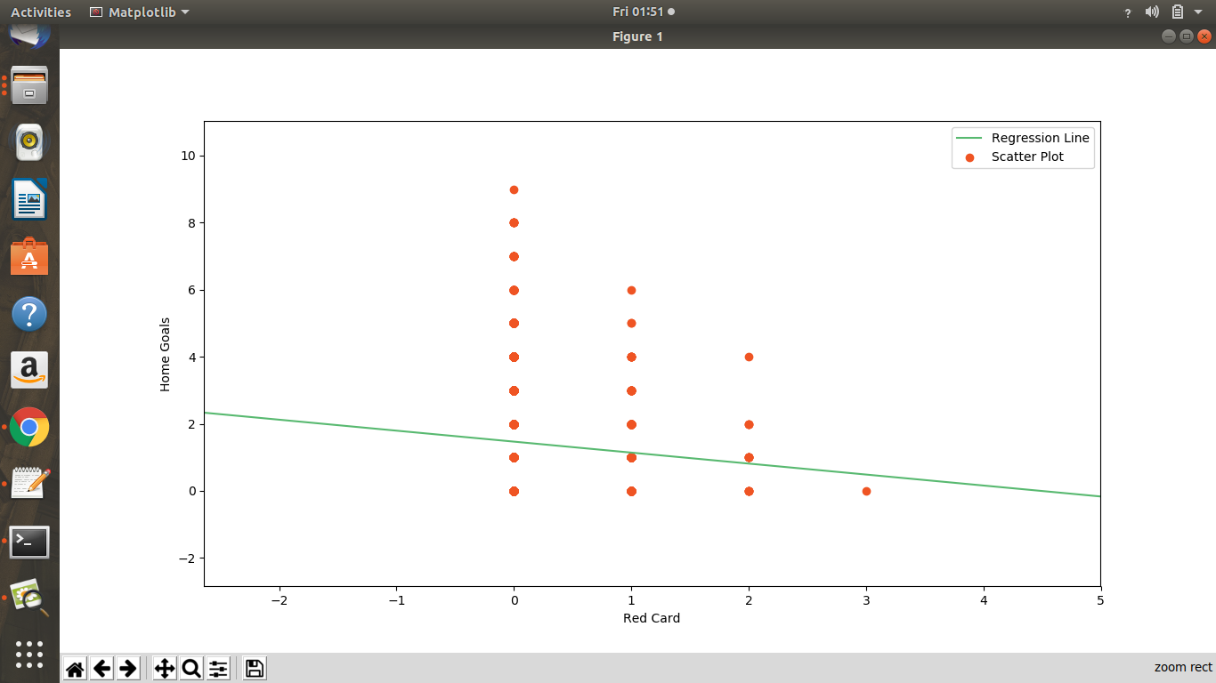
GRAPH ANALYSIS RED CARD VS HOME GOALS

Slide 23
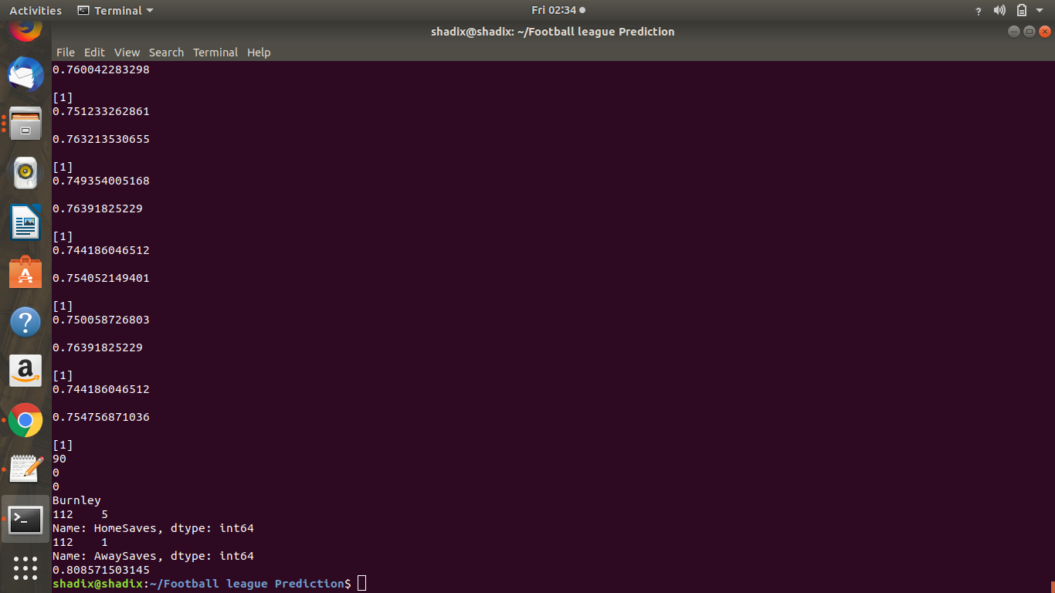
ACCURACY USING KNN ALGORITHM

Slide 24
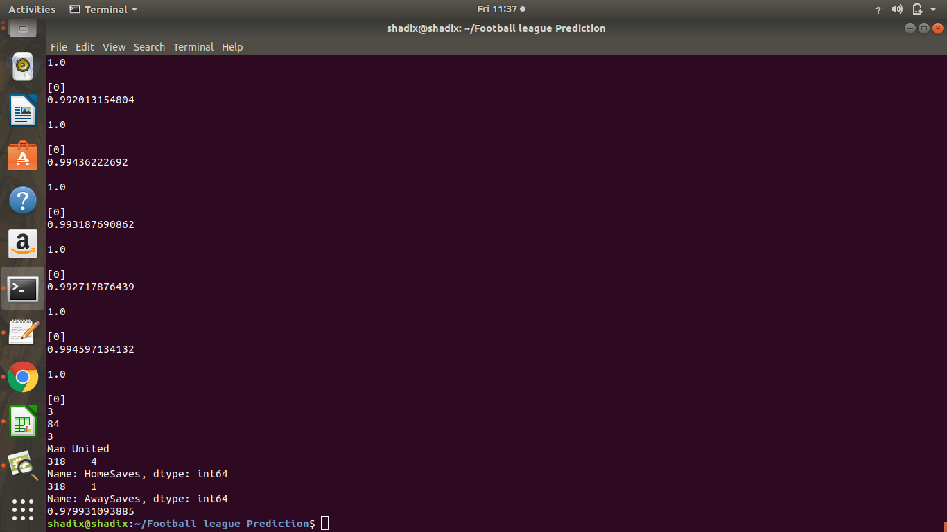
ACCURACY USING RANDOM FOREST CLASSIFIER

Slide 25
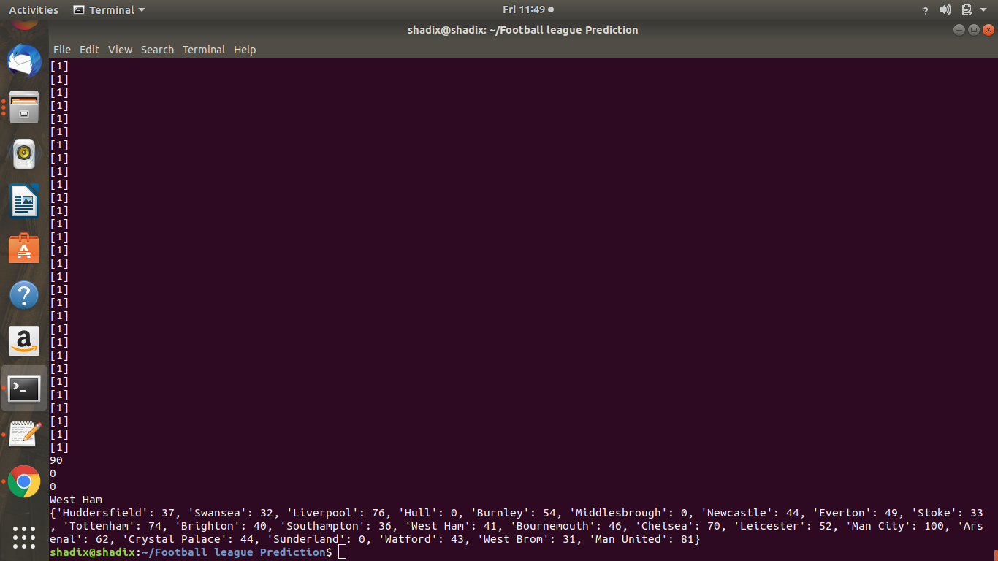
POINTS TABLE USING RANDOM FOREST CLASSIFIER

Slide 26
FUTURE WORK
As we know that, the performance of a team also depends on team coach, key players of the team i.e. how good a player is. Moreover it also depends a lot on the goalkeeper because a strong goalkeeper who is able to stop difficult goals multiplies the chances of that team winning the match.
To implement a Machine Learning algorithm, firstly, we should be able to map the skills of different players and coaches with a mathematical value, after that we can put a column in our dataset in which we can feed the values corresponding to the skill of the coach and also of the key players and the goalkeeper and then we can apply different algorithms in order to get the output.
Weights can assigned to various parameters as they can matter the result of the match too. Like a red card can change the result of the game as the red card awarded team becomes a player less when compared to the other team.
Dataset could be updated automatically for future seasons and old datasets can be removed when new ones get added.

Slide 27
REFERENCES
1. Association Football ” Wikipedia
2. English Premier League “ Wikipedia
3. Nearest Neighbour Methods” scikit-learn.org
4.Effective Learning and Classification using Random Forest Algorithm by Vrushali Y Kulkarni, Pradeep K Sinha in International Journal of Engineering and Innovative Technology (IJEIT) Volume 3, Issue 11, May 2014.
5.A Study on Soccer Prediction using Goals and Shots on Target by Snorre Gebhardt Stenerud, Norwegian University of Science and Technology, June 2015.

