Slide 1
Mongo query rewrite algorithm

Slide 2
Motivation (1)
A query can be executed in many different ways
  full table scans, index scans, nested loops, hash joins, etc.
The query processor creates an execution plan that describes the most efficient means of accessing the specified data
Mongo query planner doesn’t work well with certain queries
Rewriting these queries can lead to performance boost
    (a & b & c) == a & b & c
    (a | b) & c == (a & c) | ( b & c)
    (a | b) | (c | d) == a | b | c | d
    (a | b) & ( c | d) == (a & c) | (a & d) | (b & c) | (b & d)

Slide 3
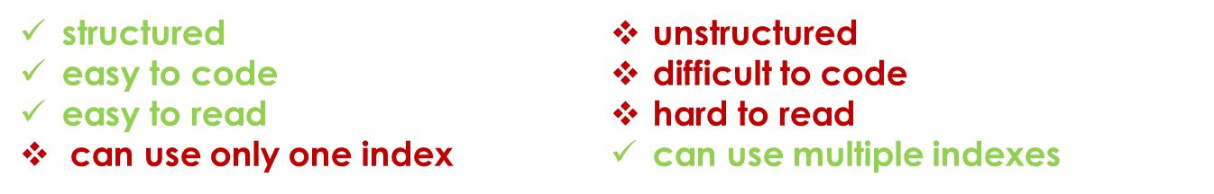
Motivation (2)
Why not write better queries from the start?
{$and: [
{$or: [
{$or: [...]},
{$and: […]} ]},
{$or: [
…
]},
{$or: [
…
]}
]}
{$or: [
{…},
…..
…..
…..
…..
…..
…..
…..
…..
{...}
]}

Slide 4
Algorithm (1)
Split the query into 3 components
    the $and operator
    the $or operator
    the rest
Rewrite each component independently
Use each result to rewrite the entire query

Slide 5
Algorithm (2)
Each component is processed with a specific method
    recursivity!
    bottom-up approach
Each result has its own format
    predictable input/output

Slide 6
Basic query format
{
$or: [
S1,
…
Sm
],
$and: [
S1,
…
Sn
],
C1,
…
Cp
}
$or operator (complex, nested $or/$and)
$and operator (complex, nested $or/$and)
other conditions (simple, ‘type’ = 262)

Slide 7
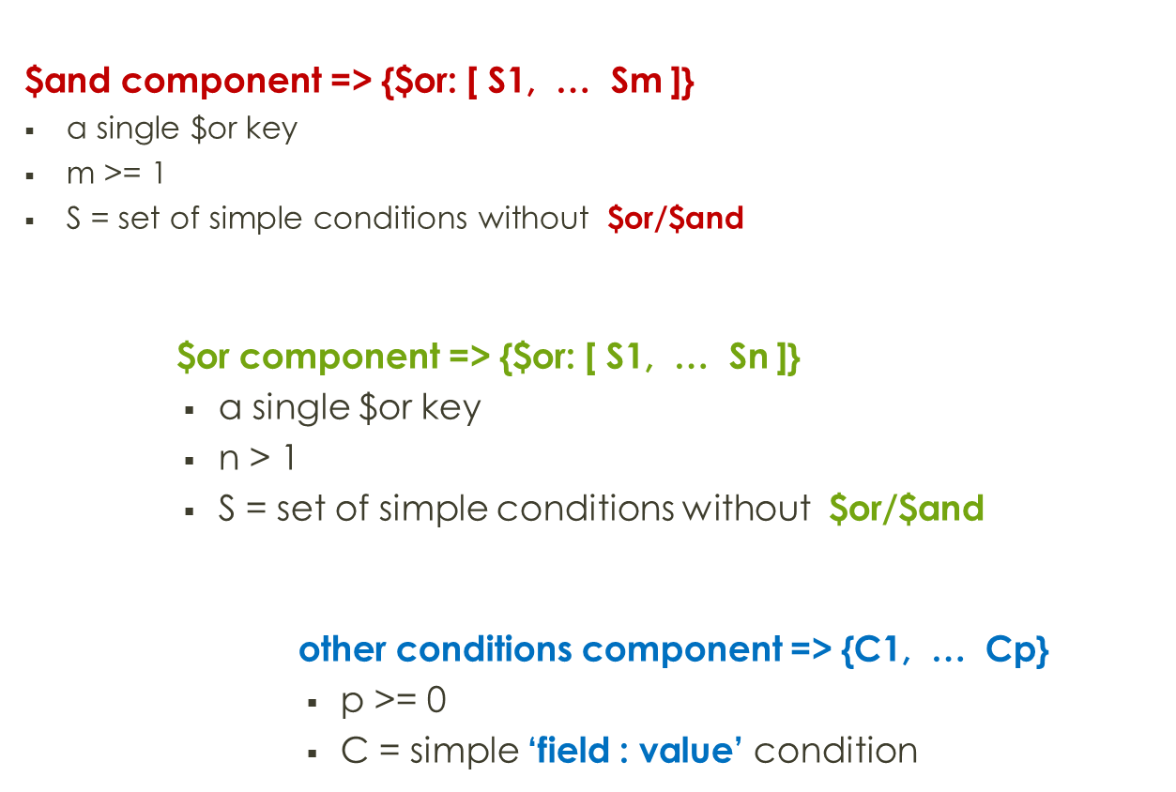
Output (components)

Slide 8
Output (final result)
The output of any query may be formulated in 2 ways
Simple ‘field = value’ conditions
  if the initial query did not contain any $or operators (except those with a single element)
  Example: {a: 1, b: 2, … , z: n}
A single $or operator
  if the initial query contained $or operators with more than one element
  Example: {$or: [{a: 1}, … , {z: n}]}

Slide 9
Optimizing $and (1)
Rewrite each set of conditions
see Output (final result)
2.1 Compute the product of all the sets that contain $or
(a | b) & ( c | d) == (a & c) | (a & d) | (b & c) | (b & d)
2.2 Merge all the rest of the sets together
(a & b ) & (c & d) == a & b & c & d
3. Add all the conditions from 2.1 to each set from 2.2
at least one to keep the output format

Slide 10
Rewrite $and (2)
$and: [
{$or: [X]},
{Y},
{$or: [A, B], C},
{$or: [D, E]},
]
$and: [
{X},
{Y}
]
{
X,
Y
}
1
2.2
3
$or: [
{A, C, D, X, Y},
{A, C, E, X, Y},
{B, C, D, X, Y},
{B, C, E, X, Y}
]
1
3
$or: [
{A, C, D},
{A, C, E},
{B, C, D},
{B, C, E}
]
$and: [
{$or: [{A, C}, {B, C}]},
{$or: [D, E]},
]
2.1

Slide 11
Rewrite $and (3)
$and: [
{$or: [X]},
{Y},
]
$and: [
{X},
{Y}
]
{
X,
Y
}
1
2.2
3
$or: [
{X, Y}
]
1
3
$and: [
{}
]
$or: [
{}
]
2.1
*At least one element to keep the output format

Slide 12
Rewrite $or (1)
Optimize each set of conditions
see Output (final result)
2.1 Remove 2nd tier of $or operators
(a | b) | (c | d) == a | b |c | d
$or: [
{$or: [X]},
{Y},
{$or: [A, B], C},
{$or: [D, E]}
]
$or : [
{X},
{Y},
{$or: [{A, C}, {B, C}]},
{$or: [D, E]},
]
$or : [
{X},
{Y},
{A, C},
{B, C}
{D},
{E}
]

Slide 13
Rewrite other fields
Rewrite each condition where field is not $or / $and
  remove $in operator with only one element
  replace $nin operator with only one element with $ne operator

Slide 14
Final rewrite (1)
Compute the product between the result of $or / $and components
      - each result contains only one $or operator
Add all the conditions from the third component result to each set resulting from step 1.
      - the result from step 1. also contains only one $or operator with one or more sets of simple conditions
Remove $or condition if it contains only one element

Slide 15
Final rewrite (2)
{$or: [
A,
B
]}
{$or: [
{A, C},
{A, D},
{B, C},
{B, D}
]}
{
$or: […],
$and: […],
X, Y
}
{$or: [
C,
D
]}
{$or: [
{A, C, X, Y},
{A, D, X, Y},
{B, C, X, Y},
{B, D, X, Y}
]}
{
X,
Y,
}
{
X,
Y,
}

Slide 16
Field collision (1)
Condition 1 is subset of condition 2
  a > 5 and a > 7 → a > 7
  a < 5 and a < 3 → a < 3
  a IN {1, 2, 3} and a IN {2, 3} → a IN {2, 3}
Conditions intersect
  a = 2 and a > 1 → a = 2
  a IN {1,2, 3} and a IN {2, 3, 4} → a IN {2, 3}
  a IN {1, 2, 3} and a NIN {3, 4, 5} → a IN {1, 2}
  a IN {1, 2, 3} and a NIN {2, 3, 4} → a IN {1} → a = 1
  a NIN {1, 2, 3} and a NIN {4, 5, 6} → a NIN {1, 2, 3, 4, 5, 6}
  a > 3 and a IN {2, 4, 6} → a IN {4, 6}
  a > 3 and a NIN {2, 4, 6} → a > 3 and a NIN {4, 6}
  a > 3 and a NIN {2} → a > 3
Conditions are disjunctive
  a = 1 and a = 2 → remove condition
  a < 5 and a > 7 → remove condition
  a IN {1, 2, 3} and a IN {4, 5, 6} → remove condition
  a IN {1, 2, 3} and a NIN {1, 2, 3} → remove condition

Slide 17
Field collision (2)
If all conditions are removed it is necessary to add an impossible condition or to throw an exception
Otherwise a query that would normally return 0 records will return all the records
{$and: [
{$or: [
{a: 1, …},
{a: 2, ….}
]},
{$or: [
{a: 3, …},
{a: 4, ….}
]},
]}
{$or: [
{a: 1, a: 3},
{a: 1, a: 4},
{a: 2, a: 3},
{a: 2, a: 4}
]}
{$or: []}
{ _id: null }

Slide 18
Additional work
Testing
  Obviously!
Profiling
  Performance, limitations, index correlation, etc.

